Slide 1
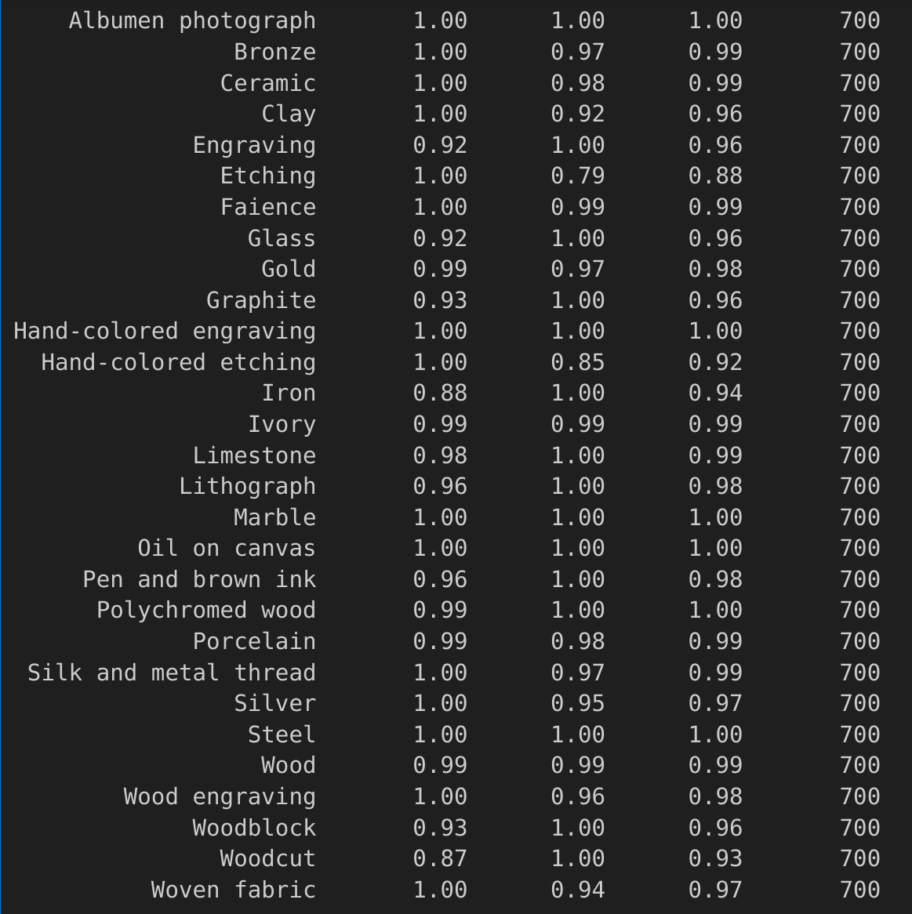
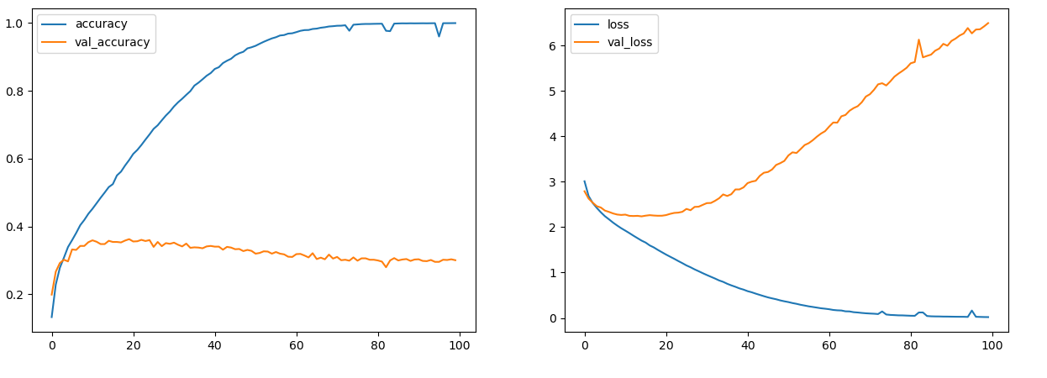
#1: Overfit to find Difficult Classes
First Training. No previous attempts
- 1 * 3x3 Convolutional kernel (ReLU)
- 1 * 4x4 MaxPool
- 64 units dense layer (ReLU)
- 29 units output layer (SoftMax)
Accuracy Train: 0.97
Accuracy Val: 0.307
Hand-colored etching → Engraving, Graphite, Lythograph, Pen and Brown Ink
Silver, Gold, Bronze, Clay → Iron
Woven Fabric, Wood Engraving, Hand Colored Etching, Etching → Woodcut
X

Slide 2
