Slide 1

Introduction to Human Language Technology:
Semantic Textual Similarity
Alberto Becerra Tomé
Javier González Béjar

Slide 2
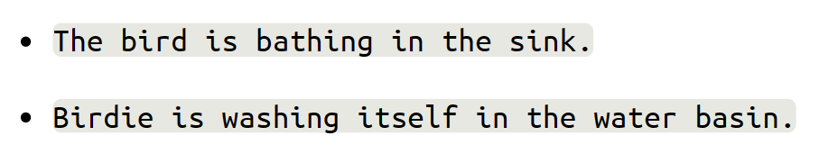
Introduction
Semantic Textual Similarity (STS)
Semantic equivalence between two texts
Paraphrase Detection
Procedure:
1. Use data from SemEval 2012
2. Implement different approaches to detect paraphrase
3. Compare results with GS
LEARNING MODEL

Slide 3
Data Cleaning and Pre-Processing Step
Time expressions standardization (24 h format)
1pm, 13.00, 1:00 -> 13:00
Grammatical abbreviation removal
I’ll, I’ve -> I
Convert indexing symbols to words
<.idx> -> idx
Remove courtesy titles
Mr., Ms…
Number standardization
100,000 -> 100000
Currency sign Removal
$
Tokenization
“I am five years old” ->
[“I”, “am”, “five”, “years”, “old”]
Lemmatization
Running -> run
Stop words Removal
At, this, a, for
Punctuation Removal
? , ! . : ;

Slide 4
Feature Extraction
Text Comparison
String Similarity Measures
Longest Common Substring
Longest Common Subsequence
Greedy String Tiling
Jaro Similarity
Jaro-Winkler Similarity
Monge-Elkan Similarity
Levenshtein Distance
N-Gram Similarity Measures
NLTK Wordnet tokenizer
Spacy Lemmatizer
Porter-Stemmer
Jaccard
Dice
Cosine
Overlap Coefficient
Semantic Comparison
Semantic Similarity Measures
- List of word synsets
Path Similarity
Wu-Palmer
Leacock-Chodorow
Lin
Word Disambiguation Similarity Measures
- Synset resulting after Lesk algorithm
Structure Comparison
Stop Words Similarity using N-Grams SM

Slide 5

Training Methodology
Complete testing data
(Including surprise sets)
Test
Training
Complete
Model
Output
Complete
training data
MSRpar/MSRvid/SMTeuroparl testing data
Test
Training
Individual Model
Output
MSRpar/MSRvid/SMTeuroparl training data

Slide 6
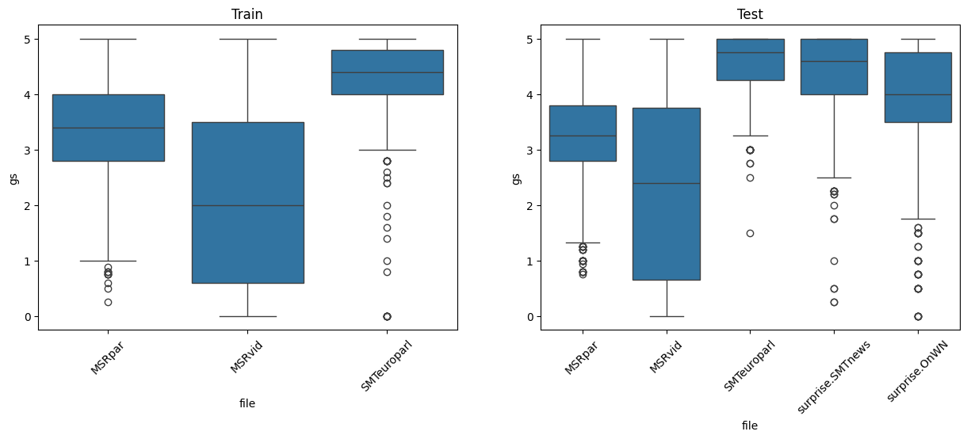
Datasets Distributions

Slide 7
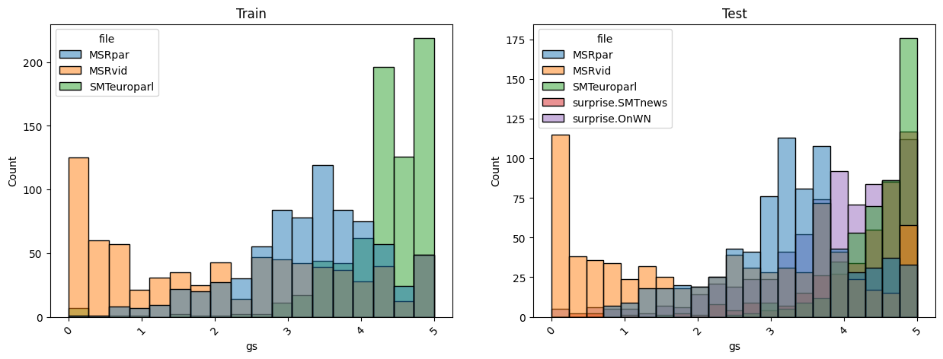
Datasets Distributions

Slide 8
Modeling Methodology 1: All Features
Algorithm: Random Forest Regressor
Strategy: 10 folds CV
Dataset | Size | Estimators | Min Samples Leaf | N Features (per tree) | Mean Training Time (s) | CV Pearson | Test Pearson
All | 2234 | 250 | 2 | 9 (sqrt) | 2.88 | 0.73 | 0.74
MSRpar | 750 | 250 | 6 | 6 (log2) | 0.66 | 0.67 | 0.66
MSRvid | 750 | 100 | 2 | 9 (sqrt) | 0.62 | 0.83 | 0.85
SMTeuroparl | 750 | 300 | 2 | 6 (log2) | 1.12 | 0.69 | 0.37

Slide 9
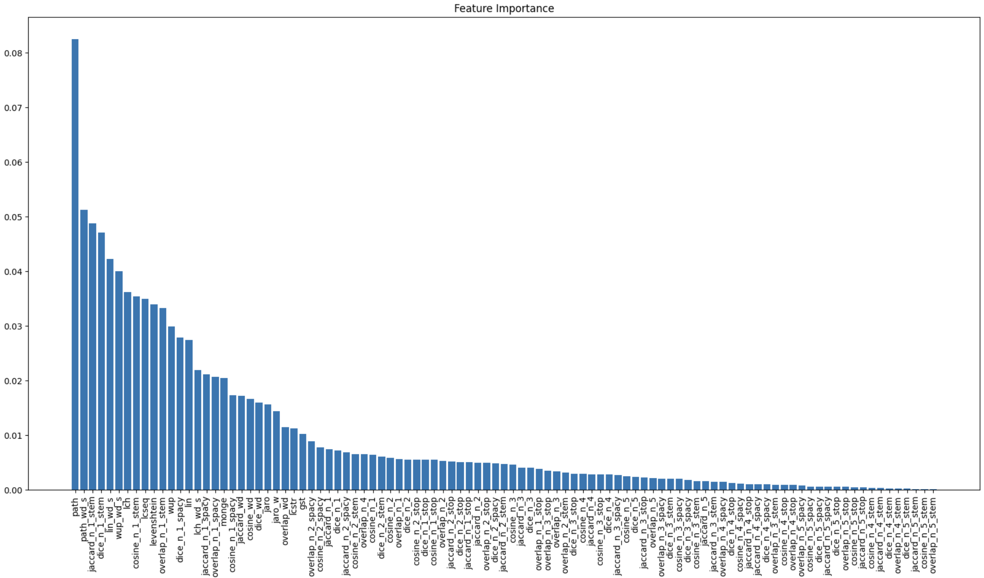
Modeling Methodology 1: All Features
All dataset
Position | Feature
#1 | path
#2 | path_wd
#3 | jaccard_n_1_stem
#4 | dice_n_1_stem
#5 | lin_wd_s
#6 | wup_wd_s
#7 | lch
#8 | cosine_n_1_stem
#9 | lcseq
#10 | Cosine_n_1_stem

Slide 10
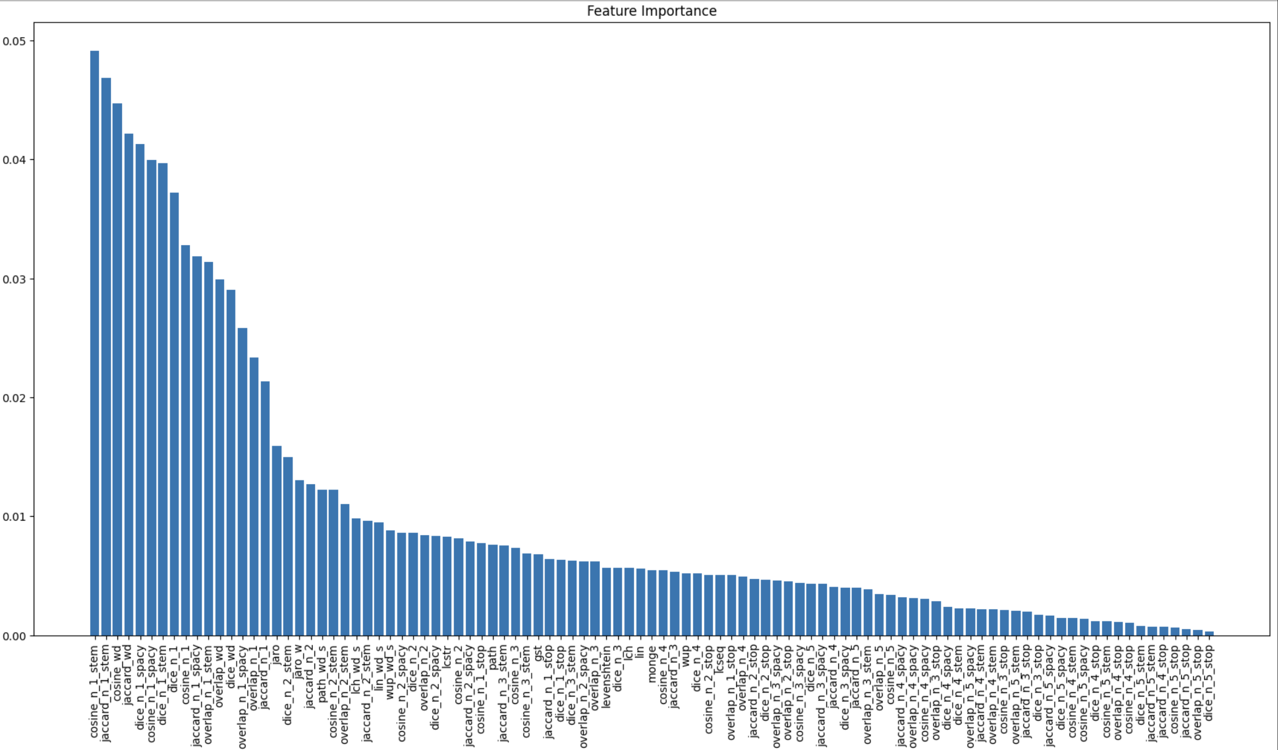
Modeling Methodology 1: All Features
MSRpar dataset
Position | Feature
#1 | cosine_n_1_stem
#2 | jaccard_n_1_stem
#3 | cosine_wd
#4 | jaccard_wd
#5 | dice_n_1_spacy
#6 | cosine_n_1_spacy
#7 | dice_n_1
#8 | cosine_n_1
#9 | jaccard_n_1_spacy
#10 | overlap_n_1_stem

Slide 11
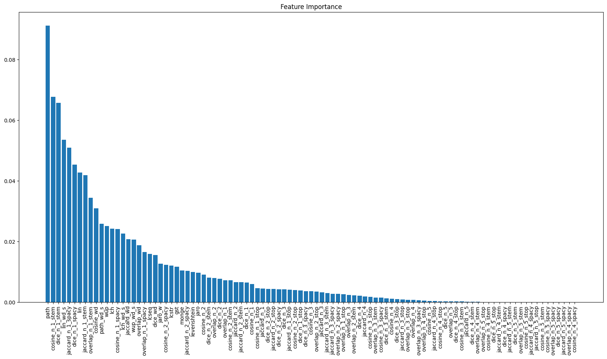
Modeling Methodology 1: All Features
MSRvid dataset
Position | Feature
#1 | path
#2 | cosine_n_1_stem
#3 | dice_n_1_stem
#4 | lin_wd_s
#5 | jaccard_n_1_spacy
#6 | dice_n_1_spacy
#7 | lin
#8 | jaccard_n_1_stem
#9 | overlap_n_1_stem
#10 | cosine_wd

Slide 12
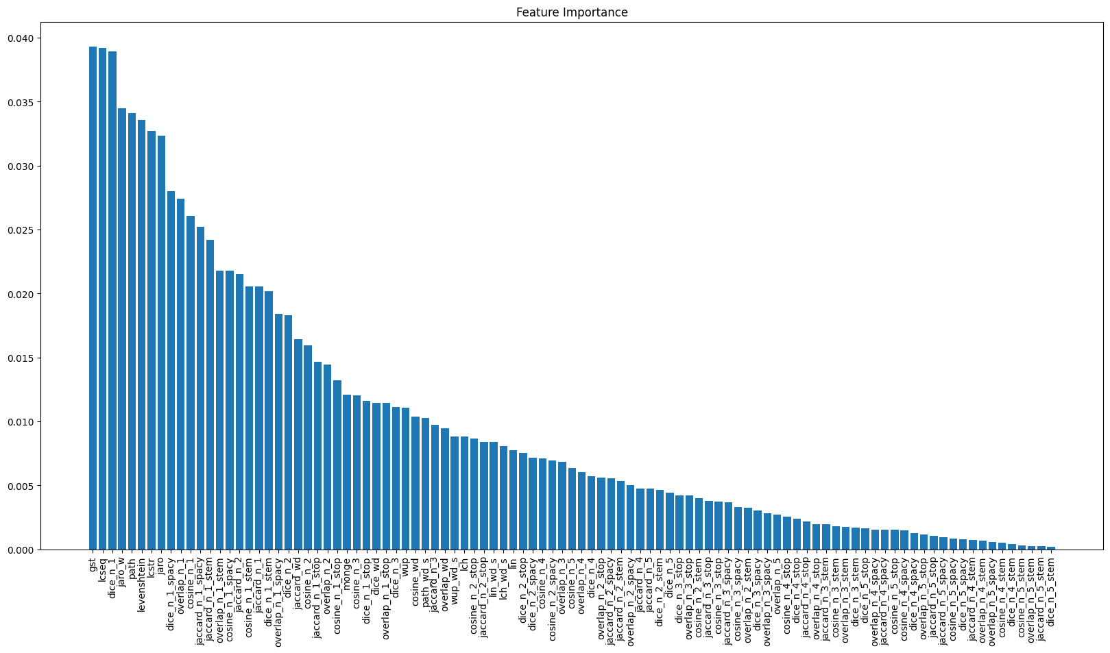
Modeling Methodology 1: All Features
SMTeuroparl dataset
Position | Feature
#1 | gst
#2 | lcseq
#3 | Dice_n_1
#4 | Jaro_w
#5 | path
#6 | levenshtein
#7 | lcstr
#8 | jaro
#9 | dice_n_1_spacy
#10 | Overlap_n_1

Slide 13
Modeling Methodology 2: Reduced Features
LASSO
(Dim Red)
Model
Output
Dataset
Reduced Dataset
Dataset | Size | Estimators | Min Samples Leaf | N Features (per tree) | Mean Training Time (s) | CV Pearson | Test Pearson
All | 2234 | 250 | 2 | 9 (sqrt) | 1.25 | 0.73 | 0.74
MSRpar | 750 | 250 | 6 | 6 (log2) | 0.73 | 0.67 | 0.65
MSRvid | 750 | 450 | 2 | 5 (sqrt) | 1.07 | 0.83 | 0.85
SMTeuroparl | 750 | 150 | 2 | 6 (log2) | 0.48 | 0.69 | 0.33

Slide 14
Modeling Methodology 2: Reduced Features
Dataset | Size | Estimators | Min Samples Leaf | N Features (per tree) | Mean Training Time (s) | CV Pearson | Test Pearson
All | 2234 | 250 | 2 | 9 (sqrt) | 2.88 | 0.73 | 0.74
Dataset | Size | Estimators | Min Samples Leaf | N Features (per tree) | Mean Training Time (s) | CV Pearson | Test Pearson
All | 2234 | 250 | 2 | 9 (sqrt) | 1.25 | 0.73 | 0.74
Dataset | Features
All | 82
MSRpar | 54
MSRvid | 26
SMTeuroparl | 57

Slide 15
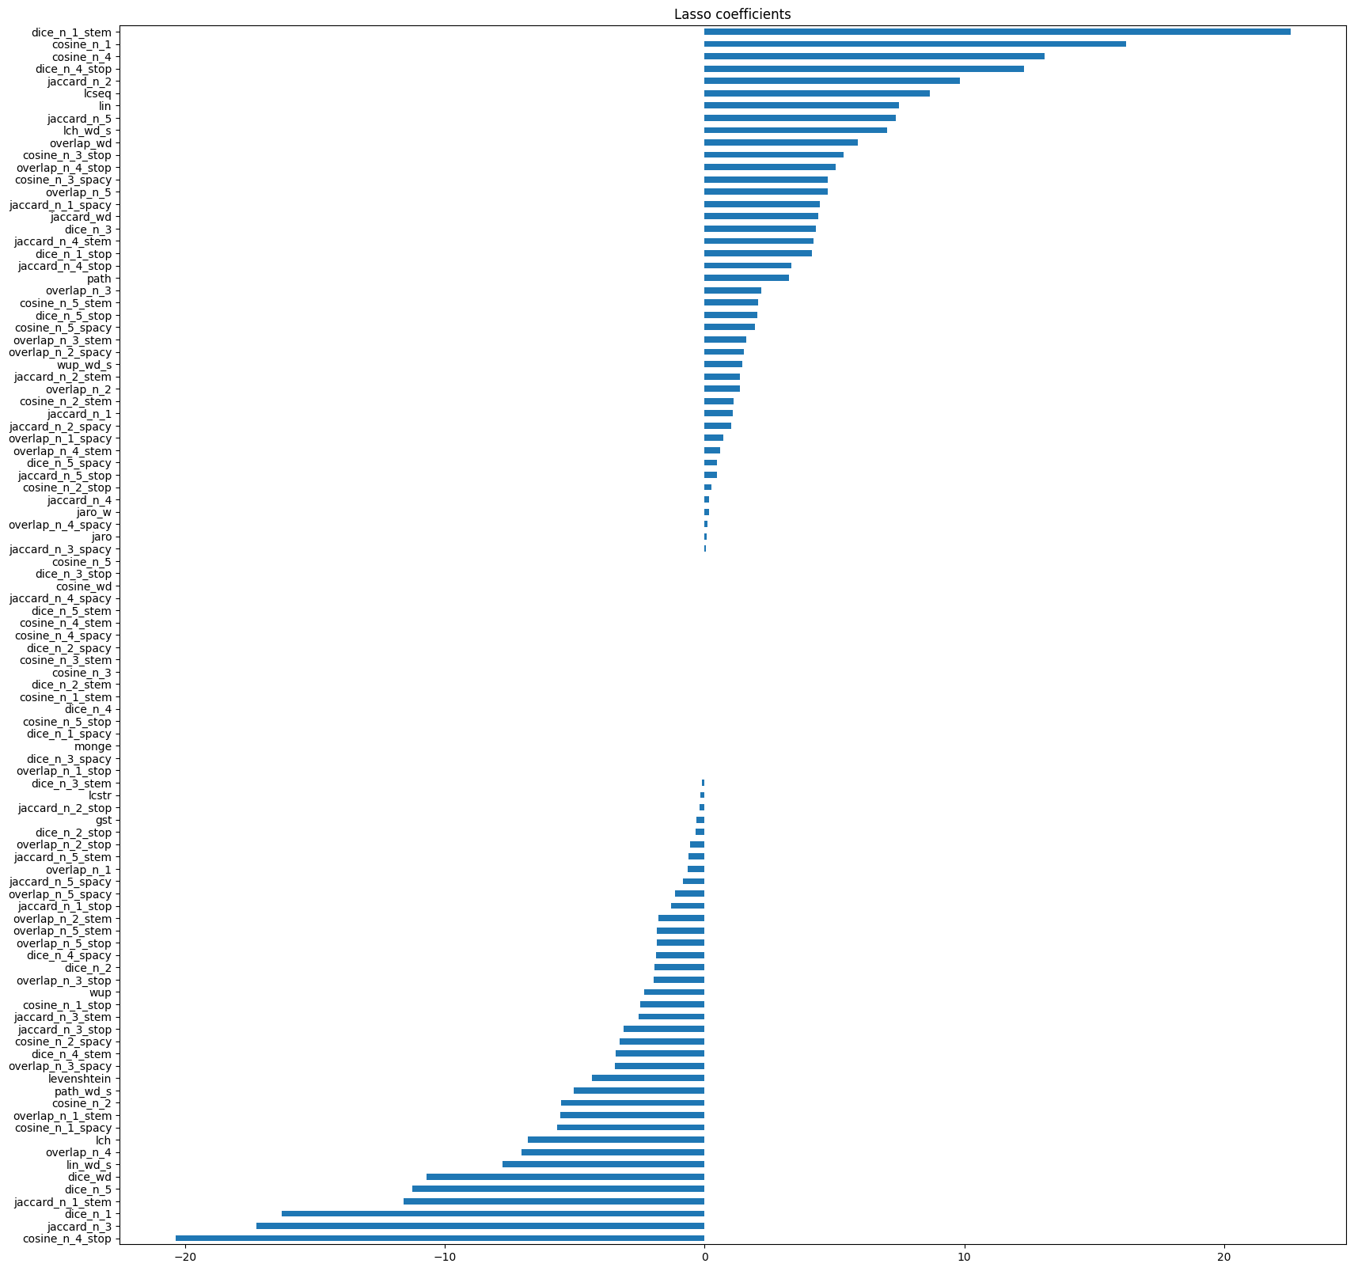
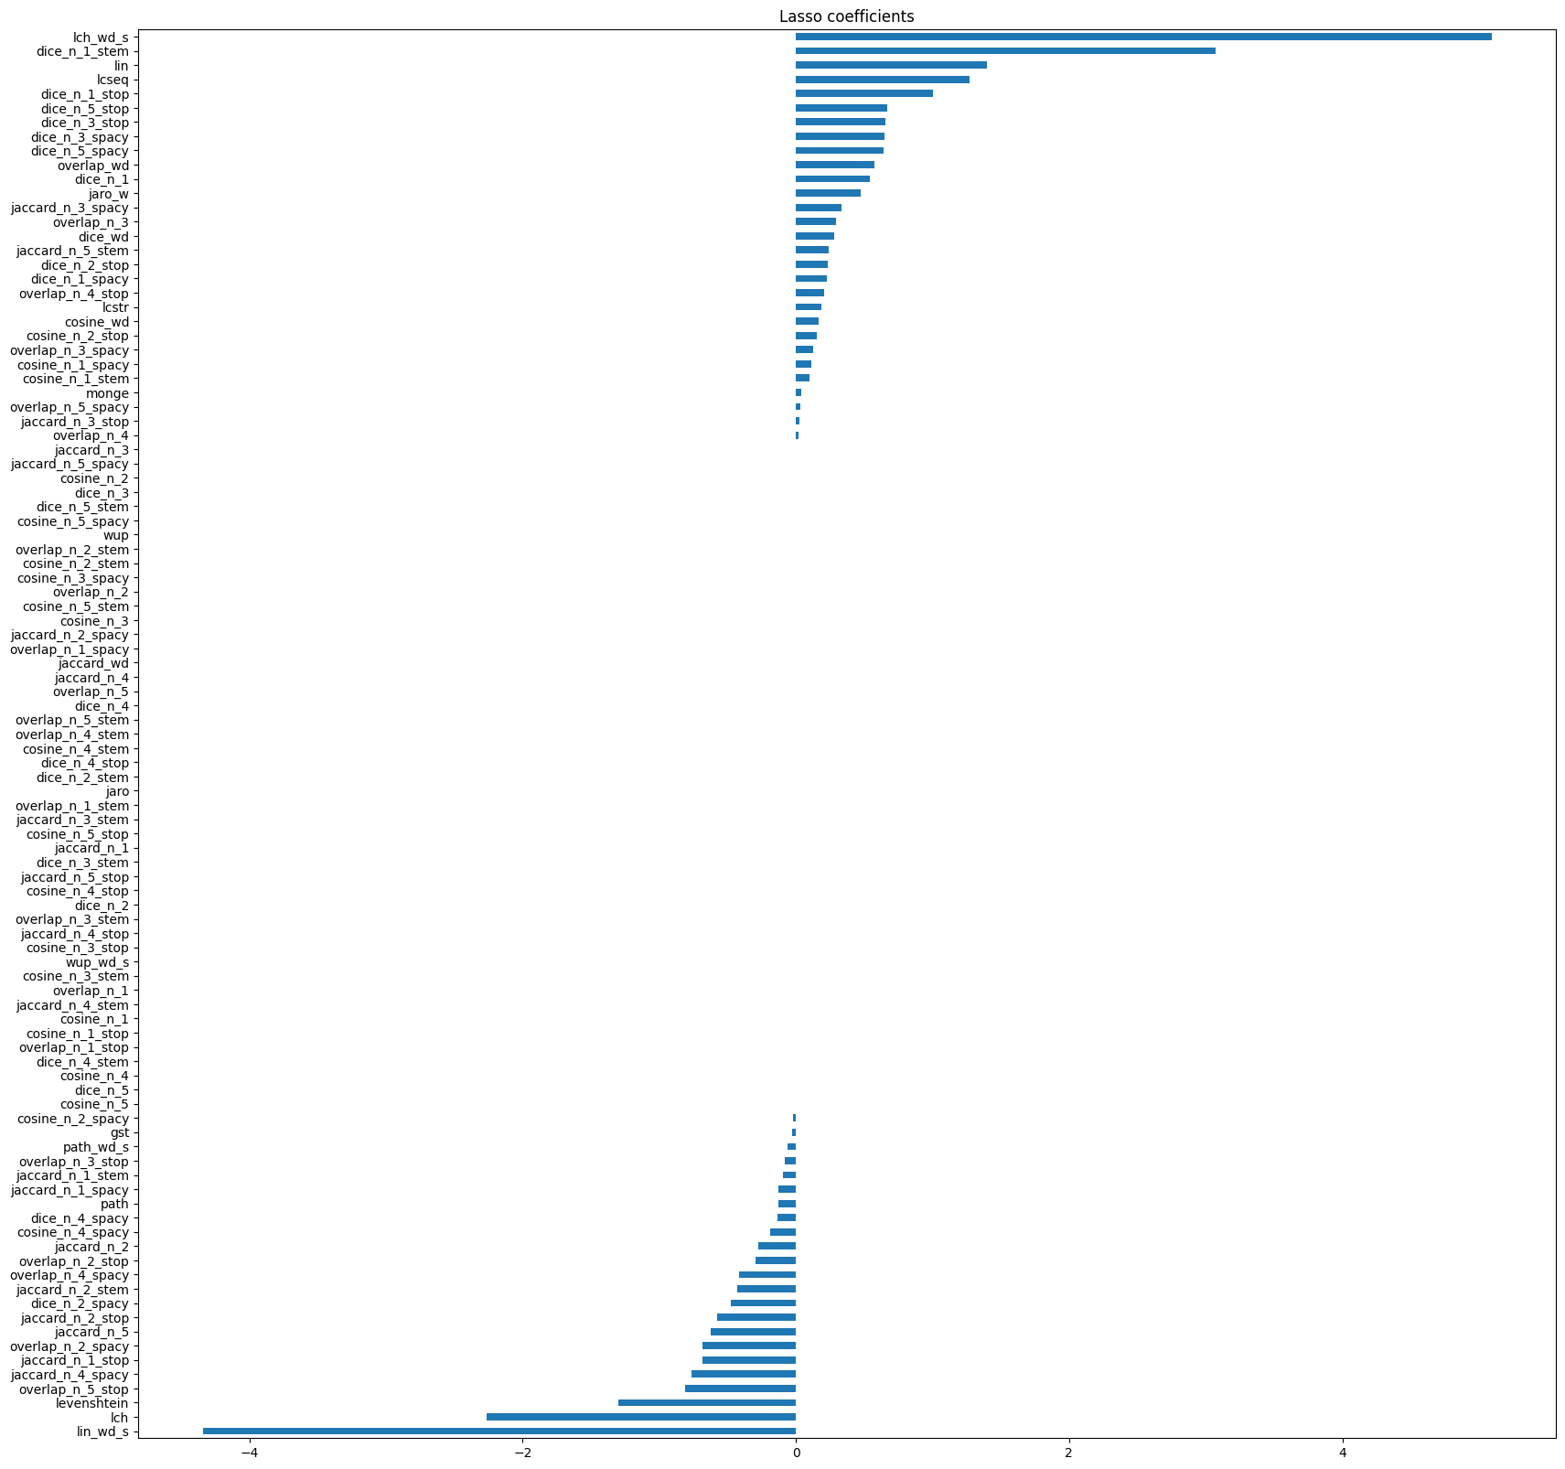
Modeling Methodology 2: Reduced Features
All dataset
MSRpar

Slide 16
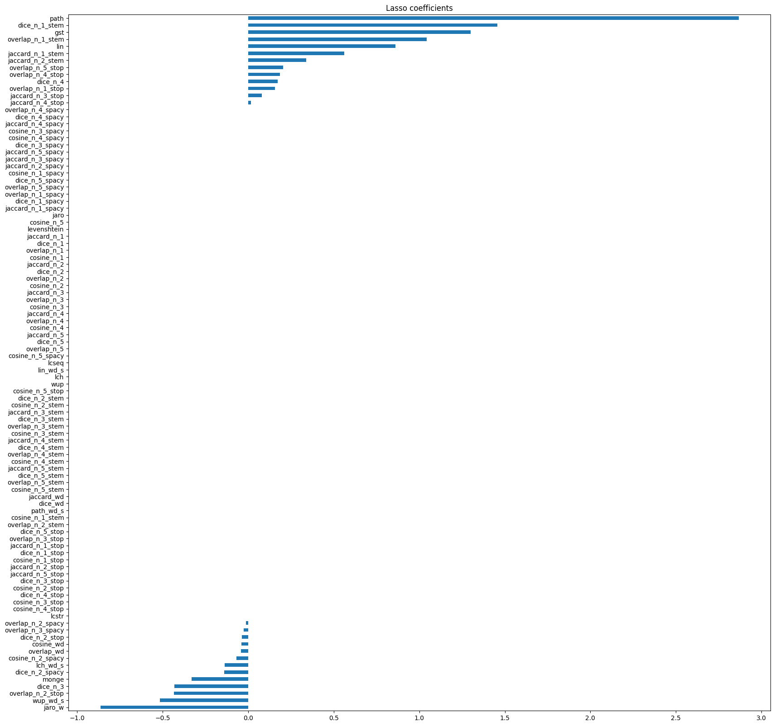
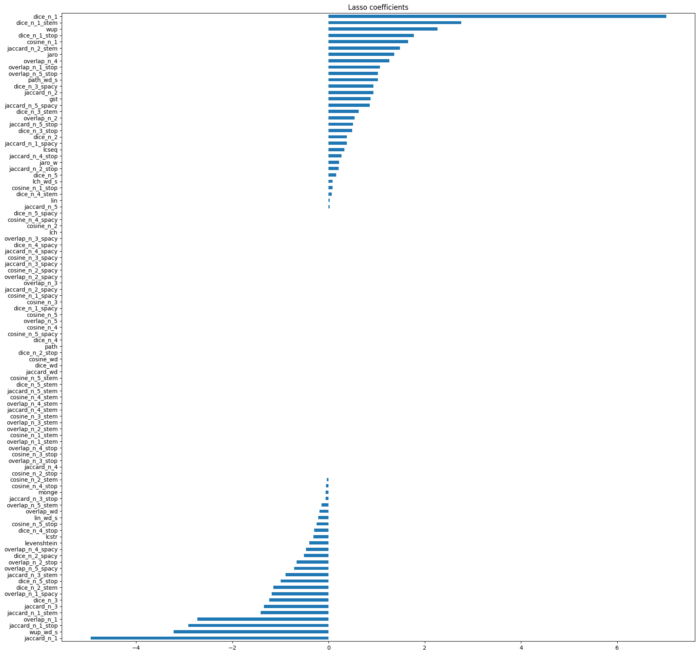
Modeling Methodology 2: Reduced Features
MSRvid
SMTeuroparl

Slide 17
Modeling Methodology 2: Reduced Features
 | ALL | ALLNrm | Weighted | MSRpar | MSRvid | SMTeuroparl | OnWN | SMTNews
Model 1 | 0.777 | 0.777 | 0.644 | 0.649 | 0.848 | 0.368 | 0.692 | 0.475
Model 2 | 0.777 | 0.777 | 0.643 | 0.652 | 0.856 | 0.333 | 0.685 | 0.505

Slide 18
Conclusions
Classical methods in NLP tasks strongly depend on the nature of the dataset
Multicollinearity and features redundancy are an important factor when designing this kind of systems
Different dimensions in text composition and structure have been explored and implemented
Both developed models improve the results of the 10th position in STS competition

Slide 19
Further Improvements
Use features related to Machine Translation in order to provide more flexibity and better performance on MT datasets
Increment the information about syntactic structure may be interesting in the case of MSRpar
Introduction of more complex text vectorization such as pretrained embeddings

Slide 20
References
[1] [UKP: Computing Semantic Textual Similarity by Combining Multiple Content Similarity Measures](https://aclanthology.org/S12-1059) (Bär et al., SemEval-*SEM 2012)
[2] [TakeLab: Systems for Measuring Semantic Text Similarity](https://aclanthology.org/S12-1060) (Šarić et al., SemEval-*SEM 2012)
[3] [SemEval-2012 Task 6: A Pilot on Semantic Textual Similarity](https://aclanthology.org/S12-1051) (Agirre et al., SemEval-*SEM 2012)

