Slide 1
Vision Mamba: Efficient Visual Representation Learning with Bidirectional State Space Model
Authors: Lianghui Zhu, Bencheng Liao, Qian Zhang, Xinlong Wang, Wenyu Liu, Xinggang Wang
Alberto Becerra Tomé
Barcelona, April 2024

Slide 2
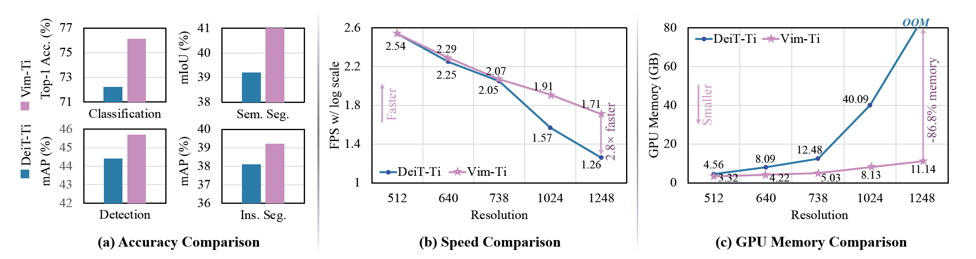
Motivation
Introducing Vision Mamba (Vim) with Bidirectional SSM
Improving existing SOTA Transformer based models (DeiT) for high resolution in terms of:
Memory efficiency
Performance in Vision Tasks

Slide 3
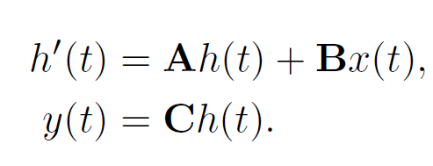
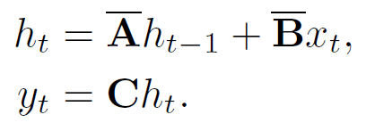
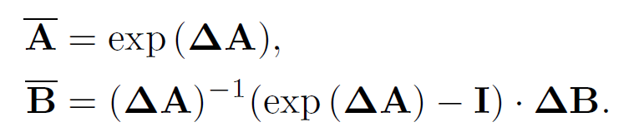
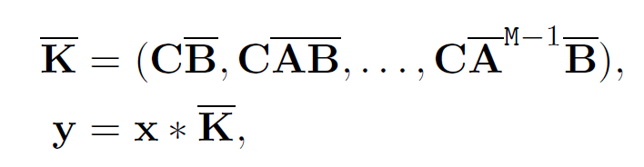
State Space Models (SSM)
They are inspired in basic 1-D continuous differential models for sequences
Learnable parameters: Step size (Δ)
Method: Convolution (Efficient in GPU)
Discretization
Notes:
* The key in efficiency here is that our convolution kernel K can be precomputed and convolutions are known to be pretty efficient in GPU

Slide 4
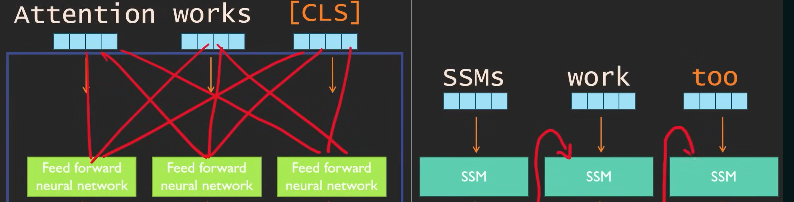
SSMs vs. Transformers (Efficiency)
*Images: AICoffeeBreak, (2024, April 08). MAMBA and State Space Models explained | SSM explained [Video]. YouTube.
URL: https://www.youtube.com/watch?v=vrF3MtGwD0Y&t=1s&ab_channel=AICoffeeBreakwithLetitia
Notes:
When a new token is added to a sequence (increase of sequence length) computational complexity increases quadratically in space as it needs to compute scores for each pair.
However, in SSMs adding one more token just means doing one more time the SSM and computation only doubles.
The main problem is that they use the same A, B and C for predicting every token. This is solved by introducing selective SSMs.

Slide 5
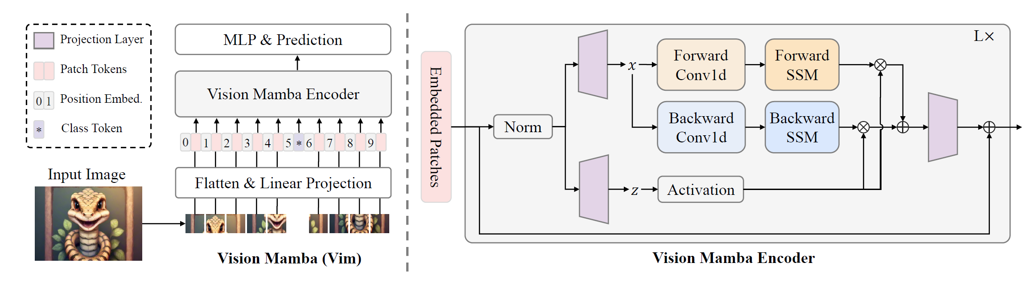

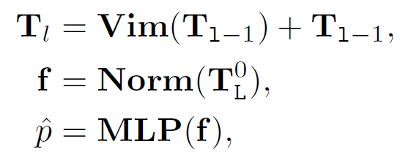
Vision Mamba
BxMxD
BxMxE
BxMxE
BxMxN
BxMxExN
BxMxD
Tiny Small
L : Number of vim blocks 24 24
D: Hidden state dimension 192 384
E: Expanded state dimension 384 768
N: SSM dimensión 16 16

Slide 6
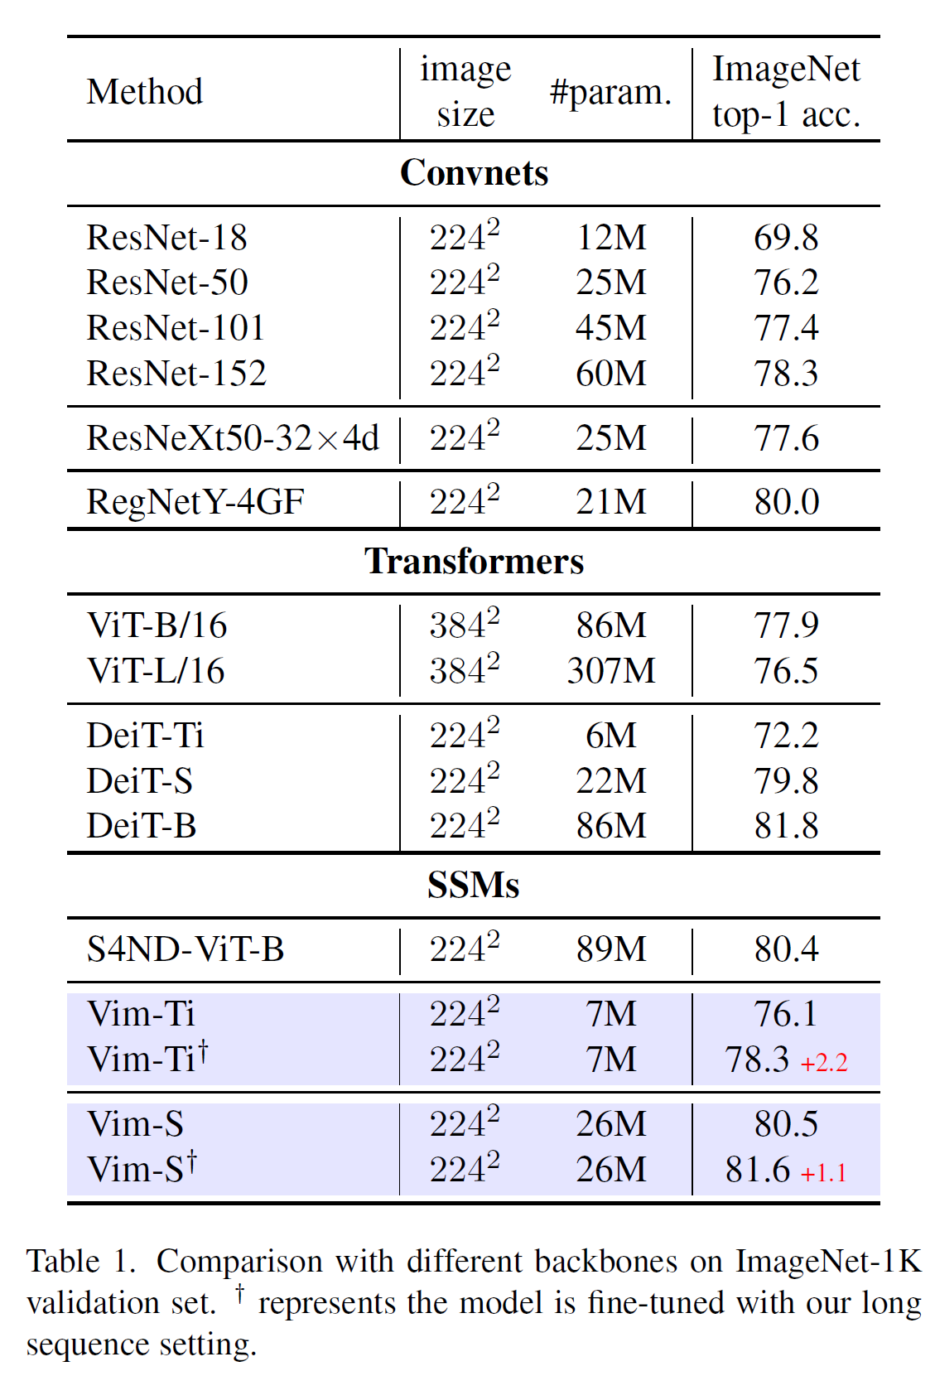
Experiments: Classification
ImageNet-1K Dataset:
- 1.28M training images
- 50K validation images
- 1,000 categories
Long Sequence Fine-Tuning: Double of patches than DeiT with the same size (stride 8, 16x16).
Results:
3.9 points higher for Vim-Tiny over DeiT-Tiny
0.7 points higher for Vim-Small over DeiT-Small
Vim-S achieves results similar to DeiT-B with LSFT
1248×1248: Vim is 2.8× faster than DeiT and saves 86.8% GPU memory

Slide 7
Experiments: Classification
ImageNet-1K Dataset:
- 1.28M training images
- 50K validation images
- 1,000 categories
Long Sequence Fine-Tuning: Double of patches than DeiT with the same size (stride 8, 16x16).
Results:
3.9 points higher for Vim-Tiny over DeiT-Tiny
0.7 points higher for Vim-Small over DeiT-Small
Vim-S achieves results similar to DeiT-B with LSFT
1248×1248: Vim is 2.8× faster than DeiT and saves 86.8% GPU memory
+3.9

Slide 8
Experiments: Classification
ImageNet-1K Dataset:
- 1.28M training images
- 50K validation images
- 1,000 categories
Long Sequence Fine-Tuning: Double of patches than DeiT with the same size (stride 8, 16x16).
Results:
3.9 points higher for Vim-Tiny over DeiT-Tiny
0.7 points higher for Vim-Small over DeiT-Small
Vim-S achieves results similar to DeiT-B with LSFT
1248×1248: Vim is 2.8× faster than DeiT and saves 86.8% GPU memory
+0.7

Slide 9
Experiments: Classification
ImageNet-1K Dataset:
- 1.28M training images
- 50K validation images
- 1,000 categories
Long Sequence Fine-Tuning: Double of patches than DeiT with the same size (stride 8, 16x16).
Results:
3.9 points higher for Vim-Tiny over DeiT-Tiny
0.7 points higher for Vim-Small over DeiT-Small
Vim-S achieves results similar to DeiT-B with LSFT
1248×1248: Vim is 2.8× faster than DeiT and saves 86.8% GPU memory

Slide 10
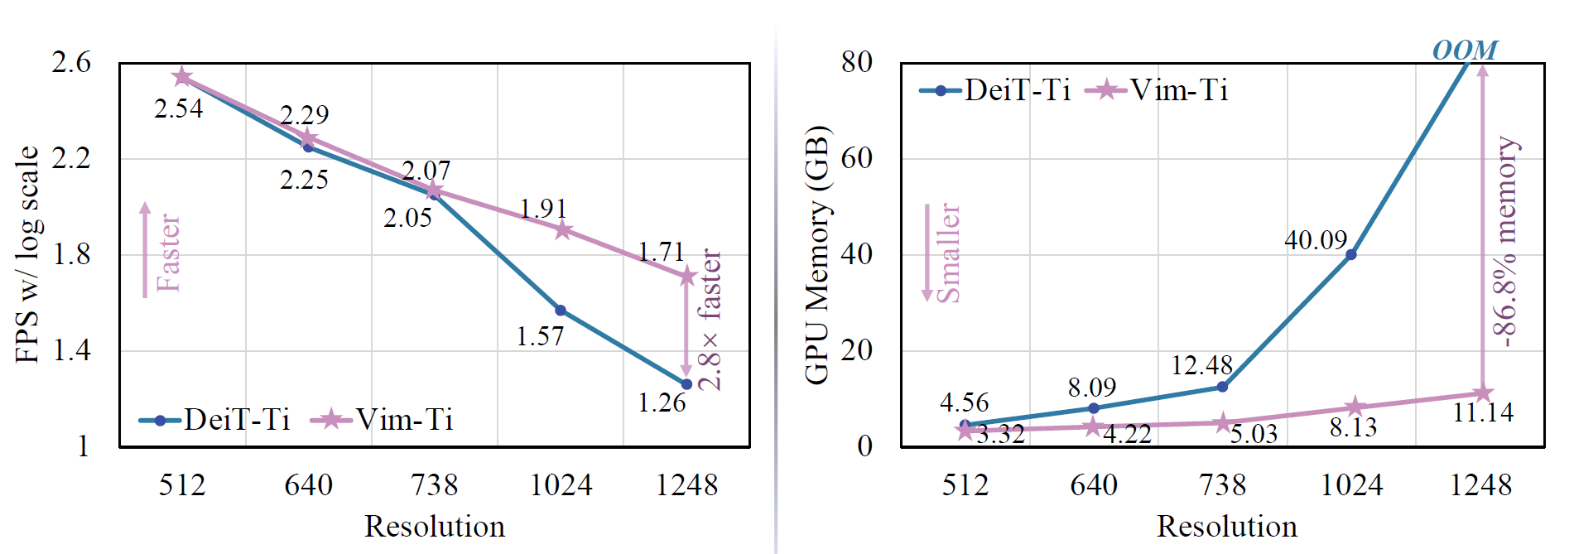
Experiments: Classification
ImageNet-1K Dataset:
- 1.28M training images
- 50K validation images
- 1,000 categories
Long Sequence Fine-Tuning: Double of patches than DeiT with the same size (stride 8, 16x16).
Results:
3.9 points higher for Vim-Tiny over DeiT-Tiny
0.7 points higher for Vim-Small over DeiT-Small
Vim-S achieves results similar to DeiT-B with LSFT
1248×1248: Vim is 2.8× faster than DeiT and saves 86.8% GPU memory

Slide 11
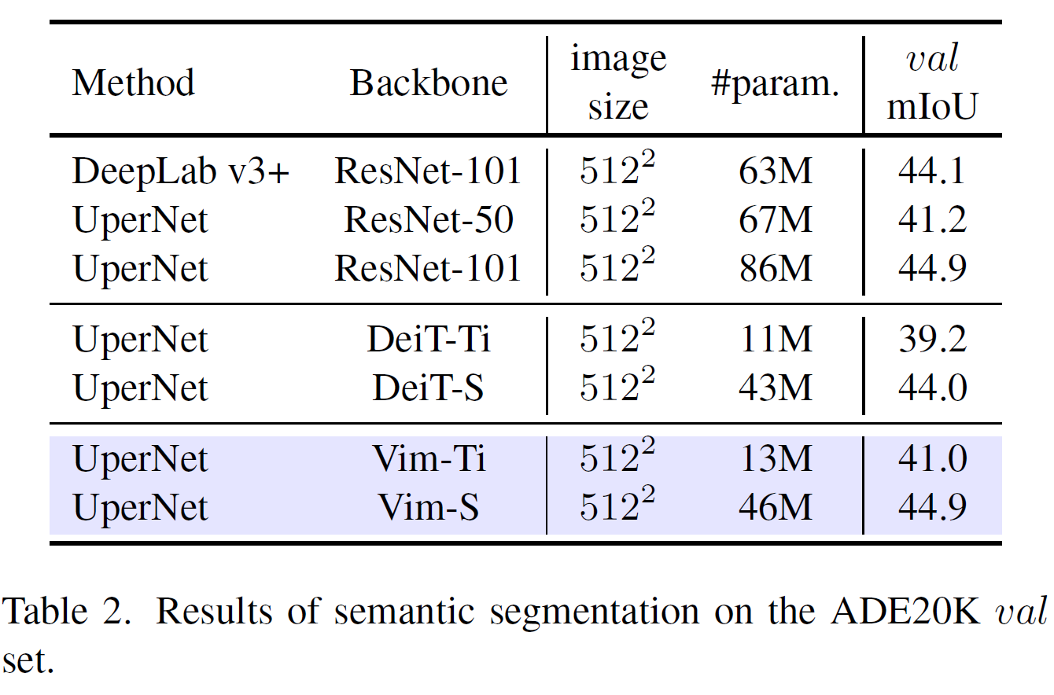
Experiments: Semantic Segmentation
ADE20K Dataset:
- 20K training images
- 2K validation images
- 150 categories
- UperNet framework
Results:
1.8 mIoU higher for Vim-Ti over DeiT-Ti
0.9 mIoU higher for Vim-S over DeiT-S
Vim-S similar to ResNet-101 but 2x fewer parameters

Slide 12
Experiments: Semantic Segmentation
ADE20K Dataset:
- 20K training images
- 2K validation images
- 150 categories
- UperNet framework
Results:
1.8 mIoU higher for Vim-Ti over DeiT-Ti
0.9 mIoU higher for Vim-S over DeiT-S
Vim-S similar to ResNet-101 but 2x fewer parameters
+1.8

Slide 13
Experiments: Semantic Segmentation
ADE20K Dataset:
- 20K training images
- 2K validation images
- 150 categories
- UperNet framework
Results:
1.8 mIoU higher for Vim-Ti over DeiT-Ti
0.9 mIoU higher for Vim-S over DeiT-S
Vim-S similar to ResNet-101 but 2x fewer parameters
+0.9

Slide 14
Experiments: Semantic Segmentation
ADE20K Dataset:
- 20K training images
- 2K validation images
- 150 categories
- UperNet framework
Results:
1.8 mIoU higher for Vim-Ti over DeiT-Ti
0.9 mIoU higher for Vim-S over DeiT-S
Vim-S similar to ResNet-101 but 2x fewer parameters

Slide 15
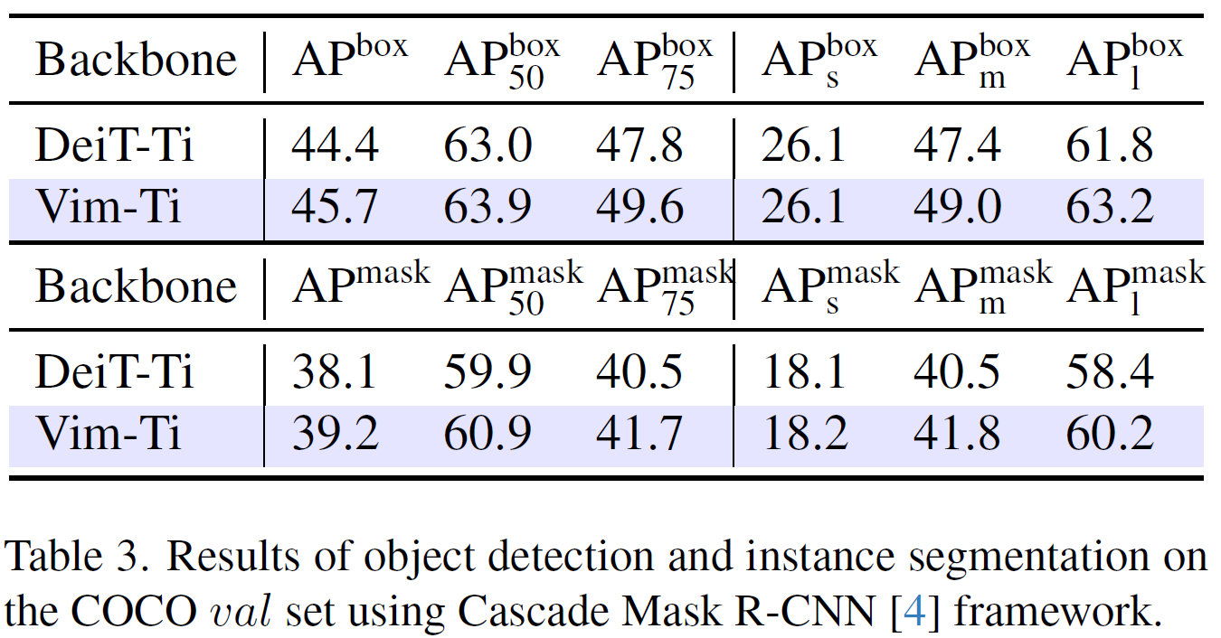
Experiments: Object Detection and Instance Segmentation
COCO 2017 Dataset:
- 118K training images
- 5K validation images
- Cascade Mask R-CNN base framework
Results:
Vim-Ti surpasses DeiT-Ti for medium-size and big objects
Better long-range context learning
Not necessary window attention

Slide 16
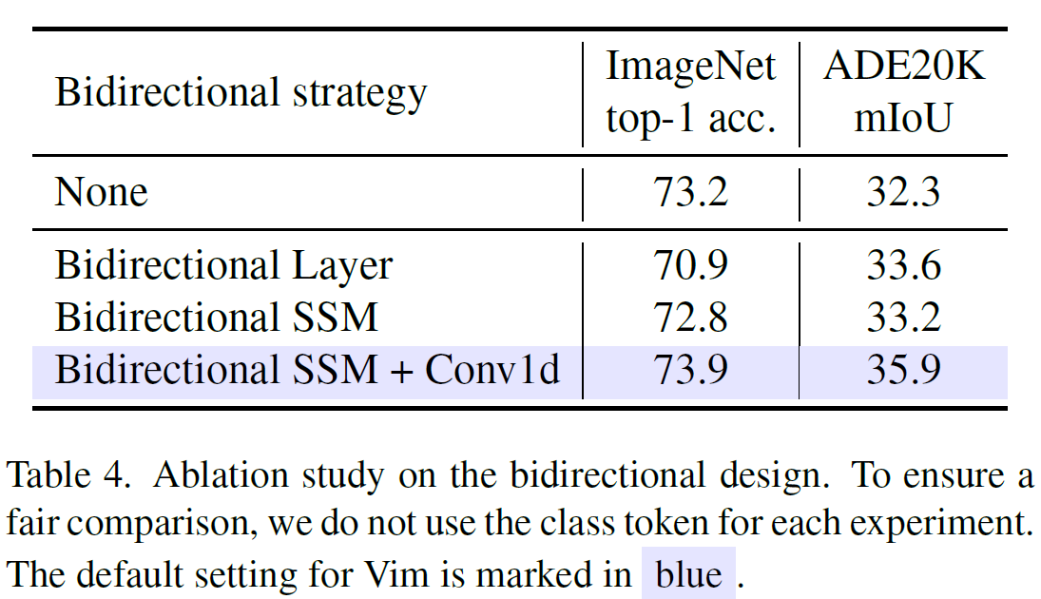
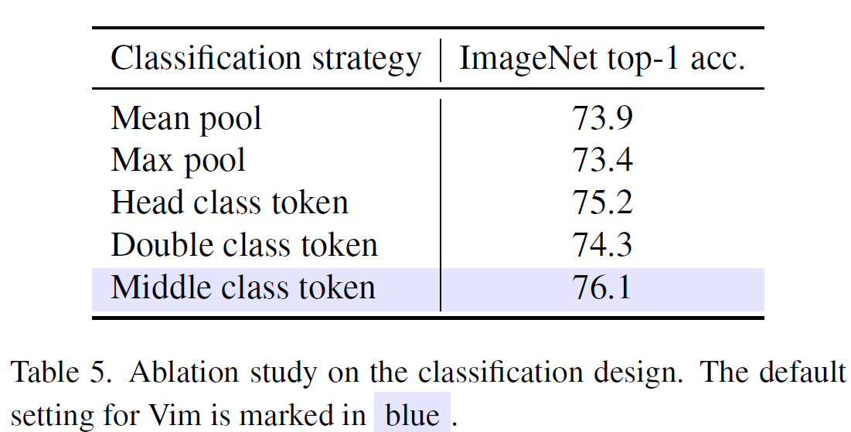
Experiments: Ablation Study for Design
Unidirectionality makes Mamba Block (None) fail in dense classification tasks (i.e. segmentation)
Bidirectional Block improves segmentation (+1.3 mIoU).
Further enhancement with Bidirectional SSM + Conv1D.
Concatenating class token to the visual sequence and performing classification on it outperforms pooling strategy .
The best design is by adding class token at the middle of the visual sequence and then perform classification on the final middle class token.

Slide 17
Conclusions
Possible alternative to Transformer based backbones
Computational complexity linear on sequence length as shown for text
Modeling power similar to DeiT and superior for higher resolution images thanks to efficient long sequences management

Slide 18
Possible Improvements and Future Work
Different Datasets and Frameworks
Ablation study on Hyperparameters
Self-Supervised Learning
Comparison of improvements for SOTA systems based on Transformers

Slide 19
References
Zhu, L., Liao, B., Zhang, Q., Wang, X., Liu, W., & Wang, X. (2024). Vision Mamba: Efficient Visual Representation Learning with Bidirectional State Space Model. arXiv preprint arXiv:2401.09417 [cs.CV].
Gu, A., & Dao, T. (2023). Mamba: Linear-Time Sequence Modeling with Selective State Spaces. arXiv preprint arXiv:2312.00752 [cs.LG].
Li, K., Li, X., Wang, Y., He, Y., Wang, Y., Wang, L., & Qiao, Y. (Year). VideoMamba: State Space Model for Efficient Video Understanding. arXiv preprint arXiv:2403.06977 [cs.CV].
AICoffeeBreak, (2024, April 08). MAMBA and State Space Models explained | SSM explained [Video]. YouTube. URL: https://rb.gy/phwzer

