Slide 1
KRISSBERT Knowledge-Rich Self-Supervision for Biomedical Entity Linking
Sheng Zhang, Hao Cheng, Shikhar Vashishth, Cliff Wong, Jinfeng Xiao†, Xiaodong Liu, Tristan Naumann, Jianfeng Gao, Hoifung Poon
Microsoft Research
†University of Illinois at Urbana-Champaign
Alberto Becerra Tomé
Barcelona, November 2024

Slide 2
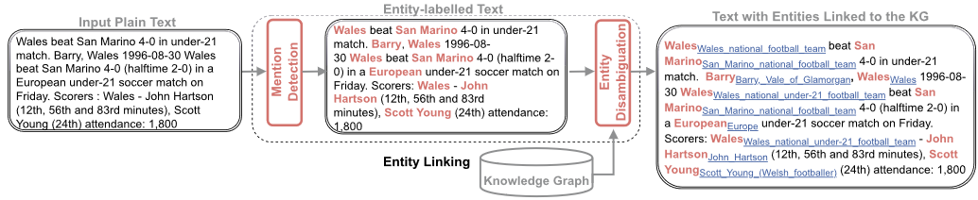
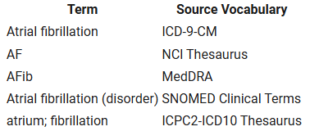
Entity Linking in Biomedical Domain
Process of matching a mention in text to an ontology record.
Mentions disambiguation is critical in biomedical applications.
Unified Medical Language System (UMLS): Representative ontology for biomedicine with +4M entities.
Image (left): Sevgili, Özge, Artem Shelmanov, Mikhail Arkhipov, Alexander Panchenko, and Chris Biemann. “Neural Entity Linking: A Survey of Models Based on Deep Learning.” Semantic Web 13, no. 3 (January 1, 2022): 527–70. https://doi.org/10.3233/SW-222986.
Image (right): https://www.nlm.nih.gov/research/umls/new_users/online_learning/Meta_001.html
Notes:
The key idea of zero-shot methods is to train an EL system on a domain with rich labeled data resources and apply it to a new domain with only minimal available data like descriptions of domain-specific entities.

Slide 3
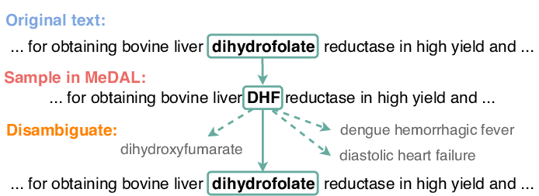
Motivations
H1: Address entity ambiguity and variability in biomedical domain.
H2: Overcome limitations of zero-shot methods such as not considering entity context.
H3: Leverage domain-specific ontologies and self-supervision to enable scalable, accurate biomedical entity linking without labeled examples.
Image: Wen, Zhi & Lu, Xing Han & Reddy, Siva. (2020). MeDAL: Medical Abbreviation Disambiguation Dataset for Natural Language Understanding Pretraining. 130-135. 10.18653/v1/2020.clinicalnlp-1.15.
Notes:
The key idea of zero-shot methods is to train an EL system on a domain with rich labeled data resources and apply it to a new domain with only minimal available data like descriptions of domain-specific entities.

Slide 4
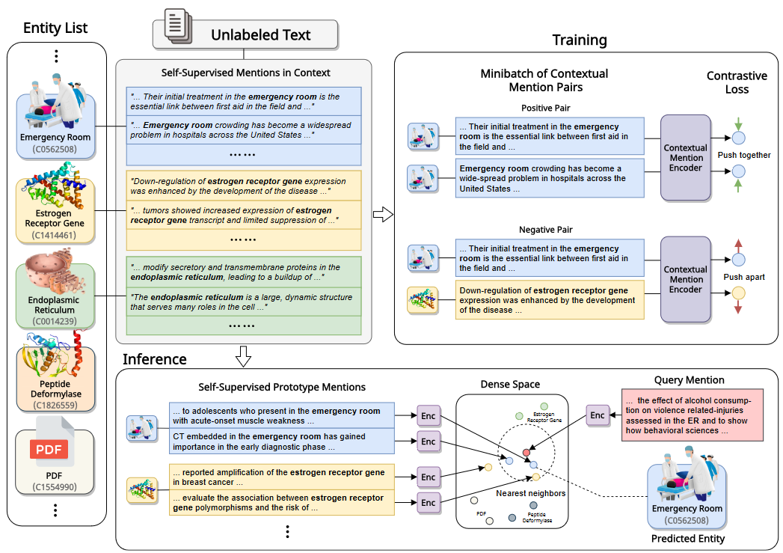
Methodology Overview

Slide 5
Methodology: Data
UMLS
Over 4M concepts
Semantic hierarchy (ISA)
Descriptions (6% concepts)
PubMed
Over 1.6B mention examples
Dictionary search + context retrieval (64 tokens window)

Slide 6
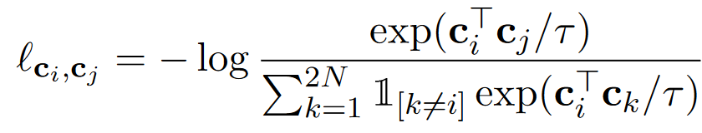
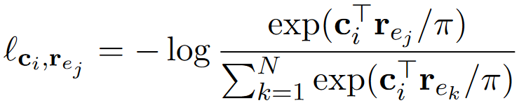
Methodology: Training
For each minibatch, 2N mentions for N entities are sampled
[CLS] ctx_{L} [Ms] mention [Me] ctx_{R} [SEP]
Enriched with N entity-centered references (aliases + semantic):
[CLS] stn [SEP] type [SEP] aliases [SEP]

Slide 7
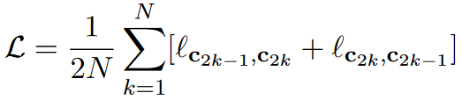
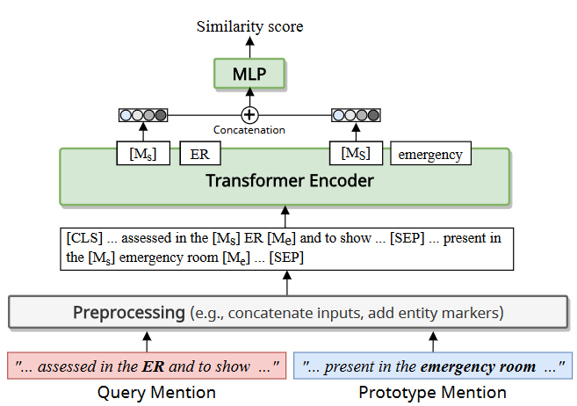

Methodology: Training
Candidates Generation
K candidates per mention
Cross-encoder reranker
[CLS] Mention Candidate
Linear Layer
Cross-Encoder Re-ranker
Ranked Candidates

Slide 8

Methodology: Inference
Prototypes: Sampled mentions for each entity
Supervised data:
Prototypes = Gold Standard
Lazy Supervised data:
Prototypes = GS + Self-Sup Mentions

Slide 9
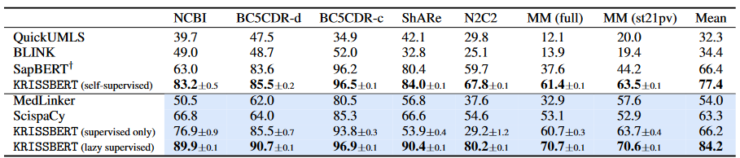
Results: Self-supervision
disease
17,809
discharge
13,609
Variety
350k
Unsupervised
Supervised
disease
6,892
disease
5,818
chemical
4,409
21 most common
types
Batch size: 512
Learning rate: 10−5
Dropout rate: 0.1
p_{mask} = p_{replace} = 0.2
τ = π = 1.0
α = β = 0.5
K = 100 (number of prototypes for re-ranking)
Initialization weights: PubMedBERT
Training time: 3 hours on 4 NVIDIA V100 GPUs
Biggest improvement for generic datasets
Outperforms supervised and unsupervised systems
Notes:
When a new token is added to a sequence (increase of sequence length) computational complexity increases quadratically in space as it needs to compute scores for each pair.
However, in SSMs adding one more token just means doing one more time the SSM and computation only doubles.
The main problem is that they use the same A, B and C for predicting every token. This is solved by introducing selective SSMs and Scan, an algorithm which preserves linear complexity with sequence length.

Slide 10
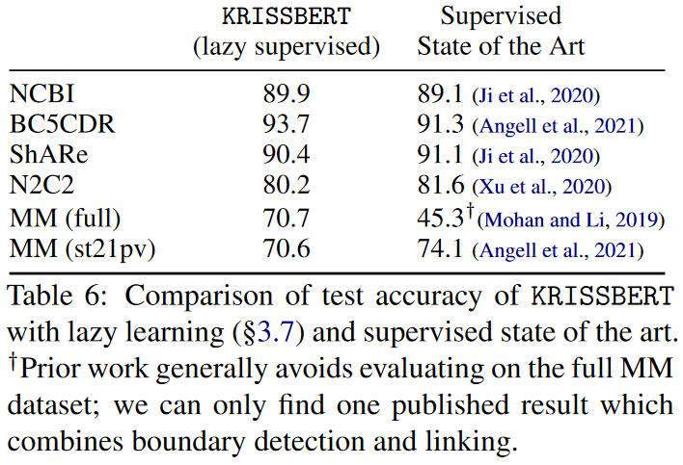
Results: Lazy Supervision
Notes:
When a new token is added to a sequence (increase of sequence length) computational complexity increases quadratically in space as it needs to compute scores for each pair.
However, in SSMs adding one more token just means doing one more time the SSM and computation only doubles.
The main problem is that they use the same A, B and C for predicting every token. This is solved by introducing selective SSMs and Scan, an algorithm which preserves linear complexity with sequence length.

Slide 11
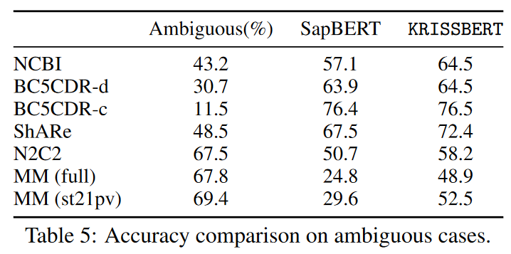
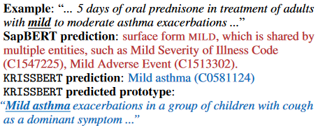
Results: Disambiguation
*We consider a mention as ambiguous if it can’t be matched to a unique entity as is.

Slide 12
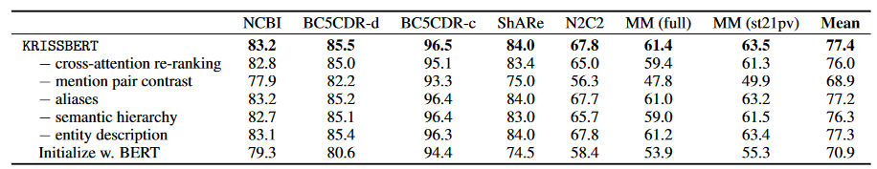
Results: Design
Notes:
When a new token is added to a sequence (increase of sequence length) computational complexity increases quadratically in space as it needs to compute scores for each pair.
However, in SSMs adding one more token just means doing one more time the SSM and computation only doubles.
The main problem is that they use the same A, B and C for predicting every token. This is solved by introducing selective SSMs and Scan, an algorithm which preserves linear complexity with sequence length.

Slide 13
Conclusions
H1: Address entity ambiguity and variability in biomedical domain.
C1: Consistent performance even in MedMentions (high variability, large scale)
H2: Overcome limitations of zero-shot methods such as not considering entity context.
C2: Scalable and efficient context encoding and entity-centered encoded mentions (Design).
H3: Leverage domain-specific ontologies and self-supervision to enable scalable, accurate biomedical entity linking without labeled examples.
C3: Self-supervised inference consistently outperforms most of the SOTA systems including SapBERT.
Promising Tool for Low-Resource Settings: Valuable solution for biomedical NLP tasks where labeled data is scarce.
Lazy-supervision Technique: Verification of positive impact of enriching self-supervised mentions with gold standard.

Slide 14
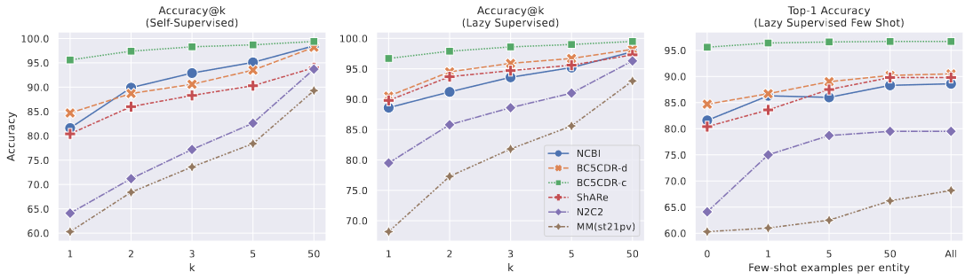
Limitations and Proposed Solutions
Huge difference in Accuracy@k in some datasets.
Solution:
Initialize cross-encoder re-ranker with strong pretrained weights using models such as jina-reranker-v2.
Using more advanced techniques for negative mining in contrastive learning such as Top-k with percentage to positive threshold [3].

Slide 15
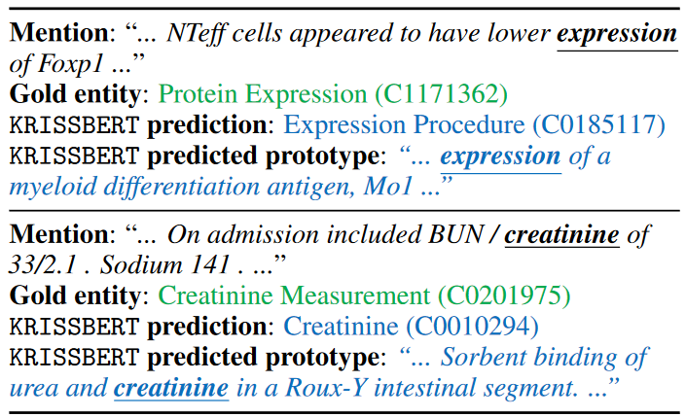
Limitations and Proposed Solutions
Confusing entities in different ontology branches such as Procedures and Substances
Solution: Split the ontology in different types + NERC + Specific fine-tuned model
Mentions
Disease
Finding
Procedure
Model-d
Model-f
Model-p

Slide 16
Limitations and Proposed Solutions
Not extensible to other languages with less resources
Solution: Use this self-supervised approach in other languages such as Spanish, with a populated UMLS version and extensive text databases such as Scielo.

Slide 17
References
[1] Zhang, Sheng, Hao Cheng, Shikhar Vashishth, Cliff Wong, Jinfeng Xiao, Xiaodong Liu, Tristan Naumann, Jianfeng Gao, and Hoifung Poon. “Knowledge-Rich Self-Supervision for Biomedical Entity Linking.” arXiv, May 23, 2022. https://doi.org/10.48550/arXiv.2112.07887.
[2] Sevgili, Özge, Artem Shelmanov, Mikhail Arkhipov, Alexander Panchenko, and Chris Biemann. “Neural Entity Linking: A&nbsp;Survey of Models Based on Deep Learning.” Semantic Web 13, no. 3 (January 1, 2022): 527–70. https://doi.org/10.3233/SW-222986.
[3] Moreira, Gabriel de Souza P., Radek Osmulski, Mengyao Xu, Ronay Ak, Benedikt Schifferer, and Even Oldridge. “NV-Retriever: Improving Text Embedding Models with Effective Hard-Negative Mining.” arXiv, July 22, 2024. https://doi.org/10.48550/arXiv.2407.15831.
[4] Zhang, Sheng, Hao Cheng, Shikhar Vashishth, Cliff Wong, Jinfeng Xiao, Xiaodong Liu, Tristan Naumann, Jianfeng Gao, and Hoifung Poon. “Knowledge-Rich Self-Supervision for Biomedical Entity Linking.” arXiv, May 23, 2022. https://doi.org/10.48550/arXiv.2112.07887.
[5] Gallego, Fernando, Guillermo López-García, Luis Gasco-Sánchez, Martin Krallinger, and Francisco J. Veredas. “ClinLinker: Medical Entity Linking of Clinical Concept Mentions in Spanish.” arXiv, April 9, 2024. https://doi.org/10.48550/arXiv.2404.06367.
[6] Liu, Fangyu, Ehsan Shareghi, Zaiqiao Meng, Marco Basaldella, and Nigel Collier. “Self-Alignment Pretraining for Biomedical Entity Representations.” arXiv, April 7, 2021. https://doi.org/10.48550/arXiv.2010.11784.

Slide 18

Thank You

