Slide 1
Vision Mamba: Efficient Visual Representation Learning with Bidirectional State Space Model
Authors: Lianghui Zhu, Bencheng Liao, Qian Zhang, Xinlong Wang, Wenyu Liu, Xinggang Wang
Alberto Becerra Tomé
Barcelona, April 2024

Slide 2
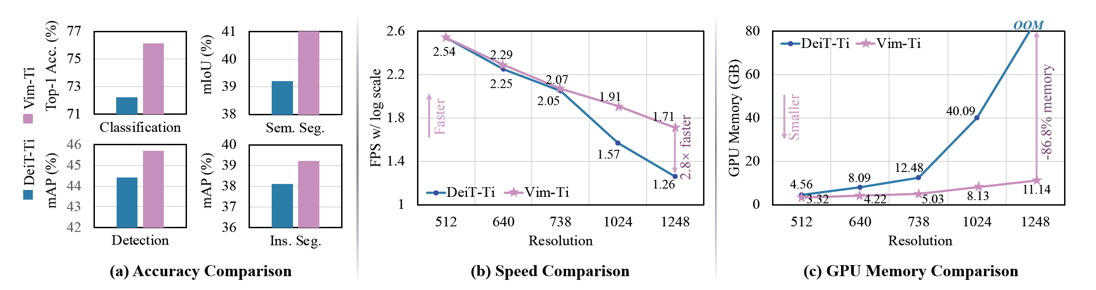
Motivation
Introducing Vision Mamba (Vim) with Bidirectional SSM
Improving existing SOTA Transformer based models (DeiT) for high resolution in terms of:
Memory efficiency
Performance in Vision Tasks
Notes:
In this paper, the authors address the limitations in SSMs when applied to visual data. They propose a new vision backbone, Vim, which utilizes
Bidirectional Mamba blocks and SSMs to process image sequences.
Mamba, is an SSM based model, originally developed for language.The superior scaling performance of Mamba indicates that this is a promising alternative to Transformer in language modeling and it may be for vision.
The key motivations are:
- Overcoming the dependency on self-attention in traditional vision transformers.
- Providing a more efficient, hardware-friendly model for visual tasks.
- Achieving high performance while significantly reducing computation and memory overhead compared to established vision transformers like DeiT.
The results demonstrate that Vim outperforms existing vision transformers in various benchmarks such as ImageNet classification, COCO object detection, and ADE20k semantic segmentation, while also being significantly faster and using much less memory. This indicates that Vim has the potential to become a strong candidate for the next-generation backbone for vision-based foundation models.

Slide 3
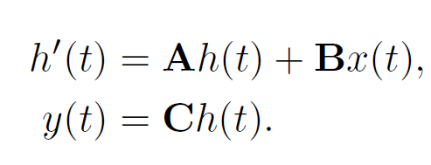
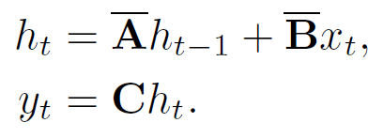
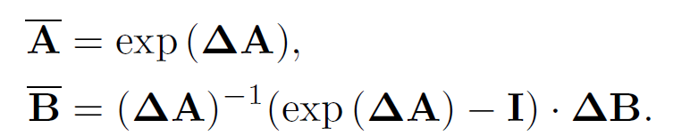
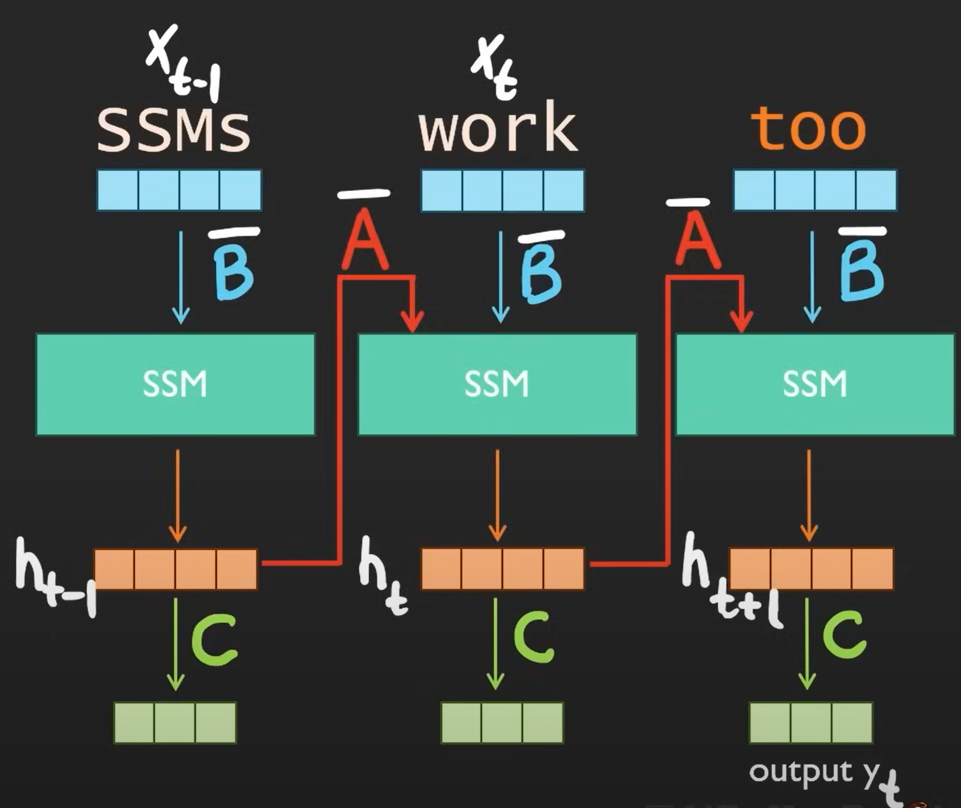
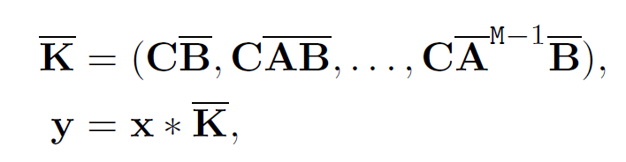
State Space Models (SSM)
They are inspired in basic 1-D continuous differential models for sequences
Learnable parameters: Step size (Δ), B, C
Method: Convolution (Efficient in GPU)
Discretization
*Images: AICoffeeBreak, (2024, April 08). MAMBA and State Space Models explained | SSM explained [Video].
YouTube. URL: https://www.youtube.com/watch?v=vrF3MtGwD0Y&t=1s&ab_channel=AICoffeeBreakwithLetitia
Notes:
Historically, they have their origins in the matricial solution of linear differential equations. It can be considered that the state h depends on its current state plus the action of external agent. Discretization step comes from the discrete, computable, definition of derivative.
The key in efficiency here is that our convolution kernel K can be precomputed and convolutions are known to be pretty efficient in GPU.

Slide 4
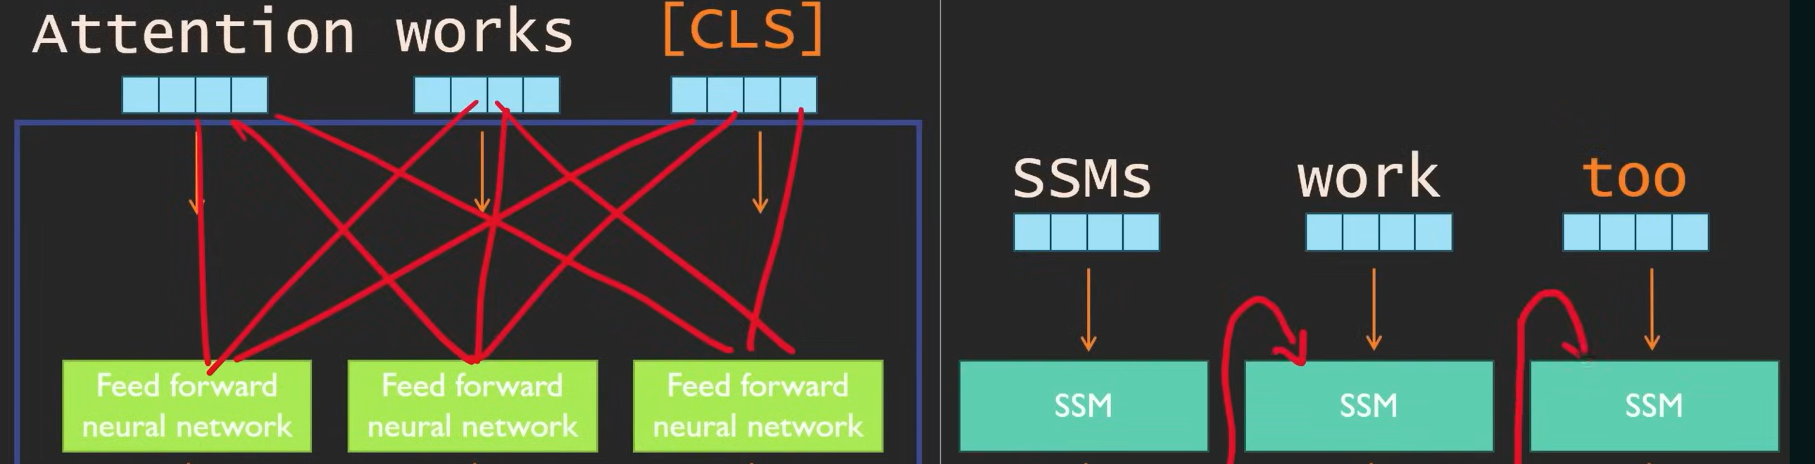
SSMs vs. Transformers (Efficiency)
*Images: AICoffeeBreak, (2024, April 08). MAMBA and State Space Models explained | SSM explained [Video]. YouTube.
URL: https://www.youtube.com/watch?v=vrF3MtGwD0Y&t=1s&ab_channel=AICoffeeBreakwithLetitia
Notes:
When a new token is added to a sequence (increase of sequence length) computational complexity increases quadratically in space as it needs to compute scores for each pair.
However, in SSMs adding one more token just means doing one more time the SSM and computation only doubles.
The main problem is that they use the same A, B and C for predicting every token. This is solved by introducing selective SSMs and Scan, an algorithm which preserves linear complexity with sequence length.

Slide 5
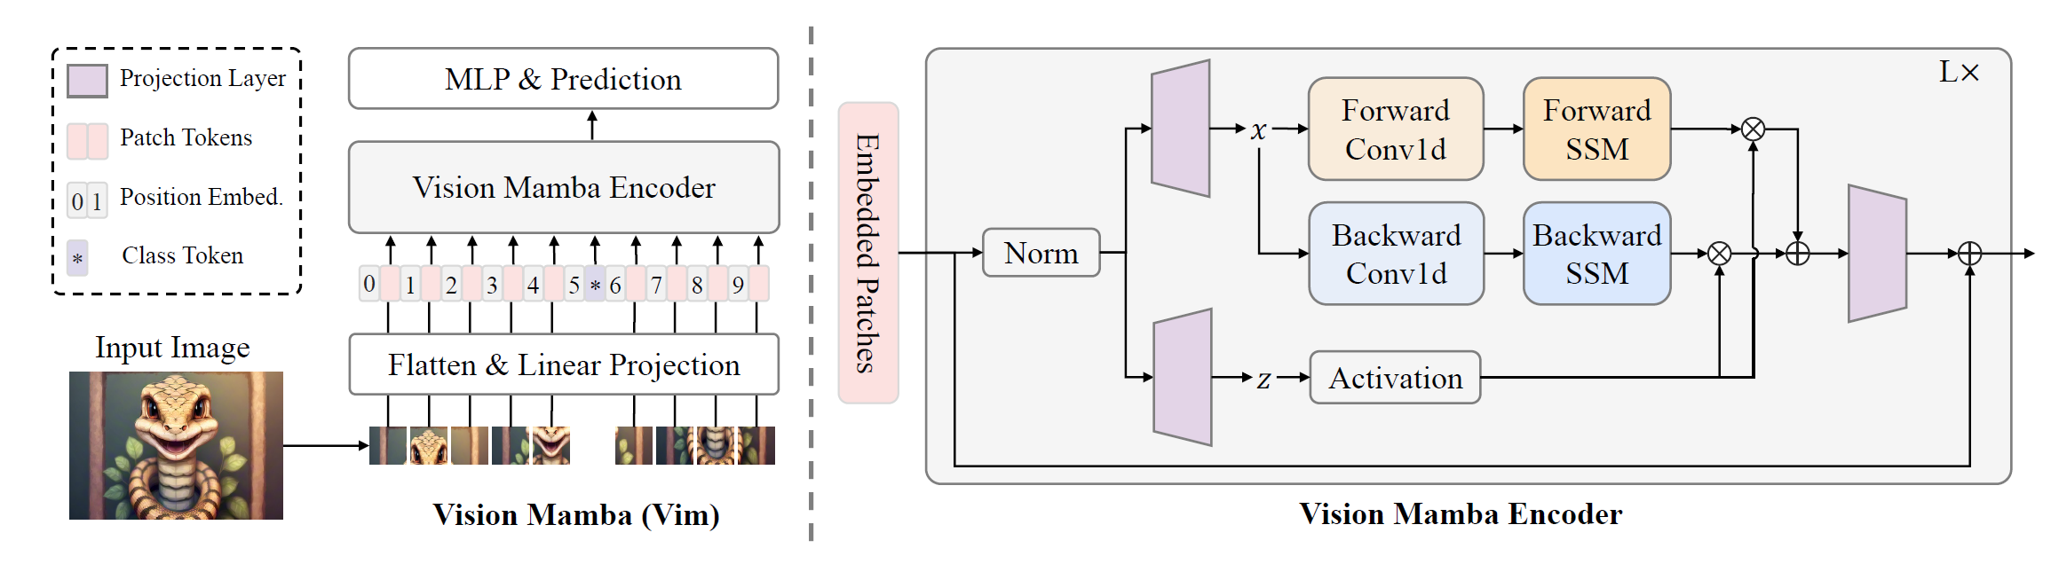

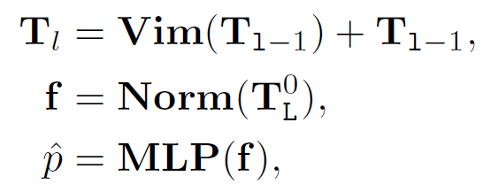
Vision Mamba
BxMxD
BxMxE
BxMxE
BxMxN
BxMxExN
BxMxD
Tiny Small
L : Number of vim blocks 24 24
D: Hidden state dimension 192 384
E: Expanded state dimension 384 768
N: SSM dimensión 16 16
Notes:
There are two problems in the transition from Mamba to Vim:
- Unidirectional modeling. Images are not interpreted as an inherently oredered sequence.
- Lack of positional awareness, which is crucial to understand the spatial layout and semantic relationships
This is solved by incorporating the bidirectional SSMs and position embeddings as in transformer encoding.
This way, patches are linearly projected, flattened and positionally encoded. After that, it goes into a Vision Mamba Encoder Block, where bidirectional
SSM is applied.

Slide 6
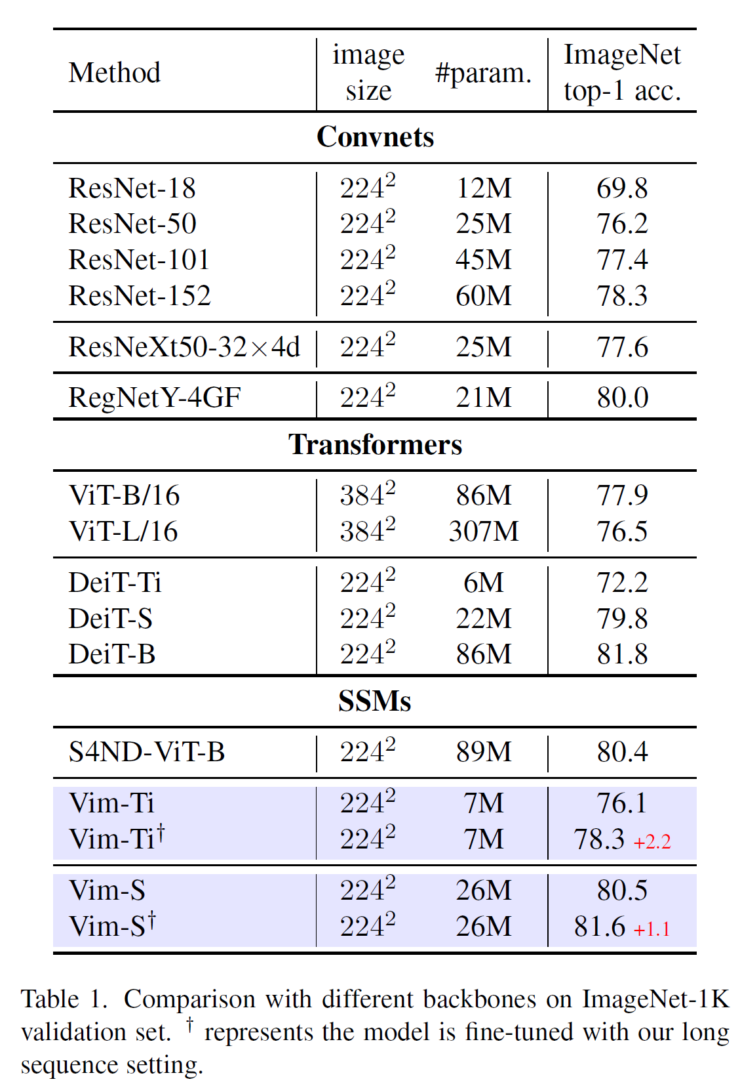
Experiments: Classification
ImageNet-1K Dataset:
- 1.28M training images
- 50K validation images
- 1,000 categories
Long Sequence Fine-Tuning: Double of patches than DeiT with the same size (stride 8, 16x16).
Results:
3.9 points higher for Vim-Tiny over DeiT-Tiny
0.7 points higher for Vim-Small over DeiT-Small
Vim-S achieves results similar to DeiT-B with LSFT
1248×1248: Vim is 2.8× faster than DeiT and saves 86.8% GPU memory
Notes:
In all the cases, Vim outperforms the convolutional ResNet backbones, having much less params.

Slide 7
Experiments: Classification
ImageNet-1K Dataset:
- 1.28M training images
- 50K validation images
- 1,000 categories
Long Sequence Fine-Tuning: Double of patches than DeiT with the same size (stride 8, 16x16).
Results:
3.9 points higher for Vim-Tiny over DeiT-Tiny
0.7 points higher for Vim-Small over DeiT-Small
Vim-S achieves results similar to DeiT-B with LSFT
1248×1248: Vim is 2.8× faster than DeiT and saves 86.8% GPU memory
+3.9

Slide 8
Experiments: Classification
ImageNet-1K Dataset:
- 1.28M training images
- 50K validation images
- 1,000 categories
Long Sequence Fine-Tuning: Double of patches than DeiT with the same size (stride 8, 16x16).
Results:
3.9 points higher for Vim-Tiny over DeiT-Tiny
0.7 points higher for Vim-Small over DeiT-Small
Vim-S achieves results similar to DeiT-B with LSFT
1248×1248: Vim is 2.8× faster than DeiT and saves 86.8% GPU memory
+0.7
Notes:
300 epochs for normal training
300 + 30 of fine tuning with LSFT

Slide 9
Experiments: Classification
ImageNet-1K Dataset:
- 1.28M training images
- 50K validation images
- 1,000 categories
Long Sequence Fine-Tuning: Double of patches than DeiT with the same size (stride 8, 16x16).
Results:
3.9 points higher for Vim-Tiny over DeiT-Tiny
0.7 points higher for Vim-Small over DeiT-Small
Vim-S achieves results similar to DeiT-B with LSFT
1248×1248: Vim is 2.8× faster than DeiT and saves 86.8% GPU memory

Slide 10
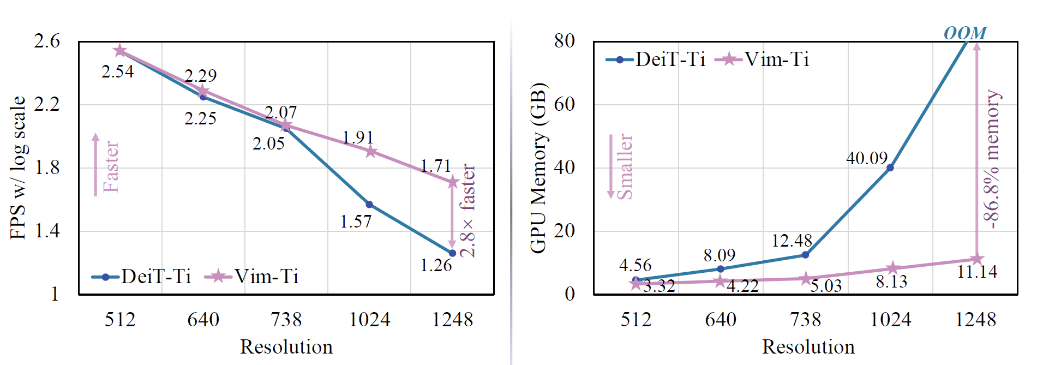
Experiments: Classification
ImageNet-1K Dataset:
- 1.28M training images
- 50K validation images
- 1,000 categories
Long Sequence Fine-Tuning: Double of patches than DeiT with the same size (stride 8, 16x16).
Results:
3.9 points higher for Vim-Tiny over DeiT-Tiny
0.7 points higher for Vim-Small over DeiT-Small
Vim-S achieves results similar to DeiT-B with LSFT
1248×1248: Vim is 2.8× faster than DeiT and saves 86.8% GPU memory in batch inference

Slide 11
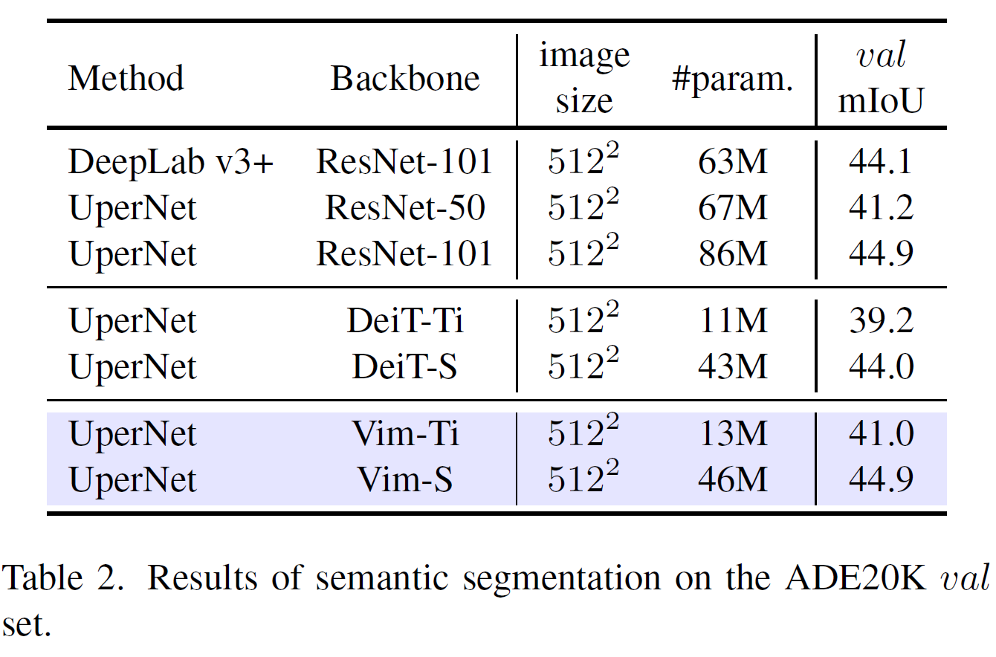
Experiments: Semantic Segmentation
ADE20K Dataset:
- 20K training images
- 2K validation images
- 150 categories
- UperNet framework
Results:
1.8 mIoU higher for Vim-Ti over DeiT-Ti
0.9 mIoU higher for Vim-S over DeiT-S
Vim-S similar to ResNet-101 but 2x fewer parameters

Slide 12
Experiments: Semantic Segmentation
ADE20K Dataset:
- 20K training images
- 2K validation images
- 150 categories
- UperNet framework
Results:
1.8 mIoU higher for Vim-Ti over DeiT-Ti
0.9 mIoU higher for Vim-S over DeiT-S
Vim-S similar to ResNet-101 but 2x fewer parameters
+1.8

Slide 13
Experiments: Semantic Segmentation
ADE20K Dataset:
- 20K training images
- 2K validation images
- 150 categories
- UperNet framework
Results:
1.8 mIoU higher for Vim-Ti over DeiT-Ti
0.9 mIoU higher for Vim-S over DeiT-S
Vim-S similar to ResNet-101 but 2x fewer parameters
+0.9

Slide 14
Experiments: Semantic Segmentation
ADE20K Dataset:
- 20K training images
- 2K validation images
- 150 categories
- UperNet framework
Results:
1.8 mIoU higher for Vim-Ti over DeiT-Ti
0.9 mIoU higher for Vim-S over DeiT-S
Vim-S similar to ResNet-101 but 2x fewer parameters

Slide 15
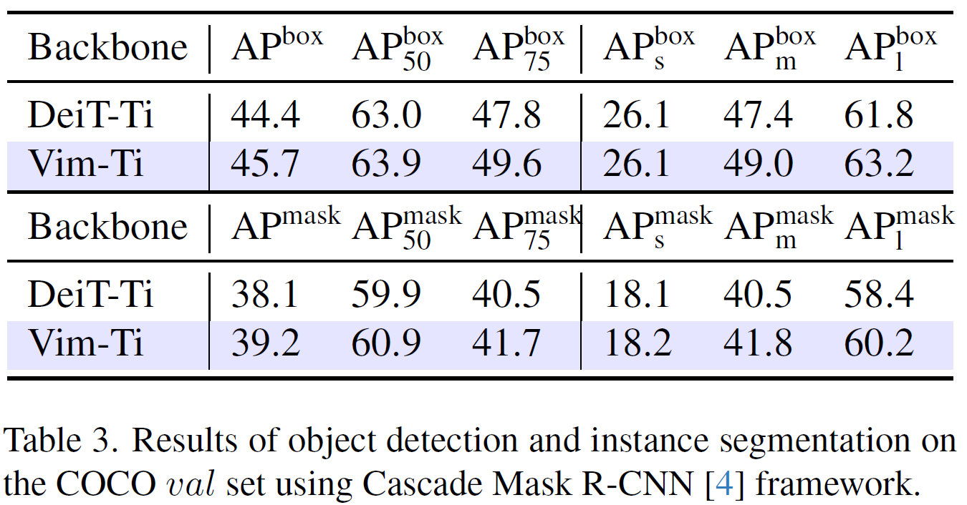
Experiments: Object Detection and Instance Segmentation
COCO 2017 Dataset:
- 118K training images
- 5K validation images
- Cascade Mask R-CNN base framework
Results:

Slide 16
Experiments: Object Detection and Instance Segmentation
COCO 2017 Dataset:
- 118K training images
- 5K validation images
- Cascade Mask R-CNN base framework
Results:
Vim-Ti surpasses DeiT-Ti for medium-size and big objects,
demonstrating better long-range context learning

Slide 17
Experiments: Object Detection and Instance Segmentation
COCO 2017 Dataset:
- 118K training images
- 5K validation images
- Cascade Mask R-CNN base framework
Results:
Vim-Ti surpasses DeiT-Ti for medium-size and big objects,
demonstrating better long-range context learning
Not necessary window attention

Slide 18
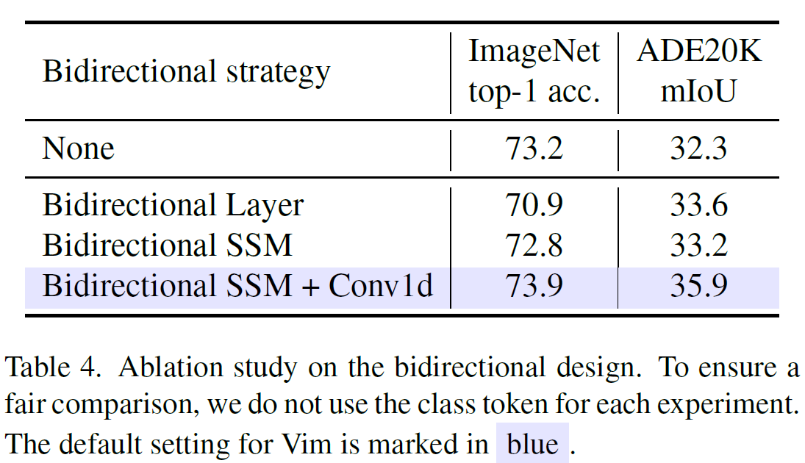
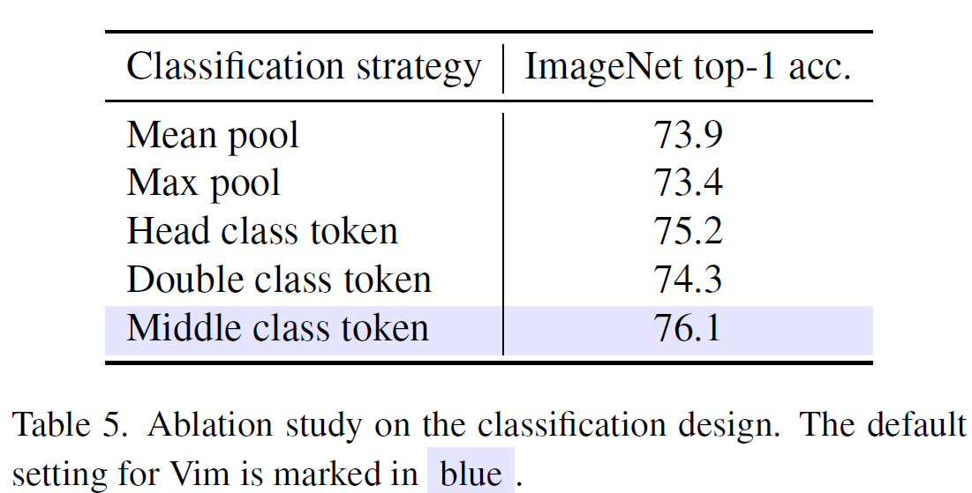
Experiments: Ablation Study for Design
Unidirectionality makes Mamba Block (None) fail in dense classification tasks (i.e. segmentation)
Bidirectional Block improves segmentation (+1.3 mIoU).
Further enhancement with Bidirectional SSM + Conv1D.
Concatenating class token to the visual sequence and performing classification on it outperforms pooling strategy .
The best design is by adding class token at the middle of the visual sequence and then perform classification on the final middle class token.

Slide 19
Conclusions
Computational complexity linear on sequence length as shown for text
Modeling power similar to DeiT and superior for higher resolution images thanks to efficient long sequences management
Possible alternative to Transformer based backbones
Future Lines:
Broader Exploration. Running on different Datasets and Frameworks
Self-Supervised Learning
Comparison of improvements for SOTA systems based on Transformers
As with Transformer architecture, opening a path to explore nexxt-generation AI based applications.

Slide 20
References
Zhu, L., Liao, B., Zhang, Q., Wang, X., Liu, W., & Wang, X. (2024). Vision Mamba: Efficient Visual Representation Learning with Bidirectional State Space Model. arXiv preprint arXiv:2401.09417 [cs.CV].
Gu, A., & Dao, T. (2023). Mamba: Linear-Time Sequence Modeling with Selective State Spaces. arXiv preprint arXiv:2312.00752 [cs.LG].
Li, K., Li, X., Wang, Y., He, Y., Wang, Y., Wang, L., & Qiao, Y. (Year). VideoMamba: State Space Model for Efficient Video Understanding. arXiv preprint arXiv:2403.06977 [cs.CV].
AICoffeeBreak, (2024, April 08). MAMBA and State Space Models explained | SSM explained [Video]. YouTube. URL: https://rb.gy/phwzer

