Slide 1
SemEval 2025 Shared Task 7: Multilingual and Crosslingual Fact-Checked Claim Retrieval
Organized by:
Qiwei Peng, Anders Søgaard (University of Copenhagen)
Simon Ostermann (German Research Center for Artificial Intelligence)
Michal Gregor, Ivan Srba, Marián Šimko, Jaroslav Kopčan, Juraj Podroužek, Matúš Mesarčík, Róbert Móro (Kempelen Institute of Intelligent Technologies)
Agustín Conesa Celdrán
Alberto Becerra Tomé
Barcelona, December 2024

Slide 2
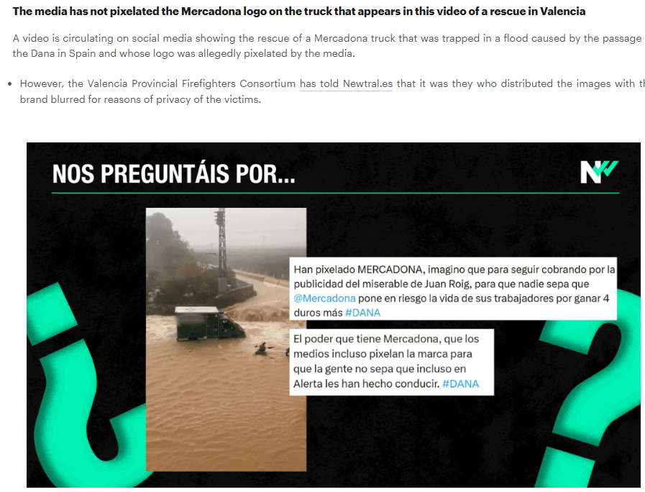
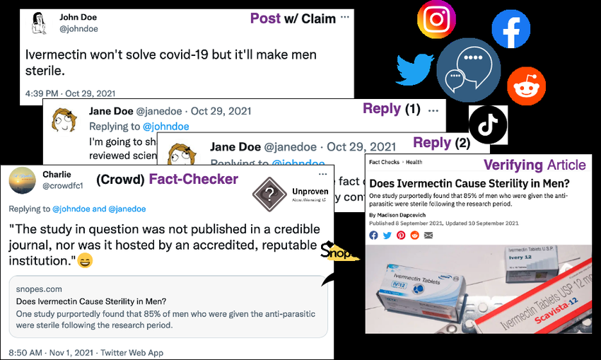
Main Goal
Efficiently identifying previously fact-checked claims across multiple languages.
Image sources: https://www.newtral.es/bulos-dana/20241030/
Notes:
The key idea of zero-shot methods is to train an EL system on a domain with rich labeled data resources and apply it to a new domain with only minimal available data like descriptions of domain-specific entities.

Slide 3
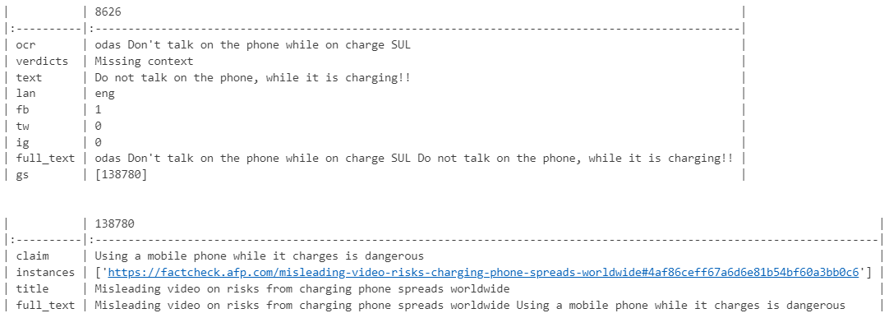
Dataset: Example
Link
Notes:
The key idea of zero-shot methods is to train an EL system on a domain with rich labeled data resources and apply it to a new domain with only minimal available data like descriptions of domain-specific entities.

Slide 4

Dataset: Example
Notes:
The key idea of zero-shot methods is to train an EL system on a domain with rich labeled data resources and apply it to a new domain with only minimal available data like descriptions of domain-specific entities.

Slide 5
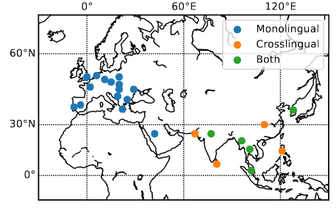
Dataset: MultiClaim
The MultiClaim dataset was generated by collecting:
Fact-checks: A total of 205,751 fact-checks from 142 organizations in 39 languages, including claims, titles, publication dates, and URLs.
Social Media Posts: 28,092 posts in 27 languages from platforms like Facebook, Instagram, and Twitter, selected and linked to relevant fact-checks by professional fact-checkers.
Pairs: 31,305 post-fact-check pairs (26,774 monolingual and 4,212 crosslingual), created based on professional fact-checker assignments.
Pikuliak, Matúš, Ivan Srba, Robert Moro, Timo Hromadka, Timotej Smolen, Martin Melisek, Ivan Vykopal, Jakub Simko, Juraj Podrouzek, and Maria Bielikova. “Multilingual Previously Fact-Checked Claim Retrieval.” In Proceedings of the 2023 Conference on Empirical Methods in Natural Language Processing, 16477–500, 2023. https://doi.org/10.18653/v1/2023.emnlp-main.1027.
Notes:
The key idea of zero-shot methods is to train an EL system on a domain with rich labeled data resources and apply it to a new domain with only minimal available data like descriptions of domain-specific entities.

Slide 6
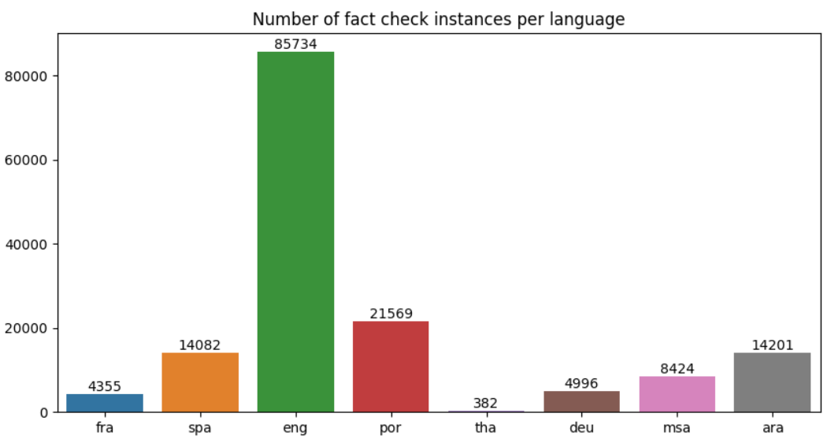
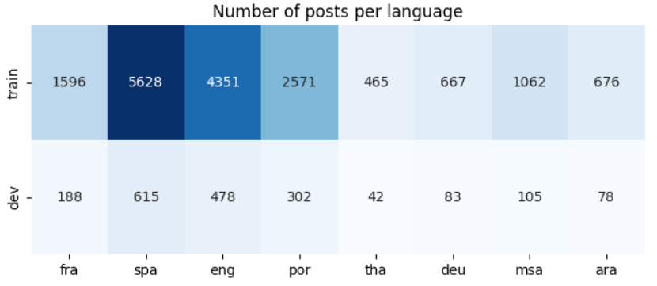
Dataset: Provided Splits
Total Posts (24,431)
153,743 fact checks
24,431 posts
25,743 post-fact-check pairs
Monolingual
18,907
17,016 + 1,891
Crosslingual
5,524
4,972 + 552

Slide 7
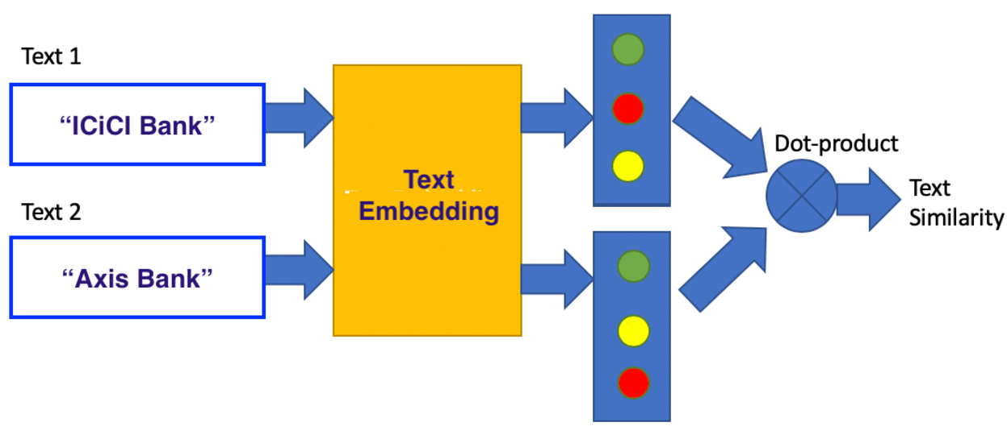
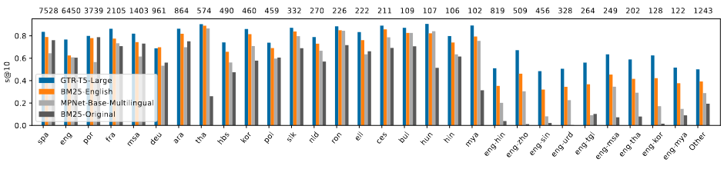
Previous Approaches: Retrieval Systems
Sparse Retrieval: BM25 vectorizer (tf-idf based; No training + fast inference)
Dense Retrieval: Multilingual embeddings (Pre-trained + slower inference)
Post
Vectorizer
Fact Check Claim

Slide 8
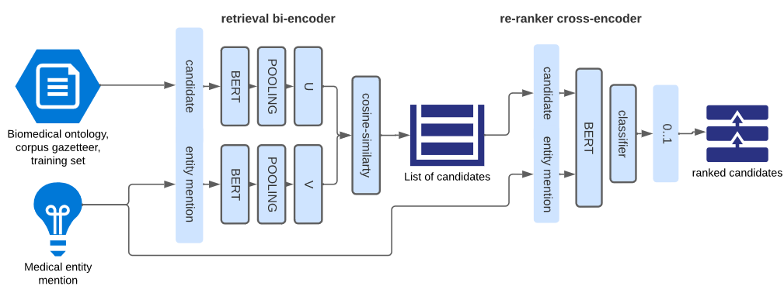
Proposed Approaches: Contrastive Learning
Contrastive Learning Approach
Biencoder selection:
BM25
Multilingual TEMs
English Translations + TEMs
Hybrid
Training Re-ranker using contrastive learning
Triplets Generation
Negative Sampling
Gallego, Fernando, Guillermo López-García, Luis Gasco-Sánchez, Martin Krallinger, and Francisco J. Veredas. “ClinLinker: Medical Entity Linking of Clinical Concept Mentions in Spanish.” arXiv, April 9, 2024. https://doi.org/10.48550/arXiv.2404.06367.

Slide 9
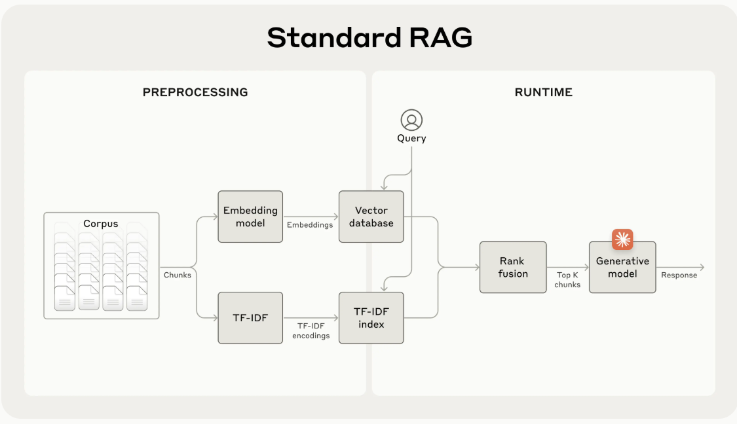
Proposed Approaches: Generative Models
K-shot Naïve Generation
Instruction Fine-tuning
RAG
https://www.anthropic.com/news/contextual-retrieval

Slide 10
References
Cuconasu, F., Trappolini, G., Tonellotto, N., & Silvestri, F. (2024). A Tale of Trust and Accuracy: Base vs. Instruct LLMs in RAG Systems (arXiv:2406.14972; Version 1). arXiv. https://doi.org/10.48550/arXiv.2406.14972
Gao, L., Dai, Z., & Callan, J. (2021). Rethink Training of BERT Rerankers in Multi-Stage Retrieval Pipeline (arXiv:2101.08751). arXiv. https://doi.org/10.48550/arXiv.2101.08751
Khaliq, M. A., Chang, P., Ma, M., Pflugfelder, B., & Miletić, F. (2024). RAGAR, Your Falsehood RADAR: RAG-Augmented Reasoning for Political Fact-Checking using Multimodal Large Language Models (arXiv:2404.12065; Version 1). arXiv. https://doi.org/10.48550/arXiv.2404.12065
Moreira, G. de S. P., Osmulski, R., Xu, M., Ak, R., Schifferer, B., & Oldridge, E. (2024). NV-Retriever: Improving text embedding models with effective hard-negative mining (arXiv:2407.15831). arXiv. https://doi.org/10.48550/arXiv.2407.15831
Panchendrarajan, R., & Zubiaga, A. (2024). Claim detection for automated fact-checking: A survey on monolingual, multilingual and cross-lingual research. Natural Language Processing Journal, 7, 100066. https://doi.org/10.1016/j.nlp.2024.100066
Passaro, L., Bondielli, A., Lenci, A., & Marcelloni, F. (2020). UNIPI-NLE at CheckThat! 2020: Approaching Fact Checking from a Sentence Similarity Perspective Through the Lens of Transformers. DEU. https://arpi.unipi.it/handle/11568/1067421?mode=full.523
Pikuliak, M., Srba, I., Moro, R., Hromadka, T., Smolen, T., Melisek, M., Vykopal, I., Simko, J., Podrouzek, J., & Bielikova, M. (2023). Multilingual Previously Fact-Checked Claim Retrieval. Proceedings of the 2023 Conference on Empirical Methods in Natural Language Processing, 16477–16500. https://doi.org/10.18653/v1/2023.emnlp-main.1027
Sturua, S., Mohr, I., Akram, M. K., Günther, M., Wang, B., Krimmel, M., Wang, F., Mastrapas, G., Koukounas, A., Wang, N., & Xiao, H. (2024). jina-embeddings-v3: Multilingual Embeddings With Task LoRA (arXiv:2409.10173). arXiv. https://doi.org/10.48550/arXiv.2409.10173
Wang, L., Yang, N., Huang, X., Jiao, B., Yang, L., Jiang, D., Majumder, R., & Wei, F. (2024). Text Embeddings by Weakly-Supervised Contrastive Pre-training (arXiv:2212.03533). arXiv. https://doi.org/10.48550/arXiv.2212.03533
Wang, L., Yang, N., Huang, X., Yang, L., Majumder, R., & Wei, F. (2024). Multilingual E5 Text Embeddings: A Technical Report (arXiv:2402.05672). arXiv. https://doi.org/10.48550/arXiv.2402.05672
Introducing Contextual Retrieval \ Anthropic. (n.d.). Retrieved October 15, 2024, from https://www.anthropic.com/news/contextual-retrievalWang, F., Wan, X., Sun, R., Chen, J., & Arık, S. Ö. (2024, October 9).
Astute RAG: Overcoming Imperfect Retrieval Augmentation and Knowledge Conflicts for Large Language Models. arXiv.Org. https://arxiv.org/abs/210.07176v1

