Slide 1
TrialGPT Matching patients to clinical trials with large language models
Jin, Q., Wang, Z., Floudas, C.S. et al.
National Center for Biotechnology Information (NCBI)
University of Illinois at Urbana-Champaign
Published online: 18 November 2024
Alberto Becerra Tomé
Barcelona, December 2024

Slide 2
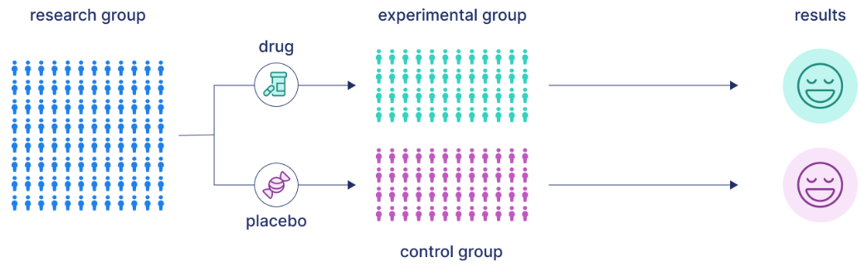
Clinical Trial
“A research study in which one or more human subjects are prospectively assigned to one or more interventions (which may include placebo or other control) to evaluate the effects of those interventions on health-related biomedical or behavioral outcomes.” – National Institutes of Health (U.S.)
https://www.scribbr.com/research-bias/placebo-effect/
Notes:
The key idea of zero-shot methods is to train an EL system on a domain with rich labeled data resources and apply it to a new domain with only minimal available data like descriptions of domain-specific entities.

Slide 3
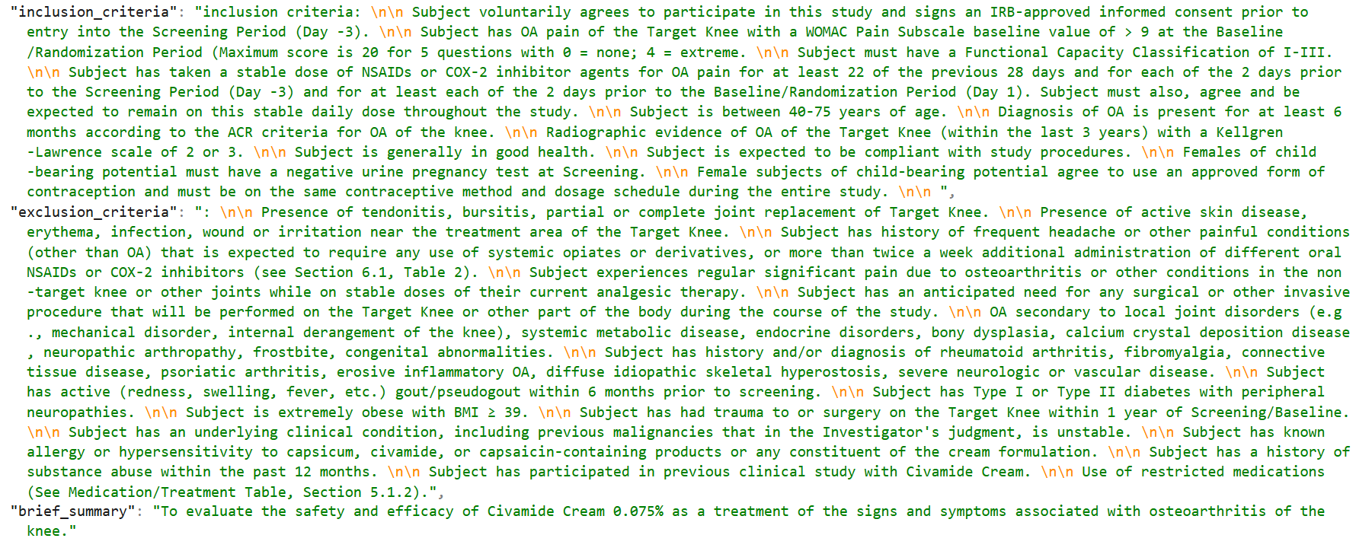
Clinical Trial
C
Image: https://raw.githubusercontent.com/ncbi-nlp/TrialGPT/refs/heads/main/dataset/sigir/corpus.jsonl
Notes:
The key idea of zero-shot methods is to train an EL system on a domain with rich labeled data resources and apply it to a new domain with only minimal available data like descriptions of domain-specific entities.

Slide 4
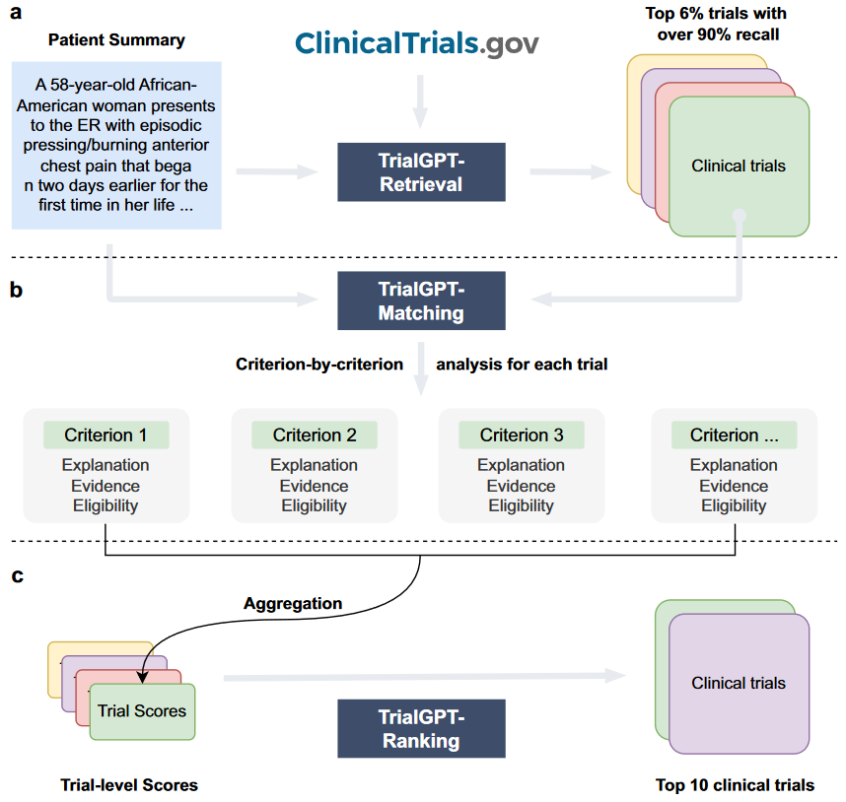
TrialGPT: Patient-to-Trial Matching
Data:
183 patient notes
Over 75,000 trial annotations
Modules:
TrialGPT-Retrieval: large-scale filtering to retrieve candidate trials.
TrialGPT-Matching:
Explanation of the eligibility
Locations of relevant sentences in the patient note that are relevant to the target criterion
Eligibility classification
TrialGPT-Ranking: generates trial-level scores
Image: Jin, Qiao, Zifeng Wang, Charalampos S. Floudas, Fangyuan Chen, Changlin Gong, Dara Bracken-Clarke, Elisabetta Xue, Yifan Yang, Jimeng Sun, and Zhiyong Lu. “Matching Patients to Clinical Trials with Large Language Models.” Nature Communications 15, no. 1 (November 18, 2024): 9074. https://doi.org/10.1038/s41467-024-53081-z.

Slide 5
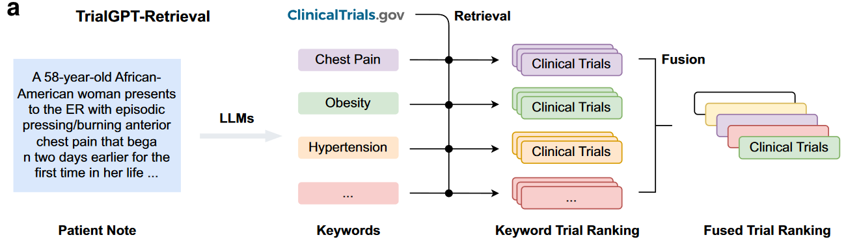

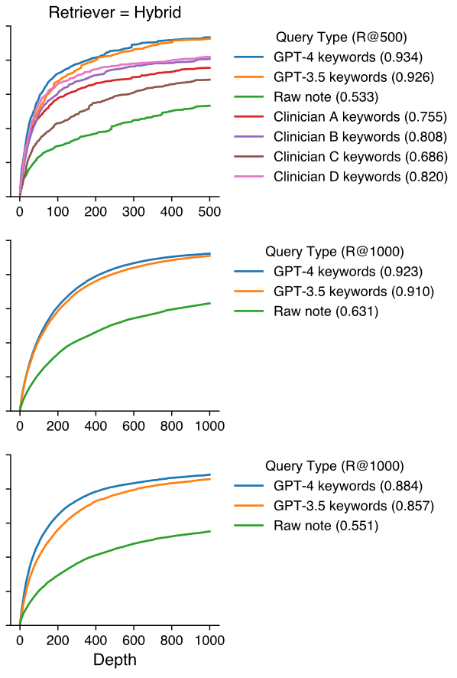
TrialGPT-Retrieval
Evaluation Results:
GPT-4 Retrieves 90% of the relevant clinical trials with only 5.5% of the data (500 Clinical Trials per Pacient).
LLMs can already generate better keywords than human clinicians for clinical trial retrieval.
Image: Jin, Qiao, Zifeng Wang, Charalampos S. Floudas, Fangyuan Chen, Changlin Gong, Dara Bracken-Clarke, Elisabetta Xue, Yifan Yang, Jimeng Sun, and Zhiyong Lu. “Matching Patients to Clinical Trials with Large Language Models.” Nature Communications 15, no. 1 (November 18, 2024): 9074. https://doi.org/10.1038/s41467-024-53081-z.

Slide 6
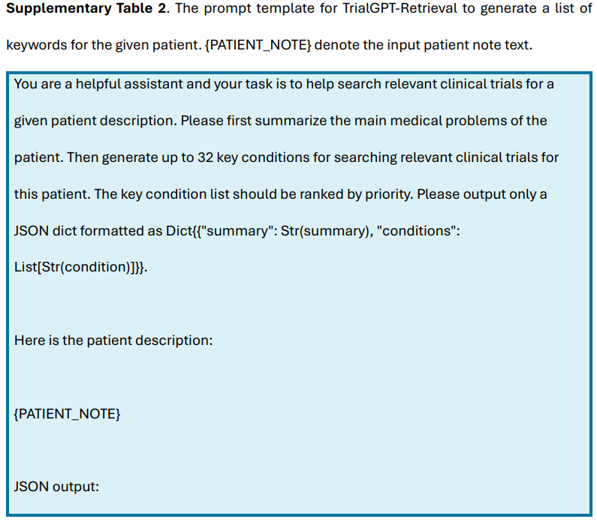
TrialGPT-Retrieval
Image: Jin, Qiao, Zifeng Wang, Charalampos S. Floudas, Fangyuan Chen, Changlin Gong, Dara Bracken-Clarke, Elisabetta Xue, Yifan Yang, Jimeng Sun, and Zhiyong Lu. “Matching Patients to Clinical Trials with Large Language Models.” Nature Communications 15, no. 1 (November 18, 2024): 9074. https://doi.org/10.1038/s41467-024-53081-z.

Slide 7
TrialGPT-Matching
Evaluation Data:
Manually annotated 1015 patient-criterion from 53 patients (SIGIR)
Correctness of explanations
Relevant sentence locations patients notes
Patient’s eligibility prediction
Relevance Explanation: TrialGPT-Matching provides 88% correct relevance explanations, with errors mainly in criteria requiring implicit reasoning.
Sentence Location: It identifies relevant sentences with 89% F1, matching human expert performance.
Eligibility Prediction: Achieves 87% accuracy, close to experts, but struggles with ambiguous exclusion labels, highlighting areas for improvement.
Image: Jin, Qiao, Zifeng Wang, Charalampos S. Floudas, Fangyuan Chen, Changlin Gong, Dara Bracken-Clarke, Elisabetta Xue, Yifan Yang, Jimeng Sun, and Zhiyong Lu. “Matching Patients to Clinical Trials with Large Language Models.” Nature Communications 15, no. 1 (November 18, 2024): 9074. https://doi.org/10.1038/s41467-024-53081-z.

Slide 8
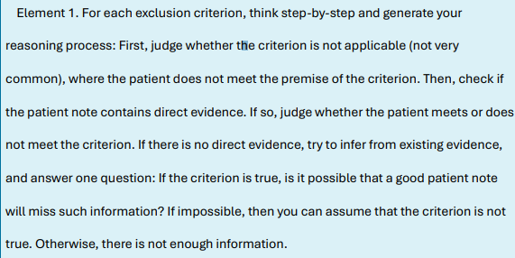
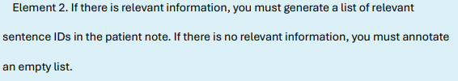
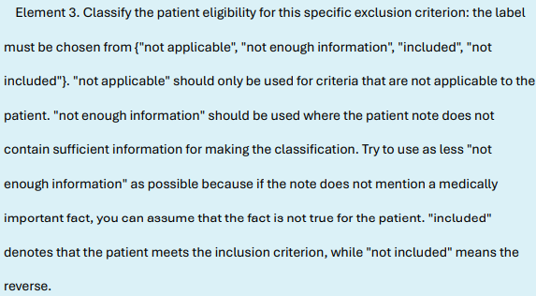
TrialGPT-Matching
Image: Jin, Qiao, Zifeng Wang, Charalampos S. Floudas, Fangyuan Chen, Changlin Gong, Dara Bracken-Clarke, Elisabetta Xue, Yifan Yang, Jimeng Sun, and Zhiyong Lu. “Matching Patients to Clinical Trials with Large Language Models.” Nature Communications 15, no. 1 (November 18, 2024): 9074. https://doi.org/10.1038/s41467-024-53081-z.

Slide 9
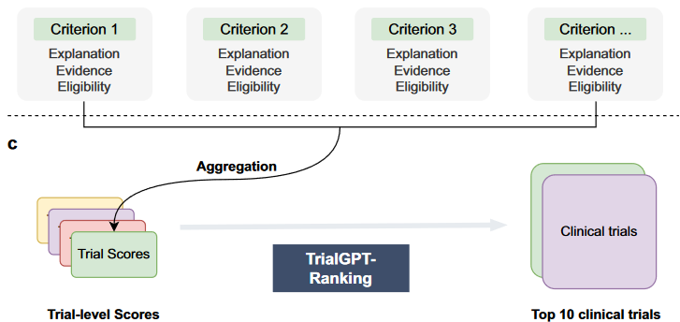
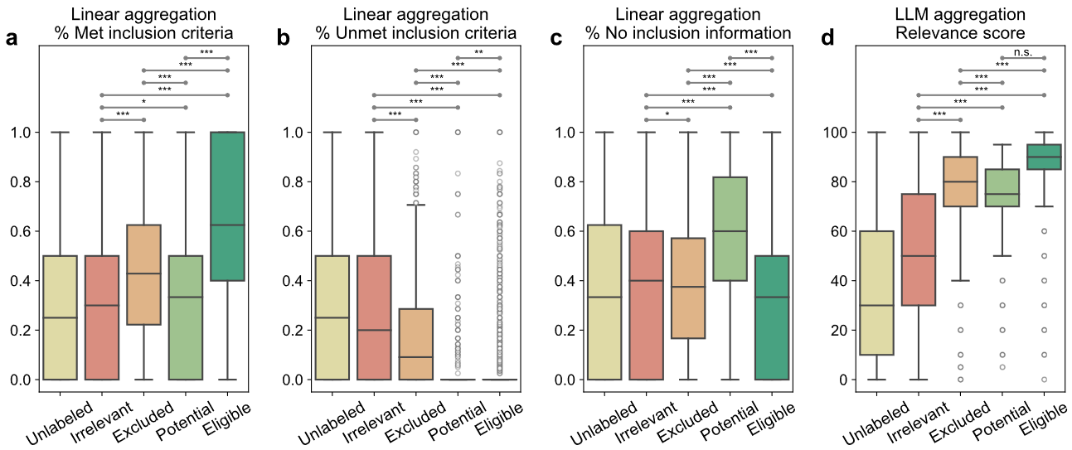
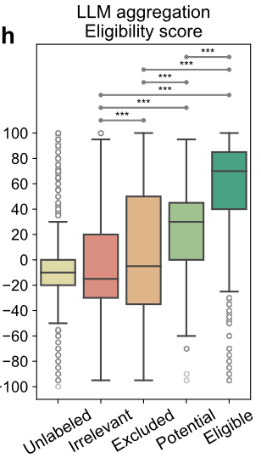
TrialGPT-Ranking
Evaluation Data:
Again, the previous 1015 patient-trial
Metrics:
Trial level metric
Linear Aggregation (%met inclusion/exclusion)
LLM Aggregation
Feature combination
Image: Jin, Qiao, Zifeng Wang, Charalampos S. Floudas, Fangyuan Chen, Changlin Gong, Dara Bracken-Clarke, Elisabetta Xue, Yifan Yang, Jimeng Sun, and Zhiyong Lu. “Matching Patients to Clinical Trials with Large Language Models.” Nature Communications 15, no. 1 (November 18, 2024): 9074. https://doi.org/10.1038/s41467-024-53081-z.

Slide 10
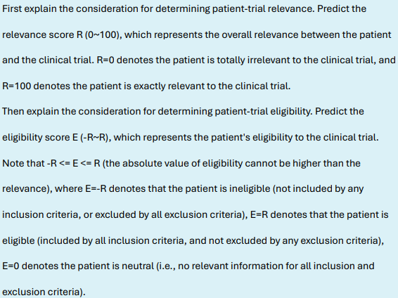
TrialGPT-Ranking
Image: Jin, Qiao, Zifeng Wang, Charalampos S. Floudas, Fangyuan Chen, Changlin Gong, Dara Bracken-Clarke, Elisabetta Xue, Yifan Yang, Jimeng Sun, and Zhiyong Lu. “Matching Patients to Clinical Trials with Large Language Models.” Nature Communications 15, no. 1 (November 18, 2024): 9074. https://doi.org/10.1038/s41467-024-53081-z.

Slide 11
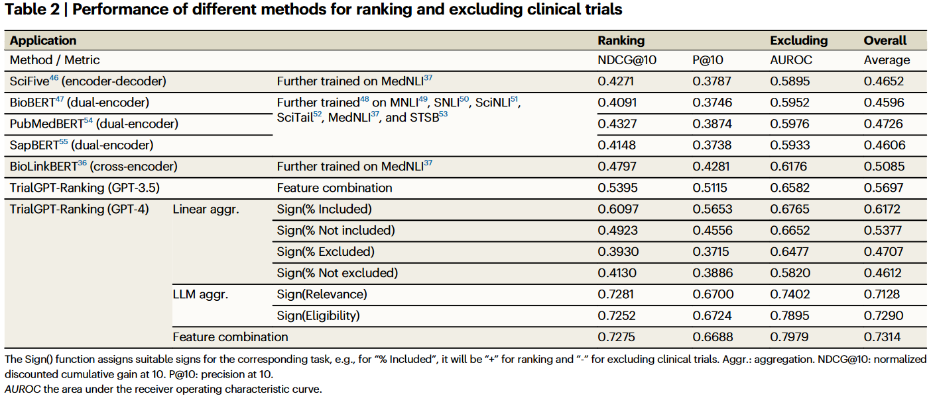
Results

Slide 12
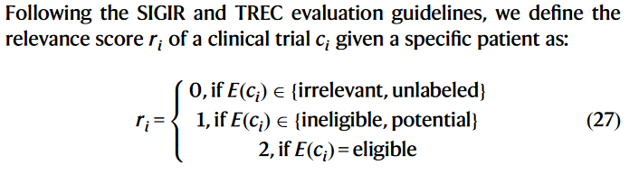
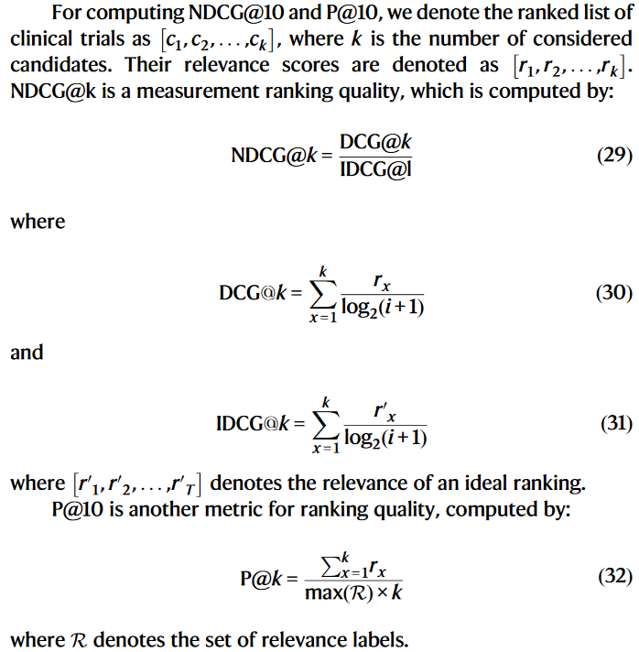
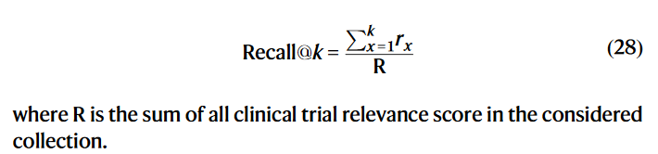
Metrics

Slide 13
Conclusions
TrialGPT Framework Effectiveness:
TrialGPT is a novel architecture using GPT-4 and GPT-3.5 for patient-to-trial matching, consisting of three components: Retrieval, Matching, and Ranking.
It demonstrates high accuracy and efficiency
Recalls over 90% of relevant trials
Achieves 87.3% accuracy in criterion-level predictions
Outperforms baselines by 43.8% in trial ranking and exclusion tasks.
Explainability and User Assistance:
Provides natural language explanations.
Highlights relevant patient data to provide evidences.
Supports human decision-making and improves trust and usability.

Slide 14
Future work
Drawbacks
Performance difference between GPT-4 and GPT-3.5 and long input prompts which can mean high economic cost.
Subjective evaluation system dependent on the clinicians.
Multimodal input (patient note + radiography + lab results).

Slide 15
References
[1] Jin, Qiao, Zifeng Wang, Charalampos S. Floudas, Fangyuan Chen, Changlin Gong, Dara Bracken-Clarke, Elisabetta Xue, Yifan Yang, Jimeng Sun, and Zhiyong Lu. “Matching Patients to Clinical Trials with Large Language Models.” Nature Communications 15, no. 1 (November 18, 2024): 9074. https://doi.org/10.1038/s41467-024-53081-z.
[2] Cuconasu, Florin, Giovanni Trappolini, Nicola Tonellotto, and Fabrizio Silvestri. “A Tale of Trust and Accuracy: Base vs. Instruct LLMs in RAG Systems.” arXiv, June 21, 2024. https://doi.org/10.48550/arXiv.2406.14972.
[3] Khaliq, M. Abdul, P. Chang, M. Ma, B. Pflugfelder, and F. Miletić. “RAGAR, Your Falsehood RADAR: RAG-Augmented Reasoning for Political Fact-Checking Using Multimodal Large Language Models.” arXiv, April 18, 2024. https://doi.org/10.48550/arXiv.2404.12065.
[4] Koopman, B., & Zuccon, G. (2016). A Test Collection for Matching Patients to Clinical Trials. Proceedings of the 39th International ACM SIGIR conference on Research and Development in Information Retrieval.
[5] Jin, Q., Tan, C., Zhao, Z., Yuan, Z. & Huang, S. Alibaba DAMO Academy at TREC Clinical Trials 2021: Exploring Embedding-based First-stage Retrieval with TrialMatcher. In Proc. Thirtieth Text REtrieval Conference (TREC 2021) (2021).
[6] Roberts, K., Demner-Fushman, D., Voorhees, E. M., Bedrick, S. & Hersh, W. R. Overview of the TREC 2022 Clinical Trials Track. In Proc. Thirty-First Text REtrieval Conference (TREC 2022) (2022).

