Slide 1
Simple Diffusion: end-to-end diffusion for high resolution images
Authors: Emiel Hoogeboom, Jonathan Heek, Tim Salimans
Alberto Becerra Tomé
Barcelona, March 2024

Slide 2
Table of Contents
Motivation
Diffusion Models
Experiments
Conclusion

Slide 3
Area of Research: The paper focuses on diffusion models for high-resolution image generation, specifically exploring the use of the U-ViT architecture, which combines transformers and ResBlocks in the context of generative modeling.
Problem Addressed: The paper addresses the challenge of applying diffusion models to high-resolution image generation while maintaining simplicity in the model architecture. Previous approaches often involved complex setups like cascaded diffusion or latent diffusion for high-resolution images, adding unnecessary complexity to the diffusion framework.
Contribution: The key contribution of the paper is proposing a method to train standard diffusion models on high-resolution images while achieving state-of-the-art performance without the need for sampling modifiers. The paper introduces to enhance denoising diffusion for high-resolution images:
adjustments to the noise schedule
architecture scaling
dropout placement
downsampling strategies
Minimum Details for Understanding: To understand the proposed method, one needs to grasp the concept of diffusion models, the role of neural networks in denoising processes, the adjustments made to the noise schedule for high-resolution images, the scaling of the U-Net architecture, the incorporation of dropout for improved performance, and the utilization of downsampling techniques.
Method Testing: The method was tested on ImageNet datasets at resolutions of 128x128, 256x256, and 512x512. The evaluation involved comparing the proposed simple diffusion model with other existing methods in terms of FID scores and Inception Scores. Competing methods included ADM, CDM, RIN, and MaskGIT, among others.
Improvement Over Competing Methods: The proposed simple diffusion model, particularly the U-ViT architecture, demonstrated superior performance in terms of FID scores and Inception Scores compared to existing methods like CDM, RIN, and MaskGIT, showcasing the effectiveness of the proposed modifications for high-resolution image generation.
Limitations: One potential limitation of the proposed method could be the specific adjustments required for different resolutions and the need for careful tuning of noise schedules and architecture scaling. Additionally, the method's performance may vary depending on the dataset and specific use cases.
Ablation Studies: The paper likely conducted experiments to analyze the individual contributions of adjustments such as noise schedule modifications, architecture scaling, dropout placement, and downsampling strategies to assess their impact on the overall performance of the diffusion model.
Conclusions: After analyzing the results, the paper likely concludes that the proposed modifications to the denoising diffusion framework for high-resolution images, particularly the U-ViT architecture, offer a simple yet effective approach to achieving state-of-the-art performance in image generation without the need for complex sampling modifiers.

Slide 4
Motivation
Generative models for high-resolution
Goal: Improve denoising diffusion for high-resolution images while keeping the model as simple as possible

Slide 5
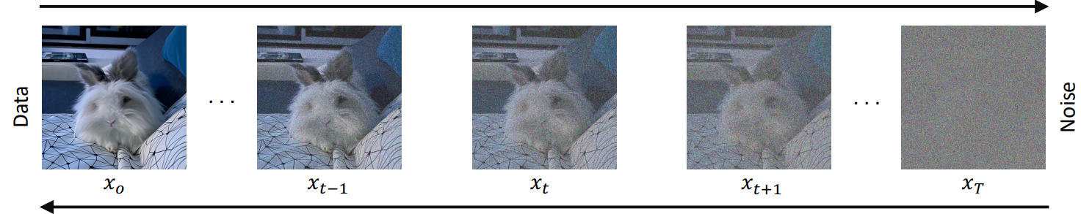
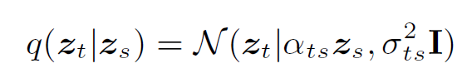


Diffusion Models
z
z
z
z
z
Forward Process: a Markov Chain where Gaussian noise is added in successive steps
to obtain a set of noisy samples.
Variance preserving process
F. -A. Croitoru, V. Hondru, R. T. Ionescu and M. Shah, "Diffusion Models in Vision: A Survey," in IEEE Transactions on Pattern Analysis and Machine Intelligence, vol. 45, no. 9, pp. 10850-10869, 1 Sept. 2023, doi: 10.1109/TPAMI.2023.3261988
Notes:
DIFFUSION models constitute a subset of deep generative models that have recently gained significant attention in the field of computer vision. They demonstrate remarkable generative capabilities, encompassing both intricate details and a wide range of diversity in the generated outputs. It can be argued that these models have set a new standard in generative modeling, particularly exemplified by prominent models such as Imagen and Latent Diffusion Models (LDMs). This assertion finds support in the image samples depicted in Figure 2, which are produced by Stable Diffusion, a variant of LDMs generating images based on textual prompts. These generated images display minimal artifacts and closely align with the provided prompts. Notably, the prompts intentionally depict unrealistic scenarios not encountered during training, highlighting the remarkable generalization ability of diffusion models.
Diffusion models are characterized by their probabilistic approach to generative modeling, learning to reverse a process that gradually degrades the structure of the training data. This training process consists of two phases: forward diffusion and backward denoising. During forward diffusion, noise is incrementally added to input images across multiple steps, progressively degrading the data until it resembles pure Gaussian noise. The subsequent backward denoising phase reverses this process, iteratively removing noise to reconstruct the original images. At inference, images are generated by gradually reconstructing them from random white noise, with the noise removal at each step estimated by a neural network, typically utilizing a U-Net architecture, to maintain dimensional coherence.

Slide 6



Diffusion Models
z
z
z
z
z
Forward Process: a Markov Chain where Gaussian noise is added in successive steps
to obtain a set of noisy samples.
Reverse Process: Conditioned on a single data point x ,
with:
F. -A. Croitoru, V. Hondru, R. T. Ionescu and M. Shah, "Diffusion Models in Vision: A Survey," in IEEE Transactions on Pattern Analysis and Machine Intelligence, vol. 45, no. 9, pp. 10850-10869, 1 Sept. 2023, doi: 10.1109/TPAMI.2023.3261988
Notes:
DIFFUSION models constitute a subset of deep generative models that have recently gained significant attention in the field of computer vision. They demonstrate remarkable generative capabilities, encompassing both intricate details and a wide range of diversity in the generated outputs. It can be argued that these models have set a new standard in generative modeling, particularly exemplified by prominent models such as Imagen and Latent Diffusion Models (LDMs). This assertion finds support in the image samples depicted in Figure 2, which are produced by Stable Diffusion, a variant of LDMs generating images based on textual prompts. These generated images display minimal artifacts and closely align with the provided prompts. Notably, the prompts intentionally depict unrealistic scenarios not encountered during training, highlighting the remarkable generalization ability of diffusion models.
Diffusion models are characterized by their probabilistic approach to generative modeling, learning to reverse a process that gradually degrades the structure of the training data. This training process consists of two phases: forward diffusion and backward denoising. During forward diffusion, noise is incrementally added to input images across multiple steps, progressively degrading the data until it resembles pure Gaussian noise. The subsequent backward denoising phase reverses this process, iteratively removing noise to reconstruct the original images. At inference, images are generated by gradually reconstructing them from random white noise, with the noise removal at each step estimated by a neural network, typically utilizing a U-Net architecture, to maintain dimensional coherence.

Slide 7
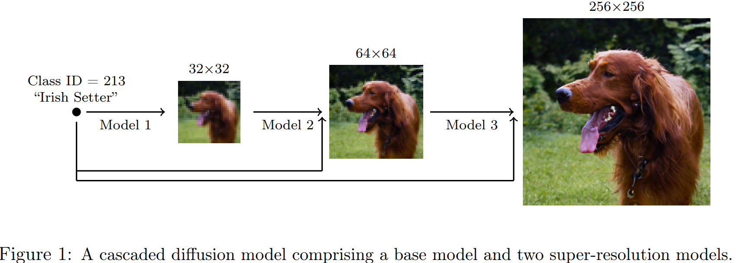
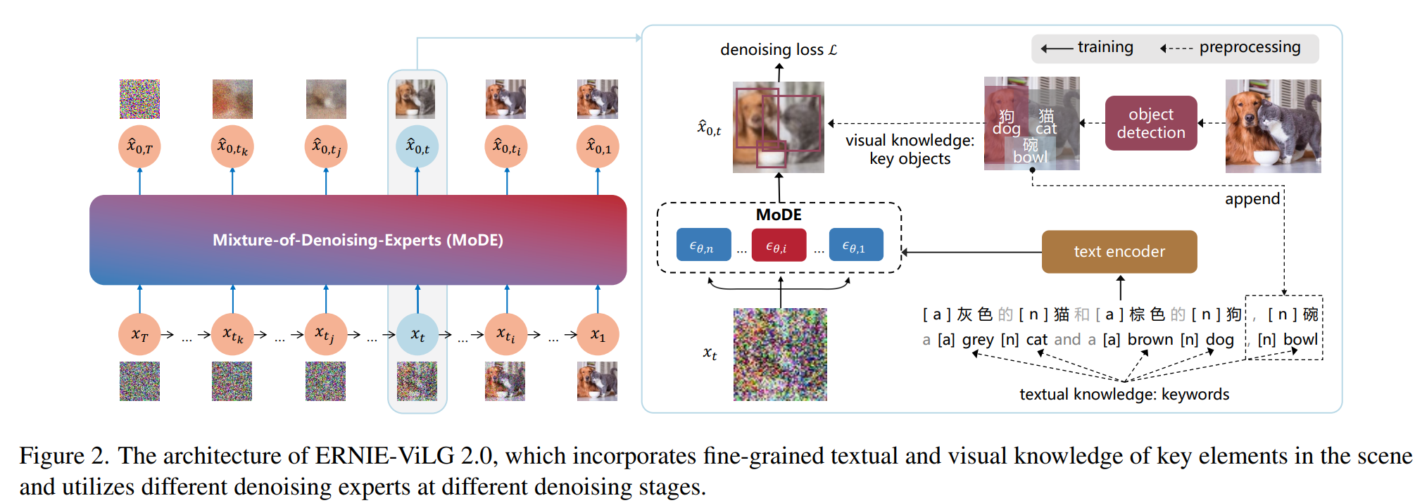
*
**
* Ho, J., Saharia, C., Chan, W., Fleet, D. J., Norouzi, M., and Salimans, T. Cascaded diffusion models for high fidelity image generation. J. Mach. Learn. Res., 23:47:1–47:33, 2022.
** Feng, Z., Zhang, Z., Yu, X., Fang, Y., Li, L., Chen, X., Lu, Y., Liu, J., Yin, W., Feng, S., Sun, Y., Tian, H., Wu, H., and Wang, H. Ernie-vilg 2.0: Improving text-to-image diffusion model with knowledge-enhanced mixture-of-denoising-experts. CoRR, abs/2210.15257, 2022.
Notes:
Diffusion models for high resolutions (for example 5122, 2562, 1282) on complicated data (such as ImageNet) are generally not learned directly. Instead, approaches in literature divide the generative process into subproblems via super-resolution (Ho et al., 2022), or mixturesof-denoisers (Feng et al., 2022; Balaji et al., 2022). Alternatively, other approaches project high resolution data down to a lower dimensional latent space (Rombach et al., 2022).
Although this sub-division makes optimization easier, the engineering complexity increases: Instead of dealing with a single model, one needs to train and keep track of multiple models.
We show that it is possible to train a single denoising diffusion model for resolutions up to 512 × 512 with only a small number modifications with respect to the original (modern) formulation in (Ho et al., 2020)

Slide 8
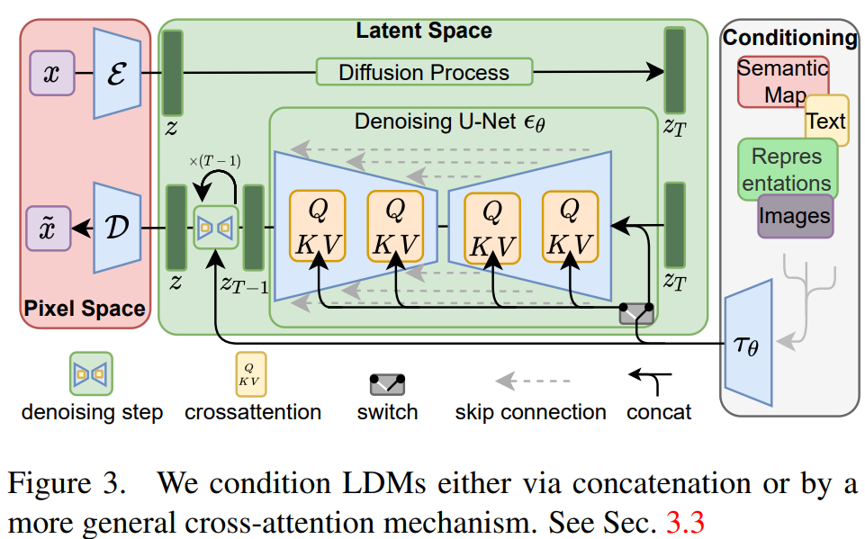
Latent-based density models (LDMs) offer computational efficiency over pixel-based methods but may compromise precision, particularly in tasks requiring fine-grained accuracy.
Notes:
Latent-based density models (LDMs) offer computational efficiency over pixel-based methods but may compromise precision, particularly in tasks requiring fine-grained accuracy.

Slide 9
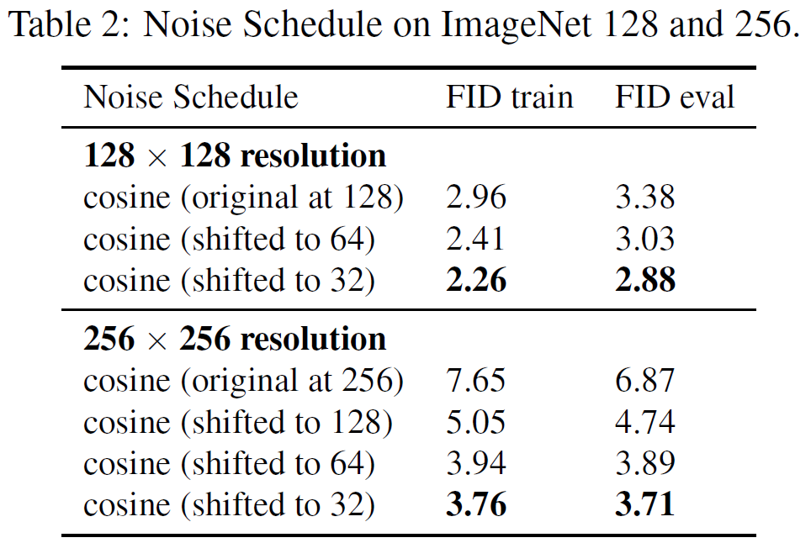
Experiment 1: Noise Schedule.
Notes:
In this experiment it is studied how the noise schedule effects the quality of generated images, evaluated on FID50K score on both train and eval data splits. Recall that our hypothesis was that the cosine schedule does not add sufficient noise, but can be adjusted by ‘shifting’ its log SNR curve using the ratio between the image resolution and the noise resolution. In these experiments, the noise resolution is varied from the original image resolution (corresponding to the conventional cosine schedule) all the way down to 32 by factors of two.
As can be seen in Table 2 for ImageNet at resolution 128 × 128 and resolution 256 × 256, shifting the noise schedule considerably improves performance. The difference is especially noticeable at the higher resolution, where the difference is 7.65 for the original cosine schedule against 3.76 for the shifted schedule in FID on the train data. Notice that the difference in performance between the shift towards either 64 and 32 is relatively small, albeit slightly better for the 32 shift. Given that the difference is small and that the shift 64 schedule performed slightly better in early iterations, we generally recommend the shift 64 schedule.

Slide 10
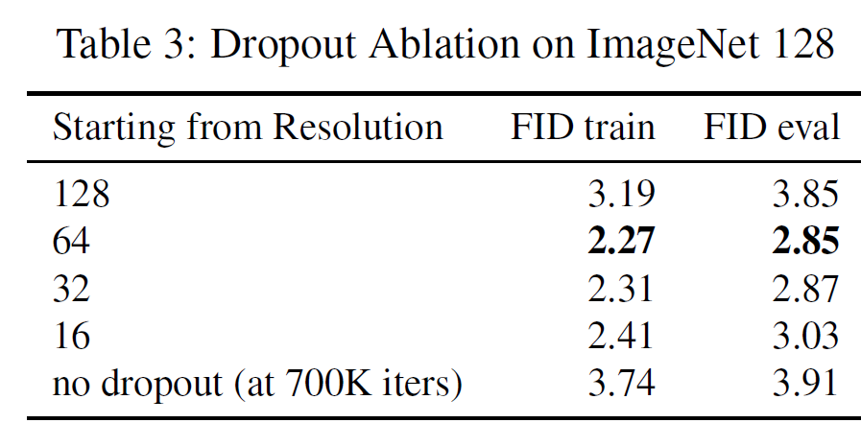
Experiment2: Dropout.
Notes:
Dropout The ImageNet dataset has roughly 1 million images. As noted by prior work, it is important to regularize the networks to avoid overfitting (Ho et al., 2022; Dhariwal & Nichol, 2021). Although dropout has been successfully applied to networks at resolutions of 64 × 64, it is often disabled for models operating on high resolutions. In this experiment we enable dropout only on a subset of the network layers: Only for resolutions below the given ‘starting resolution’ hyperparameter. For example, if the starting resolution is 32, then dropout is applied to modules operating on resolutions 32 × 32, 16 × 16 and 8 × 8.
Recall our hypothesis that it should be sufficient to regularize the modules of the network that operate on the lower resolution feature maps. As presented in Table 3, this hypothesis holds. For this experiment on images of 128×128, adding dropout from resolutions 64, 32, 16 all perform comparatively.
Although adding dropout from 16 × 16 performed a little worse, we use this setting throughout the remainder of the experiments because it converged faster in
early iterations.
The experiment also shows two settings that do not work and should be avoided: either adding no dropout, or adding dropout starting from the same resolution as the data. This may explain why dropout for high resolution diffusion has not been widely used thus far: Typically dropout is set as a global parameter for all feature maps at all resolutions, but this experiment shows that such a regularization is too aggressive.

Slide 11
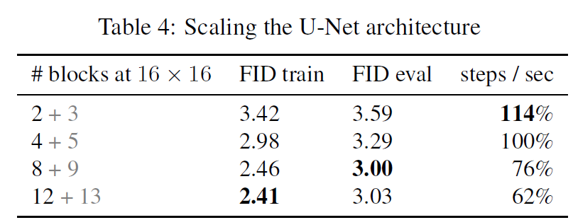
Experiment 3: Architecture Scaling.
Notes:
In this section, we examine the impact of augmenting the quantity of 16 × 16 network modules. In UNets, the 'number of blocks' parameter typically pertains to blocks along the 'down' path. Many implementations additionally employ one extra block for 'up' blocks. When the table indicates '2 + 3' blocks, it signifies 2 blocks for downward progression and 3 for upward, conventionally referred to as 2 blocks.
Typically, augmenting module count enhances performance, as evident in Table 4. A notable exception is the eval FID, which slightly decreases when transitioning from 8 to 12 blocks. This observation suggests that increased regularization might be necessary as the network scales, a phenomenon likely more pronounced in larger U-ViT architectures.

Slide 12
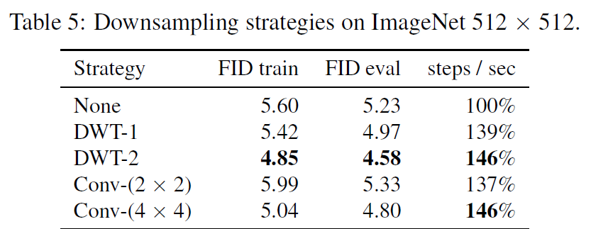
Experiment 4: Downsampling.
Notes:
In this investigation, our aim is to explore the impact of downsampling methods in mitigating high-resolution feature map issues. Initially, we employ a standard U-Net designed for 512-resolution images. Subsequently, through downsampling, either to 256 or 128, facilitated by conventional layers or the DWT, we maintain the total number of blocks constant by redistributing high-resolution blocks to lower-resolution ones (refer to Appendix B for elaboration).
We recall our hypothesis that downsampling should incur minimal loss in sample quality while significantly enhancing model efficiency. Surprisingly, models employing downsampling strategies not only exhibit improved speed but also yield superior sample quality. It appears that downsampling at such high resolutions empowers the network to optimize more effectively for sample quality. Crucially, it enables training without excessively large feature maps, thereby avoiding performance deterioration.

Slide 13
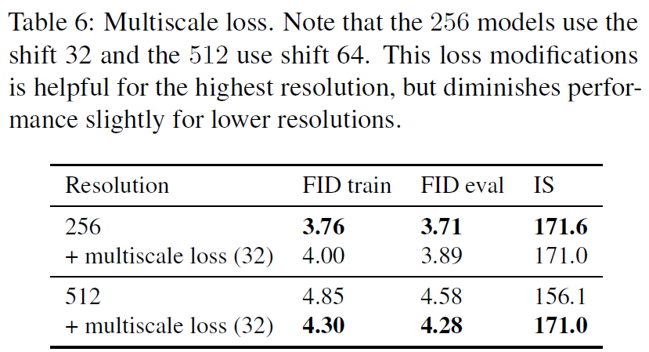
Experiment 5: Multiscale Loss.
Notes:
In this concluding experiment, we evaluate the disparity between the conventional loss and the multiscale loss, which places greater emphasis on lower frequencies within the image. We assess sample quality, measured by FID score, for resolutions 256 and 512, comparing models trained with the multiscale loss enabled or disabled. Figure 6 illustrates that for 256 resolution, the loss appears to have minimal impact and performs marginally worse. However, for the higher resolution of 512, the loss demonstrates a notable effect, resulting in a reduction in FID score.

Slide 14
References
Notes:
In this concluding experiment, we evaluate the disparity between the conventional loss and the multiscale loss, which places greater emphasis on lower frequencies within the image. We assess sample quality, measured by FID score, for resolutions 256 and 512, comparing models trained with the multiscale loss enabled or disabled. Figure 6 illustrates that for 256 resolution, the loss appears to have minimal impact and performs marginally worse. However, for the higher resolution of 512, the loss demonstrates a notable effect, resulting in a reduction in FID score.

