Slide 1
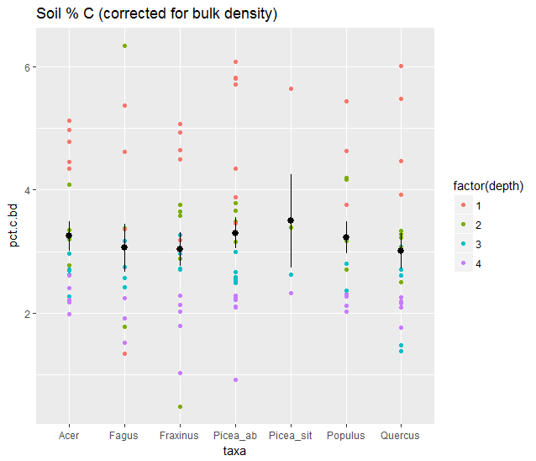
Depth has significant effect on % C
(ANOVA, p<2e-16)

Slide 2
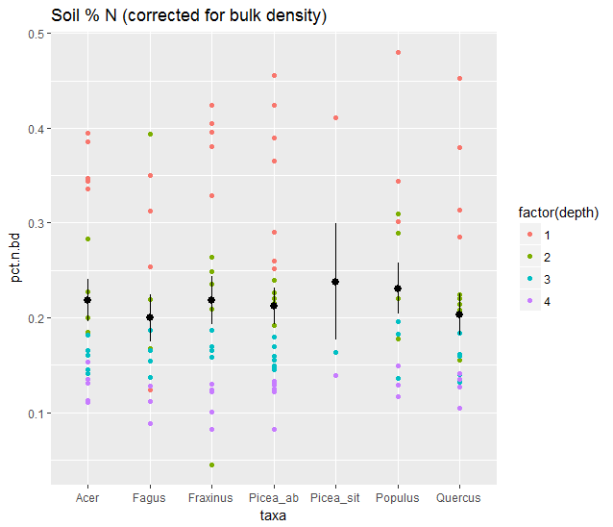
Depth has significant effect on % N
(ANOVA, p<2e-16)

Slide 3
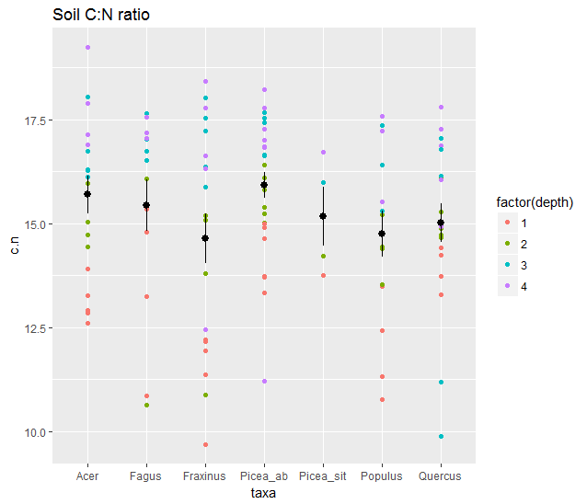
Fraxinus and depth have significant effect on % C (using linear model)
Fraxinus:
coefficient= -1.035, p=0.034
Depth2:
coefficient=1.598, p=0.0001
Depth3:
coefficient=3.205, p=4.46e-13
Depth4:
coefficient=3.627, p=1.61e-15

Slide 4
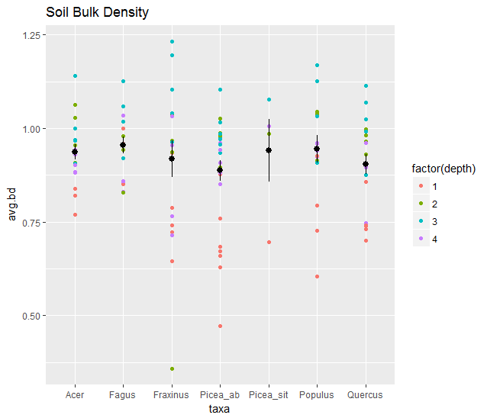

Slide 5
