Slide 1
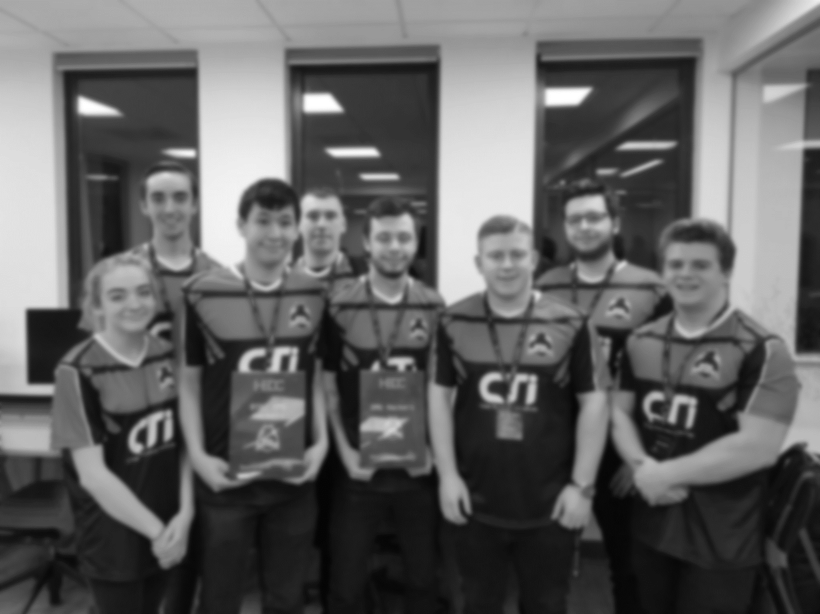



/dmuhackers
@dmuhackers
Privelege Escalation

Slide 2
WOW! Congrats
on getting user!!
Where do you go from there? Is that it?
Nope. Now it’s time to get an admin account or even better, root.
This is called privilege escalation.

Slide 3
Privilege escalation is the act of exploiting a bug, design flaw or configuration oversight in an operating system or software application to gain elevated access to resources that are normally protected from an application or user. The result is that an application with more privileges than intended by the application developer or system administrator can perform unauthorized actions.

Slide 4
1. KERNEL EXPLOITS
Kernel exploits are programs that leverage kernel vulnerabilities in order to execute code with elevated permissions.
Kernel exploits will give attackers super user access to systems in the form of a root command prompt.
Escalating to root on a linux system can be as simple as downloading an exploit to the target system, compiling the exploit, and then executing it.

Slide 5
1. KERNEL EXPLOITS
DirtyCow exploit – Linux Kernel <= 3.19.0-73.8
A race condition was found in the way the Linux kernel’s memory subsystem handled the copy-on-write (COW) breakage of private read-only memory mappings. An unprivileged local user could use this flaw to gain write access to otherwise read-only memory mappings and thus increase their privileges on the system.
It was one of the most serious privilege escalation vulnerability ever discovered and it affected almost all the major Linux distros.
$ whoami – tells us the current user is chris (non-root user) $ uname -a – gives us the kernel version which we know is vulnerable to dirtycow > downloaded the dirtycow exploit from here – https://www.exploit-db.com/exploits/40839/ > Compiled and executed it. It replaces the ‘root’ user with a new user ‘harrison’ by editing the /etc/passwd file. $ su rash – It changes the current logged in user to ‘harrison’ which is root.
Notes:
Copy On Write is an internal memory concept where, primarily for performance reasons, operations that make a copy of a section of memory don't actually get their own copy unless and until they make a change to that memory - at which point, you quickly make their copy, make the change to that and hand it back to them. The advantage is that you don't have to do the work of making the copy unless and until they actually change it - faster, less memory usage, better caching.

Slide 6
2. Exploiting services running as root
EternalBlue
The famous EternalBlue exploit exploited the smb service which generally runs as root.
With just one exploit, an attacker can get remote code execution and Local Privilege Escalation as well.
It was heavily used to spread ransomware across of the globe because of it’s deadly combination. Remember WannaCry and the NHS anyone????
Notes:
Copy On Write is an internal memory concept where, primarily for performance reasons, operations that make a copy of a section of memory don't actually get their own copy unless and until they make a change to that memory - at which point, you quickly make their copy, make the change to that and hand it back to them. The advantage is that you don't have to do the work of making the copy unless and until they actually change it - faster, less memory usage, better caching.

Slide 7

3. EXPLOITING SUID EXECUTABLES
SUID which stands for set user ID, is a Linux feature that allows users to execute a file with the permissions of a specified user. For example, the Linux ping command typically requires root permissions in order to open raw network sockets. By marking the ping program as SUID with the owner as root, ping executes with root privileges anytime a low privilege user executes the program.
Notes:
Copy On Write is an internal memory concept where, primarily for performance reasons, operations that make a copy of a section of memory don't actually get their own copy unless and until they make a change to that memory - at which point, you quickly make their copy, make the change to that and hand it back to them. The advantage is that you don't have to do the work of making the copy unless and until they actually change it - faster, less memory usage, better caching.

Slide 8
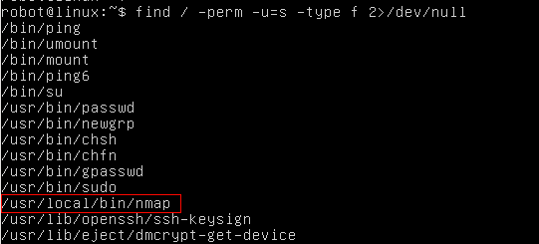
3. EXPLOITING SUID EXECUTABLES
Exploiting vulnerable SUID executable to get root access
$ find / -perm -u=s -type f 2>/dev/null – It prints the executables which have SUID bit set
$ nmap –interactive – runs nmap interactive mode
$ !sh – Lets you escape to the system shell from nmap shell
Notes:
Copy On Write is an internal memory concept where, primarily for performance reasons, operations that make a copy of a section of memory don't actually get their own copy unless and until they make a change to that memory - at which point, you quickly make their copy, make the change to that and hand it back to them. The advantage is that you don't have to do the work of making the copy unless and until they actually change it - faster, less memory usage, better caching.

Slide 9
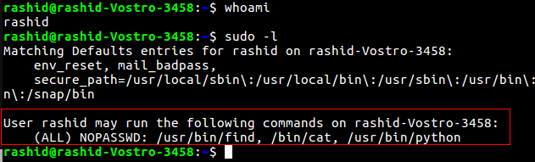
4. EXPLOITING SUDO RIGHTS/USER
If the attacker can’t directly get root access via any other techniques he might try to compromise any of the users who have SUDO access. Once he has access to any of the sudo users, he can basically execute any commands with root privileges.
SUDO access doesn’t necessarily mean the user can run anything as root, it could mean he can run just a few different programs as root.
$ sudo -l – Prints the commands which we are allowed to run as SUDO
Notes:
Copy On Write is an internal memory concept where, primarily for performance reasons, operations that make a copy of a section of memory don't actually get their own copy unless and until they make a change to that memory - at which point, you quickly make their copy, make the change to that and hand it back to them. The advantage is that you don't have to do the work of making the copy unless and until they actually change it - faster, less memory usage, better caching.

Slide 10

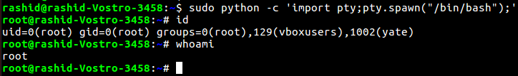
4. EXPLOITING SUDO RIGHTS/USER
We can run find, cat and python as SUDO. These all commands will run as root when run with SUDO. If we can somehow escape to the shell through any of these commands, we can get root access.
$ sudo find /home -exec sh -i \; – find command’s exec parameter can be used for arbitrary code execution.
Notes:
Copy On Write is an internal memory concept where, primarily for performance reasons, operations that make a copy of a section of memory don't actually get their own copy unless and until they make a change to that memory - at which point, you quickly make their copy, make the change to that and hand it back to them. The advantage is that you don't have to do the work of making the copy unless and until they actually change it - faster, less memory usage, better caching.

Slide 11
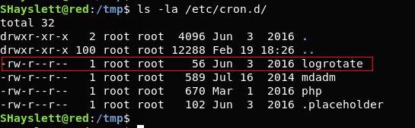
5. EXPLOITING BADLY CONFIGURED CRON JOBS
Cron jobs, if not configured properly can be exploited to get root privilege.
1. Any script or binaries in cron jobs which are writable?
2. Can we write over the cron file itself.
3. Is cron.d directory writable?
$ ls -la /etc/cron.d – prints cron jobs which are already present in cron.d
Notes:
Copy On Write is an internal memory concept where, primarily for performance reasons, operations that make a copy of a section of memory don't actually get their own copy unless and until they make a change to that memory - at which point, you quickly make their copy, make the change to that and hand it back to them. The advantage is that you don't have to do the work of making the copy unless and until they actually change it - faster, less memory usage, better caching.

Slide 12
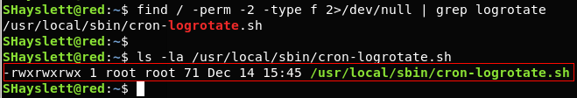
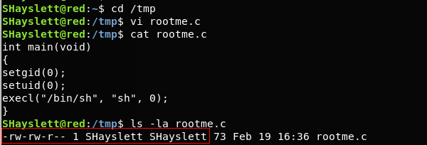
5. EXPLOITING BADLY CONFIGURED CRON JOBS
$ find / -perm -2 -type f 2>/dev/null – prints world writable files
$ ls -la /usr/local/sbin/cron-logrotate.sh – Let’s confirm if the cron-logrotate.sh is world writable.
cron-lograte.sh is world writable and it is being run by logrotate cronjob. Any command we write/append in cron-lograte.sh would be executed as ‘root’.
We write a C file in /tmp directory and compile it.
Notes:
Copy On Write is an internal memory concept where, primarily for performance reasons, operations that make a copy of a section of memory don't actually get their own copy unless and until they make a change to that memory - at which point, you quickly make their copy, make the change to that and hand it back to them. The advantage is that you don't have to do the work of making the copy unless and until they actually change it - faster, less memory usage, better caching.

Slide 13
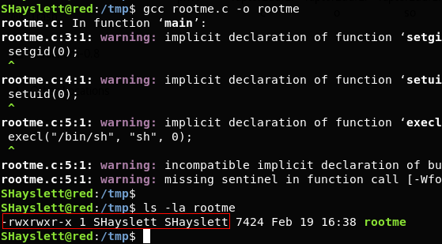
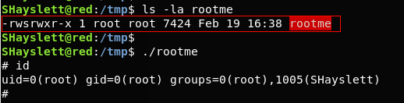
5. EXPLOITING BADLY CONFIGURED CRON JOBS
$ echo “chown root:root /tmp/rootme; chmod u+s /tmp/rootme;”>/usr/local/sbin/cron-logrotate.sh – This will change the executable’s owner and group as root. It will also set the SUID bit.
$ ls -la rootme – After 5 minutes, the logrotate cronjob was run and cron-logrotate.sh got executed with root privilege.
$ ./rootme – spawns a root shell.
Notes:
Copy On Write is an internal memory concept where, primarily for performance reasons, operations that make a copy of a section of memory don't actually get their own copy unless and until they make a change to that memory - at which point, you quickly make their copy, make the change to that and hand it back to them. The advantage is that you don't have to do the work of making the copy unless and until they actually change it - faster, less memory usage, better caching.

Slide 14
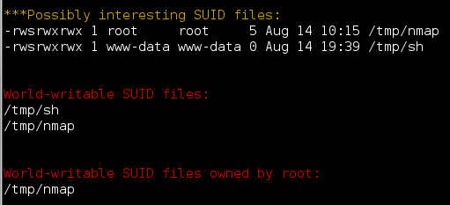
LinEnum.sh
https://github.com/rebootuser/LinEnum
LinEnum is the holy grail of automation for basic Linux privilege escalation enumeration checks. If you execute the script it will perform over 80 different commands to check for possible ways to escalate your privileges on a linux machine and also give you general information about the box.
Notes:
Copy On Write is an internal memory concept where, primarily for performance reasons, operations that make a copy of a section of memory don't actually get their own copy unless and until they make a change to that memory - at which point, you quickly make their copy, make the change to that and hand it back to them. The advantage is that you don't have to do the work of making the copy unless and until they actually change it - faster, less memory usage, better caching.

