Slide 1






/dmuhackers
@dmuhackers
Wi-Fi Hacking and pcap Analysis
25.10.2018

Slide 2
Wi-Fi Hacking
Notes:
We do:
Ethical hacking
Wi-Fi hacking
Web app pentesting
Lock picking
This weeks talk is on soar point bug bounty + email spoofing hands on

Slide 3

Disclaimer
Notes:
We do:
Ethical hacking
Wi-Fi hacking
Web app pentesting
Lock picking
This weeks talk is on soar point bug bounty + email spoofing hands on

Slide 4

Why?
Notes:
Two styles:
Jeopardy – explain
Red Blue team – explain
Prizes
Often food, travel and accommodation is paid for
Starting a CTF team
jerseys
Trying to get sponsorship

Slide 5



Aircrack-ng Suite
Aircrack-ng is a complete suite of tools to assess WiFi network security.
It focuses on different areas of WiFi security:
Monitoring: Packet capture and export of data to text files for further processing by third party tools
Attacking: Replay attacks, deauthentication, fake access points and others via packet injection
Testing: Checking WiFi cards and driver capabilities (capture and injection)
Cracking: WEP and WPA PSK (WPA 1 and 2)
All tools are command line which allows for heavy scripting. A lot of GUIs have taken advantage of this feature. It works primarily Linux but also Windows, OS X, FreeBSD, OpenBSD, NetBSD, as well as Solaris and even eComStation 2.
Notes:
Two styles:
Jeopardy – explain
Red Blue team – explain
Prizes
Often food, travel and accommodation is paid for
Starting a CTF team
jerseys
Trying to get sponsorship

Slide 6
Usage
Notes:
Two styles:
Jeopardy – explain
Red Blue team – explain
Prizes
Often food, travel and accommodation is paid for
Starting a CTF team
jerseys
Trying to get sponsorship

Slide 7
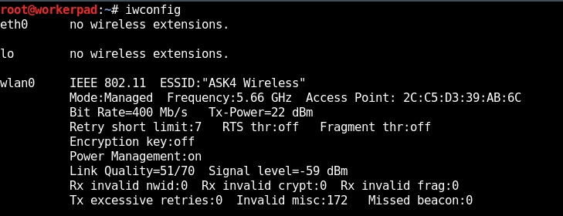
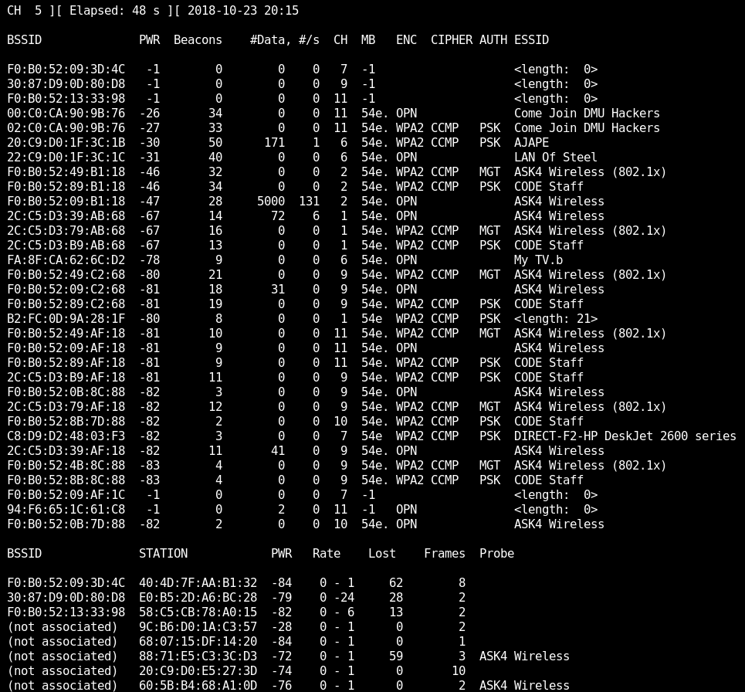
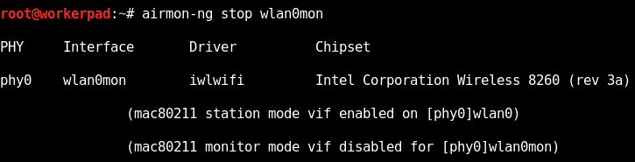
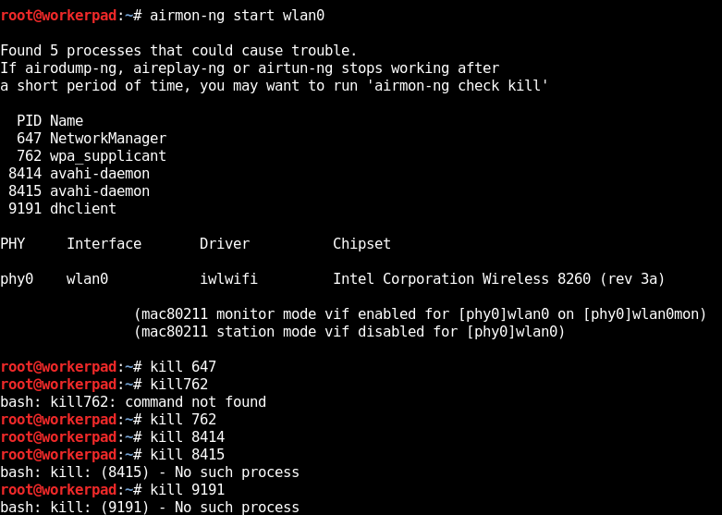
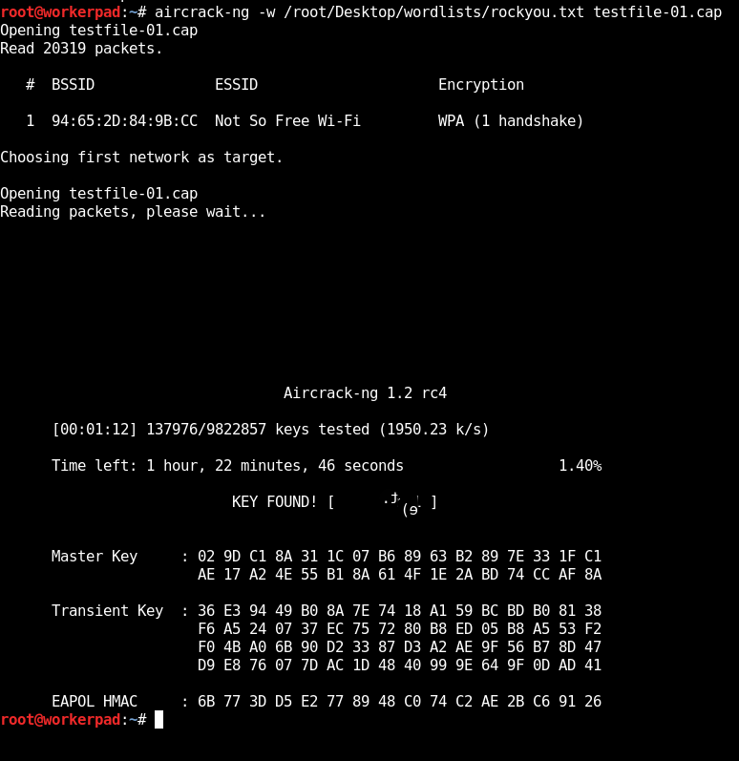
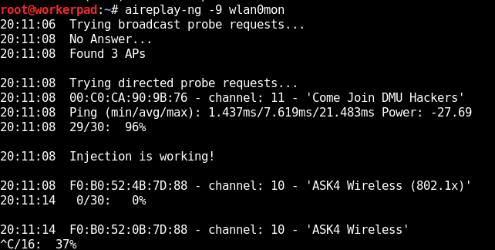
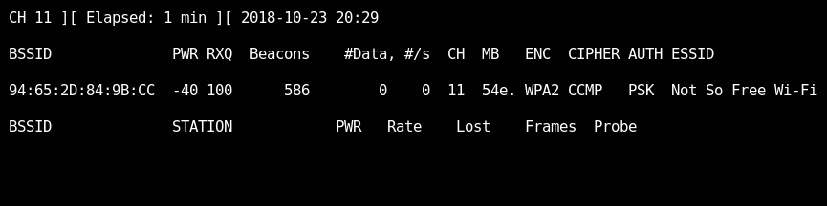
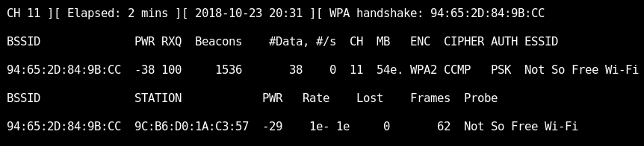
iwconfig
airmon-ng start wlan0
aireplay-ng -9 wlan0mon
airodump-ng wlan0mon
airodump-ng –w testfile –-bssid 94:65:2D:84:9B: –c 11 wlan0mon
*WPA Handshake*
airmon-ng stop wlan0mon
aircrack-ng –w /root/Desktop/wordlists/rockyou.txt testfile-01.cap
Notes:
Two styles:
Jeopardy – explain
Red Blue team – explain
Prizes
Often food, travel and accommodation is paid for
Starting a CTF team
jerseys
Trying to get sponsorship

Slide 8
Syntax
iwconfig Shows current wireless interface info
airmon-ng start wlan0 Puts your wireless interface into monitor mode
aireplay-ng -9 wlan0mon Conducts an injection test with your wireless interface
Injection is working!
airodump-ng wlan0mon Dumps all wireless network info using your interface
airodump-ng –w testfile –-bssid 94:65:2D:84:9B –c 11 wlan0mon Dumps details of network to specified file
WPA Handshake:
airmon-ng stop wlan0mon Puts your wireless interface out of monitor mode
aircrack-ng –w /root/Desktop/wordlists/rockyou.txt testfile-01.cap Cracks the hash captured with the wordlist
KEY FOUND!
Desired interface name (alfa card)
Attack mode 9 (injection test)
Use wireless interface created earlier
Use wireless interface created earlier (wlan0mon, mon0 etc.)
Write to filename you choose
Dump details of network with BSSID shown from airodump and with channel from airodump
Use wireless interface created earlier
Specify path of wordlist/dictionary to use
Specify .cap file to crack created earlier
Notes:
Two styles:
Jeopardy – explain
Red Blue team – explain
Prizes
Often food, travel and accommodation is paid for
Starting a CTF team
jerseys
Trying to get sponsorship

Slide 9
https://www.cheatography.com/itnetsec/cheat-sheets/aircrack-ng-suite/
Aircrack-ng Cheatsheet
Notes:
Deloitte CTF

Slide 10
Using HashCat to crack WPA hashes
Notes:
We do:
Ethical hacking
Wi-Fi hacking
Web app pentesting
Lock picking
This weeks talk is on soar point bug bounty + email spoofing hands on

Slide 11
Why?
Notes:
Two styles:
Jeopardy – explain
Red Blue team – explain
Prizes
Often food, travel and accommodation is paid for
Starting a CTF team
jerseys
Trying to get sponsorship

Slide 12
Syntax
Use hashcat.net/cap2hccapx to convert you hash to a file that hashcat can understand
hashcat –m 2500 testfile-01.cap rockyou.txt Cracks WPA hash using specified wordlist
hashcat –m 2500 –a3 testfile-01.cap ?d?d?d?d?d?d?d?d Cracks WPA hash using specified mask (8 numbers 0-9)
Hashcat Cheatsheet
https://bit.ly/2RbIFTO
Converted .hccapx hash file name
Specify path of wordlist/dictionary to use
Hash type (2500 for WPA/WPA2)
Attack mode 3 (bruteforce)
Converted .hccapx hash file name
Mask.
?d for a number 0-9,
?l for lowercase character
?u for uppercase character
?h for 0-9 and a-f
?H for 0-9 and A-F
?s for special characters
? b for all ASCII characters
Notes:
Two styles:
Jeopardy – explain
Red Blue team – explain
Prizes
Often food, travel and accommodation is paid for
Starting a CTF team
jerseys
Trying to get sponsorship

Slide 13
pcap Analysis
Notes:
We do:
Ethical hacking
Wi-Fi hacking
Web app pentesting
Lock picking
This weeks talk is on soar point bug bounty + email spoofing hands on

Slide 14
Andromeda
What was the password for the zip file?
Titan
It is suspected that an attacker broke into one of our servers. Can you answer our questions using the provided network log?
What was the IP of the attacker?
What sort of attack did the attacker perform to try and gain access?
Was he successful in gaining access to the server?
If so, what files were accessed or exfiltrated?
Notes:
Cyber Security Challenge CTF – 1st

