Slide 1
Choosing the Best Borough to set up a Restaurant in London
BsC . Francisco Guerrero

Slide 2
Criteria
Crime statistics
Restaurants number
Population
Average Wage

Slide 3
Tools
Python 3.6
Numpy
Pandas
Folium
Beautiful Soup

Slide 4
Data
The data was collected from different sources , for that I used distinct tools because it was untidy and messy

Slide 5
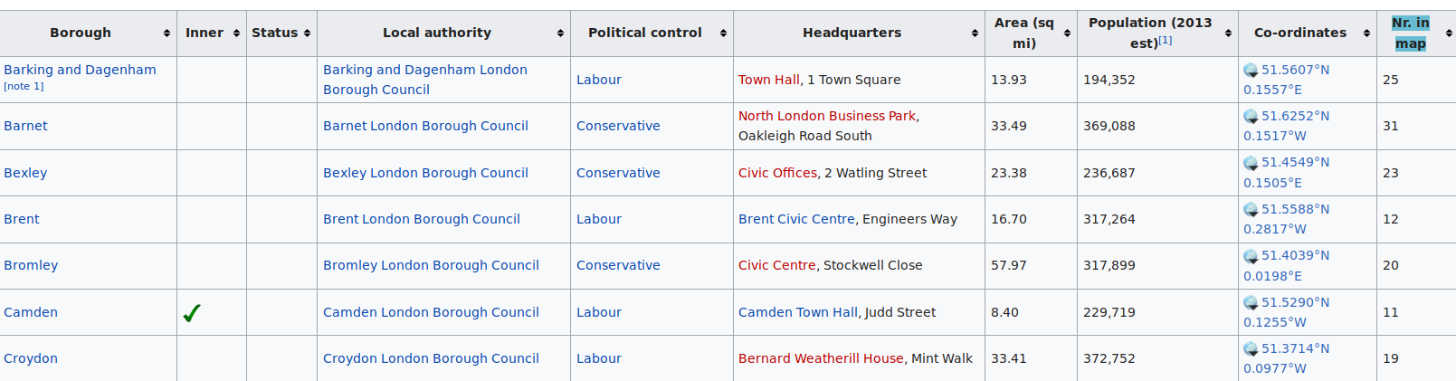
Population
The data was collected from wikipedia it has the above form, Beautiful Soup was needed for interpret it

Slide 6
Restaurants
London’s public databases offer the real number of restaurants,pubs and takeaways for 2001-2017 as an excel table, it shows the number of each per Borough ,

Slide 7
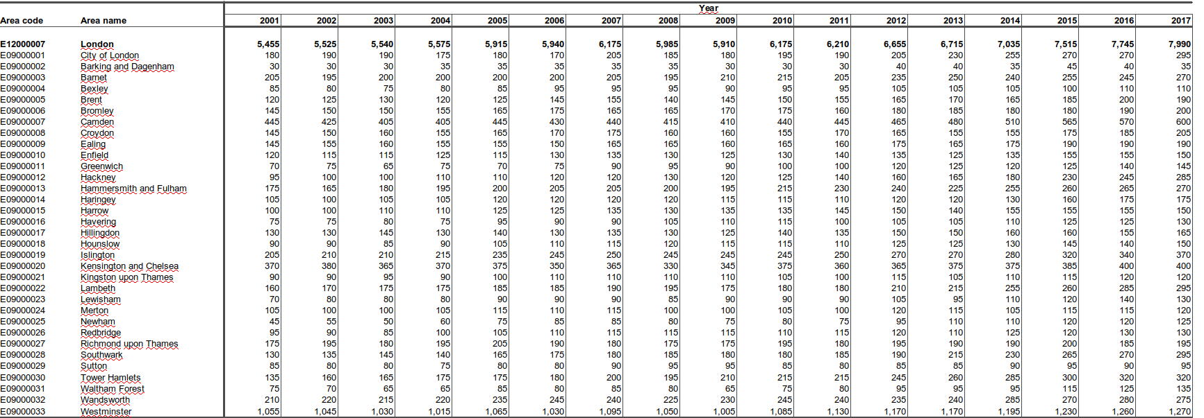
Restaurant number in xls format

Slide 8
Crime statistics
London open data has collected the incidences of crime types per LSOA in 9 years (2008-2016). It’s a medium size file ( ~1 gb) and contains 13 million records

Slide 9
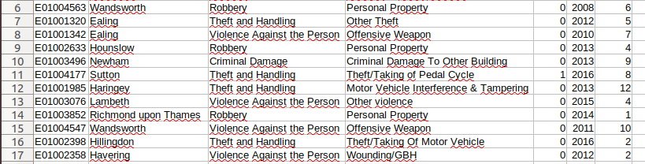
Crime database structure

Slide 10
Tidying the data
In order to work with the data , we need to apply some processing to it.
The intended objective is to set all the crime ocurrences , restaurants , populations in boroughs

Slide 11
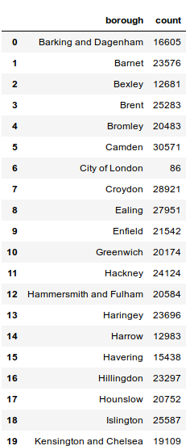
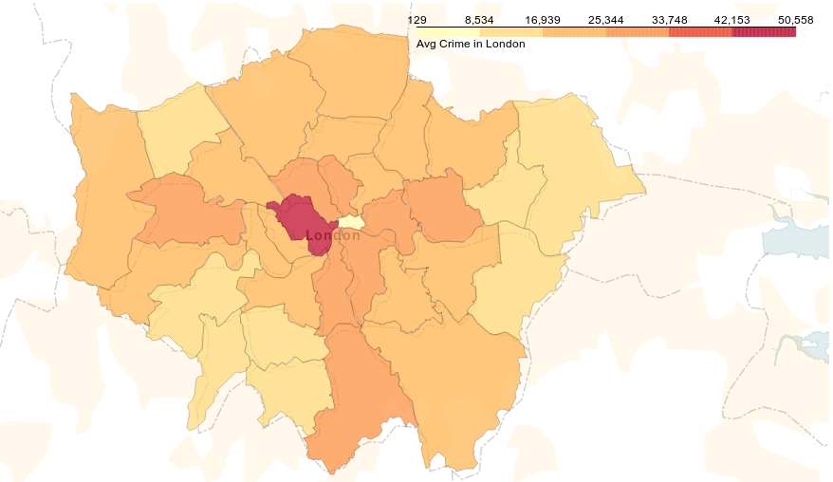
Tyding the Data
Crime distribution in London
Average crime per borough

Slide 12
However
It’s very important to note that not all places have the same number of population , so in order to find the most dangerous places we’ll use Crime Density

Slide 13
Crime density
I’ ve defined crime density as the Avg(Crime per borough) for this i’ve scraped population from wikipedia table using beautiful soup.

Slide 14
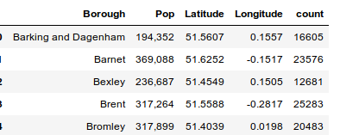
Result

Slide 15
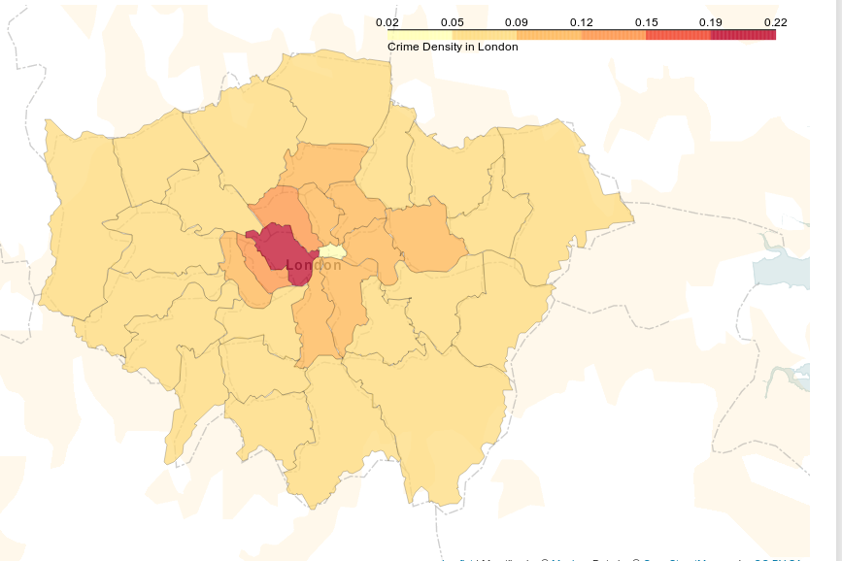
Crime Density
This shows some interesting results , as more farthest from the centre crime disminishes

Slide 16
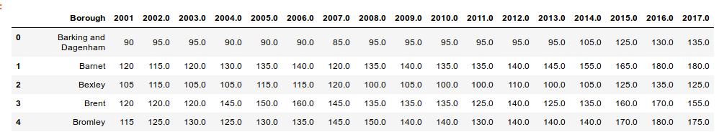
Restaurants
This the head of the ordered data from restaurants . We’ll use for the initial analysis 2017 data

Slide 17
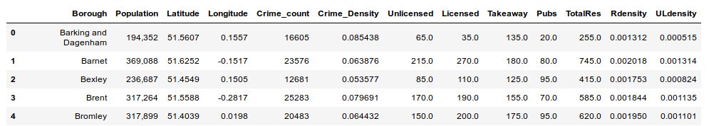
Merging Data
This is the essential dataframe that it’ll be used for further analysis

Slide 18
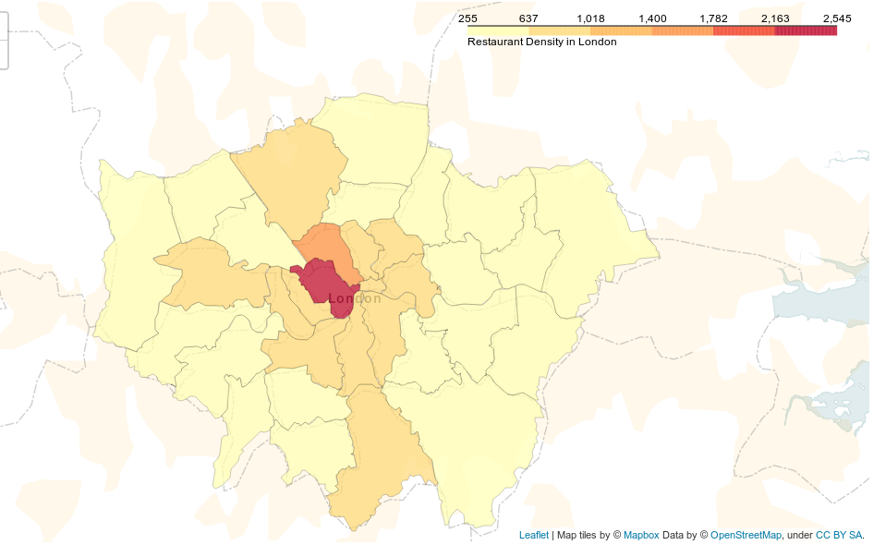
Total number of Restaurants
IIn this slide we can appreciate the number of restaurants per borough including takeaways, and pubs

Slide 19
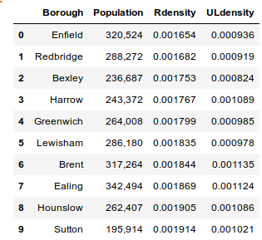
After ordering
After ordering based on crime density and Restaurant density it shows the borough in order of the most viables ones

Slide 20
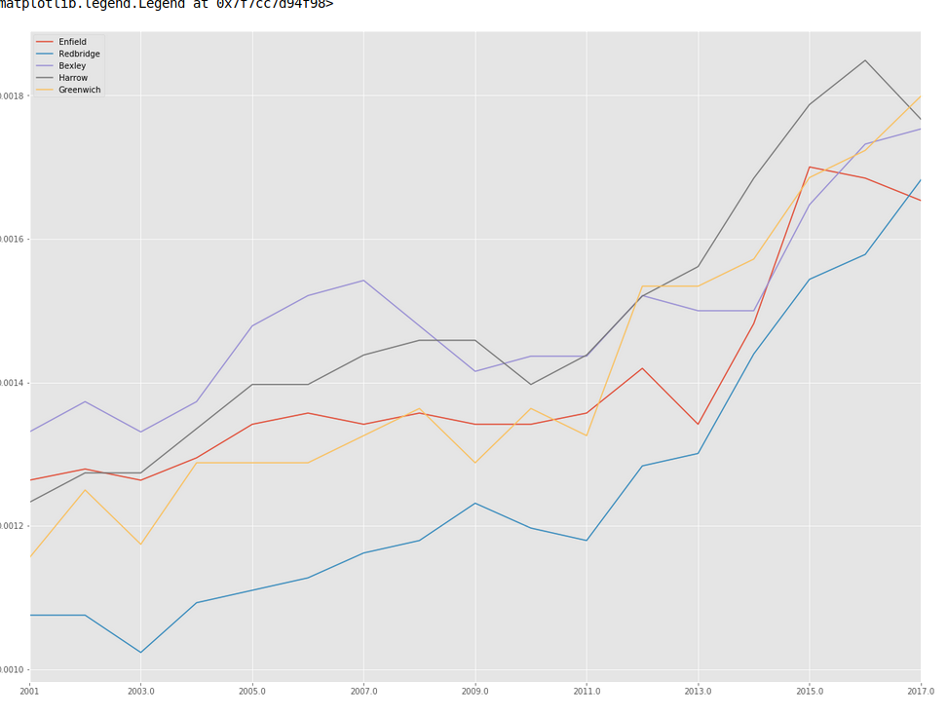
Which is the most suitable one
For finding the best borough i’ve plottted the time series of restaurant number to find in which borough the business are growing or viceversa

Slide 21
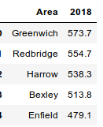
Choosing
As As a first conclussion from the slide from above Greenwich and harrow are the most suitable places to set up a restaurant however in order to choose between both I downloaded average wage per borough these data helped me, And i could find that Greenwich is the most suitable place

Slide 22
Foursquare API
The foursquare api are not suitable for this application because their numbers of venues is not the real ,

Slide 23
