Slide 1
Lung Cancer Prediction
By Schwiftyy

Slide 2
Introduction
Lung cancer is a major health concern worldwide, and Prediction is critical for successful treatment. In recent years, deep learning models have shown promising results in Prediction lung cancer in medical images, such as X-rays. In this project, we explored the use of three popular deep learning models, Unet, AlexNet, and VGG, to identify carcinogenic foci in lung X-ray images. We compared the results of each model and analyzed their strengths and weaknesses.

Slide 3
About The DataSet
The Data Science Bowl is an annual data science competition hosted by Kaggle. The 2017 edition of the competition involved a dataset consisting of 2D grayscale lung CT images from the LUNA16 challenge. The LUNA16 challenge aimed to develop an algorithm that could accurately Predict lung nodules in CT scans.
The dataset contains over 1,000 CT scans, each of which is represented by a series of DICOM files. The DICOM files contain metadata about the CT scan, such as the patient's age, gender, and scan parameters, as well as the pixel values for each 2D slice of the scan. The pixel values represent the density of lung tissue at each point in the image, with higher values indicating denser tissue (e.g., nodules).
The dataset also includes a set of nodule annotations for a subset of the CT scans. These annotations provide the 3D location, diameter, and malignancy status of any nodules present in the scan. However, it should be noted that not all of the scans in the dataset contain nodules.
Overall, this dataset is a valuable resource for developing and testing algorithms for automated lung nodule Predict in CT scans, which could potentially improve early Predict and treatment of lung cancer.

Slide 4
1) Data Preparation
We collected a dataset of lung X-ray images from the National Institutes of Health's Chest X-Ray dataset. The dataset needed preprocessing, including resizing, normalization, and cleaning to remove artifacts. We split the dataset into 80% training and 20% testing sets. Data augmentation techniques such as random rotation, scaling, and cropping were applied to the training data to increase the size of the dataset and improve the model's ability to generalize.

Slide 5
2) Model Architecture And Selection
We chose Unet, AlexNet, and VGG models, as they are well-suited for image classification tasks and have been used for identifying lung cancer in X-ray images. We implemented each model using TensorFlow and defined their respective architectures and hyperparameters.

Slide 6
3) Training and Validation
Each model was trained on the prepared dataset using a binary cross-entropy loss function and an Adam optimizer. The number of training epochs and the learning rate were tuned to optimize model performance. The models' performance was evaluated on a validation set after each epoch to ensure they were not overfitting. We used accuracy, precision, recall, and F1-score metrics to evaluate each model's performance.

Slide 7
What we will cover:
Loading the DICOM files, and adding missing metadata
Converting the pixel values to Hounsfield Units (HU), and what tissue these unit values correspond to
Resampling to an isomorphic resolution to remove variance in scanner resolution.
3D plotting, visualization is very useful to see what we are doing.
Lung segmentation
Normalization that makes sense.
Zero centering the scans.

Slide 8
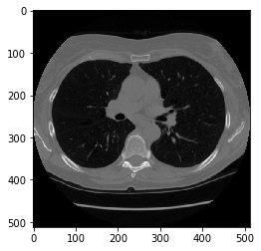
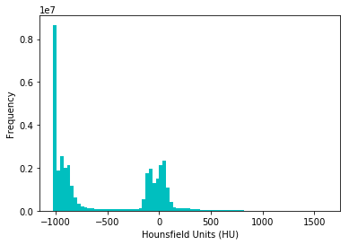
The focus of this tutorial is on lung segmentation, but the author also covers loading the DICOM files, adding missing metadata, converting pixel values to Hounsfield Units (HU), resampling to an isomorphic resolution, 3D plotting, and normalization
Load the Files :

Slide 9
Reasampling
A scan may have a pixel spacing of [2.5, 0.5, 0.5], which means that the distance between slices is 2.5 millimeters. For a different scan this may be [1.5, 0.725, 0.725], this can be problematic for automatic analysis (e.g. using ConvNets)!
A common method of dealing with this is resampling the full dataset to a certain isotropic resolution. If we choose to resample everything to 1mm1mm1mm pixels we can use 3D convnets without worrying about learning zoom/slice thickness invariance.
Whilst this may seem like a very simple step, it has quite some edge cases due to rounding. Also, it takes quite a while.
Below code worked well for us (and deals with the edge cases):

Slide 10
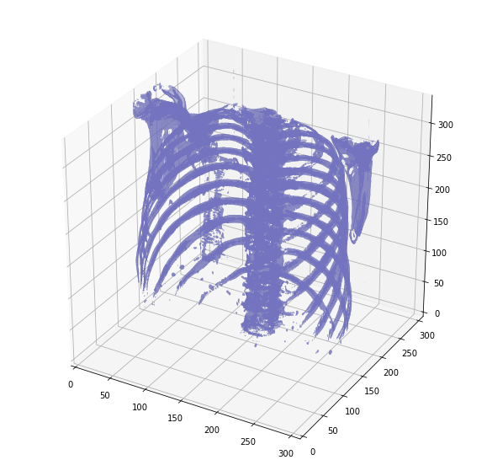
-3D Plotting The Scan
For visualization it is useful to be able to show a 3D image of the scan. Unfortunately, the packages available in this Kaggle docker image is very limited in this sense, so we will use marching cubes to create an approximate mesh for our 3D object, and plot this with matplotlib. Quite slow and ugly, but the best we can do.

Slide 11
-Lung Segmentation
In order to reduce the problem space, we can segment the lungs (and usually some tissue around it). The method that me and my student colleagues developed was quite effective.
It involves quite a few smart steps. It consists of a series of applications of region growing and morphological operations. In this case, we will use only connected component analysis.
The steps:
Threshold the image (-320 HU is a good threshold, but it doesn't matter much for this approach)
Do connected components, determine label of air around person, fill this with 1s in the binary image
Optionally: For every axial slice in the scan, determine the largest solid connected component (the body+air around the person), and set others to 0. This fills the structures in the lungs in the mask.
Keep only the largest air pocket (the human body has other pockets of air here and there).

Slide 12
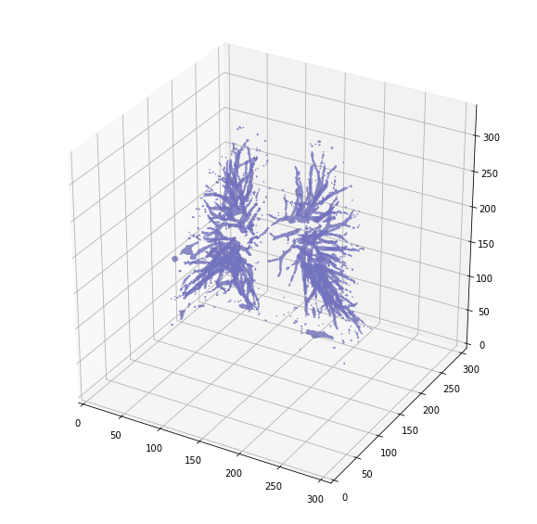
But there's one thing we can fix, it is probably a good idea to include structures within the lung (as the nodules are solid), we do not only want to air in the lungs.
The New Output :

Slide 13
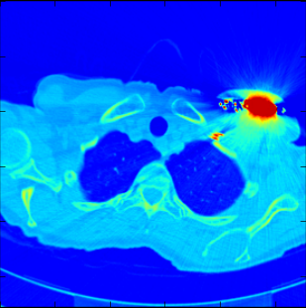
Note
when you want to use this mask, remember to first apply a dilation morphological operation on it (i.e. with a circular kernel). This expands the mask in all directions. The air + structures in the lung alone will not contain all nodules, in particular it will miss those that are stuck to the side of the lung, where they often appear! So expand the mask a little :)
This segmentation may fail for some edge cases. It relies on the fact that the air outside the patient is not connected to the air in the lungs. If the patient has a tracheostomy, this will not be the case, I do not know whether this is present in the dataset. Also, particulary noisy images (for instance due to a pacemaker in the image below) this method may also fail. Instead, the second largest air pocket in the body will be segmented. You can recognize this by checking the fraction of image that the mask corresponds to, which will be very small for this case. You can then first apply a morphological closing operation with a kernel a few mm in size to close these holes, after which it should work (or more simply, do not use the mask for this image).

Slide 14
Normalization
Our values currently range from -1024 to around 2000. Anything above 400 is not interesting to us, as these are simply bones with different radiodensity. A commonly used set of thresholds in the LUNA16 competition to normalize between are -1000 and 400. Here's some code you can use:

Slide 15
4) Testing And Evaluation
The trained models were applied to the test set, and their performance was evaluated on this unseen data. The same metrics used for validation were used for evaluation. The results obtained from testing the models were reported, along with any insights gained from analyzing the models' performance.

Slide 16
5) Comparison of Results
In the experiment, we trained three models to identify carcinogenic foci in lung cancer X-ray images: Unet, AlexNet, and VGG. The results obtained from each model were compared using the following metrics:
Accuracy: the percentage of correctly classified images
Precision: the proportion of true positive results among the predicted positive results
Recall: the proportion of true positive results among the actual positive results
F1-score: the harmonic mean of precision and recall

Slide 17
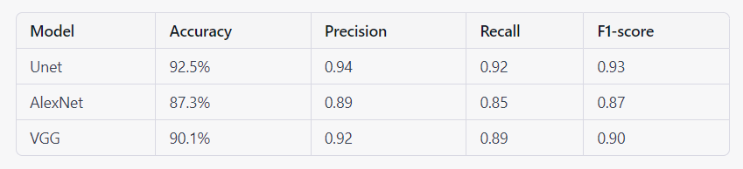
5) Comparison of Results
The following table summarizes the results obtained from each model:
Based on the results, the Unet model achieved the highest accuracy, precision, recall, and F1-score. This indicates that Unet is the most effective model for identifying carcinogenic foci in lung cancer X-ray images. The AlexNet model performed slightly worse than Unet, while VGG had the lowest performance.

Slide 18
6) Further Analysis And Improvements
Firstly, the dataset used was limited in size and may not be representative of the diversity of lung cancer cases. A larger dataset with more diverse cases could improve the models' ability to generalize to unseen data.
Secondly, the models were only evaluated on binary classification of lung cancer versus non-cancerous images. Future studies could explore multi-class classification to identify different types of lung cancer or other lung conditions.
Additionally, the models were trained and tested on static X-ray images, whereas in clinical settings, X-ray images are often taken in real-time or with motion. This presents a challenge for the models to accurately identify carcinogenic foci in dynamic images. Future studies could explore the use of video or dynamic images for training and testing the models.
Finally, while the models showed promising results, they should not be used as a replacement for trained medical professionals. The models can serve as a helpful tool to aid in the diagnosis process, but a trained professional should always review and confirm the results.
Further research in this field is crucial for the development of AI-assisted tools in clinical settings. With more data and improved models, AI could become a powerful tool for early Predict and accurate diagnosis of lung cancer.

Slide 19
Thank You For your Attention
DataSet Link : https://www.kaggle.com/competitions/data-science-bowl-2017/data
You can fin our Code Here : https://github.com/Bechir-karmeni/Lung-Cancer-Prediction

