Slide 1
Bakkle Apple Watch
Watterson – Tandon – Carroll

Slide 2
Apple Watch – Overview
Apple Watch is primarily a notification system.
Bakkle Functionality
Push Notifications: Item, chat, offers
Application: View feed
Bakkle icon on home screen launches the app. Notifications are displayed when received.

Slide 3
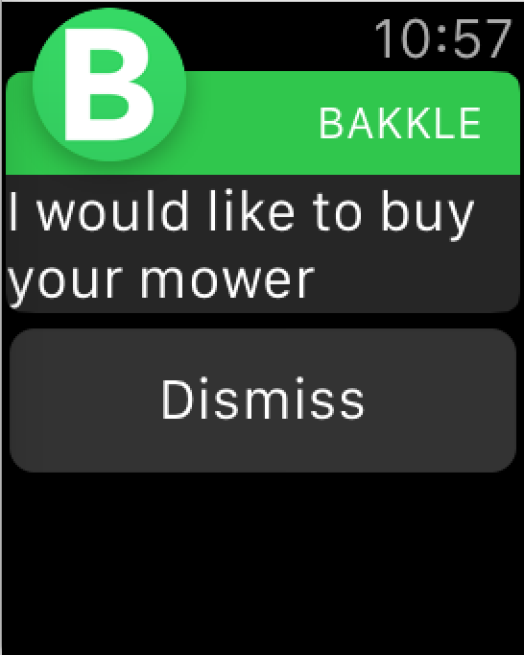
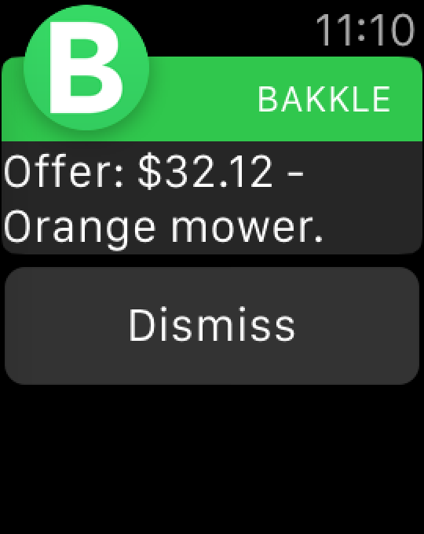
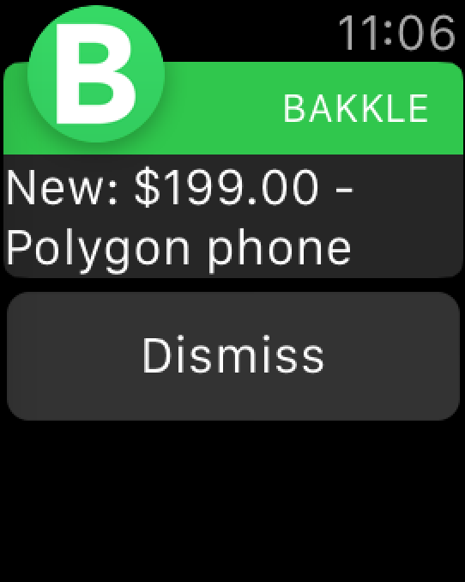
Notifications
Apple recommends using short, simple but high-value notifications. Sash color provides tie-in to branding.
Chat Message
Offer on Item
Item Posted

Slide 4
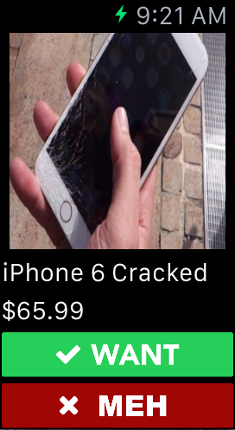
Feed
Mimics Phone Feed
See next item in feed
Want and Meh
No Swiping
Requires scrolling

