Slide 1
CHECKPOINT DATA BASES
Introduction to Databases

Slide 2
CONTENTS OF THIS TEMPLATE
What is SQL?
What is NO SQL
Difference between MongoDB VS SQL

Slide 3

What is SQL?
Structured Query Language ➔SQL give you the access and manipulation to databases ➔SQL became a standard of the American National Standards Institute (ANSI) in 1986, and of the International Organization for Standardization (ISO) in 1987

Slide 4
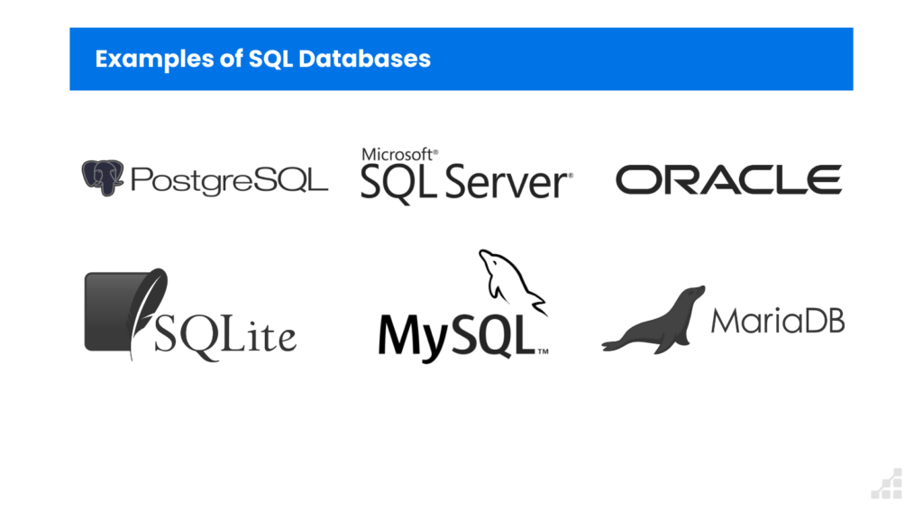
TABLE OF CONTENTS

Slide 5
What is NO SQL?
NoSQL, also referred to as “not only SQL”, “non-SQL”
Is an approach to database design that enables the storage and querying of data outside the traditional structures found in relational databases.

Slide 6
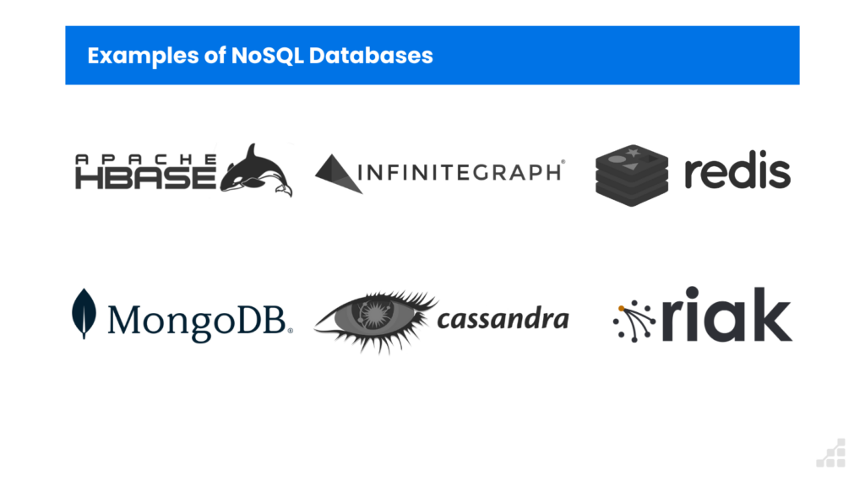

Slide 7


MongoDB VS. SQL
MongoDB
SQL
MongoDB is used to save unstructured data in JSON format.
MongoDB does not support advanced analytics and joins like SQL databases support.
SQL databases are used to store structured data while NoSQL databases like MongoDB are used to save unstructured data.

Slide 8
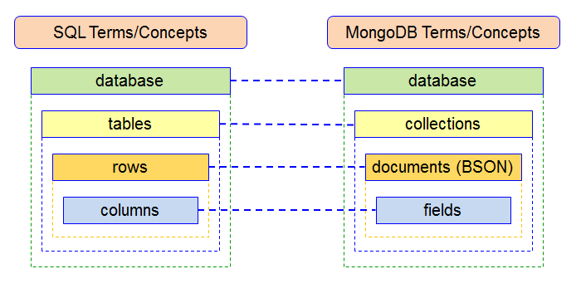
Difference

Slide 9
—SOMEONE FAMOUS
“This is a quote, words full of wisdom that someone important said and can make the reader get inspired.”

Slide 10

A PICTURE IS WORTH A THOUSAND WORDS

Slide 11

DATA
In this post we covered a thorough comparison between MongoDB vs SQL database and saw various options of performing analytics on MongoDB data.

Slide 12
CONCLUSIONS
To answer the question,
“Why I should use X over Y?”
you need to take into consideration your project goals and many other things.

Slide 13


