Slide 1


Fetch

Slide 2
Fetch
The Fetch API is a modern interface that allows for http/http(s) asynchronous requests from web browsers.
Older methods of http/http(s) requests used the XMLHttpRequest (XHR) object.
Fetch can perform all tasks that the XHR object can.
Fetches uses cleaner syntax as well.
Fetch supports promises.
Fetches uses cleaner syntax as well.
Note: Does not support Internet Explorer

Slide 3
Simple Fetch: Fido Retrieves a bone.
If fido tries to retrieve a bone several outcomes can happen:
Fido retrieves the bone (success/resolved)
Fido cannot retrieve the bone (failure/rejected)

Slide 4
bones.json
JSON
JSON
bones
bones.json
[
{"id":"1", "boneType":"t-bone" },
{"id":"2", "boneType": "porterhouse"},
{"id":"3", "boneType": "elk Horn" }
]

Slide 5


Fidos Bone Quest: Locally or Remotely
Fido Gets a bone
Located locally
Fido Gets a bone
Located in the neighbor's yard
JSON
JSON
JSON
JSON
JSON

Slide 6
Fidos Bone Quest: Locally
Fido Gets a bone
Located in his yard
Basic challenges Local and Remote Data:
Find way to fetch the bone.
Find a way to get at the JSON content of the bone.
JSON

Slide 7

Fido’s Bone is not readily accessible: He wants the JSON content of the bone
JSON
res.json()
JSON
When we use “fetch” we also need to find a way to get the content out of the response (res) object.

Slide 8
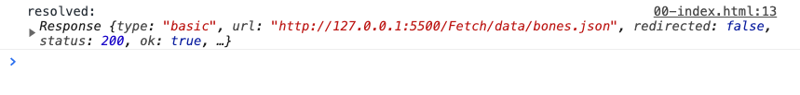
fetch: Locally
JSON
JSON
JavaScript
fetch('../data/bones.json’)
.then((res)=>{
console.log('resolved: ', res)
})
Browser Console
The fetch API makes a request to GET the data and the data was obtained from the file and outputted to the browser by a response object (res).
The problem is that the data is not in a readable format for us to examine, however we do get some meaningful information such as the “status” code, which can be used to do error handling.
Fetch/01-SimpleFetch/00-index.html
Notes:
/Fetch/01-SimpleFetch/00-index.html

Slide 9
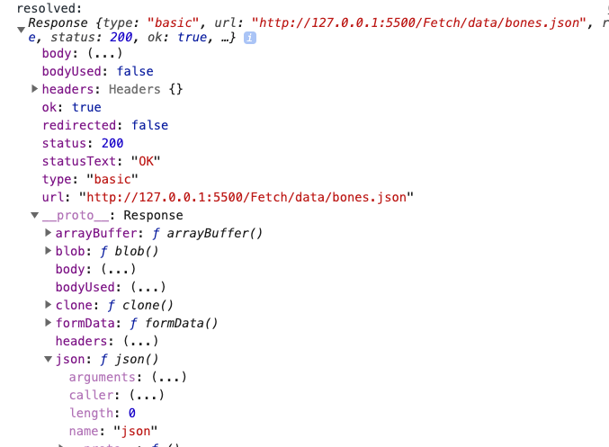
fetch: Locally
JSON
JSON
Browser Output Expanded
A JSON method is returned to the response object (res) that was fetched.
Notes:
/Fetch/01-SimpleFetch/00-index.html

Slide 10
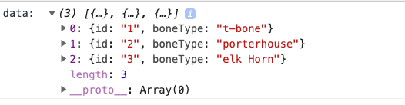
fetch: Locally
JSON
JSON
JavaScript
fetch('../data/bones.json’)
.then((res)=>{
// console.log('resolved: ', res)
//res.json returns a promise which will
//be the data object in JSON format
return res.json()
}).then(data => {
console.log('data: ', data)
})
Three Steps
Fetch the data
Return the response using the JSON() method
Do something with the data.
Browser Console
Fetch/01-SimpleFetch/01-index.html
Notes:
/Fetch/01-SimpleFetch/01-index.html

Slide 11
fetch: Locally + Error Handling
JavaScript
fetch('../12313data/bones.json’)
.then((res) => {
return res.json()
}).then(data => {
console.log('data: ', data)
//Error handling in a fetch only gets triggered if a network connection
// can not be established or maintained
}).catch((err) => {
console.log('rejected', err)
})
Note: Fetch views errors as network connection errors and not 400, 500 status codes.
Fetch/01-SimpleFetch/02-index.html
Notes:
/Fetch/01-SimpleFetch/02-index.html

Slide 12
fetch Locally: + async/await: Code
JavaScript
// async functions always returns a promise
const getLocalBones = async () =>{
//the await keyword "stalls" the JS assignment
// until the data is returned (promise resolves or is rejected)
const res = await fetch('../data/bones.json’)
const data = await res.json();
return data;
}
// After the function resolves the .then is run
let retrivedBones = getLocalBones()
.then(data => console.log('resolved',data));
Using async and await cleans the code so we do not need to chain on functionality using .then within the async function.
This becomes more powerful for multiple fetches.
Fetch/01-SimpleFetch/03-index.html
Notes:
Fetch/01-SimpleFetch/03-index.html

Slide 13
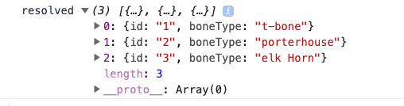
fetch Locally + async/await: Results

Slide 14
Check if the async is blocking code
// async functions always returns a promise
const getLocalBones = async () => {
//the await keyword "stalls" the JS assignment
// until the data is returned (promise resolves or is rejected)
const res = await fetch('../data/bones.json')
const data = await res.json();
return data;
}
console.log(1);
console.log(2);
let retrivedBones = getLocalBones()
.then(data => console.log('resolved', data));
console.log(3);
console.log(4);
What do you expect to be printed to the browser console?
Fetch/01-SimpleFetch/03b-index.html
Notes:
Fetch/01-SimpleFetch/03b-index.html

Slide 15
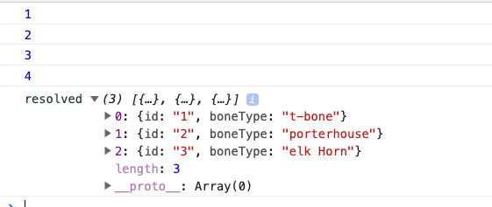
Check if the async is blocking code: Browser
console.log(1);
console.log(2);
let retrivedBones = getLocalBones()
.then(data => console.log('resolved', data));
console.log(3);
console.log(4);
The async and await function is non-blocking code, as it took longer to finish than the regular console.log statements

Slide 16
Error Handling async/await
const getLocalBones = async () => {
//fetch ill-formed JSON
const res = await fetch('../data/bad_bones.json’)
const data = await res.json();
return data;
}
let retrivedBones = getLocalBones()
.then(data => console.log('resolved', data))
// Catch the error this Error detects if the JSON can be read
// Note: No error will result if the resource you are fetching does
// exist
.catch((err) => console.log('rejected', err.message))
Fetch/01-SimpleFetch/04-index.html
Notes:
Fetch/01-SimpleFetch/04-index.html

Slide 17
bad_bones.json
JSON. Is not formatted Properly
JSON
JSON
bones
bad_bones.json
[
{id:"1", "boneType":"t-bone" },
{"id":"2", "boneType": "porterhouse"},
{"id":"3", "boneType": "elk Horn" }
]

Slide 18
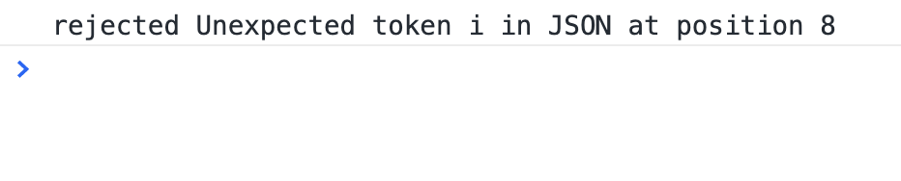
Error Handling async/await
The browser shows the rejection and the error for the attempted fetching of the JSON file

Slide 19
fetch: Remotely
Fido wants to Get a bone
Located in the neighbor's yard
JSON
JSON
JSON

Slide 20
fetch: Remotely
Fido Gets a bone
Located in the neighbor's yard
Basic challenges Local and Remote Data:
Find way to fetch the bone.
Find a way to get at the JSON content of the bone.
JSON
Additional challenges for Remote Retrieval of data:
Find a way to get over to the neighbor's yard.

Slide 21
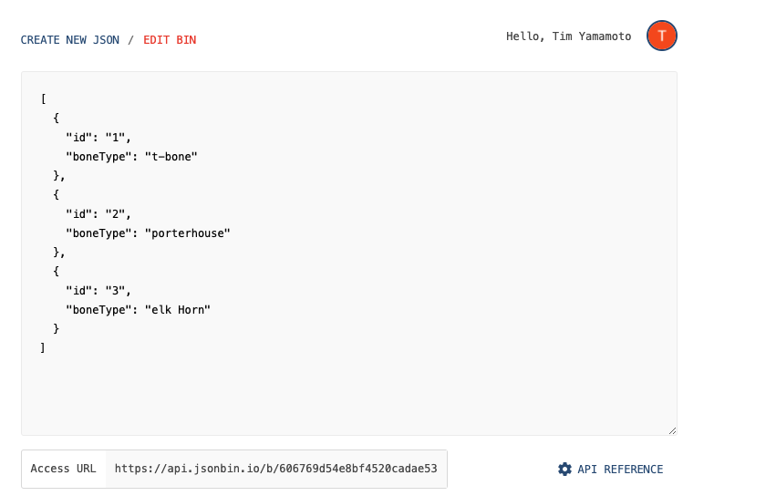
fetch: Remote: jsonbin.io
Jsonbin.io allows for the remote storage of JSON data (Free Tier allows for 10K requests)
For this example, use the Public access although one could use the private, but would need to provide the “secret” key in the client code.

Slide 22
fetch: Remotely
const remoteDataURL = "your-unique-URL"
const getRemoteBones = async () => {
//Change the URL, Add Optional Arguments:
const res = await fetch(remoteDataURL, {
//Optional arguments
method: 'GET’,
headers: {
'Accept': 'application/json. text/plain, */*’,
"Content-Type": "application/json",
},
}
)
const data = await res.json();
return data;
}
let retrivedBones = getRemoteBones()
.then(data => console.log('resolved', data))
.catch((err) => console.log('rejected', err.message))
Supply remote URL and secret key if required.
Supply optional arguments (“Pre-flight”).
Fetch/01-SimpleFetch/05-index.html

Slide 23

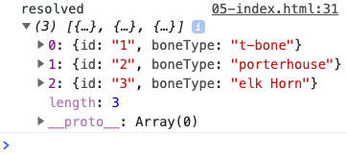
fetch(remoteDataURL, {
//Optional arguments
method: 'GET’,
headers: {
'Accept': 'application/json. text/plain, */*’,
"Content-Type": "application/json",
},
1
2
JSOBbin.io

Slide 24

Fido is Happy now
JSON
JSON
Local bone
JSON
JSON
Remote bone

Slide 25
Error Handling : Status Codes
The fetch() API only rejects a promise when:
A network error is encountered, although this usually means permissions issues or similar.”
So promises are only rejected if the user is offline, or some unlikely networking error occurs, such a DNS lookup failure.
You likely would want to deal with responses such as 400, 500 etc…..

