Slide 1
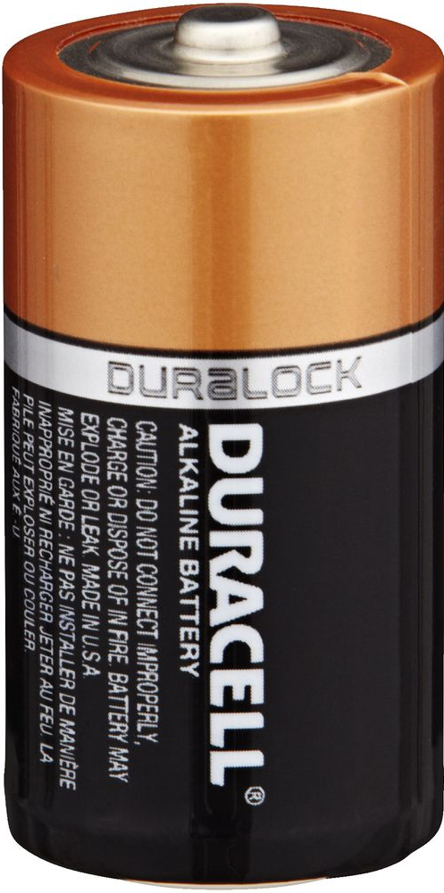
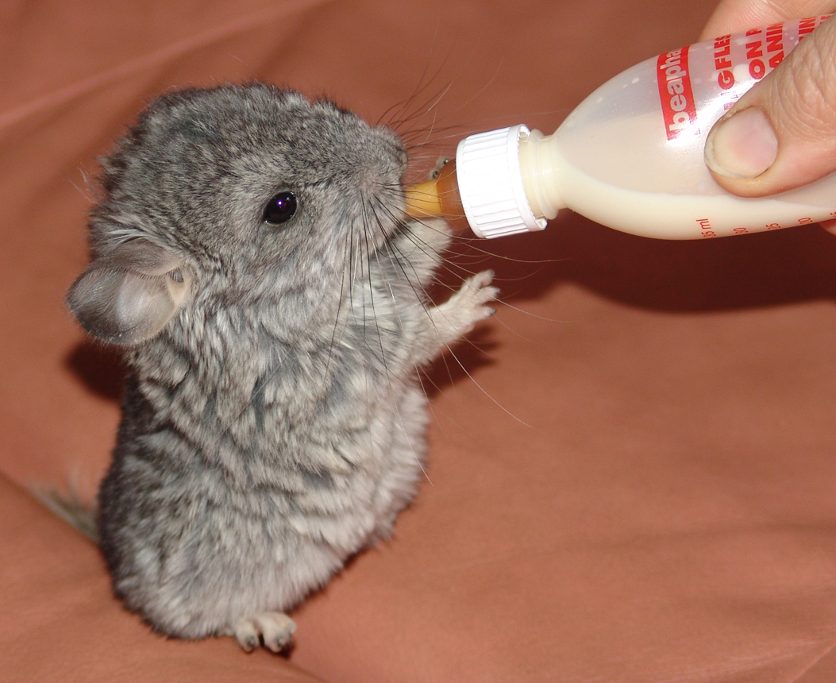
The Charged Chinchillas (AKA the Chachis)
Motivation
Batteries cycled, data points collected every 10 seconds for weeks or months – LOTS of data
Utilize all the data vs some of the data in a quantitative vs qualitative manner
There is an opportunity to explore and use this data better

Slide 2
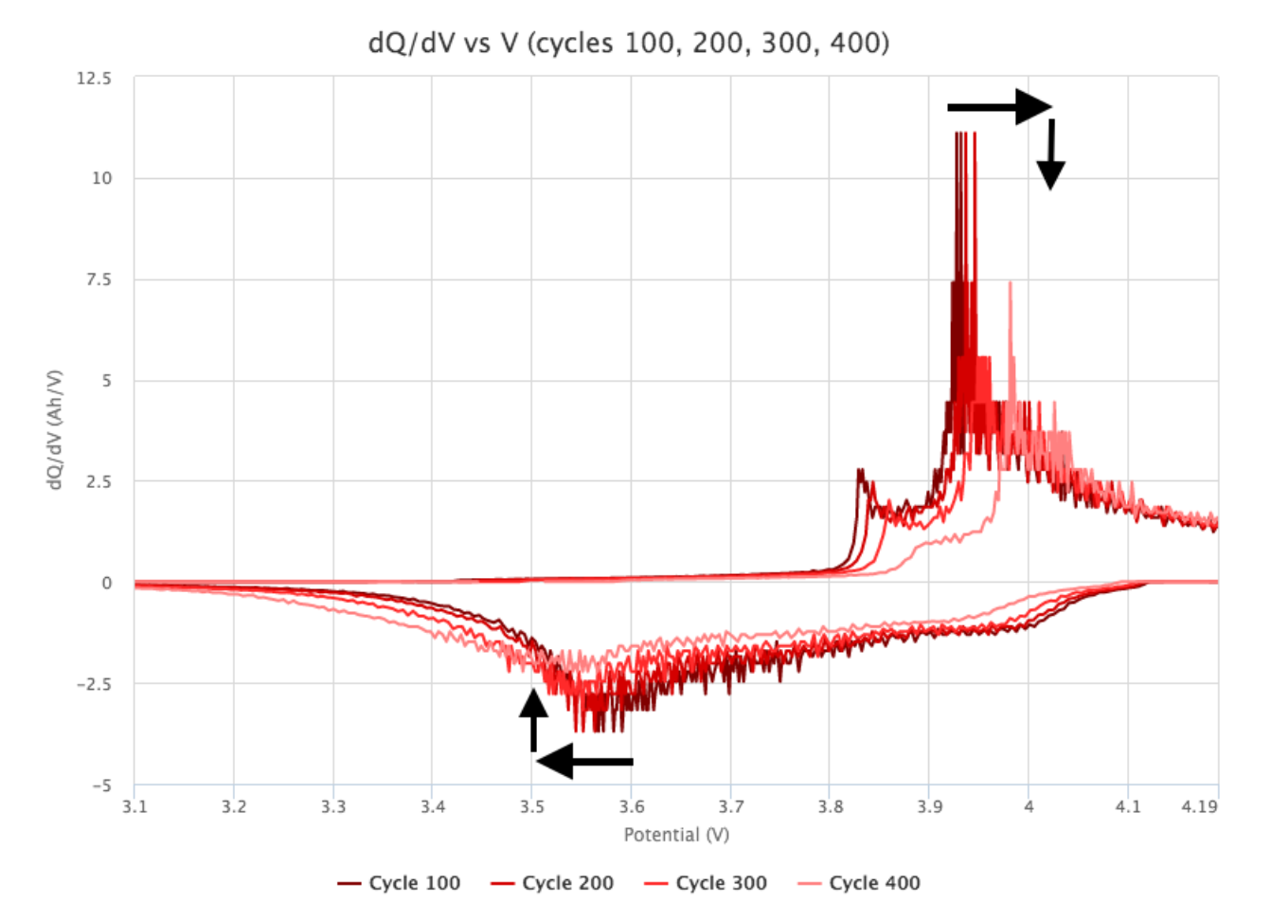
Project
Data from CALCE (University of Maryland) website
Data Visualization:
Better visualization of what is going on in the battery
User friendly interface for exploring data
2. Machine Learning:
Define a set of descriptors that describe important features (peaks)
Train a model to use the set of descriptors to classify the cycle data
Test on data with different cycling conditions
https://www.voltaiq.com/blog/electrochemistry-data-hidden-in-your-time-series-data-dq/dv
Notes:
Have algorithm recognize if cycle is near beginning or end of data
Prismatic Cells
CALC data has about 6 sets of 600 cycles for
For our use, we’ll use their prismatic cells data (full cycles)
Cycled at different rates, I think some of them are partial cycles

