Slide 1
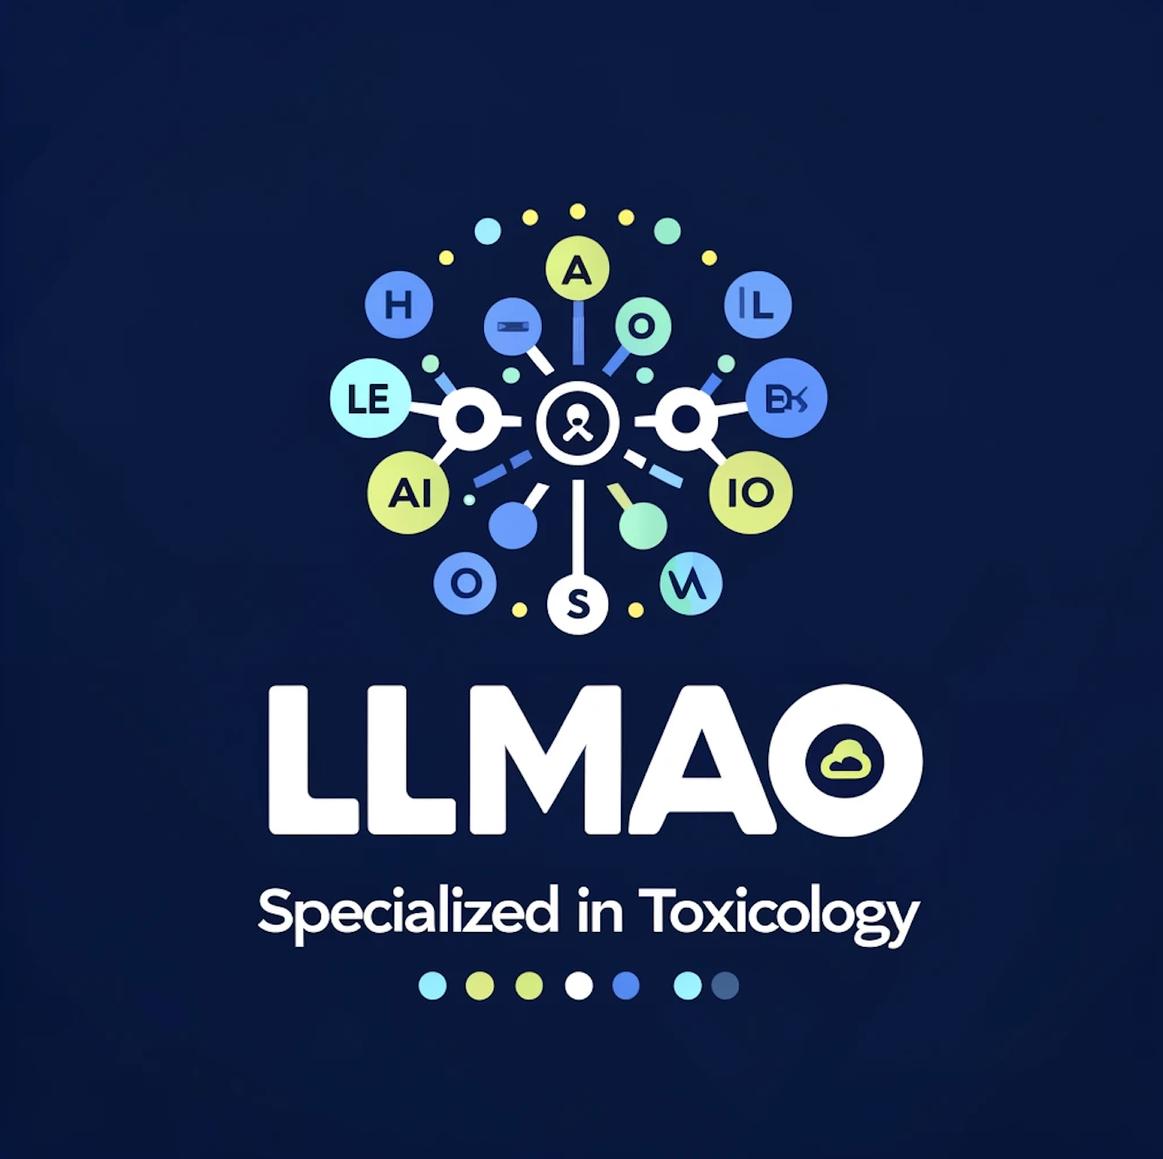
LLMao: Retrieval Augmented Generation using Large Language Models for Toxicology
Omkar Chavan, Ashley Fenton, Kenny Lam, Ali Mahmoud, Jhanvi Rana

Slide 2
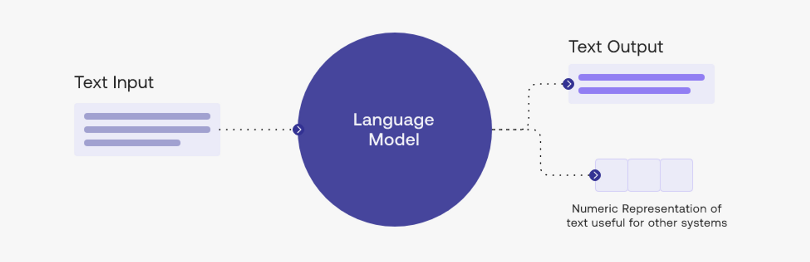

What are LLMs?
Introduction
A large language model is a deep learning algorithm that summarizes, translates and generates text to convey ideas and concepts
Notable examples include OpenAI’s GPT-3 and GPT-4
Notes:
Omkar

Slide 3


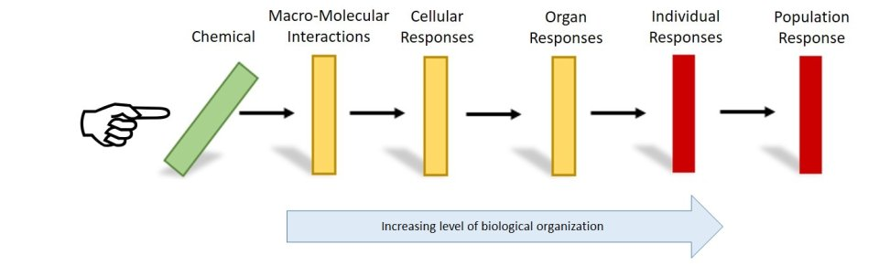
Incompetency of LLMs
Challenge
LLMs often give inaccurate and made-up responses to scientific questions
This problem is experienced more heavily in toxicology where ChatGPT does not have access to the Adverse Outcome Pathway (AOP) database
Notes:
Omkar

Slide 4

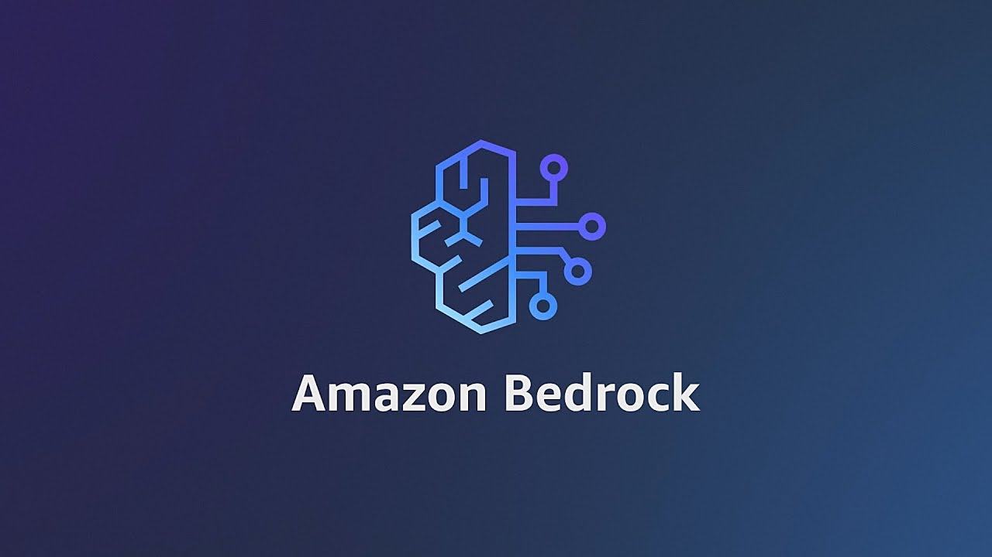
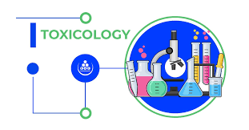
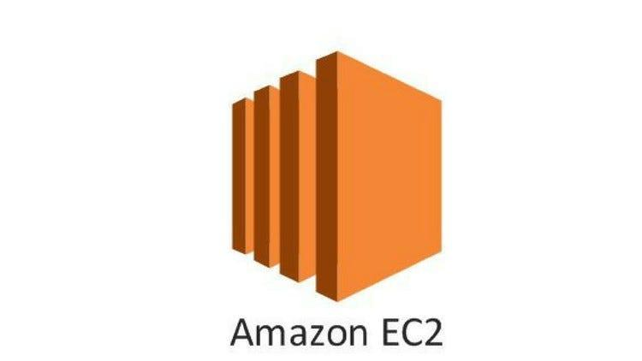

Bridge the gap between academia and general public
Objective
Build LLM that utilizes AOP database from EPA
Combine that database with cloud computing platform like Amazon Web Services (AWS)
Utilize AWS tools like Bedrock, EC2 and S3 which helps in creating a specialized AI expert in toxicology
Notes:
Omkar

Slide 5
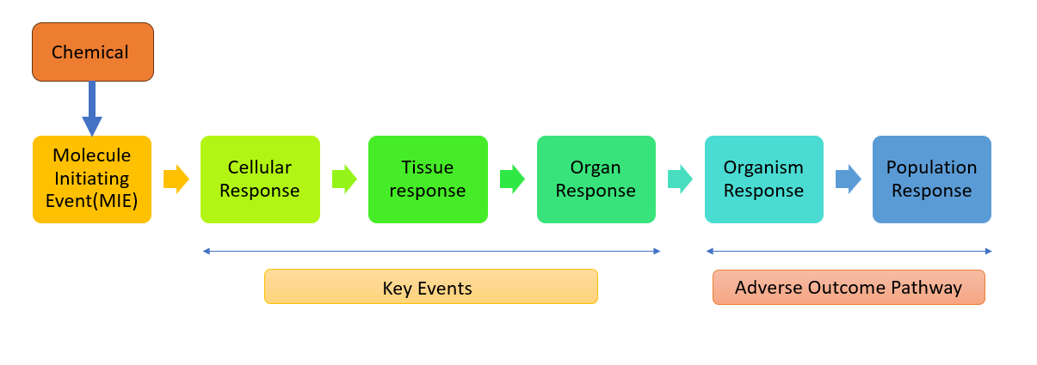
Adverse Outcome Pathway (AOP)
AOP: biological frameworks that seek to explain how a molecular level interaction with a stressor can lead to large scale adverse effects
General AOP Framework
Our LLM utilizes the AOP database from the EPA (https://aopdb.epa.gov)
Notes:
Adverse outcome pathways, (AOPs), are proposed biological frameworks that seek to explain how a molecular-level interaction with a stressor can lead to large-scale adverse effects.
It begins with being exposed to a chemical or substance that will then lead to a change at the molecular level called a molecular initiating event. This will then lead to a sequence of events in the cells and tissues called key events. It ends with the negative health outcome called the adverse outcome. Imagine knocking over the first domino, which then causes all the others to fall in a specific order, leading to the final harmful effect.
These AOPs play a vital role in the field of toxicology, which is why we have decided to use the AOP database from the EPA to perform retrieval augmented generation.

Slide 6
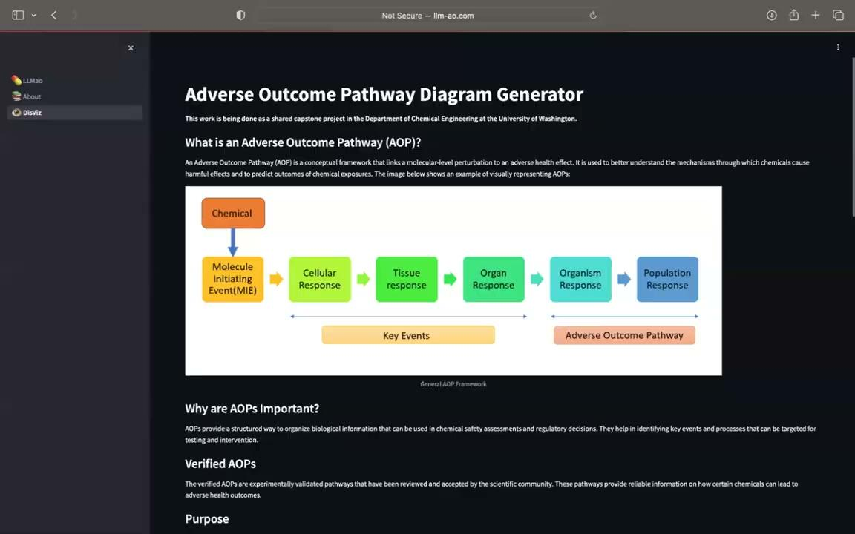
AOP Demo from llm-ao.com
Notes:
Ashley

Slide 7
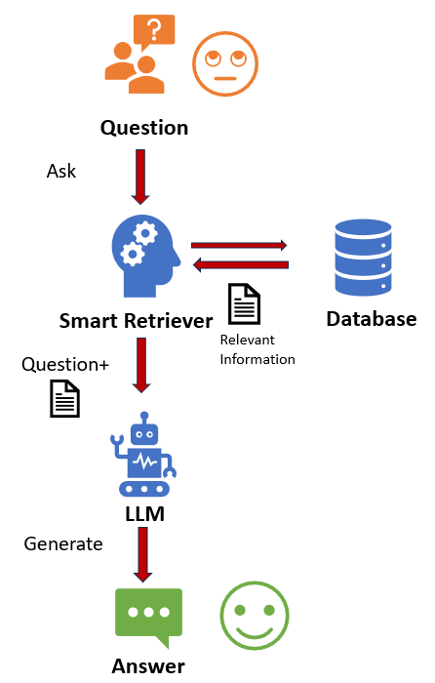
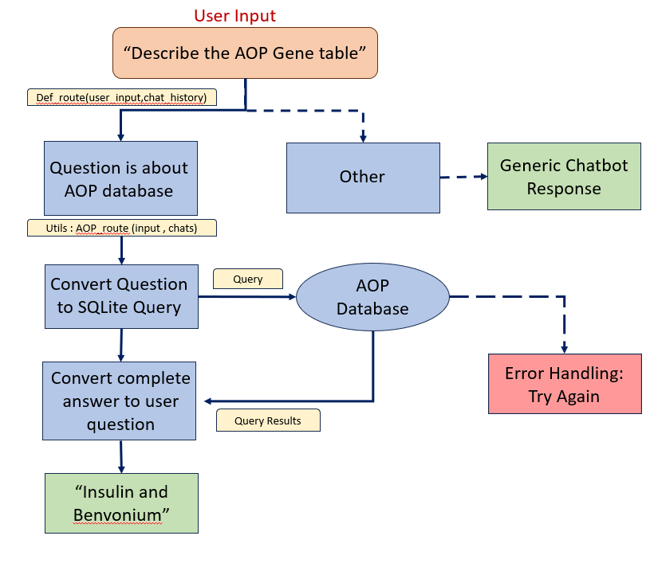
Retrieval Augmented Generation (RAG)
Implementation of RAG:
LLMao using RAG implementation:
Notes:
Jhanvi:
Unfortunately, the nature of LLM technology introduces unpredictability in LLM responses. Additionally, LLM training data is static and introduces a cut-off date on the knowledge it has.
The process of bringing the appropriate information and inserting it into the model prompt is known as Retrieval Augmented Generation (RAG).
How does Retrieval-Augmented Generation work?
Create external data
Retrieve relevant information
The next step is to perform a relevancy search. The user query is converted to a vector representation and matched with the vector databases. The relevancy was calculated and established using mathematical vector calculations and representations.
Augment the LLM prompt
Next, the RAG model augments the user input (or prompts) by adding the relevant retrieved data in context. This step uses prompt engineering techniques to communicate effectively with the LLM. The augmented prompt allows the large language models to generate an accurate answer to user queries.
Actual Working of LLM-AO
User asks question
Software defined function utils identifies whether question belongs to toxicology or not.
If it is other,provides relevant answer pertaining to that
If it belongs to toxicology, builds SQL query to search into AOP database.
If not successful,throws error.
If successful,retrieves relevant information and combines information from LLM model like langchain and augments it with details providing user more accurate up to date answer.With LLM-AO ,we get detailed answer to complex biological phenomena accurately which can be useful to biologist,researchers,drug development and pharma companies
What are the benefits of Retrieval-Augmented Generation?
Cost-effective implementation
Current information
Enhanced user trust
More developer control
# Less Detail

Slide 8

RAG Demo
Notes:
Ali

Slide 9
Conclusion & Future Developments
Completed work this quarter:
Database
Computing
LLM
UI
Future work if this project was continuing:
Additional databases
User chat history
UI optimization
More response evaluation
Notes:
Kenny
In conclusion, in this project, we successfully hosted an online chatbot which has knowledge from an established toxicology database using cloud computing service. Future extensions of the project include implementing additional databases to the LLM’s knowledge base, optimizing the UI, enabling chat history on previous sessions, setting more response evaluation metrics. These further enhances the user experience and model accuracy.

Slide 10
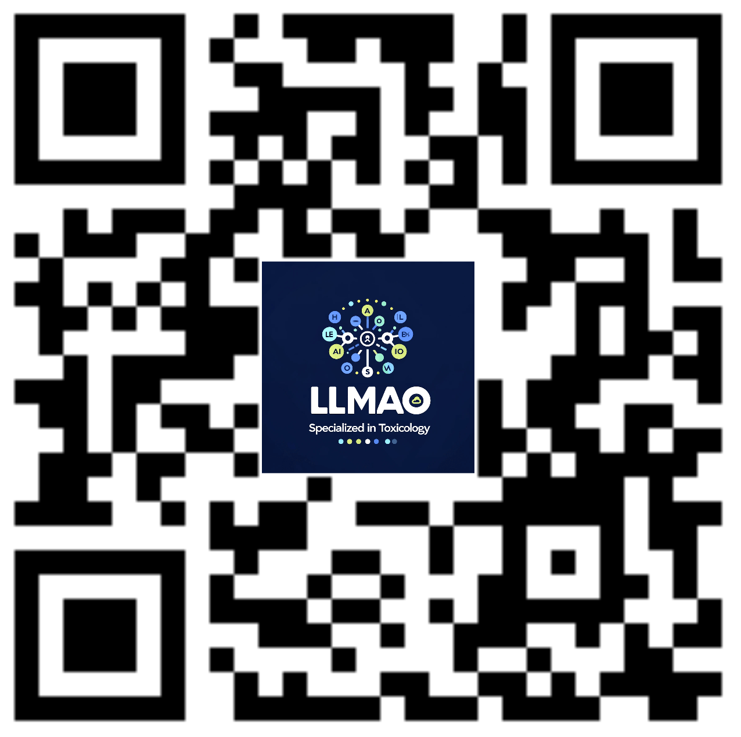
Try LLMao here:

