Slide 1
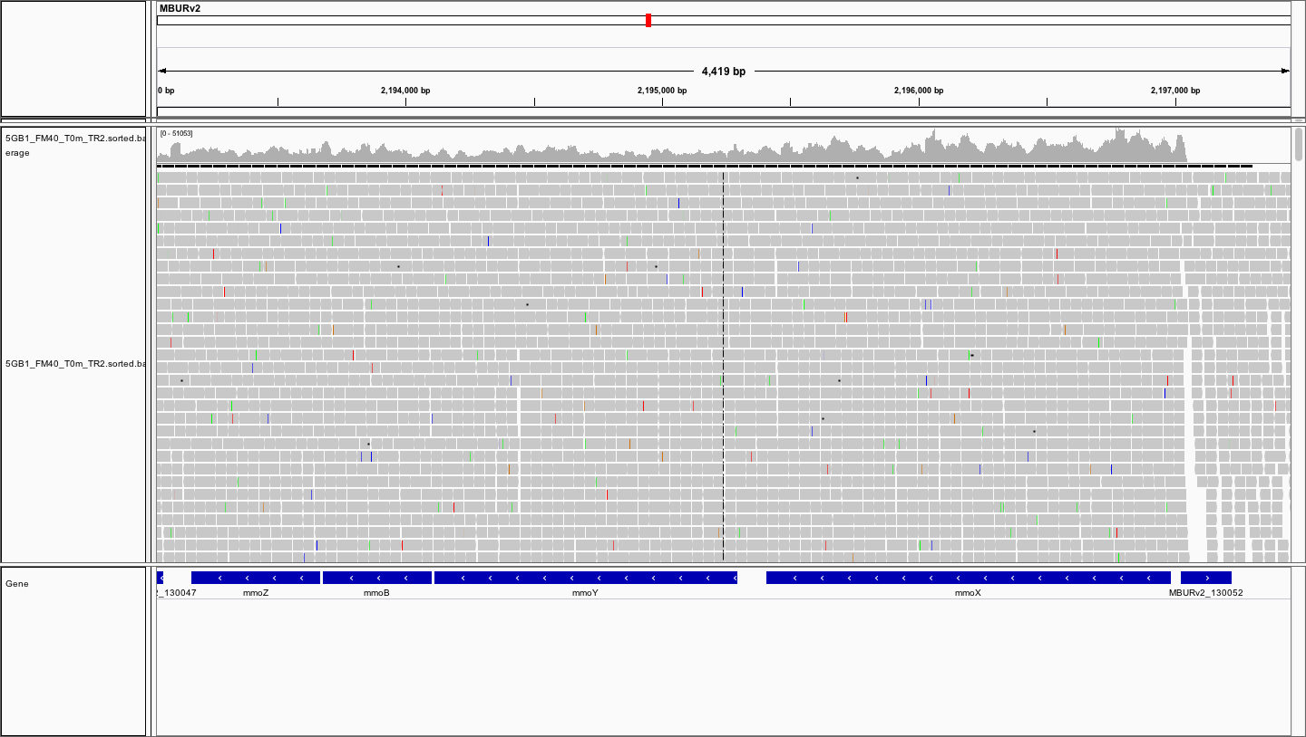
sMMO operon overview

Slide 2
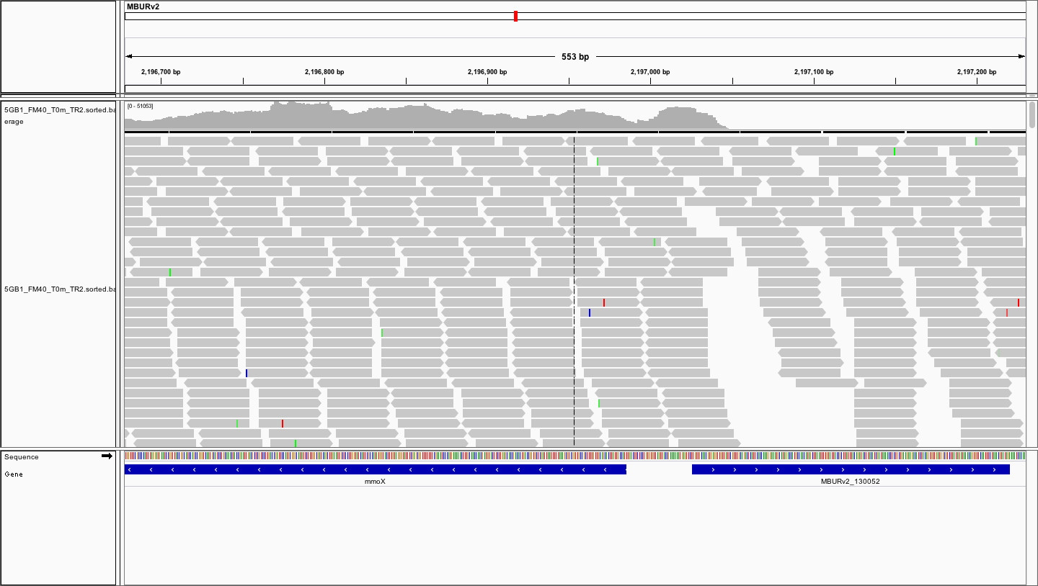
sMMO A (mmoX) start

Slide 3
sMMO A (mmoX) start
Note the read depth

Slide 4
sMMO A (mmoX) start

