Slide 1
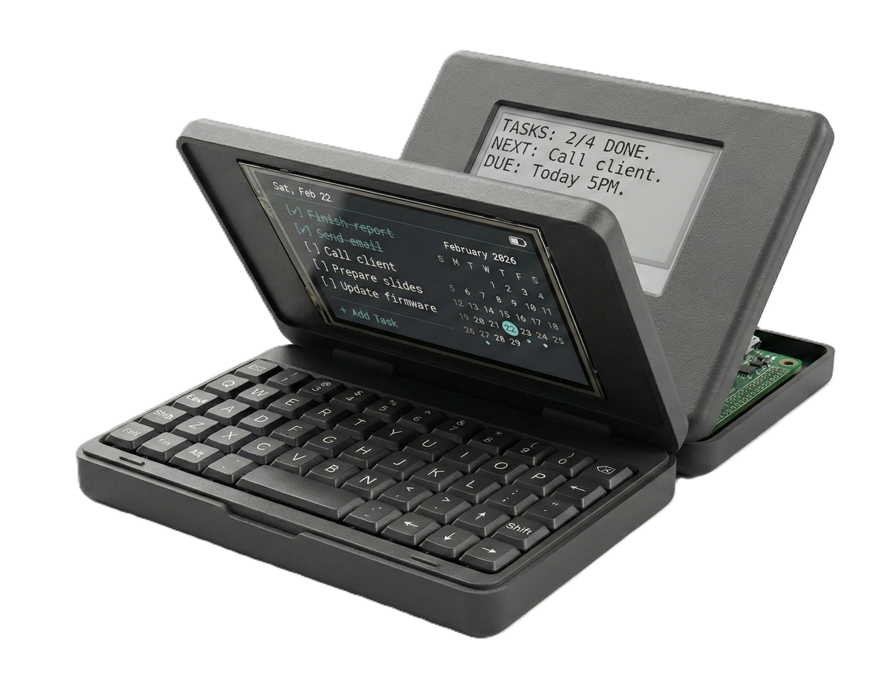
EDES 301 — Project #2 PCB Project
STIK-eNote
PCB Design — Dual-Display Pocketable Task Tracker
Beckett Lyons Mazeau
Rice University • Spring 2026
Render generated by Nano Banana Pro
Due May 5, 2026

Slide 2
Background Information
What Is STIK-eNote?
Key Features
STIK-eNote is a pocketable, clamshell-style task tracking device built around the ESP32-S3. When the device is closed, the user sees a persistent low-power ePaper display showing the current task list. Opening the device wakes the ESP32-S3 via a physical wake button, powering on a color TFT LCD and an M5Stack CardKB mini keyboard for full task editing and management.
Power is delivered by an 800mAh LiPo battery routed through a buck-boost converter to a stable +5V rail, which then feeds a linear regulator producing a clean +3.3V rail for all logic-level peripherals. The two SPI displays sit on dedicated SPI buses (FSPI and HSPI) so each can be addressed independently, while the keyboard communicates with the MCU over a shared I2C bus.
Dual Display
ePaper for always-on task view; TFT for active editing
Wake-on-Open
Physical wake button on hinge brings ESP32-S3 out of deep sleep
Compact Keyboard
M5Stack CardKB QWERTY keypad over I2C (addr 0x5F)
Open Source
Designed for sharing with the embedded community
The Story: A tool to manage daily tasks without the distractions of a phone or laptop — always in your pocket, always showing your priorities at a glance.

Slide 3
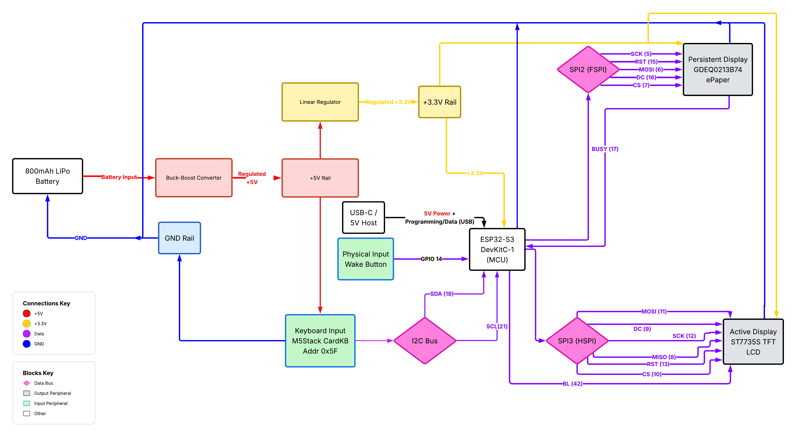
System Block Diagram — STIK-eNote V2

Slide 4
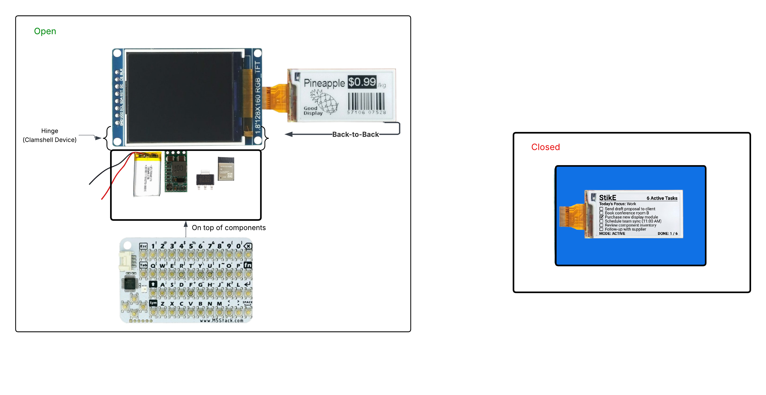
Mechanical Drawing — Clamshell Layout
OPEN (Active Mode): ePaper sits back-to-back with TFT, exposing the keyboard and the full edit view.
CLOSED (Persistent Mode): ePaper visible through window in case; ESP32-S3 deep-sleeps.
PCB outline target: 3.5” × 2.0” (within 4” × 5” budget). Components: ESP32-S3 DevKitC-1, ST7735S 1.8” TFT, GDEQ0213B74 ePaper, M5Stack CardKB, 800mAh LiPo, buck-boost converter, linear regulator, USB-C input, wake button.

Slide 5
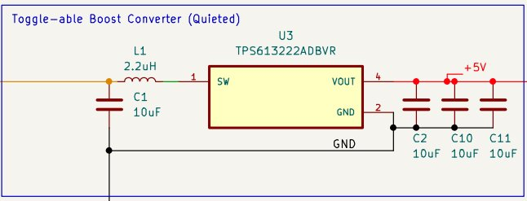
Subsystem Detail — 5V Boost Converter
How It Works
The TPS613222ADBVR is a synchronous boost converter that steps up the PocketBeagle's 3.3V rail to a clean 5V output for the mini keyboard.
A 2.2µH inductor (VLS252012ET-2R2M) stores energy during the switching cycle. The input is stabilized by a 10µF capacitor (C1), while three 10µF output capacitors (C2, C10, C11) smooth the 5V output and reduce ripple.
The converter is labeled "Quieted" because of the generous output capacitance, which minimizes voltage ripple on the 5V rail. — important for stable I2C communication with the keyboard.
Components
Ref. | Part Number | Value | Function
U3 | TPS613222ADBVR | — | Boost Converter IC
L1 | VLS252012ET-2R2M | 2.2µH | Energy storage inductor
C1 | CL10A106KP8NNNC | 10µF | Input decoupling capacitor
C2,C10,C11 | CL10A106KP8NNNC | 10µF | Output smoothing capacitors

Slide 6
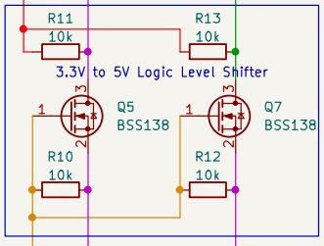
Subsystem — 3.3V to 5V Logic Level Shifter
How It Works
The PocketBeagle operates at 3.3V logic while the CardKB keyboard requires 5V I2C levels. This bidirectional level shifter uses two BSS138 N-channel MOSFETs — one per I2C line (SDA and SCL).
Each channel has a 10kΩ pull-up resistor on both the low-voltage (3.3V) and high-voltage (5V) sides. When the low side drives LOW, the MOSFET turns on and pulls the high side LOW. When the high side drives LOW, the body diode pulls the source low, turning on the MOSFET and pulling the low side LOW. When neither side drives, pull-ups hold both sides HIGH at their respective voltage levels.
This classic MOSFET-based design provides reliable, bidirectional voltage translation for I2C with minimal propagation delay.
Components
Ref. | Part Number | Value | Function
Q5, Q7 | BSS138 | — | N-CH MOSFET level shift transistors
R10, R12 | RC0603FR-0710KL | 10kΩ | Low-side (3.3V) I2C pull-ups
R11, R13 | RC0603FR-0710KL | 10kΩ | High-side (5V) I2C pull-ups

Slide 7
Bill of Materials — STIK-eNote V2
Ref(s)
Qty
Mfg P/N
Description
CAPACITORS
C1,C2,C10,C11
4
CL10A106KP8NNNC
CAP CER 10uF 10V X5R 0603
C3,C4,C6,C9,C12
5
CL10B105KA8NNNC
CAP CER 1uF 25V X7R 0603
C5 / C7
1 ea
GRM188R61E475KE11D / CC0603KRX7R9BB104
CAP CER 4.7uF 25V 0603 / CAP CER 0.1uF 50V 0603
RESISTORS
R1-R5,R9,R17
7
RC0603FR-071KL
RES 1K OHM 1% 1/10W 0603
R6, R8
2
RC0603FR-075K1L
RES 5.1K OHM 1% 1/10W 0603
R10-R13
4
RC0603FR-0710KL
RES 10K OHM 1% 1/10W 0603
R16
1
RC0603FR-07100KL
RES 100K OHM 1% 1/10W 0603
ICs, MODULES & PASSIVES (Inductors, Diodes, Transistors)
L1
1
VLS252012ET-2R2M
FIXED IND 2.2uH 1.3A 154mOHM (Boost)
D1 / D2 / D3
1 ea
BAT41ZFILM / LTST-C191KRKT / LTST-C191KGKT
Schottky 100V SOD-123 / LED Red 0603 / LED Green 0603
Q5, Q7
2
BSS138
MOSFET N-CH 50V 220mA SOT23 (I2C Level Shifter)
U1
1
TPB4056A20-ES1R
LINEAR BATTERY CHARGER 1-CELL 8-ESOP (LiPo Charger)
U2 / U3 / U5 / U6
1 ea
DRV5032FADBZR / TPS613222ADBVR / XC6206P332MR-G / ESP32-S3-WROOM-1-N16R8
Hall Effect Switch / Boost 5V SOT23-5 / LDO 3.3V SOT23 / ESP32-S3 Wi-Fi BT Module
External Modules (non-DigiKey): U_LCD — ST7735S 1.8” 128x160 SPI LCD (Amazon B0F1C8X7D8) | U_EPD — GDEY0213B74 ePaper + Adapter (AliExpress) | U_KB — M5Stack CardKB v1.1 I2C Keyboard (M5Stack SKU U035-B) | J1 — LiPo Connector (custom) | SW1, SW2 — Membrane Buttons (AliExpress)

