Slide 1
From Procedural to SOLID
PLC Design in TwinCAT 3
Notes:
[BEFORE] Up while attendees settle. Don't speak to it.
[CHECK — first action of the day] Confirm everyone has the repo cloned and a working XAE. Hands up. Anyone who can't build, surface NOW — there's a 5-minute Block 0 budget for env triage.
[CHECK] – ask for feedback on which Git client people use and what their general familiarity with repos/git/git clients is to help identify who in the class is going to have trouble switching branches
[SAY — 30-second frame, when you click forward] "You'll build the same filling line three different ways. Same requirements at every stage. The diffs tell the story."

Slide 2
The next 4 hours
Same machine — three architectures.
Same three change requests, every stage.
One running scoreboard — nine cells.
When does each architecture pay off?
Notes:
[SAY] Read the four lines slowly. The framing controls the whole day.
[KEY PHRASE] "The diffs tell the story." We are not lecturing about SOLID. We are running a controlled experiment — same inputs, three different blast radii. Define diffs = actual code changes (e.g. what lines were added, removed, and/or what files changed). Use the number of changes, types of changes, complexity of changes as metric to judge which solution strategy is most effective. So, also define pay off – efficiency, ease, fastest, least likely to introduce other bugs, etc
[DO] Coax discussion early so the precedent is set. If they sit silent, the workshop fails.
[NEXT] Branch tree comes after the schedule slide — don't dive in yet.

Slide 3
The schedule
Block 0 · Welcome · 5 min
Block 1 · Stage 1 — Procedural · 45 min
Break · 15 min
Block 2 · Stage 2 — Inheritance · 60 min
Break · 15 min
Block 3 · Stage 3 — Composition · 90 min
Block 4 · Scoreboard + take-home · 10 min
Notes:
[DO] Walk this in 60 seconds. Don't dwell.
[SAY] "We'll be done by hour 4. Breaks are real."
[STRETCH ZONES — flag verbally] - Block 1 — "Who copied from Fill?" reveal can run +10 min. - Block 2 — CR-2 'SUPER-can't-be-called' is the workshop's hardest 25 min. Plan to slow down. - Block 3 — CR-2 swap demo lands in 90 seconds; let the silence happen. - Block 4 — plan to overshoot; that's where FAEs cement what they'll teach.
[BUDGET] On paper 4:30 — plan to land in 4:00.
[BONUS] If asked about the testing demo: "Bonus content if we finish ahead. Don't count on it."

Slide 4
opening discussion
“
Who here has helped ship a 4-station-or-larger machine in the last year?
— Then this workshop is calibrated for you.
Notes:
[ASK] The question. Wait for hands. You should see most of the room.
[SAY — follow-up that lands the framing] "Then this workshop is calibrated for you. The pain we're going to surface is pain you've already felt — but you've probably never named it. Today we name it, score it, and rehearse what to say when a customer pushes back."
[REPEAT EXPECTATIONS] "We move at FAE pace. But I want lots of discussion. If something feels wrong or you've seen it work differently, say so." What is FAE?

Slide 5
Block 1
Stage 1 — Procedural
45 min
The architecture you've been writing for 20 years.
Notes:
[BEFORE] Switch presenter to `stage-1-procedural`. Open all four station FBs side by side: FB_StationFill, FB_StationCap, FB_StationLabel, FB_StationInspect.
[SAY — when you click forward] "This is the architecture you've been writing for 20 years. IEC 61131-3 was designed for it. There's nothing wrong with it. Today we feel where it stops scaling."
[STRUCTURE] 1A walkthrough → CR-1 → CR-2 → CR-3 → debrief. Stretch zone is the CR-1 'who copied from Fill?' reveal.

Slide 6
The procedural paradigm
Origin — IEC 61131-3 (1993).
Mental model — FB has its own independent version of code, runs once per cycle.
Good at simple machines — short lifespan, no changes to code, single developer
Bad at change requests — can require edits to every FB file, requires intense discipline across time and team
Notes:
[SAY — don't read aloud, summarize] "This is the architecture you've been writing for 20 years. Nothing wrong with it. We're going to feel where it stops scaling."
[CONTEXT — only if asked] - 1970s structured programming + 1980s industrial controls; codified by IEC 61131-3 in 1993. - Why it dominates TwinCAT: runtime, libraries, training, customer expectations all assume it. Path of least resistance. - "Good at" examples: panel shops, single-machine integrators, code that won't outlive the contract.
[SEGUE] Spend more time on "Bad at" — that's the bridge to the drift demo on the next slide.

Slide 7
Lab 1A: Procedural Code Inspection
Goal:
Get familiar with the procedural sample structure
Understand switching between branches
Identify similarities and differences in the function block stations
Instructions:
Open the release branch and go to the FillingLine_Procedural Project
Open the four Function Block stations in the POUs folder
Stack the open FBs side by side

Slide 8
Every station has the same five sections
Mode block — read ModeAuto / ModeManual / ModeStop.
Alarm-ack block — clear latched alarms.
Reset block — return state to 0.
HMI mapping — copy state to HMI tags.
State machine — the actual sequence (CASE).
Notes:
[DO] Pull up Fill and Cap side by side. Walk the five sections in order.
[SAY] "Sections 1, 2, 3, 5 are nearly identical between stations. Section 4 — the state machine — is the only meaningfully different part. Section 4 is what makes the station the station."
[FOUNDATION] This is the setup for the next three slides on drift. Don't editorialize on drift yet — the audience will see it themselves.

Slide 9
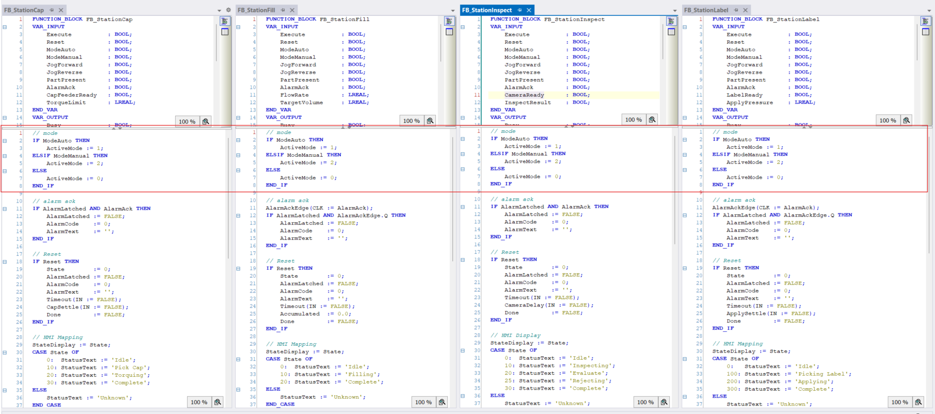
Every station has the same five sections
▸ Mode block — read ModeAuto / ModeManual / ModeStop.
Notes:
[DO] Pull up Fill and Cap side by side. Walk the five sections in order.
[SAY] "Sections 1, 2, 3, 5 are nearly identical between stations. Section 4 — the state machine — is the only meaningfully different part. Section 4 is what makes the station the station."
[FOUNDATION] This is the setup for the next three slides on drift. Don't editorialize on drift yet — the audience will see it themselves.

Slide 10
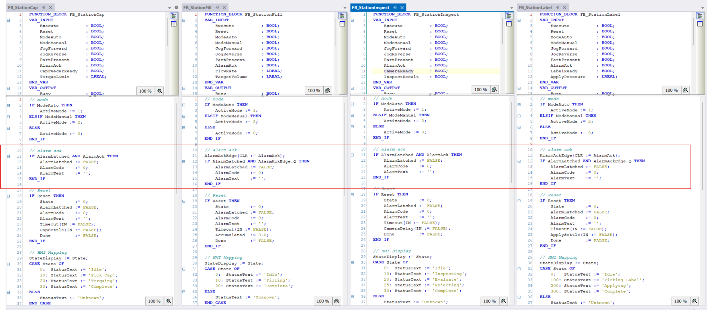
Every station has the same five sections
▸ Alarm-ack block — clear latched alarms.
Notes:
[DO] Pull up Fill and Cap side by side. Walk the five sections in order.
[SAY] "Sections 1, 2, 3, 5 are nearly identical between stations. Section 4 — the state machine — is the only meaningfully different part. Section 4 is what makes the station the station."
[FOUNDATION] This is the setup for the next three slides on drift. Don't editorialize on drift yet — the audience will see it themselves.

Slide 11
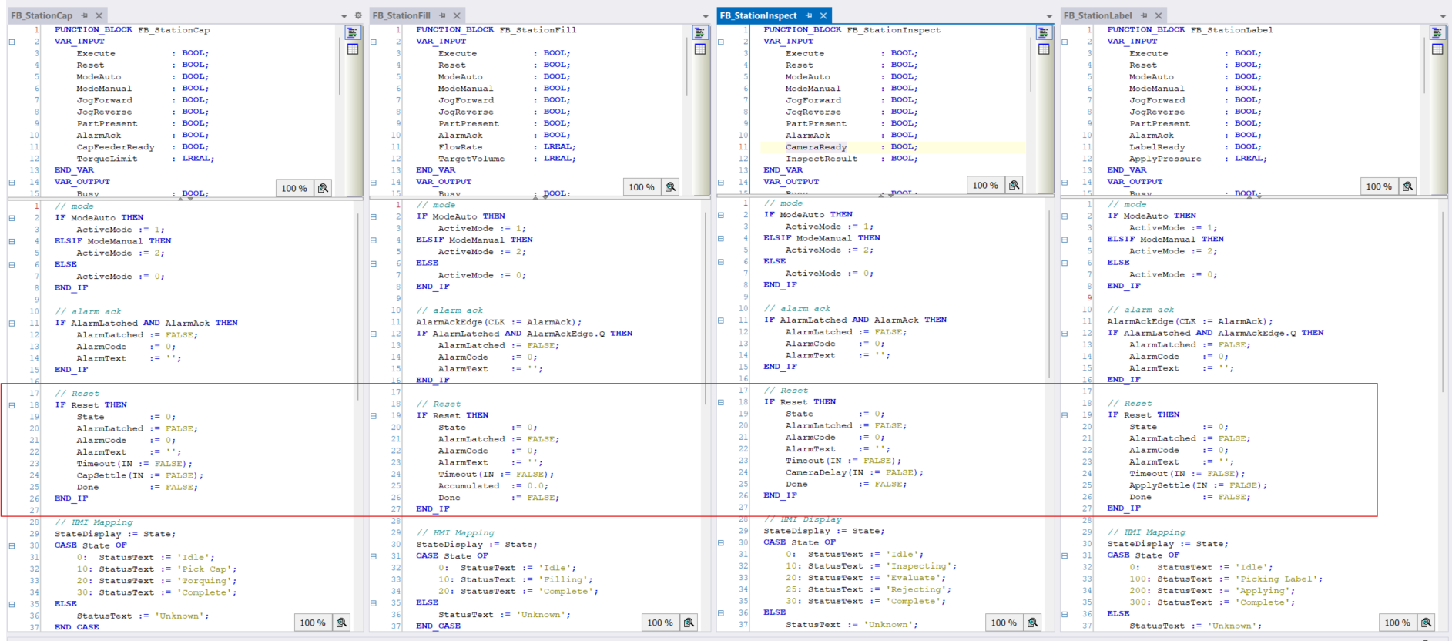
Every station has the same five sections
▸ Reset block — return state to 0.
Notes:
[DO] Pull up Fill and Cap side by side. Walk the five sections in order.
[SAY] "Sections 1, 2, 3, 5 are nearly identical between stations. Section 4 — the state machine — is the only meaningfully different part. Section 4 is what makes the station the station."
[FOUNDATION] This is the setup for the next three slides on drift. Don't editorialize on drift yet — the audience will see it themselves.

Slide 12
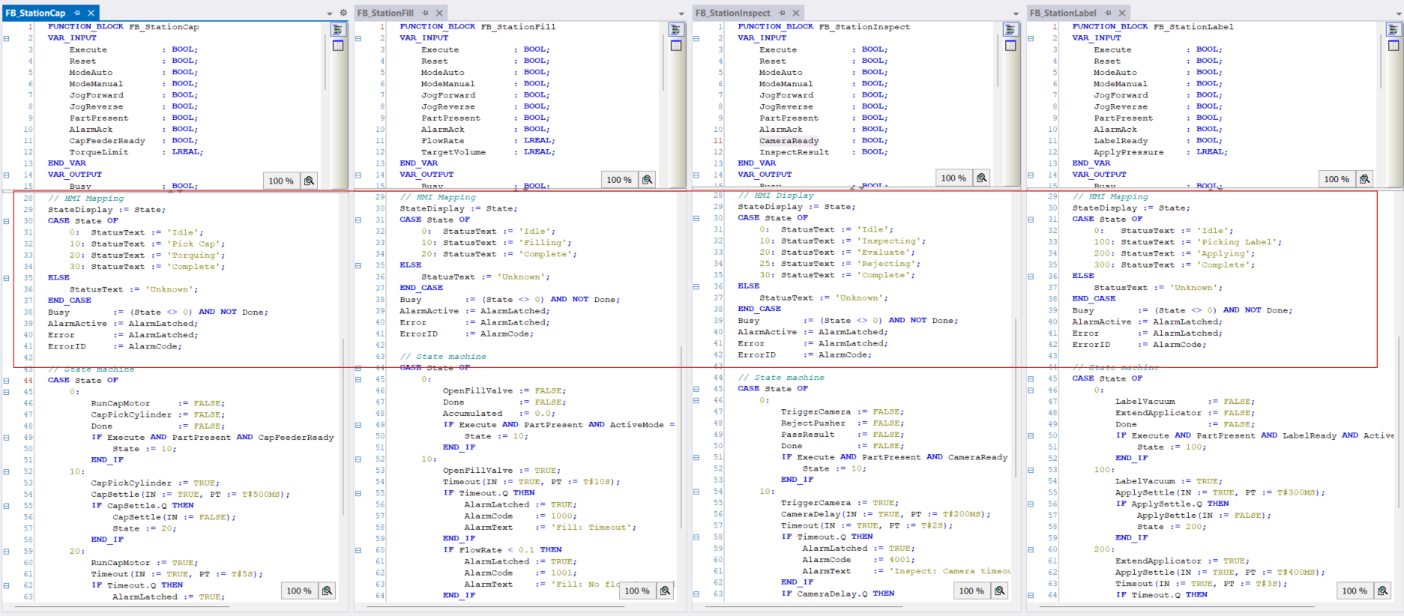
Every station has the same five sections
▸ HMI mapping — copy state to HMI tags.
Notes:
[DO] Pull up Fill and Cap side by side. Walk the five sections in order.
[SAY] "Sections 1, 2, 3, 5 are nearly identical between stations. Section 4 — the state machine — is the only meaningfully different part. Section 4 is what makes the station the station."
[FOUNDATION] This is the setup for the next three slides on drift. Don't editorialize on drift yet — the audience will see it themselves.

Slide 13
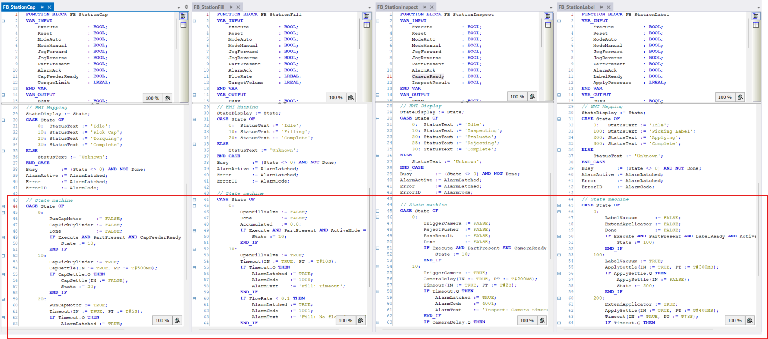
Every station has the same five sections
▸ State machine — the actual sequence (CASE).
Notes:
[DO] Pull up Fill and Cap side by side. Walk the five sections in order.
[SAY] "Sections 1, 2, 3, 5 are nearly identical between stations. Section 4 — the state machine — is the only meaningfully different part. Section 4 is what makes the station the station."
[FOUNDATION] This is the setup for the next three slides on drift. Don't editorialize on drift yet — the audience will see it themselves.

Slide 14
Every station has the same five sections
Every function block seems pretty similar, right?
Anybody see any problems?
Notes:
[SAY — only the names. The next three slides have the code.] "Three drifts, all between stations that should look the same. Pedagogical, not bugs — they're the setup for CR-1's reveal moment."
[DO] Do NOT editorialize on the drift yet. Just show the three names. The discussion happens after CR-1 when attendees discover they've inherited the drift by copy-paste.
[CONTEXT — DO NOT TIDY UP IN THE REPO] These drifts are deliberate. If you "clean them up" before the workshop, you destroy the CR-1 reveal.
[WATCH FOR] If anyone in the room laughs or groans during a drift reveal — that's the workshop working. Note who; ask them later if they have a specific story.

Slide 15
Three identifiable drifts
▸ Drift #1 — alarm-ack: edge vs level.
▸ Drift #2 — step numbering: 0/100/200/300 vs 0/10/20/30.
▸ Drift #3 — dead variable: ManualStep in Inspect, never used.
Notes:
[SAY — only the names. The next three slides have the code.] "Three drifts, all between stations that should look the same. Pedagogical, not bugs — they're the setup for CR-1's reveal moment."
[DO] Do NOT editorialize on the drift yet. Just show the three names. The discussion happens after CR-1 when attendees discover they've inherited the drift by copy-paste.
[CONTEXT — DO NOT TIDY UP IN THE REPO] These drifts are deliberate. If you "clean them up" before the workshop, you destroy the CR-1 reveal.
[WATCH FOR] If anyone in the room laughs or groans during a drift reveal — that's the workshop working. Note who; ask them later if they have a specific story.

Slide 16
Drift #1 — alarm-ack: edge vs level
STRUCTURED TEXT
// FB_StationFill — uses R_TRIG (edge-triggered)
fbAckTrig(CLK := AlarmAck);
IF fbAckTrig.Q AND AlarmActive THEN
AlarmActive := FALSE;
AlarmCode := 0;
END_IF
// FB_StationCap — uses level (held-high)
IF AlarmAck AND AlarmActive THEN
AlarmActive := FALSE;
AlarmCode := 0;
END_IF
// They look identical. They behave differently the moment AlarmAck is wired
// to a maintained switch instead of a pushbutton.
Notes:
[SAY] "Both implementations look reasonable in isolation. Side-by-side they're a maintenance trap."
[KEY POINT] Nobody wrote buggy code. Both stations work. The system itself failed to enforce consistency — there's no way for the procedural architecture to say 'all stations ack the same way.'
[SETUP FOR CR-1] This is the drift that catches people on CR-1. They copy the Pause guard from Fill (R_TRIG style) into Label (level style) and the inconsistency compounds.

Slide 17
Drift #2 — step numbering
STRUCTURED TEXT
// FB_StationFill, Cap, Inspect — clean 0/10/20/30
CASE State OF
0: // idle
10: // run
20: // complete
30: // fault
END_CASE
// FB_StationLabel — copy-pasted from a different machine years ago
CASE State OF
0: // idle
100: // run
200: // complete
300: // fault
END_CASE
Notes:
[SAY] "Both work. Neither is wrong. They diverge for no reason."
[CONTEXT] Someone clearly copied Label from a different project where 100/200/300 was the convention, and never normalized it.
[LESSON] The architecture has no opinion on naming. Conventions are tribal — they live in your head, not the compiler.
[FORESHADOW] Stage 2's base class will normalize this for free. You'll see it in Block 2.

Slide 18
Drift #3 — dead variable
STRUCTURED TEXT
// FB_StationInspect — declared, never read, never written
VAR
State : INT;
AlarmActive : BOOL;
AlarmCode : INT;
ManualStep : INT; // <-- nothing in this FB references it
PartPresent : BOOL;
Result : BOOL;
END_VAR
// Probably copied from a different station's draft 18 months ago.
// Nobody removed it because nobody knew it was safe to remove.
Notes:
[DO] Don't dwell — show it and move on.
[LESSON] In procedural code, dead state lingers because removing it requires reading every reference everywhere. Nobody owns the cleanup.
[FORESHADOW] In Stage 2 the base class won't carry ManualStep, so it can't propagate. In Stage 3 the FB has explicit dependencies; an unused field is loud.

Slide 19
Block 1 · 1A discussion
“
Anyone here written something that looks like this in the last six months?
— Hold on to that feeling — we're about to make it worse.
Notes:
[ASK — three-step audience hands-up] 1. "Anyone written something that looks like this in the last six months?" → most hands. 2. "Anyone written EXACTLY five files like this?" → some hands stay up. 3. "Anyone copied station 5 from station 4 and then had to fix four things?" → more hands.
[CLOSE] "Good. Hold on to that feeling. We're about to make it worse with CR-1."
[DO] Don't rush past this slide — earn the audience commitment before starting the timer. The first reveal is coming.

Slide 20
Anticipated Feedback from Customer
CUSTOMER
This is fine. We've shipped 50 machines like this. Why are we changing it?
ANSWER
You're right — it's fine for one machine. We're going to look at what happens when the same change has to land in four files instead of one. If that's never happened to you, this workshop won't change your mind. If it has, you'll recognize the pain.
Notes:
[ABOUT THE PUSHBACK SLIDES] First of ~10 in the deck. Format is the same throughout: customer's actual objection on top, rehearsed FAE answer below. Run THIS one explicitly so the format is established. Later ones can be flashed quickly unless the room wants to dwell.
[WHY THIS ONE MATTERS] Most common objection FAEs get from senior controls engineers.
[CUSTOMER-CONVERSATION PATTERN] Note the structure: respect the customer ("you're right") before pivoting to the cost ("what happens when…"). Flag this as a template for any pushback rebuttal.

Slide 21
Lab 1B: CR-1 · Add a Pause mode
Goal:
Add a ModePause input ModeAuto and ModeManual
Every station holds when ModePause is TRUE.
Exception — Fill must ignore Pause mid-cycle.
Instructions:
Open branch release project FillingLine_Inheritance
Add ModePause to input of every function block
Spend 5-10 minutes on working through solution
Notes:
[SAY — read CR-1 verbatim] "Add a global Pause input. When ModePause is TRUE, every station should hold. Exception: the Fill station must ignore Pause mid-cycle — pausing a half-filled bottle ruins the product."
[THE TRAP] Most attendees miss the Fill exception on first read and write a uniform Pause guard.
[DO] 1. Switch presenter to `stage-1-broken`. Show the compile error in MAIN. 2. "30 seconds to read the broken state, then 15 minutes to fix it." 3. Set the timer. Walk the room. DON'T HELP. Wait until people are ~10 minutes in before you interrupt for the reveal slide.

Slide 22
CR-1 result
git diff stage-1-procedural...stage-1-cr1-applied --stat
5 files · +54 −13
▸ Same 25 lines of guard logic, paid four times
(aka cross-cutting)
▸ Fill's exception — easy to miss, easy to copy wrong.
▸ Tomorrow's CR pays this cost too. And the next.
Easy to underestimate what a risk a “simple”
change can be
Notes:
[BEFORE] After attendees finish (or you call time): `git switch stage-1-cr1-applied` and `git diff stage-1-procedural --stat` on screen.
[DO] Write the 5 / +50 / −13 number on the physical scoreboard whiteboard.
[SAY] "This is what your codebase looks like after one CR."
[ASK] "Show of hands — who got Fill's mid-cycle exception right on the first try?" Most won't.
[FOLLOW-UP] "That's not a comment on you; it's a comment on the design. The exception is buried in the same Pause-guard logic every other station uses. You couldn't write it once and apply it correctly four ways."

Slide 23
Block 1 · CR-1 the drift trap
“
Quick check — how many of you copied Pause logic into Label from Cap? From Fill? From Inspect? Now: check if FB_StationFill has a level-based AlarmAck or if it has trigger-based AlarmAck?
— That's the procedural maintenance trap. Drift you didn't even know was there.
Notes:
[WHEN] After ~10 minutes, when most attendees are mid-fix. INTERRUPT.
[ASK — two questions, in sequence] 1. "How many of you copied your Pause logic into Label from Cap? From Fill? From Inspect?" → mixed hands. 2. "Now: who has a level-based AlarmAck and who has an R_TRIG?" → the room goes quiet because some attendees realize they copied from a station with one ack style and pasted into one with the other.
3. In concentrating on Pause, you may have missed the alarm ack behavior differences.
[DELIVER THE LESSON] "That's the procedural maintenance trap. Drift you didn't know was there. The system itself failed to enforce consistency. You weren't writing buggy code — the architecture failed to help you."
[DO] Let the silence sit for 5 seconds before moving on. The realization IS the lesson; don't trample it.

Slide 24
Anticipated Feedback from Customer
CUSTOMER
My team's careful. We use code review. Drift won't happen.
FAE ANSWER
Code review against duplicated logic catches drift sometimes. Drift you don't catch is the kind that ships. The architecture either enforces consistency or it doesn't — and code review is your last line of defense, not your first.
Notes:
[FRAME] Acknowledge that process catches some drift — then sharpen the point: process catches drift you notice; architecture catches the drift you don’t.
[CALLBACK] Pair this with the line "Discipline is bounded; architecture is unbounded." You'll use it again in Block 2.
Bounded means limited. There is a limit to how effective team discipline is, the limit being human error.

Slide 25
Lab 1C: CR-2 · Flag Bad Parts without Stopping the Line
Goal:
Flag visual defects without stopping the line.
Camera and reject pre-arm must occur at the same time (parallel), not sequentially.
Learn diff
Instructions:
Time does not permit attempt to write the code (expect 60+ lines of code changes)
Compare work in the release branch vs work in CR2-applied branch
Notice: Changes are only in FB_StationInspect.
Notes:
[SAY — read CR-2 aloud, emphasize the phrase] "Two axes of variation at once. Alarm policy AND sequencer topology. Only one station, but the patterns have to coexist with the others."
[DO] Set 15-minute timer. Walk the room.
[WATCH FOR] The attempt: rewriting Inspect's CASE machine end-to-end with QualityFlag/QualityCode/QualityText outputs and CameraDone/RejectDone parallel coordination inside step 10.
[STRETCH WHEN DONE] "How many of you ended up with a 60+ line rewrite of one CASE machine?" (Most.) "Now: think about the next station that needs parallel branches. How much of what you just wrote can the next person reuse?" (Almost none — the parallel coordination is buried in Inspect's CASE.)

Slide 26
CR-2 result
git diff stage-1-procedural...stage-1-cr2-applied --stat
2 files · +48 −12
▸ Inspect's CASE machine rewritten end-to-end.
▸ Parallel coordination buried in CASE — nothing reusable.
▸ The next station that needs parallel pays this cost again.
Notes:
[SAY] "This isn't just duplication of the base — it's duplication of NEW patterns each time they appear. Stage 2 will help with this. Stage 3 will help even more."
[PUSHBACK if asked] "Why do I care that the parallel logic isn't reusable? I only have one Inspect station." → "Today, you do. Two years from now, you might have an Inspect AND a Test station that both need parallel branches. The procedural cost of CR-2 is a tax you pay every time a new station needs the same pattern."

Slide 27
Lab 1D: CR-3 · Selective cycle logging
Goal:
▸ Log cycle data for Fill and Inspect. Cap and Label don't need it.
▸ Independent work for future to really hammer home the repetitiveness of procedural coding
Notes:
[DO] Read it, set a 10-minute timer, let them go. Most attendees finish in 7-8 minutes.
[THE TRAP] It looks small. They'll write 13 lines and feel done. The cost — duplication that will be paid every time the logging requirement evolves — is invisible until it bites.

Slide 28
CR-3 result — small, but defend it as fine?
git diff stage-1-procedural...stage-1-cr3-applied --stat
2 files · +9 −1
▸ Identical buffer code in two places.
▸ Logger evolves in 6 months — two places to change. Forget one? Drift.
▸ Smallest line count. Loses on every other dimension.
Notes:
[ASK] "That looked small. Anyone want to defend it as 'fine'?" Some attendees will defend it. Let them — then sharpen.
[FOLLOW-UP] "Now imagine the logging requirements change in six months — say we want to write to a file instead of an in-memory buffer. Where do you change the code?" (Two places.) "And if you forget one of them?" (Drift.)
[PUSHBACK if asked] "It's literally 13 lines. Stop making it a big deal." → "It's 13 lines today. The cost isn't the lines; it's the duplication. Every future change to that logic happens twice. Stage 3 — same lines, but only one place to change."

Slide 29
Block 1 debrief — Pros and Cons
Pros | Cons
Simple and familiar Every controls engineer knows this structure | Same change made in every station file No mechanism to enforce consistency
Easy to read Entire station behavior is visible in one file | Copy-paste is the only tool for sharing logic Drift is inevitable
No framework knowledge required | Discipline is the only defense against inconsistency And discipline is bounded
Fast to write for first implementation | Cross-cutting changes ripple across every station file
Easy to debug No inheritance chain to trace | One requirement, five files to touch – and counting
Notes:
[BEFORE] Switch presenter to `stage-1-complete`. Show `git diff stage-1-procedural --stat` live.
[SAY] "That's what your codebase looks like after a year of cross-cutting CRs. Five files modified, growth concentrated in Inspect, duplication on every cross-cutting concern."
[ASK — the bridge to Block 2] "Stage 1 isn't broken. It works. So why are we moving on?"
[ANTICIPATED ANSWERS — capture on whiteboard] - "Drift between files." - "Can't enforce consistency." - "Duplication compounds."
[CLOSE] "Right. Now we'll see what happens when we try to fix all of that with a base class. Spoiler: we'll fix some of it. We'll create new problems too."
[PACING] If behind, cut CR-3 hands-on (smallest CR, easiest to walk declaratively). If ahead, extend the CR-1 reveal into a longer drift discussion.

Slide 30
Block 1 → Block 2 break
BREAK
15 min
Coffee, bathroom, social conversation.
Notes:
[DO NOT SHORTEN] Don't compress to 5 minutes — you'll pay for it in Block 2's CR-2 attention crash.
[USE THE BREAK] Pull `stage-2-inheritance` on the presenter machine. Open FB_StationBase and FB_StationFill in side-by-side tabs.

Slide 31
Block 2
Stage 2 — Inheritance
60 min
The duplication evaporates.
Then the base class becomes the constraint.
Notes:
[BEFORE] Ask the audience for information on their skill level of OOP because that will dictate how much to dwell on some pages
[BEFORE] Presenter on `stage-2-inheritance`. FB_StationBase and FB_StationFill side by side.
[FRAMING] Block 2 is the trickiest to facilitate. Inheritance has real wins; don't dismiss them. But the audience has to FEEL where it stops working, not just be told. Pace the CR-2 reveal carefully — that's the workshop's hardest moment (25 min).

Slide 32
The inheritance paradigm
▸ Origin — Simula 67, Smalltalk 1972; mainstream via C++ / Java.
▸ Mental model — base encodes shared; children override to specialize.
▸ IEC 61131-3 — inheritance included in 3rd edition (2013)
▸ Promise — write the common path once.
▸ Catch — the common path becomes a constraint.
Notes:
[DON'T LECTURE] Read the bullets, gesture at the FB_StationBase tab, move on.
[SEED] "The common path becomes a constraint when ANY child needs to opt out." Plant it now — water it on the CR-2 slides.
[CONTEXT — only if asked] FB_init is TwinCAT's constructor: runs once at instantiation, takes parameters that never change. Use it for names, sizes, references the FB will hold for its lifetime.
[FRAMEWORK] Stage 2 builds on Beckhoff USA's SPT-Libraries (FB_ComponentBase). Production-grade, not academic.
PS There is a fourth edition of IEC 61131-3 (2025)

Slide 33
Lab 2A: Inheritance Code Inspection
Goal:
Get familiar with the inheritance sample structure
Understand OOP keywords: EXTENDS, THIS^, SUPER^
Understand overriding base class methods
See a glimpse of SPT Component Base
Instructions:
Open the release branch of the solution
Go to the FillingLine_Inheritance Project
Install project libraries if necessary
Open FB_StationBase and identify where the common procedural code blocks have been placed
Compare size of FB_StationFill in procedural vs inheritance projects

Slide 34
Procedural Code Blocks -> Base Class Methods
Mode block — ???
Alarm-ack block — ???
Reset block — ???
HMI mapping — ???
State machine — ???

Slide 35
Procedural Code Blocks -> Base Class Methods
▸ Mode block — Monitoring()
▸ Alarm-ack block — Monitoring()
▸ Reset block — Reset()
▸ HMI mapping — UpdateHmiStatus()
▸ State machine — ???

Slide 36
Overriding Base FB Methods
▸ Mode block — Monitoring()
▸ Alarm-ack block — Monitoring()
▸ Reset block — Reset()
▸ HMI mapping — UpdateHmiStatus()
▸ State machine — ExecuteSequence() of derived FB overrides base

Slide 37
Inheritance mechanics — four things to recognize
// 1. EXTENDS — child declares parent
FUNCTION_BLOCK FB_StationFill EXTENDS FB_StationBase
// 2. SUPER^ — explicit base call
METHOD PROTECTED CyclicLogic
SUPER^.CyclicLogic(); // run the base's mode/ack/reset
THIS^.ExecuteSequence(); // then run my sequence
// 3. Method override — child's version replaces base's
METHOD PROTECTED ExecuteSequence
CASE State OF
0: IF Mode.AllowRun THEN State := 10; END_IF
10: // ... fill logic
20: State := 0;
END_CASE
// 4. FB_init — construction-time parameters
METHOD FB_init : BOOL
VAR_INPUT
bInitRetains : BOOL;
bInCopyCode : BOOL;
Name : STRING(20);
END_VAR
SUPER^.FB_init(bInitRetains, bInCopyCode);
THIS^.Name := Name;
Notes:
[DO] Walk all four constructs by name (EXTENDS, SUPER^, override, FB_init).
[FAE-SPECIFIC] For FAEs this is review at the conceptual level. The reason you're naming them: they'll have to TEACH this to controls engineers who haven't used inheritance, and the vocabulary matters.
[SAY] "If you're going to teach Stage 2 to your customers, this slide is what you'll spend 5 minutes on. The audience needs to recognize all four constructs by sight before CR-1."

Slide 38
Same behavior, different architecture
▸ FB_StationFill — 107 lines → 67. 42% smaller
▸ Drift #1 fixed — base normalizes alarm-ack to R_TRIG.
▸ Drift #2 fixed — Label normalized to 0/10/20/30.
▸ Drift #3 fixed — dead ManualStep doesn't propagate.
Notes:
[DO] Open FB_StationFill, walk the shrinkage. Then open FB_StationBase and show where each section moved.
[EARN THE WIN] The drift fixes are the headline win for Stage 2. Walk through them slowly — earn the win before you puncture it.
[ASK] "What did this refactor cost?" Take answers. First answers will be: nothing visible, lower line count, etc.
[PUSH TO THE RIGHT ANSWER] "It cost an extra concept. Now you have to understand 'base class' and 'override' and 'THIS vs SUPER' to read this code. That's the real cost. Be honest about it."

Slide 39
Monitoring() Execution
Where is Monitoring() called?

Slide 40
Anticipated Customer Feedback
CUSTOMER
My engineers don't know inheritance. Now they can't read my code.
FAE ANSWER
That's a valid concern. Inheritance has a learning cost. The win is consistency enforcement — once your team learns it, drift goes away. The trade-off is real; you pick whichever fits your team's experience curve.
Notes:
[DON'T DISMISS] The customer is correct that inheritance has a learning cost. The honest framing is the trade-off, not the dismissal.
[VARIANT — common follow-up] "We don't have time to train the team." → "Then Stage 1 is your right answer for now. The workshop's value isn't 'always pick Stage 3.' It's 'know which stage fits your situation.'"

Slide 41
Lab 2B: CR-1 · Add a Pause mode using Inheritance
Goal:
Add a ModePause input mimicking ModeAuto and ModeManual
Every station holds when ModePause is TRUE.
Exception — Fill must ignore Pause mid-cycle.
Use inheritance
Instructions:
Start from release branch in FillingLine_Inheritance Project
Option A: add AllowPause() on the base; add AllowPause() to Fill to override base method
Option B: add Monitoring() to Fill Station to override base method; use SUPER^.Monitoring() to include base code
Spend 5-10 minutes writing code
Notes:
[DO] Read the requirement. Set 10-minute timer. Walk the room. Most attendees start with Option A — feels more "inheritance-y."
[ASK MID-EXERCISE] When attendees are stuck, walk and ask: "How are you handling the exception?" Both options will surface.
[SAY OUT LOUD WHEN BOTH SURFACE] "Option A — AllowPause exists for ONE child's exception, but Cap, Label, Inspect inherit it forever. Pollution. Option B — duplicates base mode logic in Fill. Drift risk. Pick your poison."
[REVEAL #2] This is the workshop's second reveal: inheritance trades one cost for another. Stage 1 had per-station pollution; Stage 2 puts the pollution on the base.

Slide 42
CR-1 result — base-class pollution
git diff stage-2-inheritance...stage-2-cr1-applied --stat
3 files · +? −?
▸ Inheritance vs Procedural
Majority of code changes reside in base class
Cap, Inspect, Label unchanged!
▸ Option A: Pollution lives on the base
AllowPause() is included in every derived FB just to accommodate one exception for Fill.
▸ Option B: Base code logic duplicated
overriding Monitoring() requires keeping track of duplicate code in multiple locations
▸ Inheritance didn't eliminate the cost. It relocated it.
Notes:
[SHOW] Live diff vs Stage 1 (5 files / +50 / −13) → Stage 2 (3 files / +65 / −48).
[ASK — discussion] "Which is worse — scattered pollution paid by 4 stations, or centralized pollution paid by every reader of the base?"
[POINT] There's no right answer. That's the point. Inheritance didn't eliminate the cost; it relocated it.
[BRIDGE] This sets up CR-2, where the relocation becomes a trap.

Slide 43
Block 2 · 2C
CR-2 — breaking the inheritance chain
25 min ·
Same as Stage 1, applied via inheritance.
Watch the override fight the base.
Notes:
[PLAN TO SLOW DOWN] This block is the workshop's hardest moment.
[DO] 1. Read CR-2 again — same requirement as Stage 1. 2. Set 15-minute timer. "I'll be available — this one's harder." 3. Walk the room.
[WATCH FOR] Most attendees start by overriding Monitoring and adding their quality-flag logic AFTER calling SUPER^.Monitoring(). This produces broken behavior — the base latches the alarm before their override can flag it as quality.
[NEXT SLIDE] The leading-questions slide is for when they're stuck. Use it to walk them to the realization.

Slide 44
Lab 2C: CR-2 · Flag Bad Parts without Stopping the Line
Goal:
Flag visual defects without stopping the line.
Camera and reject pre-arm must occur at the same time (parallel), not sequentially.
Use Inheritance
Instructions:
Compare work in the release branch vs work in CR2-applied
Notice: Changes is only in FB_StationInspect methods
ExecuteSequence()
Monitoring() overrides the base class – SUPER^.Monitoring() is not called, instead programmer copied contents of base method.

Slide 45
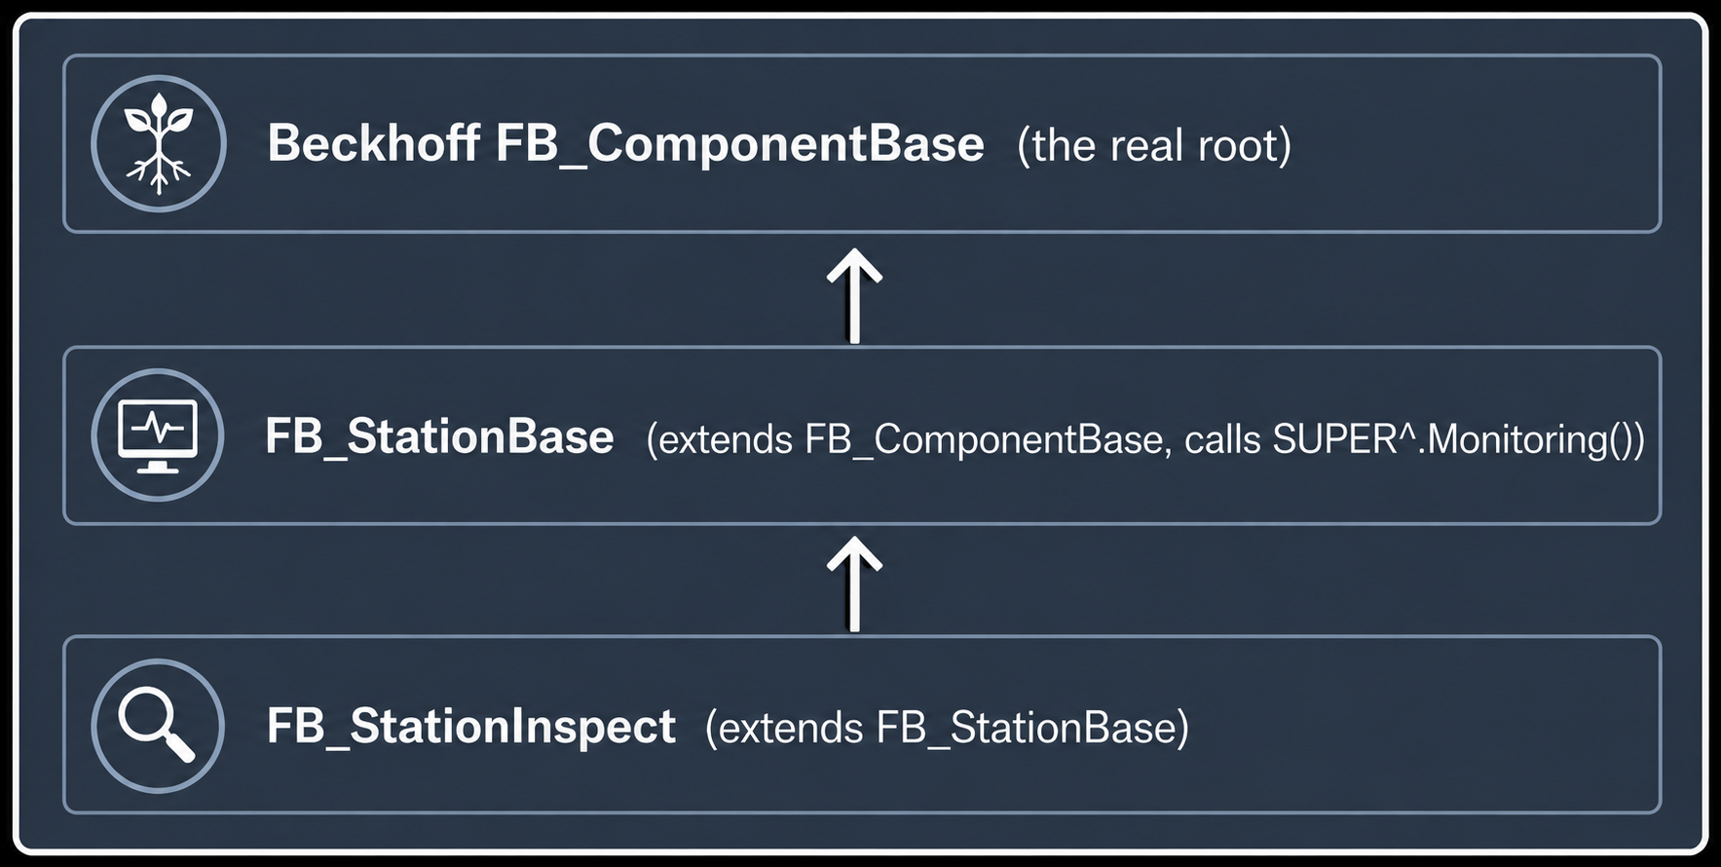
Peril of Breaking the Inheritance Chain
Skipping SUPER^ severs the inheritance chain silently – no compiler warning
Base and root class improvements no longer flow to the derived class
Duplicated logic must be maintained in two places indefinitely
A single missed update creates subtle, hard-to-find bugs
Inheritance only saves work if the chain stays intact
Notes:
[DO] Walk the room while attendees are stuck. Use these four leading questions IN ORDER. Let them arrive at the realization themselves.
[ANTICIPATED ANSWERS] 1. "Every time RaiseStationAlarm is called." 2. "Don't latch." 3. "You can't call SUPER." 4. "You have to duplicate them in your override."
[GATHER ATTENTION AND DELIVER] "There's no way to say 'inherit everything except the alarm policy.' Inheritance is all-or-nothing. Whatever the base does, every child gets — unless the child reimplements that behavior in an override."
[DO] Show stage-2-broken: "This is what mid-fix looks like in real life — a partially overridden Monitoring with TODO comments." Leave the TODOs visible; they're the visual evidence of the design fight.

Slide 46
CR-2 result — the override fight
git diff stage-2-inheritance...stage-2-cr2-applied --stat
2 files · +121 −48
▸ Inspect overrides Monitoring without calling SUPER.
▸ ~80 lines reimplement mode + ack from scratch.
▸ Every future base change is now "did we update Inspect?"
Notes:
[DO] Show the diff. Highlight the ~80-line override on the projector if you have time.
[SAY] "The visible cost is the line count. The invisible cost is the future-change burden every time the base evolves."
[COMPARE] Stage 1 CR-2 was 92 lines of inline rewrite. Stage 2 CR-2 is 121 lines of override fight. The architecture made it WORSE on lines, not better.
[NEXT SLIDE] The most important pushback in the workshop. Don't skip it.

Slide 47
Block 2 · CR-2 the breaking-point reveal
“
The base class that helped you in Stage 1 → Stage 2 has now become the constraint. Inspect can't extend the base. It has to fight the base.
— This isn't your fault. It's a property of the design. Single inheritance is all-or-nothing.
Notes:
[REVEAL #3] Workshop's third reveal. Climax of Block 2.
[DO] Read the quote slowly. Wait. Let it land. The room should be uncomfortable — that's the lesson working.
[DO NOT FILL THE SILENCE] Senior controls engineers in the room are recognizing this pattern from their own codebases right now.
[CALLBACK SETUP] Mark this in your head: in Block 3 we'll call back to this exact moment when the CR-2 swap is one line.

Slide 48
Pre-emptive pushback
CUSTOMER
This is fine — I just need to remember to mirror base changes into Inspect's override.
FAE ANSWER
That's a code-review burden you'll carry forever. Every base change is now a question of 'did we update Inspect?' Sometimes you'll forget. The architecture isn't enforcing the consistency anymore — your team's discipline is. Discipline is bounded; architecture is unbounded.
Notes:
[MOST IMPORTANT PUSHBACK] If only one customer-conversation Q&A sticks, this is the one you want.
[KEY LINE] "Discipline is bounded; architecture is unbounded." The workshop's central thesis in seven words. Mark it. Repeat it in Block 3 and Block 4. Make it the line attendees go home quoting.
[VARIANT — if asked] "Use multiple inheritance, then." → "TwinCAT doesn't support multiple inheritance, and most languages that do (C++, Python) have ugly issues with it (the diamond problem). The composition pattern in Stage 3 solves the same need without those issues. We'll get there."

Slide 49
Lab 2D: CR-3 · Selective cycle logging
Goal:
Log cycle data for Fill and Inspect. Cap and Label don't need it.
Instructions:
Open CR3-applied branch and go to FillingLine_Inheritance
Find buffer in FB_StationBase
Find added methods in FB_StationBase
Find overriding methods in derived FBs

Slide 50
CR-3 result — dead weight in unrelated children
git diff stage-2-inheritance...stage-2-cr3-applied --stat
3 files · +64 −25
▸ LogBuffer + LoggingEnabled added to the base.
▸ Cap and Label inherit storage they never use.
▸ Cognitive cost compounds even when memory cost doesn't.
Notes:
[DO] Read the requirement. 5-minute timer. The attempt: LogBuffer + LoggingEnabled virtual on the base; Fill and Inspect override to TRUE.
[ASK] "Where does Cap's LogBuffer storage live in memory?" → in every Cap and Label instance, even though they never write to it. "Is that a problem?" → in 4 stations, no. In a 50-station factory, yes.
[PUSHBACK if asked] "100 strings × 120 chars × 2 unused stations = 24KB. Why are we obsessing about this?" → "You're right — for this scale, the memory cost is academic. The bigger problem is COGNITIVE. Every reader of FB_StationBase has to understand why LogBuffer exists when half the children don't use it. As your codebase grows, that noise compounds."
[PACING] If behind, cut this hands-on entirely (just show the diff). The CR-2 breakdown is the lesson; CR-3 is supplementary.

Slide 51
Block 2 debrief — Pros and Cons
BLOCK 2 · 2E DEBRIEF (5 MIN)
Pros | Cons
Common code written once, inherited by all | Base accumulates features all children inherit whether they need them or not
Architecture enforces consistency – no discipline required | No way to modify a part of an inherited method – it’s all or nothing
Cross-cutting changes touch one file instead of four | Skipping SUPER^ severs the entire framework chain (consequence of above)
Stage 1 drift eliminated | The base that helped in CR-1 becomes the constraint in CR-2
Notes:
[DO] Switch presenter to stage-2-complete. Show the diff stat live. Walk the FB_StationBase tab — point to each new accumulation: ModePause field, AllowPause virtual, LogBuffer, LoggingEnabled virtual, LogCycleData helper.
[SAY] "It started clean. Now it's a junk drawer. Every CR added another carve-out the base wasn't designed for."
[ASK] "Stage 2 fixed real Stage 1 problems. What new problems did it create?"
[ANTICIPATED ANSWERS — capture on whiteboard] - "Base-class pollution." - "SUPER-can't-be-called fragility." - "Dead weight in unrelated children."
[BRIDGE] "Stage 3 will keep what's good — clean abstractions, consistency enforcement — and fix what's wrong. Let's go."

Slide 52
Block 2 → Block 3 break
BREAK
15 min
The longer of the two breaks if you can swing it. Block 3's payoff lands harder if the room comes back fresh.
Notes:
[USE THE BREAK] Pull `stage-3-composition` on the presenter machine. Open the file tree, then I_AlarmHandler.TcPOU and FB_AlarmHandler_LineFault.TcPOU side by side.
[SECOND LAPTOP] If you have one: open MAIN.TcPOU on it. The MAIN swap demo in Block 3 is the workshop's emotional climax — preparing it now saves a switching delay later.

Slide 53
Block 3
Stage 3 — Composition
90 min
Build the line from interface-typed building blocks.
Notes:
[BEFORE] Presenter on `stage-3-composition`. File tree visible — 18 files in three directories.
[FRAMING] This block is the EMOTIONAL PAYOFF of the workshop. Pace it so the room has time to FEEL the win, not just observe it. Don't rush past CR-2.
CR-2 — the killer requirement — becomes a one-line swap.

Slide 54
The composition paradigm
BLOCK 3 · 3A ARCHITECTURE WALKTHROUGH
Origin — Gang of Four 1994; SOLID 2000s.
Mental model — small focused FBs talk through interfaces (stations see the interface, never the FB that implements it)
IEC 61131-3 — INTERFACE, IMPLEMENTS, FB references typed by interface, FB_init for dependency injection (DI)
Promise — variation by injection
Catch — more files, more concepts, more vocabulary
Notes:
[DON'T LECTURE] Read the bullets, gesture at the file tree, move on.
[SEED] "Variation by injection." That's the seed of CR-2's swap demo. Plant it now — they'll see it in 30 minutes.
[FRAMEWORK] Beckhoff USA's Core / CoreComponents / MechatronicsCore libraries. I_Cyclic, I_Diagnostic component pattern. Production code.
[IF ASKED] "Is this just dependency injection?" → "Yes. DI is one of the patterns. We'll name them all in Block 4."

Slide 55
Lab 3A: Composition Code Inspection
Goal:
Get familiar with the composition sample structure
Understand OOP terms INTERFACE, IMPLEMENTS, constructor
Understand dependency injection (DI) with FB_Init
Instructions:
Open the release branch and go to the FillingLine_Composition Project
Open the POU folder and find the Interfaces, Building Blocks, and Stations
Note:
No base class!

Slide 56
Architecture – Interfaces, Building Blocks, Stations
Interface
A contract between a building block and everything that uses it
(x5) I_AlarmHandler, I_DataLogger, I_HmiReportable, I_Sequenceable, I_StationCore
Building block
Small, focused FB that serves only one purpose
(x4) alarm handlers, loggers, mode manager, sequencers
Station
Coordinates the building blocks
(x4) Fill, Cap, Label, Inspect
MAIN – wires the dependency graph
Notes:
[DO] Open the file tree. Walk top to bottom.
[PRE-EMPT] "This is more files than Stage 1 had." Acknowledge it explicitly.
[SAY] "Hold that judgment for one slide. The architecture's payback comes in the next 40 minutes. Don't defend it now; let CR-2 defend it."

Slide 57
Interfaces – the contract
TWINCAT INTERFACE
// I_AlarmHandler.TcPOU — a contract. No implementation.
INTERFACE I_AlarmHandler
PROPERTY IsActive : BOOL // is an alarm currently latched?
PROPERTY StopsLine : BOOL // should this alarm stop the line?
// (TRUE for line faults, FALSE for quality flags)
METHOD Raise
VAR_INPUT
Code : INT;
Text : STRING(80);
END_VAR
METHOD Acknowledge
END_METHOD
// Anyone who implements this satisfies the contract.
// Stations depend on I_AlarmHandler — they never know which implementation
// they have. That's the seam where CR-2's swap will happen.
Why use the term contract?
Notes:
[DO] Open I_AlarmHandler.TcPOU on the projector. Walk the four members.
[KEY LINE] "Stations depend on I_AlarmHandler — they never know which implementation they have. That's the seam where CR-2's swap will happen."
[FORESHADOW] Don't explain the swap yet. Just plant the seam. Reveal in 25 minutes.
Here’s some background for

Slide 58
Interfaces – contract explanation
Why use the term contract?
 | Points To | Compiler Enforced
POINTER TO BOOL | A memory address that may or may not contain a Boolean value | No
REFERENCE TO FB_myFunctionBlock | A specific FB type (FB_myFunctionBlock) | Yes – but locked to that type
I_myInterface | Anything (e.g. FB, ITF) that honors the contract (e.g. contains methods, properties, etc) | Yes – and flexible

Slide 59
Building Blocks - Two implementations of I_AlarmHandler
FB_ALARMHANDLER_LINEFAULT
FB_ALARMHANDLER_QUALITYFLAG
▸ StopsLine — TRUE.
▸ Raise() — latches, blocks downstream.
▸ Use for — real faults that should stop the line.
▸ Tells the station — "halt."
▸ StopsLine — FALSE.
▸ Raise() — sets Code/Text, does NOT latch.
▸ Use for — quality defects that feed sortation.
▸ Tells the station — "note this part; keep running."
Same Contract, Different Behavior
Notes:
[DO] Open both files side by side on the projector. Walk the symmetry.
[KEY LINE] "Same contract, opposite behavior. The station code can't tell them apart. The behavior change happens in MAIN, not in the station."
[FORESHADOW] "In 25 minutes, CR-2 is going to ask 'change Inspect's alarm policy.' We'll do it by changing one line in MAIN."

Slide 60
Stations — composition of smaller pieces
FUNCTION_BLOCK FB_StationFill IMPLEMENTS I_HmiReportable, I_Sequenceable
VAR
Mode : REFERENCE TO FB_ModeManager;
Alarm : I_AlarmHandler; // <-- depends on the INTERFACE
Logger : I_DataLogger; // <-- same
Seq : FB_StepSequencer;
END_VAR
METHOD FB_init : BOOL
VAR_INPUT
bInitRetains : BOOL;
bInCopyCode : BOOL;
ModeRef : REFERENCE TO FB_ModeManager;
AlarmHandler : I_AlarmHandler; // <-- injected at construction
DataLogger : I_DataLogger; // <-- injected at construction
END_VAR
THIS^.Mode REF= ModeRef;
THIS^.Alarm := AlarmHandler;
THIS^.Logger := DataLogger;
// The station never constructs its dependencies. It receives them.
// That's dependency injection — the seam that makes CR-2 trivial.
Variables typed by interface
Dependencies injected at construction via FB_Init
MAIN decides what the station gets
Notes:
[DO] Open FB_StationFill on the projector. Walk the VAR block first — point at I_AlarmHandler / I_DataLogger fields. Then walk FB_init — point at AlarmHandler / DataLogger parameters.
[KEY LINE] "The station never constructs its dependencies. It receives them. That's dependency injection — the seam that makes CR-2 trivial."
[IF ASKED] "What's REFERENCE TO?" → "TwinCAT's pointer-with-syntax-sugar. Use REF= to bind, then dereference with .field syntax. We use it for FB_ModeManager because there's exactly one shared instance."

Slide 61
Stations – Inheritance vs Composition
Inheritance | Composition
Station is a base class | Station has building blocks
Behavior comes from the parent | Behavior comes from the pieces
EXTENDS | FB_Init parameters
One rigid hierarchy | Freely assembled combinations
IS VS HAS

Slide 62
MAIN — the construction is the architecture
STRUCTURED TEXT
PROGRAM MAIN
VAR
Mode : FB_ModeManager;
LineFault : FB_AlarmHandler_LineFault;
QualityFlag : FB_AlarmHandler_QualityFlag; // <-- both available
CycleLogger : FB_CycleDataLogger;
Fill : FB_StationFill(
ModeRef := Mode,
AlarmHandler := LineFault, // <-- swap point
DataLogger := CycleLogger);
Cap : FB_StationCap(
ModeRef := Mode,
AlarmHandler := LineFault);
Label : FB_StationLabel(
ModeRef := Mode,
AlarmHandler := LineFault);
Inspect : FB_StationInspect(
ModeRef := Mode,
AlarmHandler := LineFault); // <-- this line
END_VAR
// Read MAIN top-to-bottom: it IS the wiring diagram for the line.
Notes:
[DO] Open MAIN on the projector. Walk the construction calls. Highlight `AlarmHandler := LineFault` on Inspect — call it the "swap point."
[KEY LINE] "Read MAIN top-to-bottom — it IS the wiring diagram for the line. In Stage 1, MAIN was 'instantiate stations.' In Stage 3, MAIN is 'wire the dependency graph.' The architecture is realized at construction."
[SETUP] This sets up CR-2 directly. The audience should be ready to predict what the swap looks like.

Slide 63
SOLID — concretely, in this codebase
▸ S — Single Responsibility — one job per FB.
▸ O — Open/Closed — add new alarm strategy, existing code untouched.
▸ L — Liskov Substitution — any I_AlarmHandler works anywhere.
▸ I — Interface Segregation — HMI sees I_HmiReportable only.
▸ D — Dependency Inversion — stations depend on I_AlarmHandler.
Notes:
[DO] Walk SOLID once, slowly, with the codebase as the example. This is the vocabulary attendees take to customer conversations.
[FAE-FRAMING] For an FAE audience, SOLID is review at the conceptual level. What's new is mapping each principle to a SPECIFIC TwinCAT file they just walked through.
[ASK — if you have time] "Which SOLID principle is doing the heavy lifting in this codebase?" Best answer is D (Dependency Inversion) — that's the seam that makes CR-2 trivial. L (Liskov) is the property that makes D safe.

Slide 64
Anticipated Customer Feedback
CUSTOMER
Eighteen files for a 4-station machine? You've got to be kidding.
FAE ANSWER
You're right — for 4 stations, this is overkill. The architecture pays back when the codebase grows. If you're shipping one machine and walking away, Stage 1 is the right answer. If you're building a product family, Stage 3 is the prerequisite for sane long-term maintenance.
Notes:
[ACKNOWLEDGE] Critical to acknowledge — for the workshop's 4-station example, the customer is RIGHT. Stage 3 IS overkill at this scale.
[FRAMING] Stage 3's payoff is at scale and over time. For a one-off machine, Stage 1 is correct. For a product family that ships 50 variants over 5 years, Stage 3 is the only sane answer.
[DON'T OVERSELL] The workshop's value is the trade-off vocabulary, not religion.

Slide 65
CR-1 — the composition way (Fill's exception comes free)
git diff stage-3-composition...stage-3-cr1-applied --stat
2 files · +19 −6
▸ Just modify FB_ModeManager. Stations are not touched.
▸ Fill's mid-cycle exception — automatic.
▸ The abstraction already encoded the right behavior.
Notes:
[DO] Read the requirement: same Pause requirement as Stage 1. 5-minute timer. The realization comes fast: just modify FB_ModeManager.
[ASK] "Why is the Fill mid-cycle exception automatic in this architecture?"
[ANTICIPATED ANSWER] Fill's state-10 logic gates on `Accumulated >= TargetVolume`, not on `AllowRun`. The right gating point was already in place. CR-1 didn't have to add new gating logic anywhere because the abstraction encoded the right behavior already.
[PUSHBACK if asked] "Sure, this works for Pause because Pause maps cleanly to a mode. What about a feature that doesn't?" → "Then you do the work to find the right abstraction. Composition isn't magic — it requires careful design. Stage 1 + 2 pay per-CR. Stage 3 pays up front and reaps savings."

Slide 66
Block 3 · 3C
CR-2 — the headline swap demo
20 min · the workshop's emotional payoff
Notes:
[PACE CAREFULLY] This is the workshop's emotional payoff.
[SAY] Read CR-2 again: "Inspect: non-faulting alarm AND parallel state-10. Same as Stage 1 (60 inline lines) and Stage 2 (the override mess). Apply it the composition way."
[DEMO FIRST] On the presenter machine, before they try. Next slide is the swap script.
One line in MAIN. Watch.
Then pause. Don't fill the silence.

Slide 67
The swap — one line in MAIN
// MAIN.TcPOU — find this line:
Inspect : FB_StationInspect(
ModeRef := Mode,
AlarmHandler := LineFault); // <-- this
// Change to:
Inspect : FB_StationInspect(
ModeRef := Mode,
AlarmHandler := QualityFlag); // <-- this
// Save. Build.
//
// Inspect's behavior just changed: alarms are now non-latching,
// the line keeps running on defect. NO INSPECT CODE WAS MODIFIED.
Notes:
[DEMO LIVE] The slide is the script — the demo is the lesson.
[SEQUENCE] 1. Open MAIN. Find the line. 2. Change LineFault to QualityFlag. 3. Save. Build. 4. PAUSE. Don't speak. Let the implication land. Count to 10 silently.
[AFTER THE SILENCE] - ASK: "Did Inspect's behavior just change?" (Yes — alarms are non-latching, line keeps running.) - ASK: "Did we modify any Inspect code?" (No.) - ASK: "How is this possible?" (Because the alarm strategy is INJECTED, not hardcoded. Inspect depends on I_AlarmHandler — anything implementing that interface plugs in.)
[THE SILENCE IS THE LESSON.] Don't fill it.

Slide 68
Block 3 · the workshop's central claim
“
Stage 1 CR-2: 92 lines of inline rewrite.
Stage 2 CR-2: 121 lines of override fight.
Stage 3 CR-2: ONE LINE.
— Same requirements, three architectures, different blast radius.
Notes:
[HEADLINE] Workshop's central claim. Read it slowly. Repeat it. This is the line attendees take home.
[SAY] "If only one slide of the workshop sticks, this is it. The 92 → 121 → 1 progression is the receipt for the entire 4 hours."
[PUSHBACK — the customer-facing version] "You're cherry-picking the example. CR-2 is designed to make composition look good." → "It's designed to be REALISTIC, not to make composition look good. Real customers ask for non-faulting alarms and parallel coordination on specific stations all the time. The point isn't that Stage 3 looks good in this CR — it's that CR-1, CR-2, AND CR-3 all look good in Stage 3. Three different shapes of cross-cutting requirement, three different costs, every one cheaper. That's pattern recognition, not cherry-picking."

Slide 69
CR-2 hands-on — the parallel sequencer
▸ Compose FB_ParallelSequencer alongside FB_StepSequencer.
▸ Configure for 2 branches in FB_init. Rework state 10.
▸ Composition, not rewriting.
▸ Final diff — 2 files, ~30 lines added.
Notes:
[DO] After the swap demo, hand them the parallel-sequencer half. 10-minute timer.
[PATTERN] What they're applying: COMPOSE a new building block (FB_ParallelSequencer) alongside an existing one (FB_StepSequencer). Not rewriting; composing.
[WHEN DONE] `git switch stage-3-cr2-applied` and show the diff. ~30 lines added in 2 files.
[PACING] If behind, skip this hands-on. The reveal moment is the swap on the presenter screen — that's the lesson. The parallel sequencer is supplementary.

Slide 70
CR-3 — DI all the way
git diff stage-3-composition...stage-3-cr3-applied --stat
3 files · +32 −11
▸ Add I_DataLogger field + FB_init param to Fill and Inspect only.
▸ Cap and Label keep their 4-arg signature — DON'T touch them.
▸ Logger swap (in-memory → file → DB) — replace one FB. Stations don't change.
Notes:
[DO] Read the requirement. 5-minute timer. The path: add I_DataLogger field + FB_init param to Fill and Inspect only.
[ASK] "Where does Cap's logger storage live now?" → nowhere. Cap doesn't have the field.
[ASK] "What changes if we swap from in-memory buffer to file-based logger?" → only FB_CycleDataLogger is replaced. Stations don't change. MAIN doesn't change.
[COMPARE] Stage 2's logger refactor cost: base + every override + LogCycleData helper. Stage 3: just the building block.

Slide 71
Even composition can be applied poorly
▸ git switch stage-3-broken — Pause via per-station guards.
▸ Compiles. Runs. Halts Fill mid-cycle.
▸ The right architecture nudges, doesn't force.
▸ Right answer: 1-file diff. Wrong answer: 5-file diff.
Notes:
[DO] Show stage-3-broken on the projector. Walk the per-station guards. Then compare to stage-3-cr1-applied (FB_ModeManager-only).
[LESSON] The right architecture makes the right thing easy and the wrong thing visible. Right answer is loud and small; wrong answer is loud and large.
[PUSHBACK] "So composition can be done wrong too. What's the point?" → "Every paradigm can be done wrong. The point is which one MAKES THE RIGHT THING EASY AND THE WRONG THING VISIBLE. Stage 1's right answer is 'modify every station' — easy to do, easy to drift. Stage 3's right answer is 'modify the shared service' — also easy, and the wrong-way alternative is loud (5-file diff) instead of quiet (1-file diff)."

Slide 72
Block 4
Scoreboard, discussion, take-home
20 min · plan to overshoot
The numbers from the diffs go on the board.
When does each stage fit your real workload?
Notes:
[FRAMING] This is where the workshop cements. Plan to overshoot the 20-minute budget if discussion is gold — that's the workshop's value.
[BEFORE] Pull up the scoreboard page on the projector OR reveal the whiteboard with cells pre-drawn.

Slide 73
The scoreboard
Stage 1 — Procedural
Stage 2 — Inheritance
Stage 3 — Composition
CR-1 Pause mode
5 files
+50 −13
3 files
+65 −48
2 files
+19 −6
CR-2 Inspect quality + parallel
2 files
+92 −55
2 files
+121 −48
1 line in MAIN
+ ~3 internal
CR-3 Selective logging
2 files
+13 −3
3 files
+64 −25
3 files
+32 −11
Stage 3 wins on every CR. The shape of the win matters more than the line count.
Notes:
[DO] Walk the matrix cell-by-cell. The audience has DONE every cell — this is consolidation, not introduction.
[READ ALOUD] - "CR-1 hits 5 files in procedural; 3 in inheritance; 2 in composition." - "CR-2 in procedural is a 92-line inline rewrite. In inheritance it's a 121-line override fight. In composition it's a 1-line swap." - "CR-3 looks small in procedural (13 lines) but the duplication is permanent. Inheritance fixes the duplication but adds dead weight. Composition has both proportional cost AND zero dead weight."
[NEXT SLIDE] The deeper lessons.

Slide 74
Reading the numbers — blast radius, not lines
▸ Stage 1 — every CR touches every station.
▸ Stage 2 — base + affected children. Until pollution.
▸ Stage 3 — building block touched. Others untouched.
Notes:
[KEY LINE] "Lines are the visible cost. BLAST RADIUS is the real cost."
[CONTEXT — examples to work in] - Stage 1 wins on raw lines for CR-3 (13). But those 13 lines are duplicated identically. The duplicate is permanent. - Stage 2 CR-2 only adds ~80 lines of override, but those 80 lines re-implement mode resolution and alarm-ack from scratch. The 'lines' are cheap; the FRAGILITY is expensive.
[FAE TAKEAWAY] The blast-radius framing is the language attendees take to customer conversations. Mark it. Repeat it.
[VISUAL ANCHOR] If you have a whiteboard: write "BLAST RADIUS" in big letters next to the scoreboard matrix.

Slide 75
The quiet long-tail value — testability
▸ Stage 1 / 2 stations — entangled with I/O. Hard to test.
▸ Stage 3 stations — accept dependencies at construction.
▸ Today — PlcTestSuite + DI + mocks → deterministic tests.
▸ Coming — Beckhoff-native framework. TcUnit also exists. Both heavier lifts than PlcTestSuite.
▸ If your shop wants CI for PLC code, this is the prerequisite.
Notes:
[FRAMING] The testability argument is the workshop's quiet long-tail value. Some attendees will care about this MORE than the blast-radius argument.
[CONTEXT — to weave in] "In a PlcTestSuite test you can construct FB_StationFill with mocks: MockMode, MockAlarm (QualityFlag — never latches), Logger (inspect buffer after each cycle). Drive MockMode.ModeAuto := TRUE, set PartPresent := TRUE, call Execute() repeatedly, assert against Logger._Buffer. No real I/O. No real alarms. Deterministic."
[FRAMEWORK LANDSCAPE — be ready, FAEs will ask] - PlcTestSuite (SimmelFlo, OSS) — what we use today. Lightest install, fastest to demo. - TcUnit (community, OSS) — the older / better-known option. More setup, more ceremony. - Beckhoff-native — first-party framework on the way. Like TcUnit, expect a heavier lift than PlcTestSuite. Worth tracking for shops standardizing later. - The architectural lesson is framework-independent: composition + DI is what makes ANY of them testable. Stage 1 / Stage 2 stations don't have the seam regardless of which framework you pick.
[IF AHEAD] Springboard into the bonus PlcTestSuite demo (see backup slides).
[IF ON TIME] Deliver as one sentence and move on. Next slide is the discussion that earns the workshop.

Slide 76
Which stage for which shop?
BLOCK 4 · 4A DISCUSSION (THE MOST IMPORTANT ONE)
Stage 1 — Procedural is right for
Stage 2 — Inheritance is right for
Stage 3 — Composition is right for
▸ Single-machine integrators
▸ Panel shops
▸ One-engineer teams
▸ Short-lifespan code
▸ Ship-and-walk-away contracts
▸ Homogeneous machine families
▸ Mid-sized teams
▸ Long-lifespan, medium variation
▸ Teams comfortable with EXTENDS / SUPER
▸ OEMs building product families
▸ Multi-engineer teams
▸ Multi-customer variation
▸ Long-lifespan codebases
▸ Shops moving toward CI / TDD for PLC
Notes:
[MOST IMPORTANT DISCUSSION OF THE WORKSHOP]
[ASK] "Walk back to your shop. What machine, codebase, or customer is each stage right for? Be specific. Name names if you can."
[DO] Take answers. Encourage debate. The slide is the framing — the workshop value is the customer-specific application.
[IF ROOM IS SHY — prime with] - "Anyone here own a single-machine codebase that Stage 1 is fine for?" → hands. - "Anyone working on a product family where Stage 3 is the prerequisite?" → hands. - "Anyone in the messy middle where Stage 2 is what you're already doing and you're feeling the limits?" → most hands.

Slide 77
Customer-conversation rehearsal
▸ You'll go back. Someone will say "this is overkill" or "just give me the procedural version."
▸ Pick three pushbacks. Roleplay.
▸ The answer isn't "composition is always right."
▸ Discipline is bounded; architecture is unbounded.
Notes:
[DO] Pick three of the deck's pushback Q&A pairs. Roleplay them with the room. Let attendees take the FAE side; you take the customer side.
[POINT] The customer-conversation rehearsal is the workshop's transferable skill. They've heard the pushbacks all day; now they practice the answers.
[PUSHBACKS WORTH PICKING — depending on audience composition] - "This is fine. We've shipped 50 machines like this." (most universal) - "I just need to remember to mirror base changes into Inspect's override." (the most important Q&A) - "Eighteen files for a 4-station machine?" (the overkill objection) - "Use multiple inheritance, then." (the technically-knowledgeable customer)
[CLOSE] "Discipline is bounded; architecture is unbounded." Repeat the line. Make sure they walk out quoting it.

Slide 78
Continuation kit
▸ Self-paced refresher — ./serve-docs.sh, walk the stages.
▸ Teaching mode — run a 1-2 hour version for your team.
▸ Deep end — PlcTestSuite on Stage 3 vs Stage 1. Visceral.
▸ Send me one specific machine this material applies to.
Notes:
[DO] Walk the four bullets in order.
[REAL ASK] "Send me one specific machine, project, or customer this material applies to. I want to know what you'll teach it for. That's how I make this workshop better."
[FRAMING] Senior FAEs who attend are the workshop's distribution channel — they need to teach it. Knowing what they'll teach it FOR makes the next iteration better.
[NEXT SLIDE] The personal-recommendation pattern — what makes the workshop stick.

Slide 79
Personal recommendations — what makes it stick
▸ Send each attendee a brief follow-up — one specific recommendation tied to their team.
▸ Sarah — motion controllers. Try the I_AlarmHandler swap on test rigs.
▸ Bob — single-machine codebase. Stage 1 is fine. Try the CR-2 swap exercise on your next vendor swap.
▸ Generic advice fades. Specific advice sticks.
Notes:
[FRAMING] The personal-recommendation pattern is what makes the workshop transferable. Generic advice ('use composition more') fades within a week; specific advice ('try the I_AlarmHandler swap on your test rigs next month') sticks.
[USE THIS SLIDE AS A TEMPLATE] Copy the structure: name, observed situation, specific recommended action.
[AUDIENCE-SIZE NOTE] If your audience is > 20: the personal-recommendation pattern doesn't scale. Skip the per-attendee follow-up; send a group note instead.

Slide 80
Wrap
FROM PROCEDURAL TO SOLID · CLOSING
Become believers, then teachers
The believer part comes from doing the workshop. You did that today.
The teacher part requires three more things: run a shorter version yourself within a month; adapt the script to your audience; track customer pushback you hear that isn't in this material — send it back.
The deepest measure of this workshop's success is when an FAE who attended teaches it, and their attendees recognize themselves in Stage 1's drift the way you recognized yourselves today.
Notes:
[DO] Read the body slowly.
[BOOKEND] The "recognize themselves in Stage 1's drift" line is the emotional bookend to the CR-1 reveal in Block 1. Pull the thread explicitly:
"Remember the silence in the room when half of you realized you'd copied from a station with one ack style? When you teach this, your attendees will have that same silence. That's the workshop working."
[Q&A] Immediately after. The workshop is technically over but the discussion is half the value — let it run.

Slide 81
Questions?
Thoughts?
Objections?
Cost /Benefit
When and where to recommend each
Do not get drawn into the emotional dogmatic approach all are valid paradigms for machine architecture.

Slide 82
THANK YOU FOR YOUR TIME

Slide 83
Backup
Facilitator reference (skip in live presentation)
reference · not for projection
Pacing levers. PlcTestSuite demo script. Materials. Shorter versions.
Notes:
[NOT FOR LIVE] Backup slides are reference material for the FAE running the workshop. Do NOT advance through them during the live class. Hide from the slide order if presenting from a printed agenda.
[STILL IN THE DECK BECAUSE] The deck doubles as a teaching kit for FAEs reusing the material later. Backup section serves them.

Slide 84
Pacing levers — what to cut, what to add
IF YOU'RE 15+ MIN BEHIND
IF YOU'RE AHEAD
▸ Block 2 CR-3 — cut hands-on. Just show the diff.
▸ Block 1 debrief — tighten. Show matrix; let audience scan.
▸ Block 3 CR-2 — demo the swap, skip the parallel sequencer.
▸ Block 4 4A — compress to a 2-min walk-through.
▸ Block 4 4B — extend customer-conversation rehearsal.
▸ Show patterns.md — name Strategy / Template Method / DI.
▸ Demo stage-3-broken — why wrong even though it compiles.
▸ PlcTestSuite demo — most powerful extension. See next slide.
Notes:
[USE DURING BREAKS] Recalibrate against the schedule.
[MOST COMMON MISTAKE] Trying to cover all 9 scoreboard cells in equal depth. CR-2 in every stage is the spine; CR-1 and CR-3 are illustrations. If you're behind, compress CR-3 first.

Slide 85
Bonus — PlcTestSuite demo (only if class finishes early)
▸ When — 20+ min ahead at Block 4, runtime available, room is engaged.
▸ Branch — stage-3-complete-tests. Library — PlcTestSuite (separate install).
▸ 2 min — read 'Why composition is testable' from testing.md.
▸ 5 min — show Test_QualityFlag_StopsLineIsFalse. Six lines = Liskov.
▸ 5 min — show Test_FillStation_HappyPath_CompletesCycle. The DI seam IS the testing seam.
▸ 5 min — if you have a runtime: build, login, RunTests := TRUE, show TEST_Result.xml.
▸ Why PlcTestSuite — TcUnit and the upcoming Beckhoff-native framework are heavier installs.
Notes:
[WHY PLCTESTSUITE, NOT TCUNIT, NOT THE BECKHOFF FRAMEWORK] - PlcTestSuite is the lightest install — single .library file. Demoable in a workshop slot. - TcUnit works fine but is a heavier setup; you spend the workshop installing it instead of teaching it. - The first-party Beckhoff framework is in flight — when it ships, it'll likely be the recommendation for shops standardizing on Beckhoff tooling. Until then, PlcTestSuite is the path of least resistance. - Whichever framework attendees pick later, the architectural lesson stays the same: only Stage 3 has the DI seam that any of them needs.
[WHY BONUS, NOT CORE] 1. PlcTestSuite is a separate library install (5+ min per machine if attendees don't have it). 2. Only works on Stage 3 code. Demonstrating WHY it doesn't work on Stage 1 or 2 takes extra time. 3. Needs a running TwinCAT runtime. Review-only attendees can't actually execute.
[FRAME AS] "This is what the rest of software engineering takes for granted. Stage 3 makes it available to control code. Composition isn't optional architecture if your shop wants CI for PLC — it's the prerequisite."
[LESSON IT SURFACES NATURALLY] "What would it take to test a Stage 1 station? A Stage 2 station? Why is this only possible on Stage 3?" → Stage 1 and 2 stations don't have the dependency-injection seam, so there's nowhere to plug in mocks.
[IF YOU DON'T GET TO IT] Send testing.md link in post-workshop follow-up. The architectural lesson lands fully without the testing demo.

Slide 86
Materials checklist
DAY-OF
DAY-AFTER
▸ Repo cloned, all branches fetched.
▸ TwinCAT XAE 3.1.4026+, two instances open.
▸ Browser with the scoreboard bookmarked.
▸ Local docs site (./serve-docs.sh) — wifi backup.
▸ Whiteboard or large sticky notes for the physical scoreboard.
▸ Timer for the timed exercises.
▸ Send each attendee a personal recommendation.
▸ Send the repo URL and scoreboard compare links.
▸ Solicit feedback in the workshop's chat / channel.
▸ Optional — only if you ran testing demo: PlcTestSuite link.
Notes:
[PRINT AND TAPE] Reference card for day-of and day-after. Print it; tape it next to your laptop.
[PHYSICAL SCOREBOARD MATTERS] Watching the cells get filled in on a whiteboard as exercises complete creates a different kind of engagement than a static slide.

Slide 87
Shorter versions — when 4 hours isn't on the table
▸ 30 min — "the one demo." Stage 3 CR-2 swap only.
▸ 1 hr — "the methodology compare." Stage 1 + Stage 3 CR-1; skip Stage 2.
▸ 2 hr — "the workshop, compressed." Cut CR-3 in every stage.
▸ 4 hr — "the full workshop." This deck.
Notes:
[USE CASE] - 30 min — customer pitches. Plant a single seed: runtime-swappable strategies are real and useful in TwinCAT. - 1 hr — internal team training. Same requirement, three different costs. - 2 hr — intermediate audience that doesn't need every cell of the scoreboard.
[NONE INCLUDE THE TESTING DEMO] Reserved for the 4-hour version, only when ahead of schedule.
[IF AN FAE ASKS] "Which version should I run?" → ask back: "What's your audience and what time do you have?" Then pick from this list.

