Slide 1
BLU CASE STUDY
Priya Yadav
Vasu Singh
Ashval Vaidya

Slide 2
Introduction
Identify and Predict the factors leading to positive/negative customer reviews on orders placed.
Problem Statement: Design prediction model to predict whether a customer's review score will be positive or negative.
Data: 50k (approx.) orders placed between September 2020 and June 2022 provided by BLU's data science team.
Goal: Help BLU to have valuable insights into customer satisfaction and be able to take appropriate actions to improve their services.

Slide 3





Project SETup
Training
49,528 Orders
Test
12507 Orders
47294 Total Customers
Decision Tree
Early Orders Delivered ,
Shipping Cost, Order Approval Days & others
12062 Positive Reviews

Slide 4
INSIGHTS

Slide 5
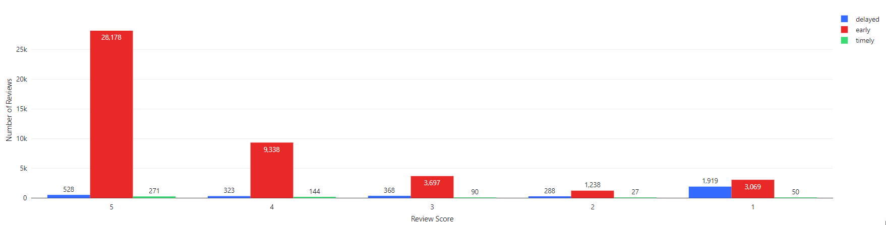
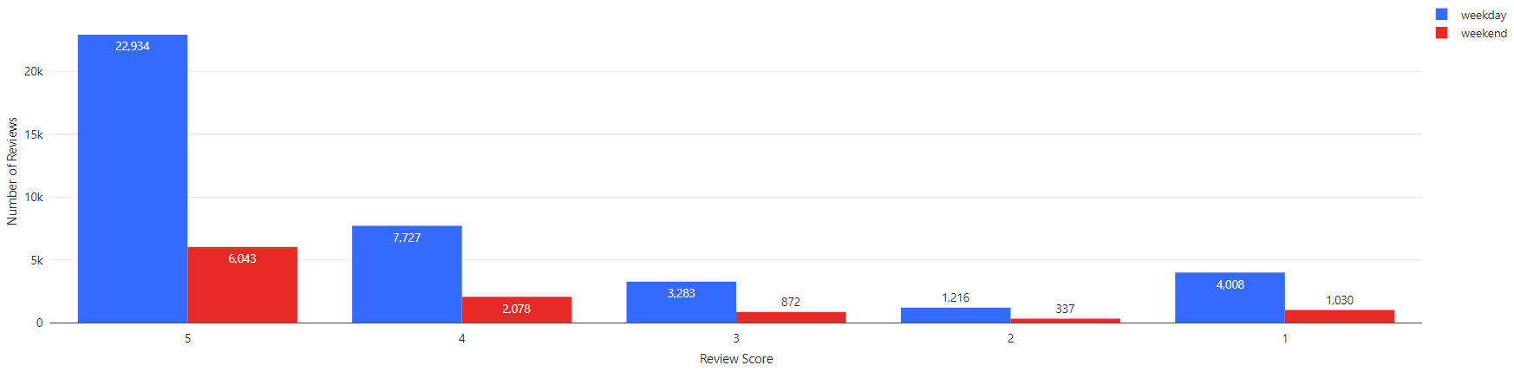
Review Score as per timely delivery of order
Review Score as per Weekday or Weekend delivery of the order

Slide 6
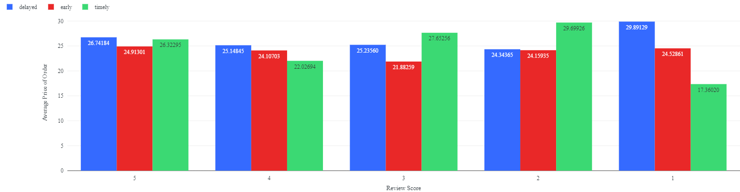
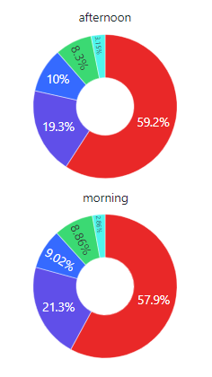
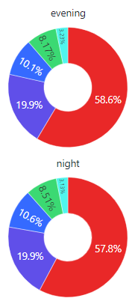

Review Score as per Average Price of Order based on timely delivery of order
Review Score as per delivery time of order

Slide 7

Data Information
Training Dataset
products: information about the products - 20500
orders: information about the orders - 51446
order_items : information about the items ordered - 51056
order_payments : information about the payments - 51445
order_reviews : information about the reviews of the orders - 51028
Test Dataset
products: information about the products​ - 7413
orders: information about the orders ​- 12825
order_items : information about the items ordered​ - 12726
order_payments : information about the payments​ - 12824

Slide 8



DATA ANALYSIS AND METHODOLOGY
CLEANING
TIME WINDOW Filtering (orders)
Label (1 – Positive, 0 – Negative)
NULL Treatment(Mean, 9999)
DUPLICATE Records Removal
Dropped approx. 382
FEATURES
Estimated Delivery Days
Days taken to approve the order
Delivery Status (Early/Late/On-Time)
Days taken to Deliver the Order
Purchase Order Time
Type of Payment
RANDOM mODEL
Benchmark – 77%

Slide 9





Modelling
Logistic Regression BINARY STATISTICAL MODEL
Train:34812
Test:14716
Auc: 0.707
Auccuracy: 0.817
DECISION TREE CLASSIFICATION MODEL
AUC: 0.707
AUCCURACY: 0.819
F1: 0.777
FEATURES SELECTION
Estimated_delivery_days, Total_Items, Actual Delivered_days,Order_to_approval_day, total_shipping_cost, payment_type

Slide 10






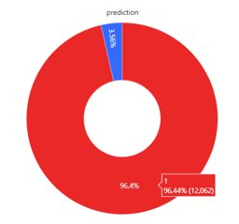
FINAL PREDICTION
HOLDOUT DATASET: 12507
Review Score / 5

Slide 11
THANK YOU

