Slide 1
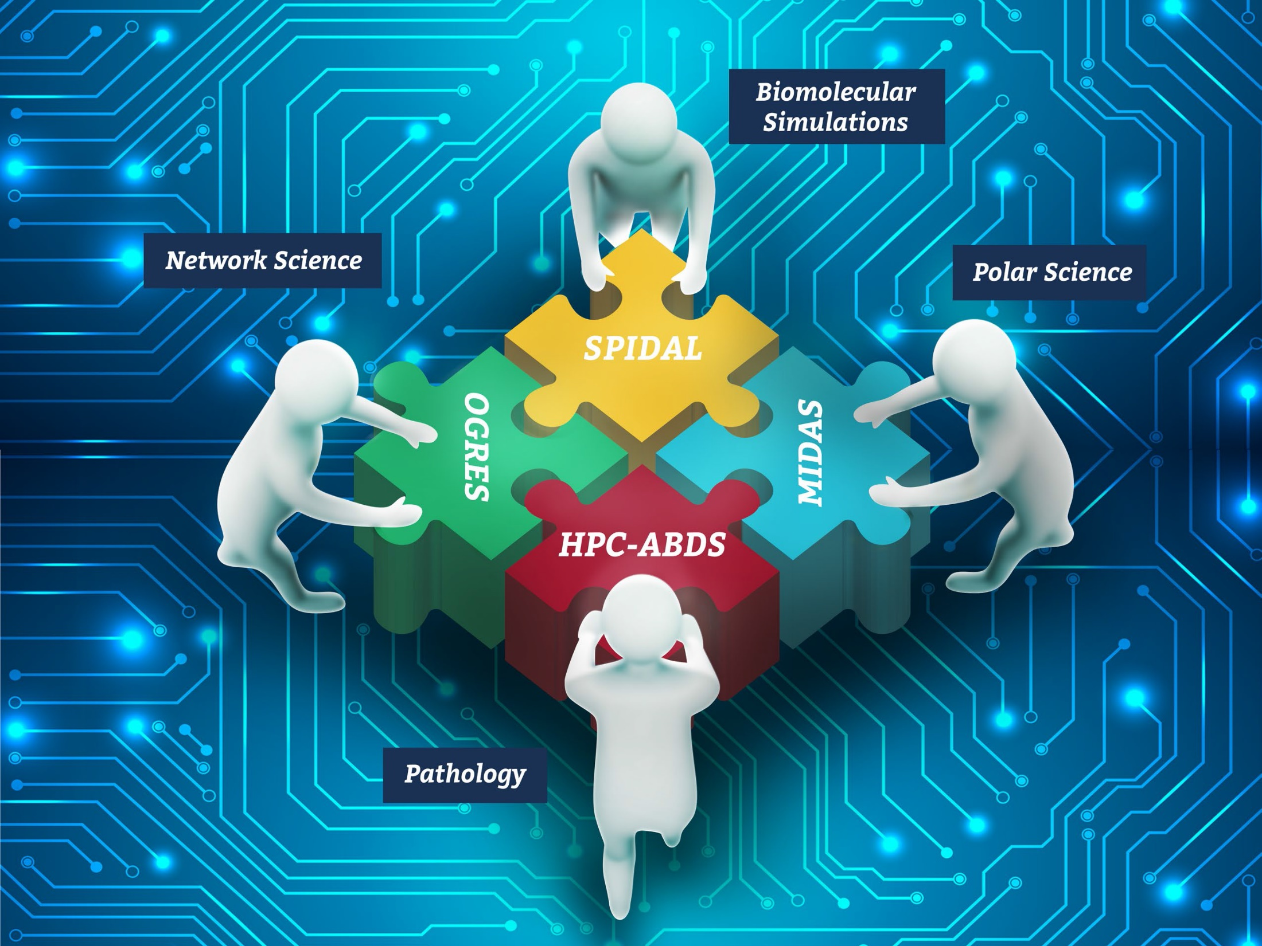




NSF 1443054: CIF21 DIBBs: Middleware and High Performance Analytics Libraries for Scalable Data Science
Software: MIDAS HPC-ABDS
Status and Challenges: January 2017

Slide 2
Status and Challenges for SPIDAL Project
Presented by Geoffrey Fox at Dibbs PI meeting January 11 2017 in Washington DC
Slides 3 and 4: Overall summary of all aspects of project
Slide 5: Challenge of broad deployment at scale
Slide 6: Comments on HPC Cloud 1.0 2.0 and 3.0 – the natural deployment environment
Slide 7: Comments on DevOps for Cloud 2.0
Slide 8: Comments on the the HPCCloud Operational Model that matches hardware features with application requirements but uses a uniform software model HPC-ABDS
Slide 9: Future Challenge: Support and Encourage Deployment

Slide 3
Status of NSF 1443054 Project
Big Data Application Analysis identifies features of data intensive applications that need to be supported in software and represented in benchmarks. This analysis was started for proposal and has been extended to support HPC-Simulations-Big Data convergence.
The project is a collaboration between computer and domain scientists in application areas in Biomolecular Simulations, Network Science, Epidemiology, Computer Vision, Spatial Geographical Information Systems, Remote Sensing for Polar Science and Pathology Informatics.
HPC-ABDS as Cloud-HPC interoperable software with performance of HPC (High Performance Computing) and the rich functionality of the commodity Apache Big Data Stack was a bold idea developed for proposal. We have successfully delivered and extended this approach, which is one of ideas described in Exascale Big Data report.

Slide 4
Status of NSF 1443054 Project
MIDAS integrating middleware that links HPC and ABDS now has several components including an architecture for Big Data analytics, an integration of HPC in communication and scheduling on ABDS; it also has rules to get high performance Java scientific code.
SPIDAL (Scalable Parallel Interoperable Data Analytics Library) now has 20 members with domain specific (general) and core algorithms.
Benchmarks. We reached out to database community with keynote and paper at WBDB2015 Benchmarking Workshop.
Language: SPIDAL Java runs as fast as C++
Designed and Proposed HPCCloud as hardware-software infrastructure supporting
Big Data Big Simulation Convergence
Big Data Management via Apache Stack ABDS
Big Data Analytics using SPIDAL and other libraries

Slide 5
Current Challenge: Allow Broad Deployment at Scale
Classic Software Engineering:
apply lessons like SPIDAL Java uniformly to each SPIDAL library member
Package and testing for each component of SPIDAL and MIDAS
Understand role of new developments like https://algorithmia.com/
Offer HPC-ABDS Capabilities as Platform as a Service with each capability specified as Ansible role giving function as a service
Will allow HPC, Cloud and converged infrastructure HPCCloud
Define good API’s to each function – current Apache libraries not well designed
Demonstrate test applications as software as a service on virtual clusters
Show that service providers (XSEDE) can deploy on variety of hardware
Not clear if HPCCloud infrastructure available as must support roles from HPC and Big Data
Comet one of best for us but need broader use of platforms to allow for example biomolecular simulations on Blue Waters

Slide 6
HPC and/or Cloud 1.0 2.0 3.0
Cloud 1.0: IaaS PaaS
Cloud 2.0: DevOps
Cloud 3.0: Insight (Solution) as a Service from IBM; server-less computing; event driven function as a service
HPC 1.0 and Cloud 1.0 separate ecosystems
HPCCloud or HPC-ABDS: Take performance of HPC and functionality of Cloud (Big Data) systems
HPCCloud 2.0 Use DevOps to invoke HPC or Cloud software on VM, Docker, HPC infrastructure
HPCCloud 3.0 Automate Solution as a Service using HPC-ABDS on varied infrastructure suitable for HPC and Big Data Management and Analytics

Slide 7
ID | 6 NIST Use Cass | Hadoop | Mesos | Spark | Storm | Pig | Hive | Drill | HDFS | HBase | Mysql | MongoDB | RethinkDB | Mahout | D3, Tableau | nltk | MLlib | Lucene/Solr | OpenCV | Python | Java | maven | Ganglia | Nagios | spark supervisord | zookeeper | AlchemyAPI | R
1 | NIST Fingerprint Matching | x |  | x |  |  | x | x |  | x | x |  |  |  |  |  |  |  |  |  | x | x | x | x | x | x
2 | Human and Face Detection |  | x | x |  |  |  |  |  |  |  |  |  |  |  |  |  |  | x | x |  |  |  |  |  | x
3 | Twitter Analysis |  |  |  | x |  |  |  |  | x |  | x |  |  | x | x |  |  |  | x | x |  |  |  |  | x | x | x
4 | Analytics for Healthcare Data/Health Informatics | x |  | x |  |  |  |  |  | x |  |  |  | x | x |  | x | x |  |  | x |  |  |  |  | x
5 | Spatial Big Data/Spatial Statistics/Geographic Information Systems | x |  | x |  |  |  |  |  |  |  |  |  | x | x |  | x |  |  |  | x | x
6 | Data Warehousing and Data Mining | x |  | x |  | x | x |  |  | x |  | x |  | x | x |  | x | x |  |  | x |  |  |  |  | x
count |  | 4 | 1 | 5 | 1 | 1 | 2 | 1 | 0 | 4 | 1 | 2 | 0 | 3 | 4 | 1 | 3 | 2 | 1 | 2 | 5 | 2 | 3 | 1 | 1 | 5 | 1 | 1

Slide 8
HPCCloud Convergence Architecture
Running same HPC-ABDS software across all platforms but data management machines has different balance in I/O, Network and Compute from “model” (data analytics, simulation) machine
Note data storage approach: HDFS v. Object Store v. Lustre style file systems is still rather unclear
The Model behaves similarly whether from Big Data or Big Simulation.
Data Management Model for Big Data and Big Simulation
HPCCloud Operational Model matches hardware features with application requirements

Slide 9
Future Challenge: Support and Encourage Deployment
Even as the middleware and analytics are being developed and properly packaged we need to address
Supported deployment
User training
proactive outreach to users and service providers.
We need to consider traditional library as well as PaaS/FaaS and SaaS deployments.
We will give a 6 hour tutorial on MIDAS and SPIDAL at a European winter school in February 2017 and this will increase our work in this area.

