Slide 1


{<>}coderSayWhat?
LogIn
Help!
Search
CSS
True Definition:
Cascading Style Sheets
Common Sense Stupid
Can’t See Shit
Add your Definition

Slide 2
CSS
True Definition:
Cascading Style Sheets
Common Sense Stupid
Can’t See Shit
Add your Definition

Slide 3
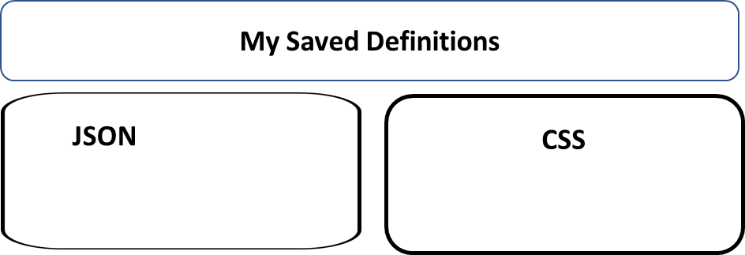
My Commented Definitions
JSON
CSS

Slide 4


Click on comments button to add your definition
You can save your favorites to your page

