Slide 1
Data Science
Oct. 13 狄尚哲

Slide 2
CONTENTS
背景介绍
Titanic
一个典型的数据处理流程
分析问题
分析数据
处理数据
解决问题
可视化
模型融合

Slide 3
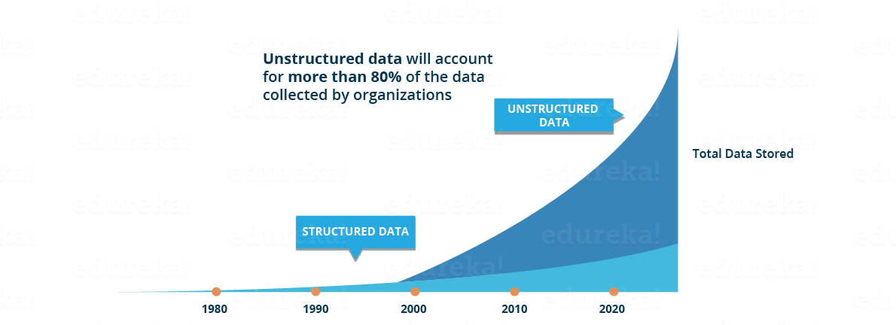
背景介绍
What is data science?
Data science is a "concept to unify statistics, data analysis, machine learning and their related methods" in order to "understand and analyze actual phenomena" with data.

Slide 4
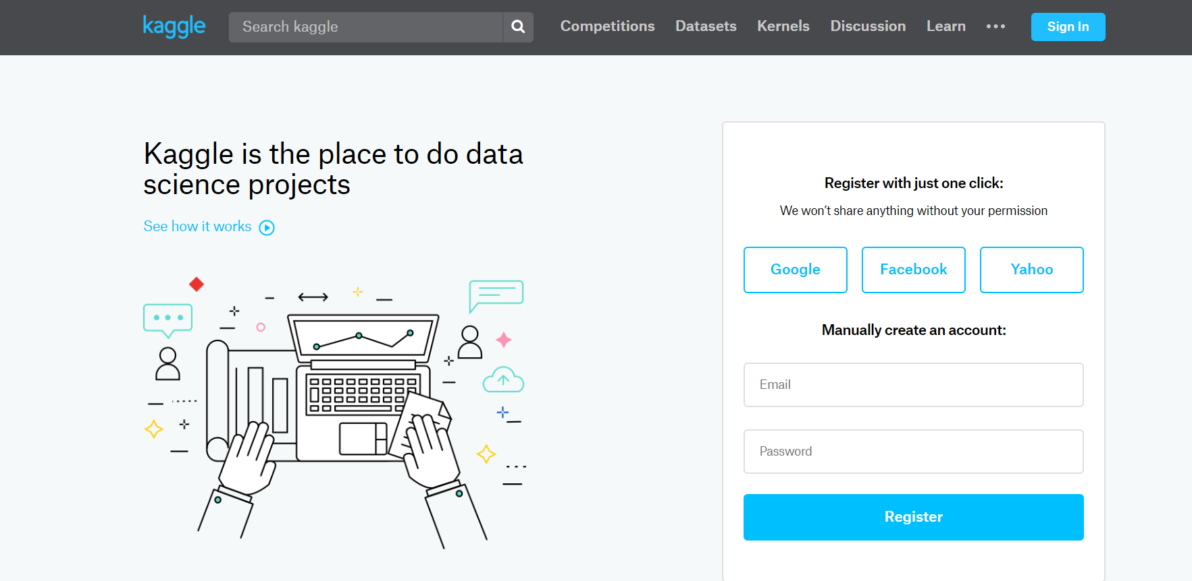
背景介绍
Kaggle
Kaggle is the world's largest community of data scientists and machine learners.
https://www.kaggle.com/

Slide 5
背景介绍
Kaggle
Kaggle is the world's largest community of data scientists and machine learners.
https://www.kaggle.com/
四种竞赛：
Featured
Research
Recruitment
Getting Started。
Notes:
Featured：这些通常是由公司、组织甚至政府赞助的，奖金池最大。
Research：这些是研究方向的竞赛，只有很少或没有奖金。它们也有非传统的提交流程。
Recruitment：这些是由想要招聘数据科学家的公司赞助的。目前仍然相对少见。
Getting Started：这些竞赛的结构和 Featured 竞赛类似，但没有奖金。它们有更简单的数据集、大量教程和滚动的提交窗口让你可以随时输入。
Getting Started 竞赛非常适合初学者，因为它们给你提供了低风险的学习环境，并且还有很多社区创造的教程

Slide 6
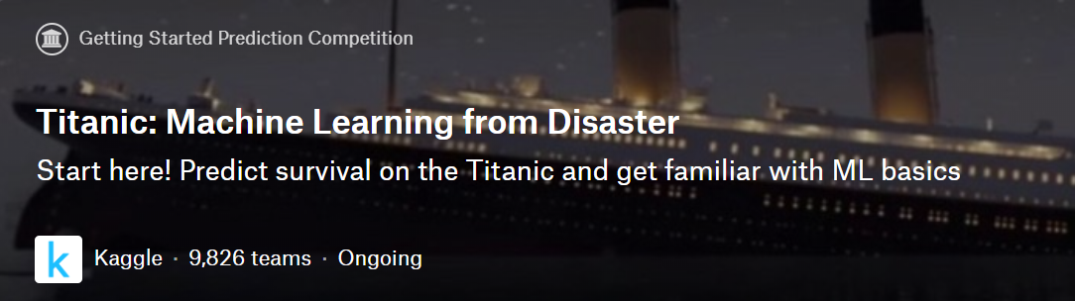
背景介绍
Titanic

Slide 7
一个典型的数据处理流程
分析问题
分析数据
处理数据
解决问题
可视化

Slide 8
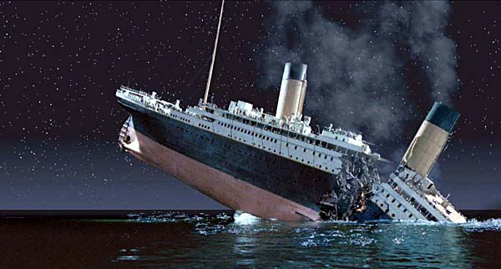
分析问题
Training set: passenger’s information & survived or not
Test set: not containing the survival information
Notes:
Competition sites like Kaggle define the problem to solve or questions to ask while providing the datasets for training your data science model and testing the model results against a test dataset.
Knowing from a training set of samples listing passengers who survived or did not survive the Titanic disaster, can our model determine based on a given test dataset not containing the survival information, if these passengers in the test dataset survived or not.
On April 15, 1912, during her maiden voyage, the Titanic sank after colliding with an iceberg, killing 1502 out of 2224 passengers and crew. Translated 32% survival rate.
One of the reasons that the shipwreck led to such loss of life was that there were not enough lifeboats for the passengers and crew.
Although there was some element of luck involved in surviving the sinking, some groups of people were more likely to survive than others, such as women, children, and the upper-class.

Slide 9
分析数据
Classifying
Correlating
Converting
Completing
Correcting
Creating
Charting
Notes:
Classifying. We may want to classify or categorize our samples. We may also want to understand the implications or correlation of different classes with our solution goal.
Correlating. One can approach the problem based on available features within the training dataset. Which features within the dataset contribute significantly to our solution goal? Statistically speaking is there a correlation among a feature and solution goal? As the feature values change does the solution state change as well, and visa-versa? This can be tested both for numerical and categorical features in the given dataset. We may also want to determine correlation among features other than survival for subsequent goals and workflow stages. Correlating certain features may help in creating, completing, or correcting features.
Converting. For modeling stage, one needs to prepare the data. Depending on the choice of model algorithm one may require all features to be converted to numerical equivalent values. So for instance converting text categorical values to numeric values.
Completing. Data preparation may also require us to estimate any missing values within a feature. Model algorithms may work best when there are no missing values.
Correcting. We may also analyze the given training dataset for errors or possibly innacurate values within features and try to corrent these values or exclude the samples containing the errors. One way to do this is to detect any outliers among our samples or features. We may also completely discard a feature if it is not contribting to the analysis or may significantly skew the results.
Creating. Can we create new features based on an existing feature or a set of features, such that the new feature follows the correlation, conversion, completeness goals.
Charting. How to select the right visualization plots and charts depending on nature of the data and the solution goals.

Slide 10
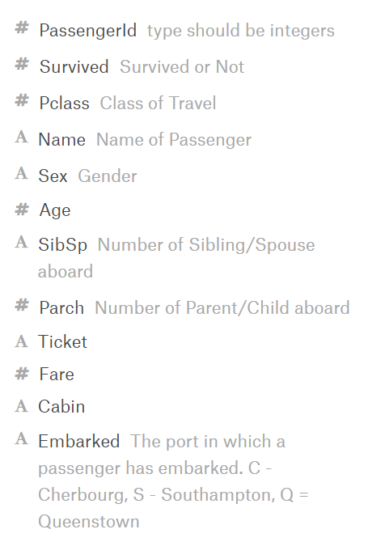
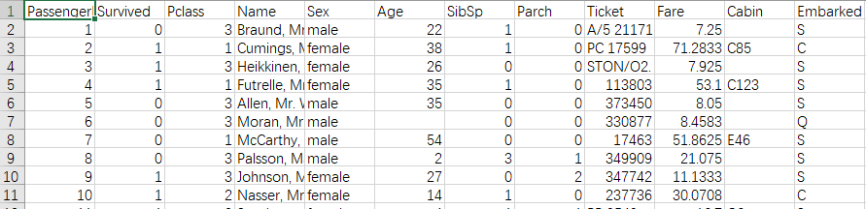
分析数据
#: Numeric
A: String
Notes:
代码1
删除PassengerId, Ticket, Cabin

Slide 11
Correlating
Sex: female
Pclass: upper class
Age: children
SibSp: negative
Parch: negative
Embarked
Fare
Tools: table & chart
Notes:
用代码2验证

Slide 12
处理数据
Ticket & Cabin: drop
Name: create Title
PassengerId: drop
Sex: convert to num
Age: Complete & convert to discrete num
SibSp & Parch: create FamilySize
Create Age*Pclass
Embarked: Complete & to num
Fare: Complete & to discrete num

Slide 13
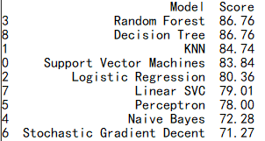
解决问题
Logistic Regression
Support Vector Machines
KNN or k-Nearest Neighbors
Naive Bayes classifier
Perceptron
Linear SVC
Stochastic Gradient Descent
Decision Tree
Random Forrest
Notes:
Logistic Regression
Support Vector Machines 支持向量机
KNN or k-Nearest Neighbors
Naive Bayes classifier 朴素贝叶斯分类器
Perceptron 感知器
Linear SVC 支持向量聚类算法
Stochastic Gradient Descent 梯度下降法
Decision Tree
Random Forrest

Slide 14
模型融合
Voting
Averaging
Bagging
Boosting
Stacking
Notes:
Voting 投票多者确定为最终的分类，适用于分类问题（离散）
Averaging 平均 / 加权平均，适用于回归问题（连续）
Bagging 就是采用有放回的方式进行抽样，用抽样的样本建立子模型,对子模型进行训练，这个过程重复多次，最后进行融合。大概分为这样两步
1. 重复K次 有放回地重复抽样建模
训练子模型 2.模型融合 分类问题：voting 回归问题：average Bagging算法不用我们自己实现，随机森林就是基于Bagging算法的一个典型例子，采用的基分类器是决策树。R和python都集成好了，直接调用。

Slide 15
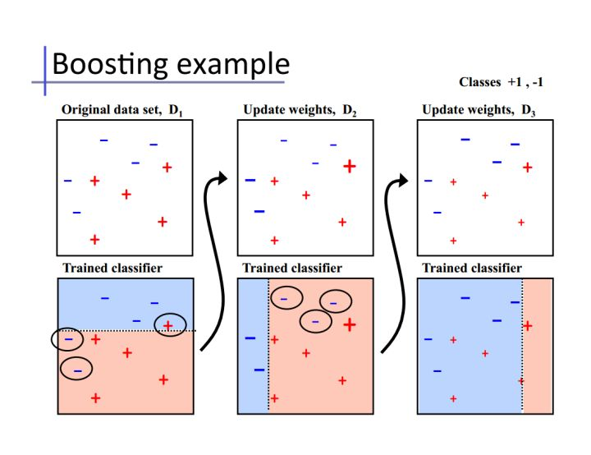
Boosting
Notes:
Boosting的思想是一种迭代的方法，每一次训练的时候都更加关心分类错误的样例，给这些分类错误的样例增加更大的权重，下一次迭代的目标就是能够更容易辨别出上一轮分类错误的样例。最终将这些弱分类器进行加权相加。

Slide 16
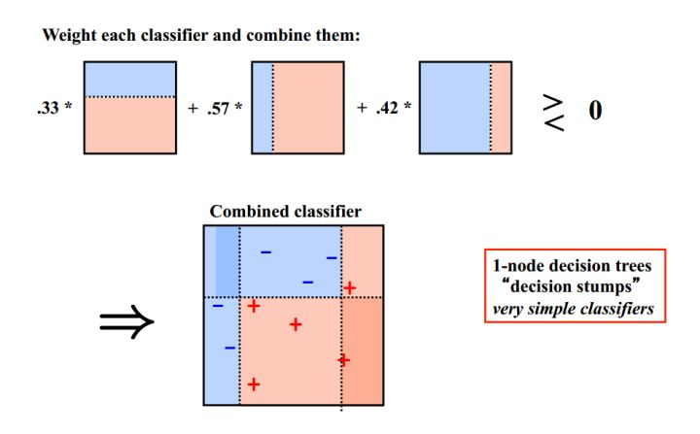
Boosting
Notes:
基于Boosting思想的有AdaBoost、GBDT等

Slide 17
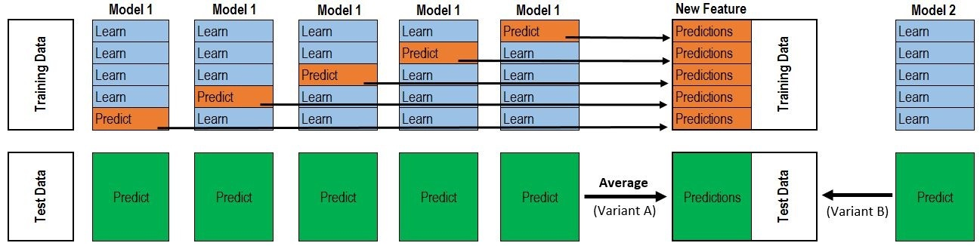
Stacking
Notes:
5-fold 举例cross validation的例子
Train Data有890行。(请对应图中的上层部分）
每1次的fold，都会生成 713行 小train， 178行 小test。我们用Model 1来训练 713行的小train，然后预测 178行 小test。预测的结果是长度为 178 的预测值。
这样的动作走5次！ 长度为178 的预测值 X 5 = 890 预测值，刚好和Train data长度吻合。这个890预测值是Model 1产生的，我们先存着，因为，一会让它将是第二层模型的训练来源。
每1次的fold，713行 小train训练出来的Model 1要去预测我们全部的Test Data（全部！因为Test Data没有加入5-fold，所以每次都是全部！）。此时，Model 1的预测结果是长度为418的预测值。
这样的动作走5次！我们可以得到一个 5 X 418 的预测值矩阵。然后我们根据行来就平均值，最后得到一个 1 X 418 的平均预测值。
Model2 & 3
最终得到来自5-fold的预测值矩阵 890 X 3和 来自Test Data预测值矩阵 418 X 3

