Slide 1

MICROSOFT MOVIE STUDIO

Slide 2
Business Problem
Microsoft sees all the big companies creating original video content and they want to get in on the fun.
They have decided to create a new movie studio, but they don’t know anything about creating movies.

Slide 3
Objectives
We were tasked with exploring what types of films are currently doing the best at the box office then translate those findings into actionable insights that the head of Microsoft's new movie studio can use to help decide what type of films to create.
We used the following datasets 'bom.movie_gross.csv','title.basics.csv' & 'title.ratings.csv' to answer the following questions;
Which are the genres of the 10 most voted movies that Microsoft should consider starting out with and what is the average domestic gross and foreign gross of those genres?
Which are the 10 top most average foreign and domestic grossing genres which Microsoft should also consider starting out with?
Which studios had produced the genres with highest voted movies that Microsoft can collaborate with in producing movies?

Slide 4
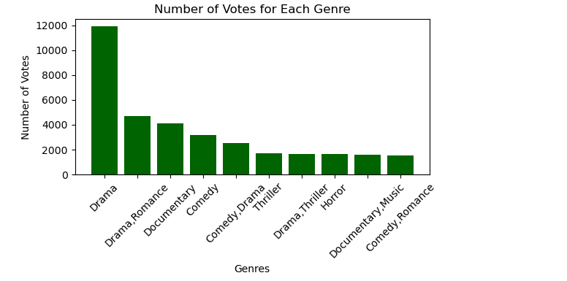
Objective 1: Genres of the 10 most voted movies that Microsoft should consider starting out with and what is the average domestic gross and foreign gross of those genres?

Slide 5
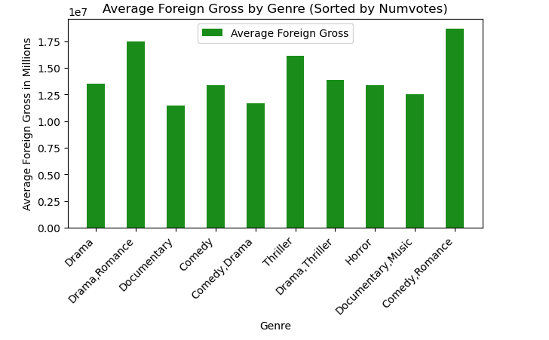
Group by genres and highest number of votes with their respective average foreign gross

Slide 6
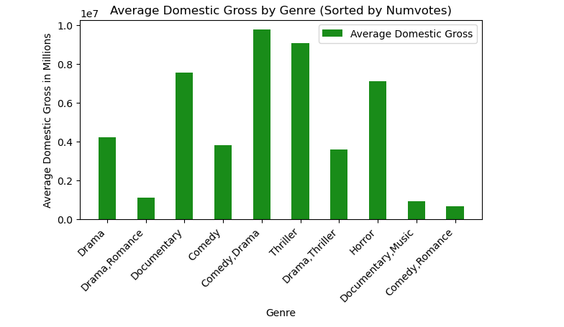
Group by genres and highest number of votes with their respective average domestic gross

Slide 7
Insight from objective 1
In terms of number of votes Microsoft should consider investing drama, drama & romance & documentary as they the most voted genres of movies.
Considering top most number of votes and foreign gross Microsoft should consider investing in comedy & romance, drama & romance and thriller as they are among the most moved genres with the highest foreign gross.
Considering top most number of votes and domestic gross Microsoft should consider investing in comedy & romance, thriller and documentary as they are among the most moved genres with the highest foreign gross.

Slide 8
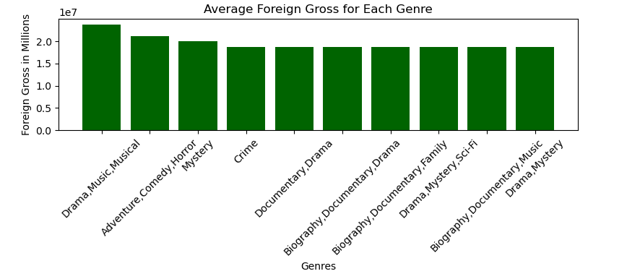
Objective 2: Which are the 10 top most average foreign and domestic grossing genres which Microsoft should also consider starting out with? 10 top most foreign grossing genres which Microsoft should also consider starting out with

Slide 9
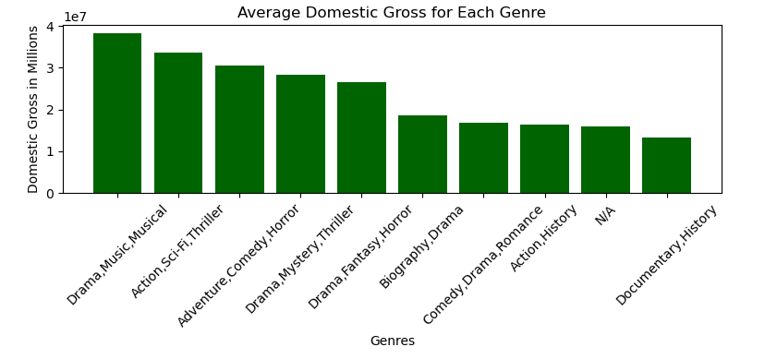
10 top most domestic grossing genres which Microsoft should also consider starting out with

Slide 10
Insight from objective 2
Considering only foreign gross Microsoft should consider investing in drama, music, musical, adventure, comedy, horror and mystery as they are top foreign grossing genres.
Considering only domestic gross Microsoft should consider investing in drama, music, musical, action, Sci-Fi, thriller and adventure, comedy as they are top domestic grossing genres.

Slide 11
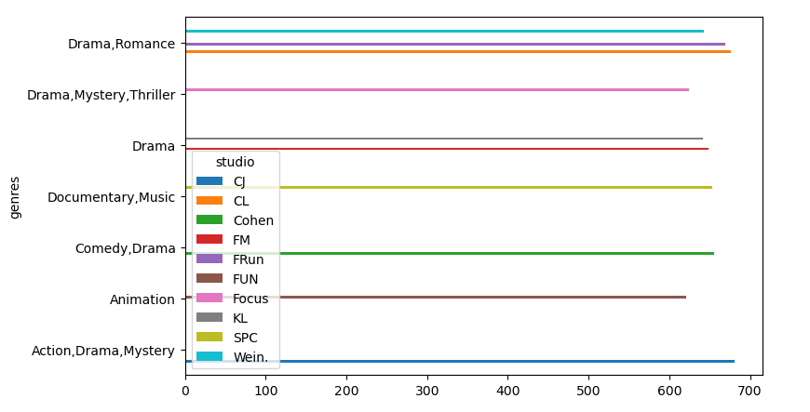
Objective 3: Which studios had produced the genres with highest voted movies that Microsoft can collaborate with in producing movies?

Slide 12
Insight from objective 3
The studios which had the genres with most voted movies produced were CJ, CL and FRUn. Microsoft should consider collaborating with them in producing movies.

