Slide 1
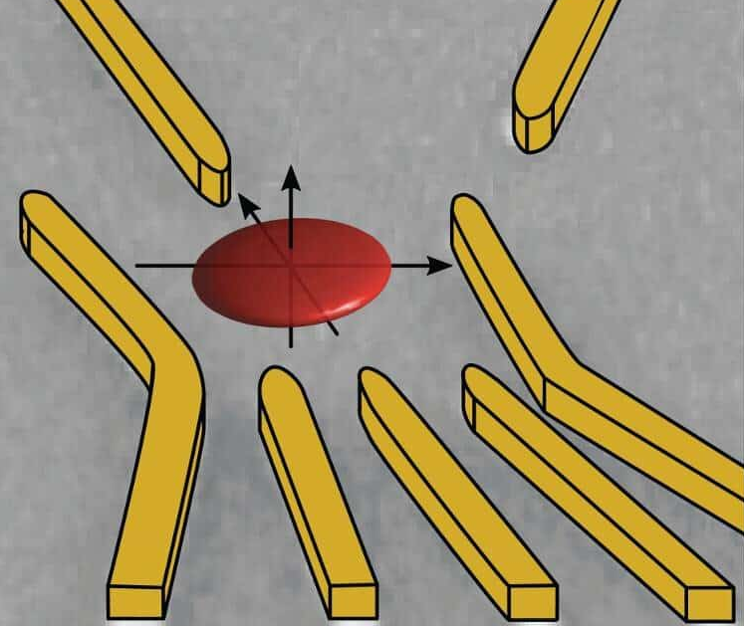
Hartree Fock Method:
Quantum Dots
Álvaro Bermejillo Seco
Daniel Bedialauneta Rodríguez
Marc Serra Peralta
Technische Universiteit Delft
08/06/2022

Slide 2
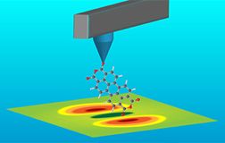
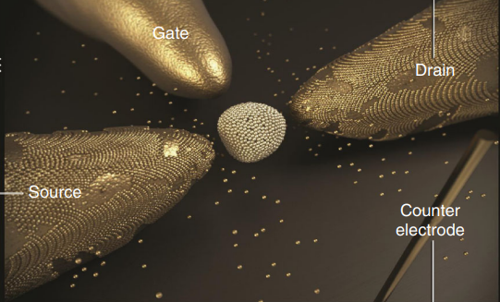
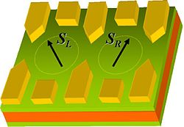
Intro Theory Checks Results F. Research Conclusions
1 Introduction: Motivation and goal
Applications that require knowing the energy levels of QD:
Scanning QD microscopy
Single-e transistors
QD qubits
GOAL: To reproduce the chemical potential of a quantum dot in GaAs.
Fujito et al. “Many-electron ground states in anisotropic parabolic QD.” Phys. Rev. B (1996)
Notes:
Applications: Scanning quantum dot microscopy, Single-electron transistor, qubits. They all require good knowledge about the energy level landscape of a quantum dot with different number of electrons. Our goal is to try to reproduce or simulate the chemical potential of a quantum dot as a function of the number of electrons. For reference, we will use this paper where they do calculations on quasi-two-dimensionally defined quantum dots using Hartree Fock.

Slide 3
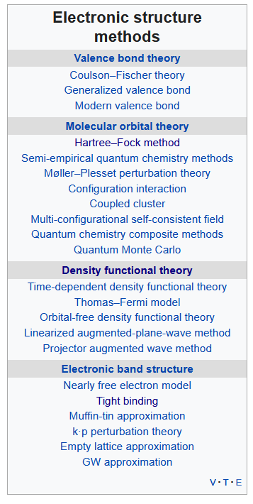
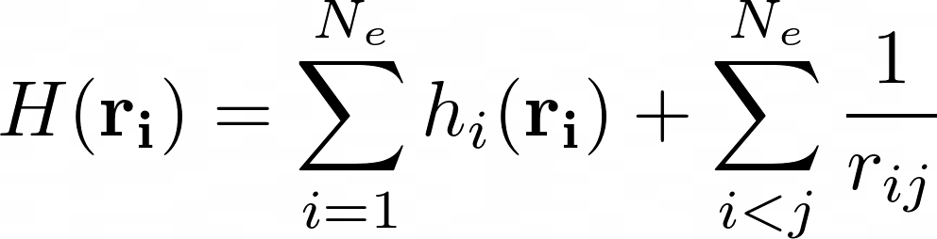
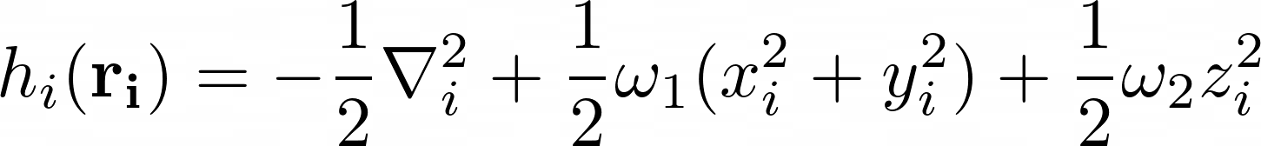
Intro Theory Checks Results F. Research Conclusions
2.1 Theory: The problem
Anisotropic parabolic Quantum Dot within the effective mass approximation
where
OBJECTIVE: find Ground State of this Hamiltonian ⇒ solve the Scrödinger equation
As we all know, from Hydrogen onwards ⇒ Complicated
Notes:
REFERENCE!!!!!!

Slide 4
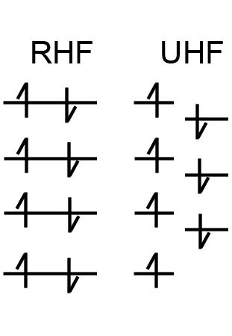
Intro Theory Checks Results F. Research Conclusions
2.2 Theory: Hartree Fock
Hartree Fock in short: Transform a PDE (Schrödinger Equation) into an approximate eigenvalue problem by introducing a finite basis set.
Restricted HF (RHF)
Uses single molecular orbitals twice: for spin up and spin down
Unrestricted HF (UHF)
Uses different molecular orbitals for spin up and spin down electrons.
Notes:
Hartree-Fock: instead of solving diff eq., it solves eigenvalue problem given a basis set
Approximation: using finite number of basis functions
More basis functions ⇒ better accuracy but more computationally expensive
Different types of HF: restricted/unrestriced , open shell/closed shell
(hacer referencia que en el paper usan UHF y nosotros usamos RHF?)

Slide 5
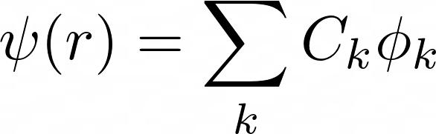

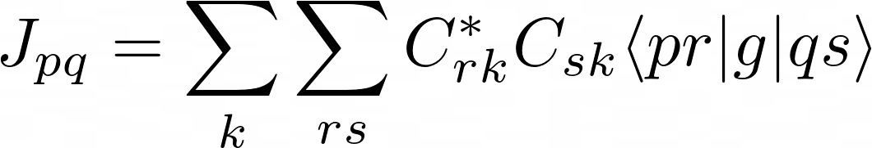
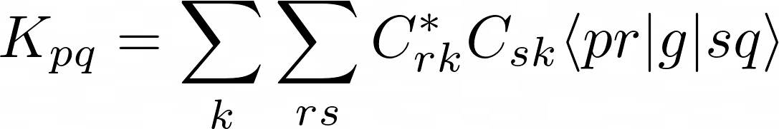
Intro Theory Checks Results F. Research Conclusions
2.2 Theory: Hartree Fock
Expand the eigenfunctions in a basis
2. Roothaan equations: create Fock matrix
, with
Harmonic oscillator eigenfunctions ⇒ Hermite polynomials and gaussians
One electron hamiltonian
Two electron coupling
J M. Thijssen “Computational Physics” (2012)
Notes:
REFERENCE!!!!!!

Slide 6
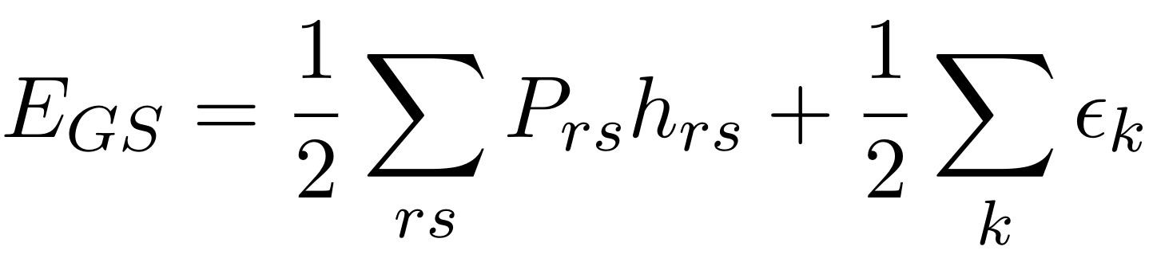
Intro Theory Checks Results F. Research Conclusions
2.2 Theory: Hartree Fock
Expand the eigenfunctions in a basis
2. Roothaan equations: create Fock matrix
3. Self Consistent Field
4. Calculate ground state energy
Convergence criteria:
RMS density matrix
Convergence trick:
F = F(C) !!
J M. Thijssen “Computational Physics” (2012)
Notes:
REFERENCE!!!!!!

Slide 7


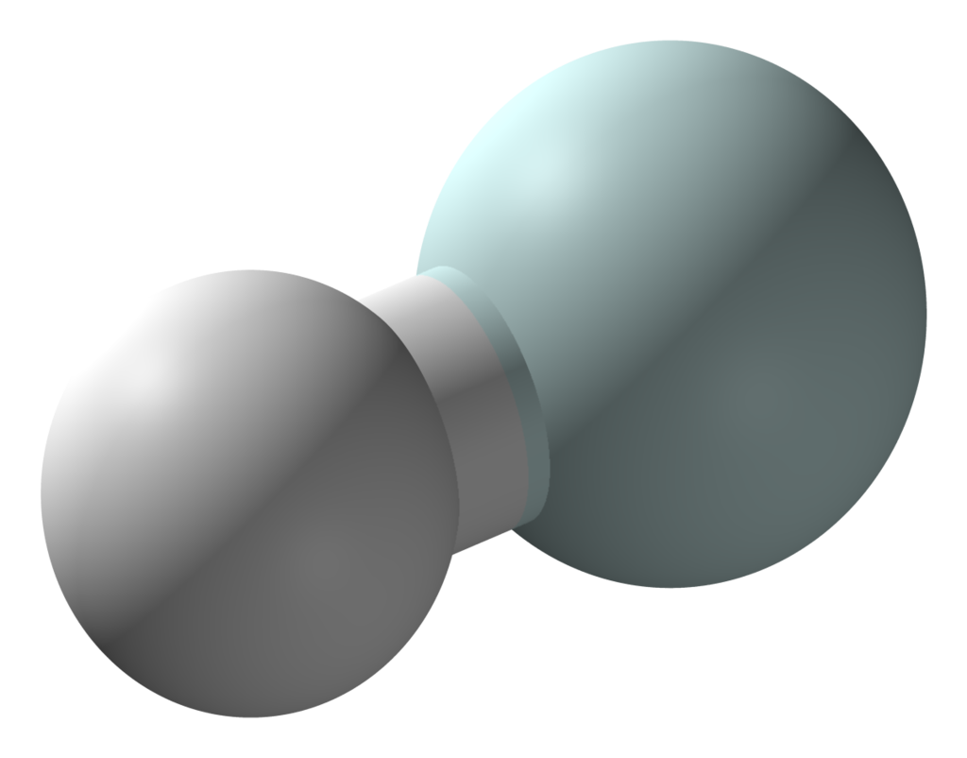
Intro Theory Checks Results F. Research Conclusions
3.1 Checks: Helium hydride ion
H-He⁺
Our result:
EG= -2.4441(1)
Bibliography:
EG= -2.4438
Basis:
Integrals: taken from
Everything else from our implementation
He
Proven that: SCF iteration leads to a satisfactory converged value for the energy
F, S
Initialization
Convergence Criteria
H
Errold G. Lewards. “Computational Chemistry: Introduction to the Theory and Applications of Molecular and Quantum Mechanics” (2016)
Notes:
The point would be to talk mainly about two but say enough about 1 so that we can compare (similarities and differences).
The first was more important in the end? Is it fair to say it that way?
1 Haldane found a model in graphene by which we could have some kind of qhe without external magnetic field, through some magnetic ordering
2 Kane and Mele generalized that model and proposed that thanks to spin orbit coupling, but without magnetic ordering, we could have two copies of the Haldane model.

Slide 8
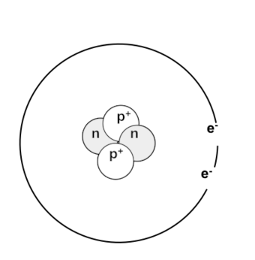
Intro Theory Checks Results F. Research Conclusions
3.2 Checks: Helium atom
2. He
Basis: 4 Gaussians
Our result: EG= −2.8540(3)
Jos result: EG= −2.8552
Exact result: EG= −2.903
Integrals: by us (MC) and Jos’ book (analytic)
Everything implemented by us
Proven that: MC integration scheme performs correct two-electron integrals
Two-electron integrals
Oscillations is SCF
H
J M. Thijssen “Computational Physics” (2012)
Notes:
The point would be to talk mainly about two but say enough about 1 so that we can compare (similarities and differences).
The first was more important in the end? Is it fair to say it that way?
1 Haldane found a model in graphene by which we could have some kind of qhe without external magnetic field, through some magnetic ordering
2 Kane and Mele generalized that model and proposed that thanks to spin orbit coupling, but without magnetic ordering, we could have two copies of the Haldane model.

Slide 9
Intro Theory Checks Results F. Research Conclusions
3.3 Error analysis
MC integration
Average Err relative: 0.07%
Maximum Err relative: 0.17%
STD MC integration: 0.08%
Comparison with analytical values for He
SCF iterations
E(numerical) = -2.8540 ± 0.0003
E(analytical) = -2.8543 ± 0.0004
Repeat SCF for He (N = 100)
E vs Nbasis for QDots with 2e⁻
Nbasis | 2 | 3 | 5 | 10 | 15
E | 8.761 | 8.635 | 8.631 | 8.634 | 8.633
Notes:
MC integration : comparison with analytical expressions for the case of He
Relative error of MC integration: 0.07%
Maximum relative error: 0.17%
Std of MC integrals : falta hacer un print y ver que tal dan
Error en SCF: error despreciable en diagonalización porque las dimensiones de las matrices son pequeñas,
però hay error en convergence ⇒ repeat SCF N=20? times and average and std, no correlation at all (random numbers alpha)
Hay acumulación de los errores de MC integration ⇒ caso de He:
E(SCF numerical) = -2.8540255 +- 0.0003073
E(SCF analytical) = -2.8542953 +- 0.0004393
Diferencia relativa de E_analytical y E_numerical: 0.001%
PRINCIPAL ERROR EN SCF ES CON EL NÚMERO DE BASES UTILIZADO, MAYBE HACER UN PLOT DE E VS # SINGLE BASIS PARA EL CASO DEL He PORQUE TAMBIÉN TENEMOS EL VALOR EXPERIMENTAL

Slide 10
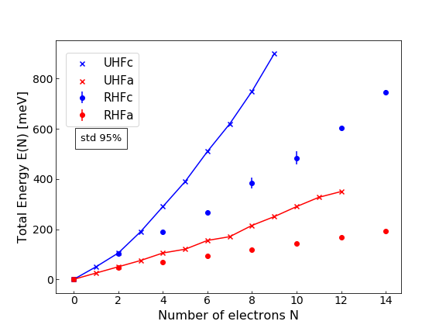
Intro Theory Checks Results F. Research Conclusions
4.1 Results: E(Nelectrons)
lx,y = 7.42 nm
QD c
lz = 4.95 nm
N = 2 in good agreement
l’x,y = 49.5 nm
N > 2 different energies
Reasons:
UHF vs RHF
Basis
QD a
lz
Fujito et al. “Many-electron ground states in anisotropic parabolic QD.” Phys. Rev. B (1996)
Notes:
First describe the graph what it is about and the different elements
Then we make a comparison of what things agree and which ones don’t
N = 2 perfect
N >2 significantly lower energies, and the main reason should be that we are considering RHF in which spin up and spin down are treated in the same way, in UHF they don’t
There’s an unexpected difference in the filled shell case (2, 6, 12)

Slide 11
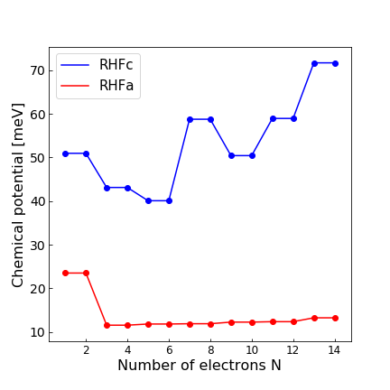
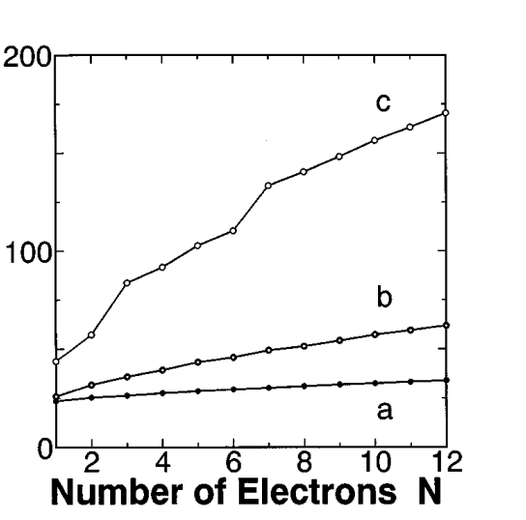
Intro Theory Checks Results F. Research Conclusions
4.2 Results: μ(Nelectrons)
Approx. behavior:
(a) Monotonous
(c) Non-monotonous
c
a
Fujito et al. “Many-electron ground states in anisotropic parabolic QD.” Phys. Rev. B (1996)
Notes:
Describe figures: on the left side we have our simulated mu(N) = E(N)-E(N-1), where the values for E(N) with N odd have been interpolated with the E(N) of N even.
By shells we mean the number nx+ny fixed. The transitions from closed shell to open shell are indicated with arrows, both in our figure and paper’s figure.
“The chemical potential of the largest quantum dot of lx = 49.5 nm seems almost to be linear with the number of electrons, as expected in the classical limit of a constant capacitance. On the other hand, for the smallest quantum dot of lx = 7.425 nm, the chemical potential deviates from the linear relation, and it reflects the ‘‘shell’’ structure of the one-electron energy level Ei” .
Comparison between our results and paper’s results?

Slide 12
Intro Theory Checks Results F. Research Conclusions
4.5 Results: Efficiency of the code
Bottleneck:
Calculation of two-electron integrals
N_{basis} = 14 and N_{points} = 10⁵
Δt ~ 9 min
N_{basis} = 14 and N_{points} = 10⁶
Δt ~ 2 h
However, due to random alpha:
Averaging over SCF
1 run of SCF
Δt ~ 3 s
N_{Electrons} = [2, 14] and 20 SCF runs each: 140 runs
140 runs of SCF
Δt ~ 9 min

Slide 13

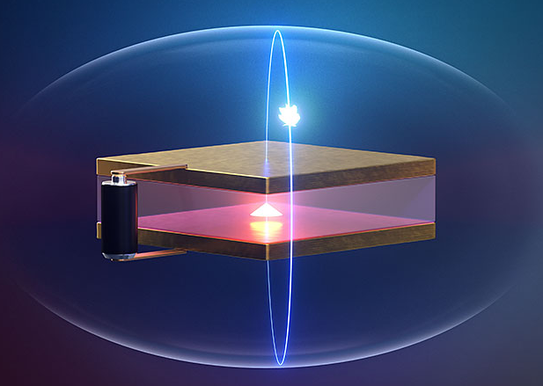
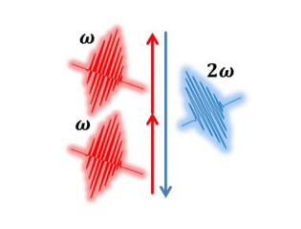
Intro Theory Checks Results F. Research Conclusions
5 Further research
Increase precision in Hartree Fock and MC integration
⇒ more basis functions & more Npoints in MC
Use Unrestricted Hartree Fock
⇒ Solve coupled for spin up and spin down
Pople–Nesbet–Berthier equations
Study further characteristics: excited states
⇒ Koopman’s theorem
⇒ Gives information about the light-QD interaction
B. Szafran et al. “Ground and excited states of few-electron systems in spherical QD” Phys. E (1998)
S.A. McCarthy et al. “Electronic structure calculation for N-electron QD” Comput. Phys. Commun (2001)

Slide 14
Intro Theory Checks Results F. Research Conclusions
6 Conclusions
Monte Carlo implementation for two-electron integrals: more versatility
We can obtain GS of systems with small amount of electrons accurately
Chemical potential is not monotonous when QDot has lx,y = 7.42 nm
QDots with greater amount of electrons benefit from UHF

Slide 15
Hartree Fock Method:
Quantum Dots
Thank you for your attention!
Álvaro Bermejillo Seco
Daniel Bedialauneta Rodríguez
Marc Serra Peralta
Technische Universiteit Delft
08/06/2022

Slide 16
Extra slide: Algorithm flow
1 Choose a basis
2 Calculate the one and two-electron integrals
3 Compute F and S
4 Solve the SCF iteratively
Harmonic oscillator eigenfunctions ⇒ Hermite polynomials and gaussians
One-electron integrals → Analytically
Two-electron integrals → Monte Carlo integration
F → previous formulas
S → analytically
E, C = scipy.eigh(F, S)
Convergence criteria: RMS density matrix
Notes:
RMS = Root mean squared value

Slide 17
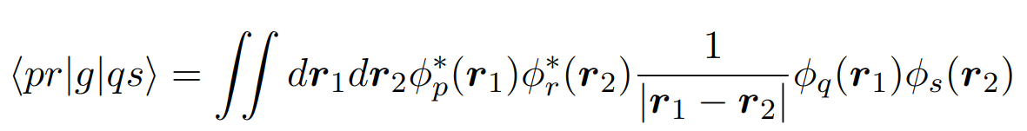
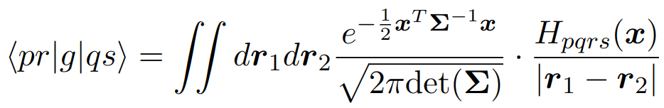


Intro Theory Implementation Results F. Research Conclusions
Extra slide: Monte Carlo for two electron integrals
Monte Carlo integration
Sampling
Integrand
Inspiration:
Michel Caffarel. “Evaluating two-electron integrals using Monte Carlo…” J. Chem. Phys. (2009)
Notes:
Write something of : Monte Carlo
Rewriting the integral as a thing to sample times a function
We got rid in the end of the Metropolis

Slide 18
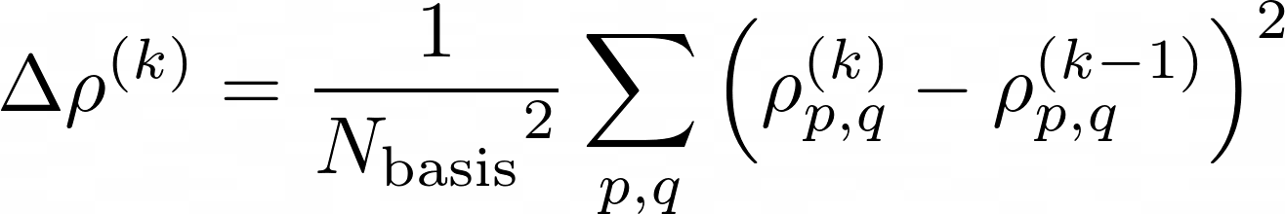

Intro Theory Implementation Results F. Research Conclusions
Extra slides SCF convergence criteria
SCF iterations
Convergence criteria
where
PROBLEM: Gets stuck oscillating
SOLUTION: Random average
J M. Thijssen “Computational Physics” (2012)
Notes:
REFERENCE!!!!!! (Jos’ book?)
For the solution to oscillations: According to Jos, the criteria is that if the change in rho is big enough, you should do an average to escape those specific oscillations, according to some previously chosen alfa. However, we found two things:
If you set a threshold above which you do the averaging, then the oscillations will happen below that threshold.
Even if you set the threshold to zero, so that there’s averaging at every step, but fixing an alfa, there will also be oscillations.
What we implemented is then to have averaging at all steps but choosing a random alfa between 0 and 1 always. Result: it converges almost always.

Slide 19
Intro Theory Implementation Results F. Research Conclusions
1 Intro
Intro:
Why do we care about this, why is hartree fock a nice tool. Differences with normal applications of HF? What paper are we following and what is our goal? What is the system we are studying.
Theory:
Explain the steps needed to get to our results and what are the difficult steps: chose a basis, compute the integrals, build the matrices, solve the Roothaan equations (SCF) and compute the energies.
Implementation: integrals computed through MonteCarlo? Roothaan equation by iteratively using scipy…
Results: the things that we have tried to copy from the paper and the comparison
Further research: improvements of the code, but also excited states and things like that
Conclusion: were we successful, what is the power of our program, what is it useful for…
We also need to fulfil the same things as for the report: (14 minutes! HARD CUTOFF so aim for 12)
o Theoretical background and the motivation for the research question
o Documents correctness checks (for the final projects, there may not be a big distinction between validity check and final result, if you are reproducing the result of a paper)
o Data is reported with uncertainty, and fitted to the expected behavior if applicable
o A variety of phenomena are investigated scientifically, and compared with known results.
o Performance is reported and discussed briefly

