Slide 1

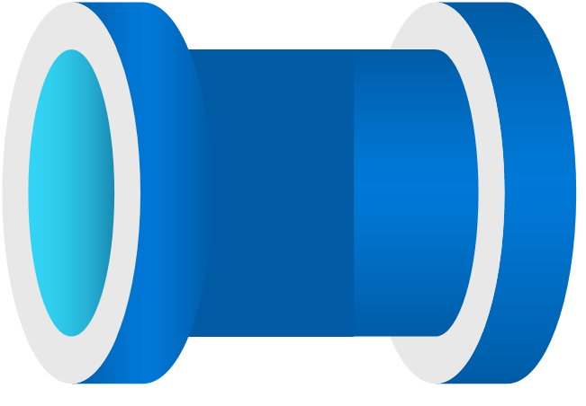

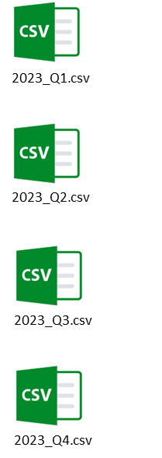

Azure Data Lake Storage Gen2
Azure Data Lake Storage Gen2
Azure Data Lake Storage Gen2
Source System
Bronze Layer
Silver
Layer
Gold
Layer
Data Ingestion
Change data capture(CDC)
Change data capture(CDC)
SCD Type-1
SCD Type-1

