Slide 1
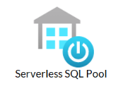
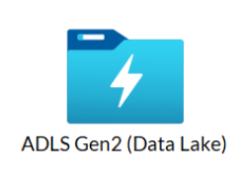
Data Flow – new 18/04
1
Standardized Storage
Zone
Curated Storage Zone
Type1
MZIN
PROFISEE
MZOUT
CZSTG
CZ
NaFP
Client
MZ_Client
CONCEPT
CONCEPT_CLASS
CONCEPT_RELATIONSHIP
RELATIONSHIP
DOMAIN
VOCABULARY
CONCEPT_ANCESTOR
CONCEPT_SYNONYM
NSHEALTH_DHW_NAFP_DHW_Query_Monthly
DAD_MZ_CLIENT
MZ_Provider
DAD
NAFP_MZ_CLIENT
MZ_Address
DSS_MZ_CLIENT
OMOP CDM Vocabulary Tables
DAD_HOSPITAL_DATA_ICD10
Type1
OMOP Domain Tables
Person
Person_ext
Provider
Provider_ext
Location
Location_ext
Death
DAD_HOSPITAL_DATA_ICD11
MZ_Address
MZ_Address
MZ_Address
Xwalk_Person
DSS
Xwalk_provider
DSS_INDIVIDUAL_2
Delta
Xwalk_Address
DSS_INDIV_CIVIC_ADDRESS
DSS_PROVIDER_2
MZ_Provider
Type2
Person
ED
NAFP_PROVIDER
Provider
External Tables
DSS_PROVIDER
Location
NSHA_Repos_PAT_NedEncounter
License Table
Speciality Table
CR
Delta
Location_stg
CLIENT_REGISTRY_COMPOSITE_VIEW
Provider_stg
DIS
Delta
IDENTIFIER
Person_stg
Person
Person_index
License_stg
PR
Speciality_stg
PROVIDER_REGISTRY_COMPOSITE_VIEW
Person newcomer_stg
Delta
Delta

Slide 2




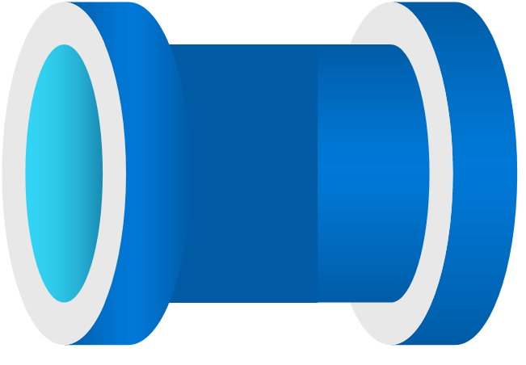

Hive Metastore tables
Hive Metastore tables
Azure Synapse Dedicated SQL Table
Source Storage Account
Curated Storage Account
Curated Storage Account
MDM Zone
OMOP Tables
Azure SQL
Profisee Jobs
Azure SQL
SZ Zone
MZIN Zone
CZ Zone
MDM Staging
MDM OUT
Databricks Notebook
Databricks Notebook
SCD Type-1
SCD Type-1
SCD Type-1

Slide 3
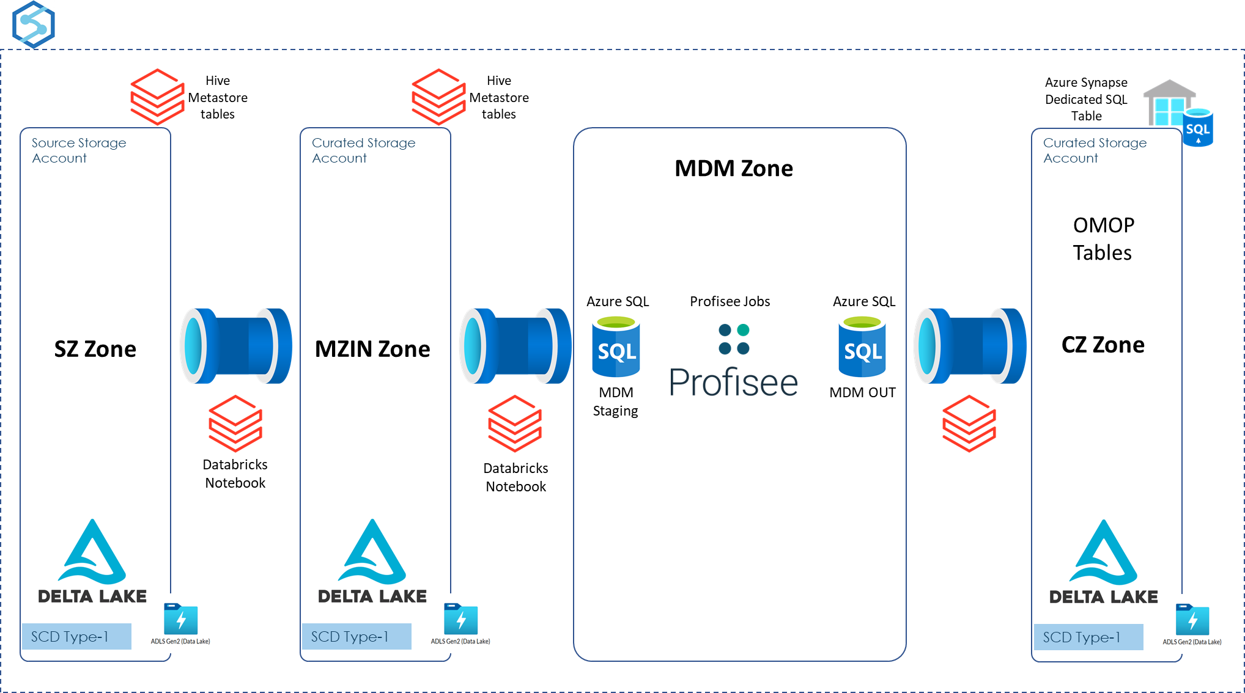
Azure Synapse Analytics

Slide 4
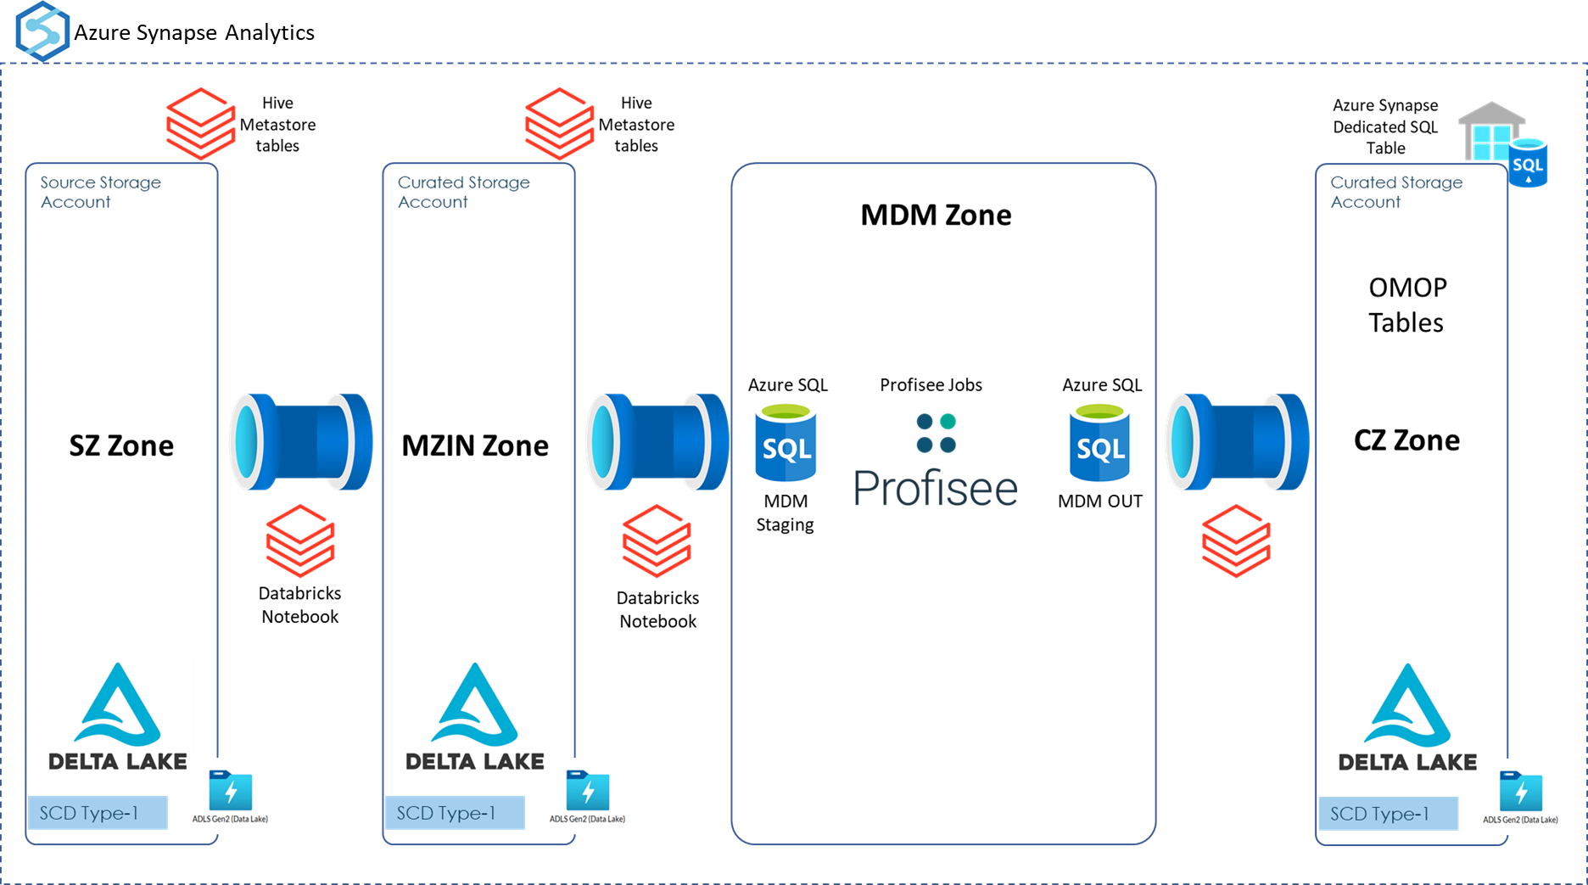

Slide 5
