Slide 1
Installation and Use of Bedrock
May 2017
Georgia Tech Research Institute
Trevor.Goodyear@gtri.gatech.edu Jason.Poovey@gtri.gatech.edu

Slide 2
Prerequisites
Docker
Containerization framework
https://www.docker.com/
A git client
Revision control software
Jupyter
Software for interactive data science
https://jupyter.org

Slide 3
Checkout Bedrock from Github.com Start the Docker Container, and Install Logit2 Notebook
These commands assume Linux or OSX installation Run these commands in order from a directory in which Bedrock is to be installed
git clone https://github.com/Bedrock-py/bedrock-core.git cd bedrock-core docker build -t bedrock . && ID=$(docker run -p 81:81 -p 82:82 -d bedrock) sh bin/docker_install_opal.sh $ID opal-analytics-logit2

Slide 4
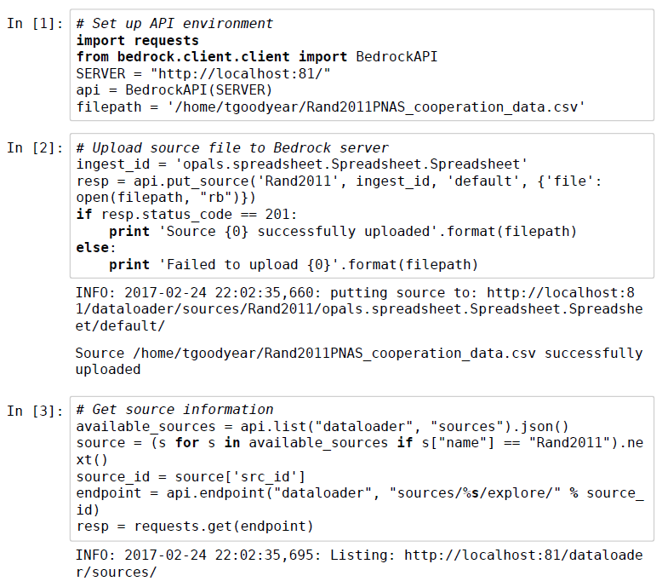
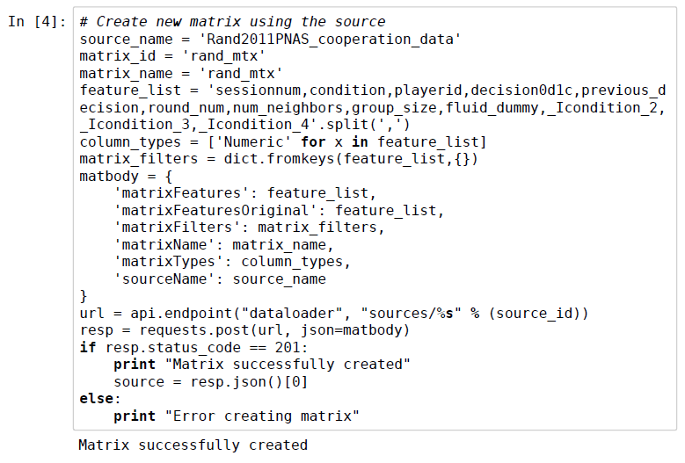
Jupyter Notebook Example

Slide 5
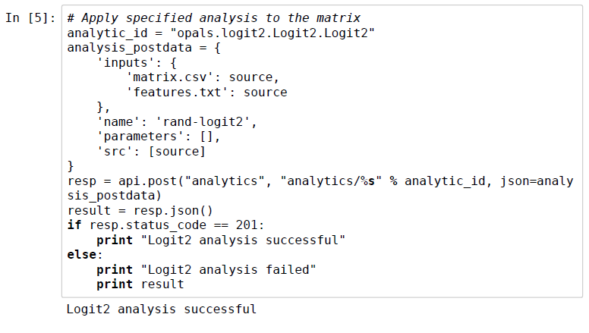
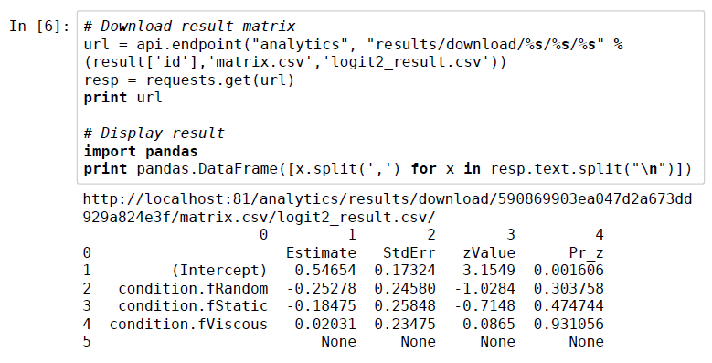
Jupyter Notebook Example

