Slide 1
Installation and Use of Bedrock

Slide 2
Prerequisites
Docker
Containerization framework
https://www.docker.com/
A git client
Revision control software
Jupyter
Software for interactive data science
https://jupyter.org

Slide 3
Checkout Bedrock from Github.com Start the Docker Container
These commands assume Linux or OSX installation Run these commands in order from a directory in which Bedrock is to be installed
git clone https://github.com/Bedrock-py/bedrock-core.git cd bedrock-core docker build -t bedrock . && ID=$(docker run -p 81:81 -p 82:82 –name bedrock -d bedrock)

Slide 4
Install logit2 Opal
Install the logit2 Opal into Bedrock (Needed because this is not installed by default by docker into a vanilla Bedrock Server) sh bin/docker_install_opal.sh bedrock https://github.com/Bedrock-py/opal-analytics-logit2.git

Slide 5
Running the Example Notebook
Locate the bedrock/examples/RAND2011study directory in the bedrock-core directory
Run `jupyter notebook` in that directory and open the workflow.ipynb notebook
This example runs a series of logit2 analyses that mirror the Rand et al 2011 study of cooperation in dynamic and static networks

Slide 6
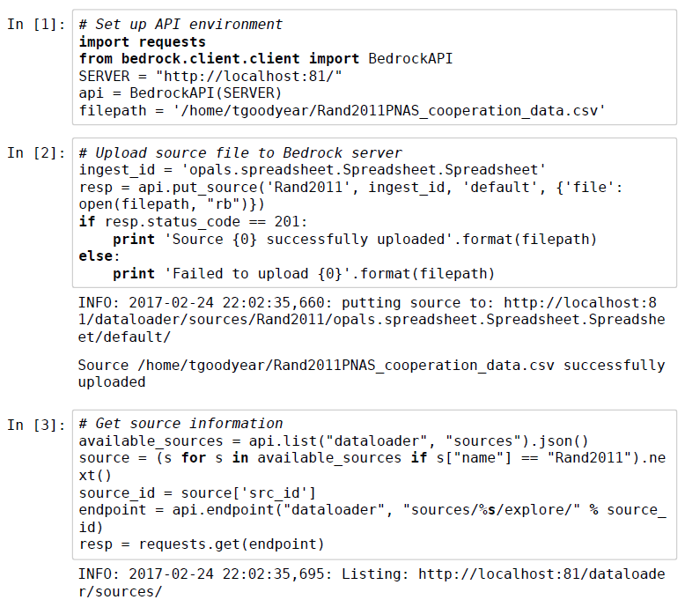
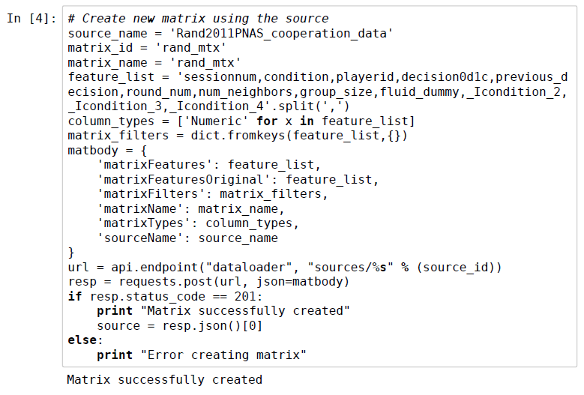
Jupyter Notebook Example

Slide 7
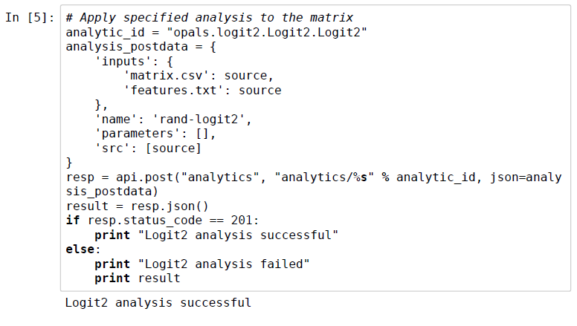
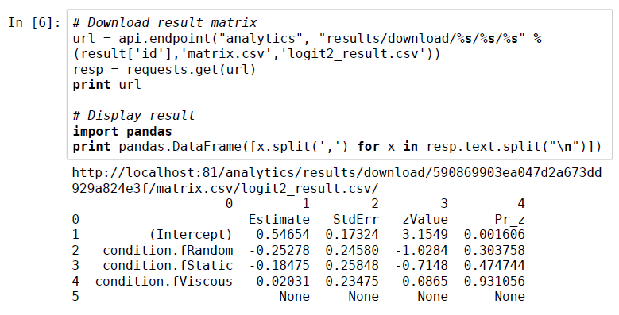
Jupyter Notebook Example

