Slide 1


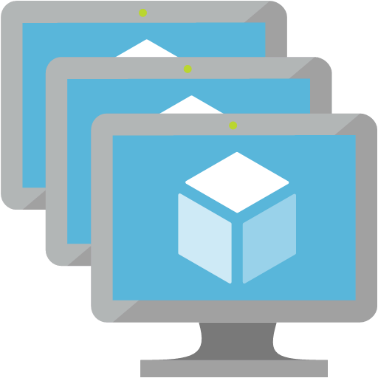



“sfabric-ip” used to access the Service Fabric Exlporer UI (Port 80) and SSH on the instances (Port 50000)
Ports: 22/19080
sfabric-ip
Service Fabric
Nodes
app-ip
Ports 80
Ports: 80
“app-ip” is used to access deployed applications over HTTP
Subnet 1

