Slide 1



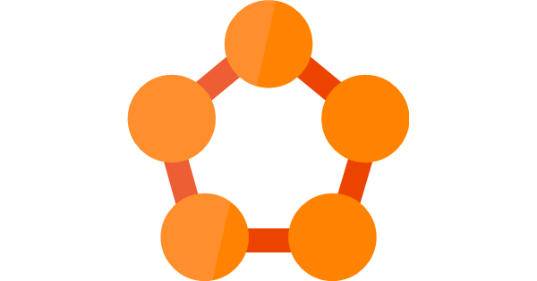
Microsoft Service Fabric Setup on GCP
Google VPC: SFNET
Bastion Host
[tags=bastion]
Firewall Rule: SSH access from ‘bastion’ to ‘sfnode’
Managed Instance Group
Google Cloud
Load Balancer
Auto Healing Health Check: HTTP Port 19080
Service Fabric Nodes
[tags=sfnode, nat-”region”]
NAT Gateway
Firewall Rule: External access for source=nat-”region”

