Slide 1
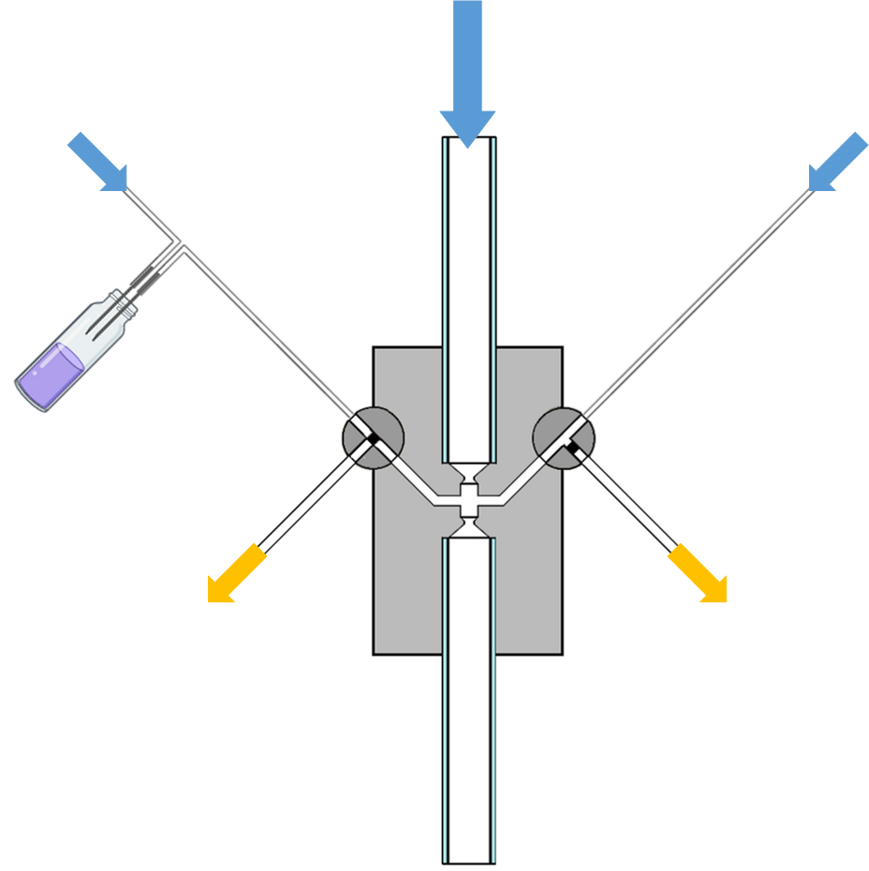
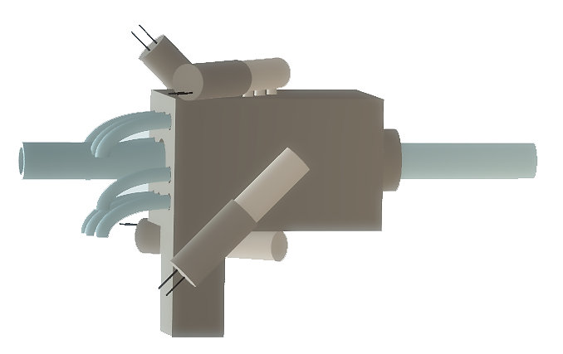

A
solenoid
valves
air
outlet
balance
valve
air
inlets
3D printed
mixing block
valved airstream
main
airstream
mixing
chamber
C
Olfactometer design
A) Schematic representation of single balanced odour channel consisting of two inlet airstreams (odour and balance) through the main body block into the mixing chamber, each controlled by separate three-way solenoid valves. Blue arrows indicate clean air inlets from a common regulated source. Yellow arrows indicate waste air stream outlet from each channel. B) 3D rendering of two channel stimulator. C) 2D top view rendering of two-channel stimulator with port for three-way solenoid valve. Dashed line illustrates location of (D) 2D cross section, illustrating mixing of main and valved airstreams in the mixing chamber.

Slide 2
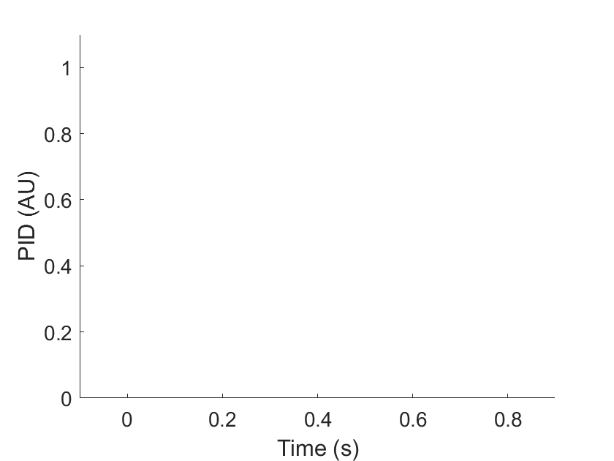
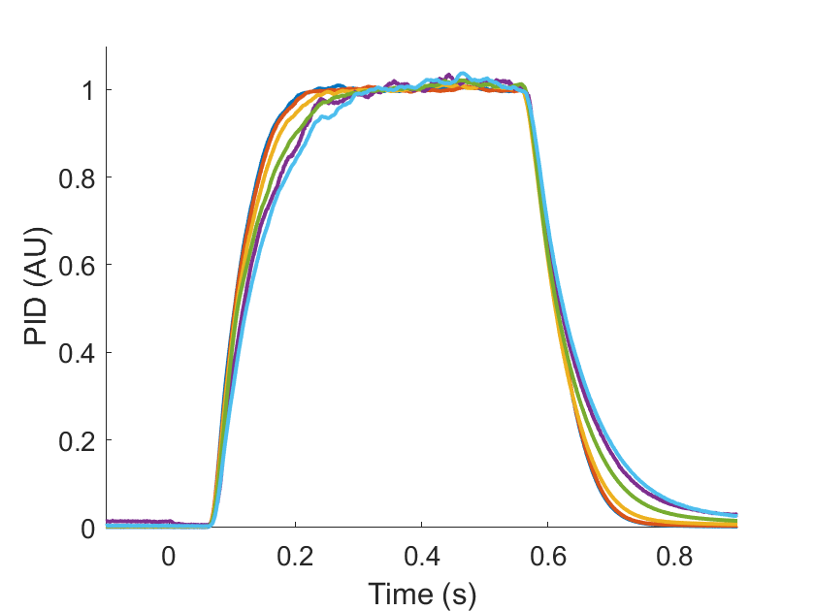
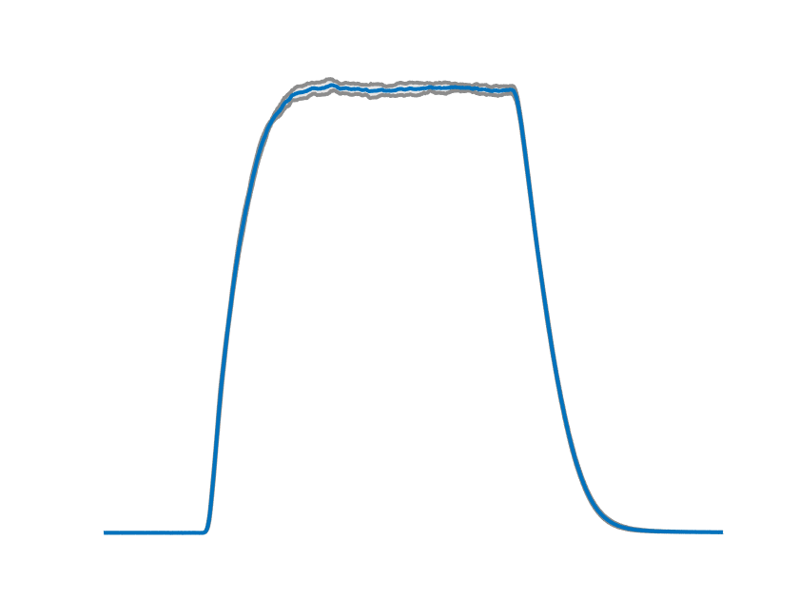
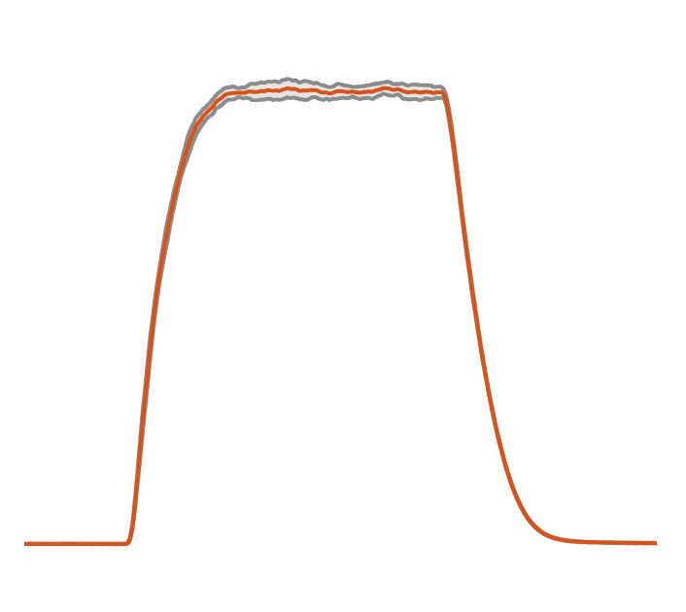
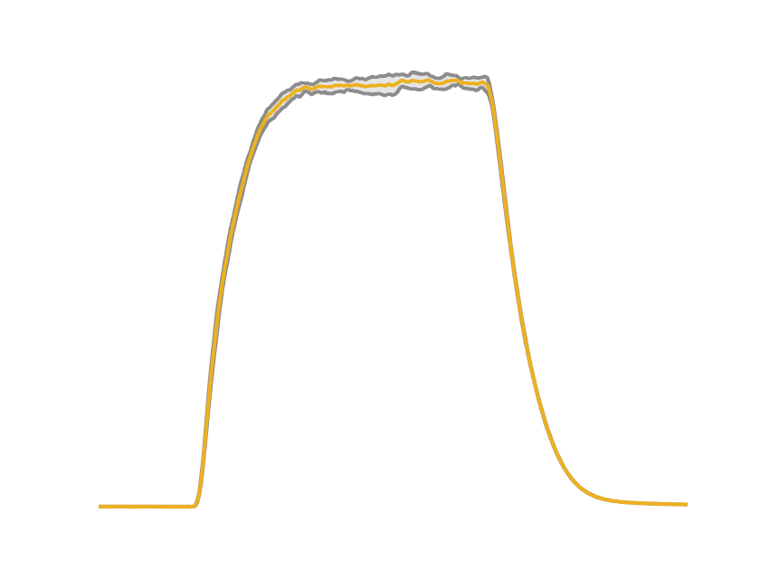
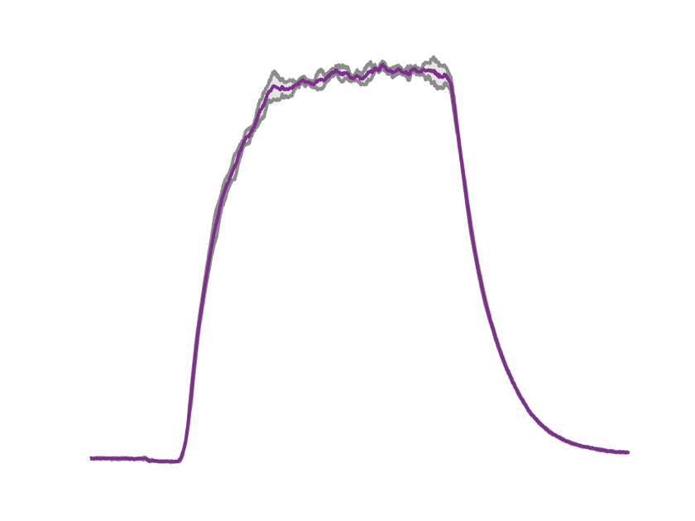
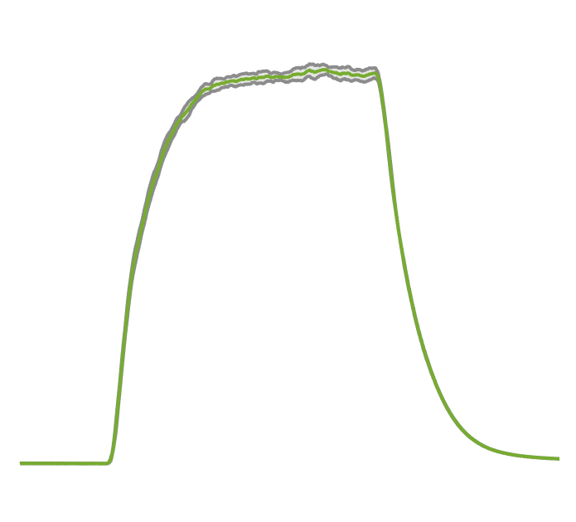
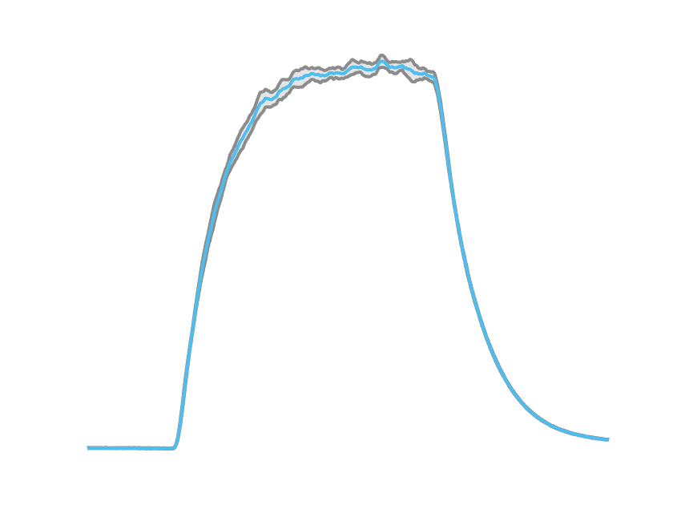
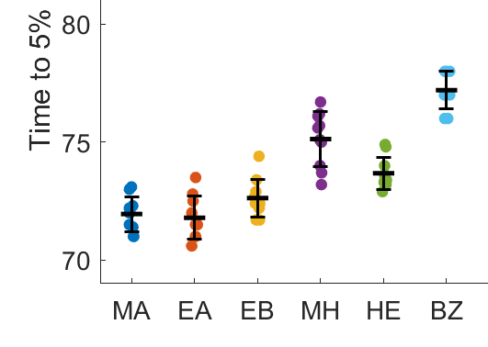
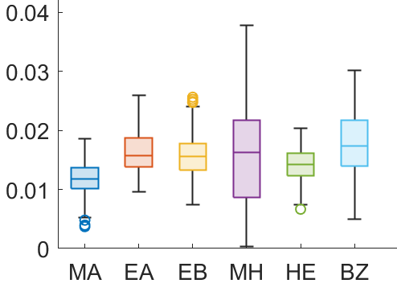
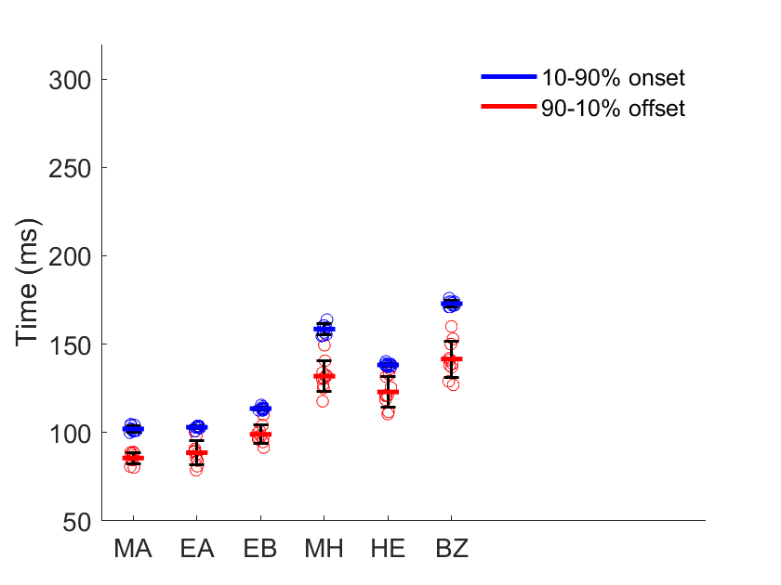
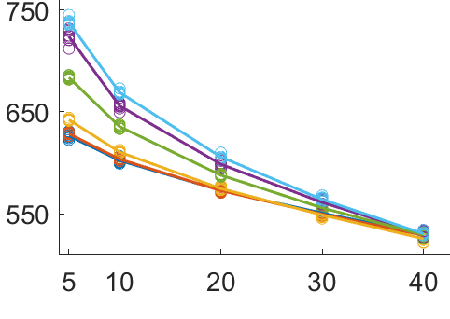
A
B
Methyl acetate 213 mmHg
Ethyl acetate 91.2 mmHg
Ethyl butyrate 14 mmHg
Methyl hexanoate 5 mmHg
2-heptanone 3.85 mmHg
Benzaldehyde 0.17 mmHg
C
D
E
F
Time (ms)
Pulse amplitude (%)
Generating reproducible single odour pulse stimuli
A) 500 ms pulses of six odours with a range of volatilities. Mean signal, normalised to maximum recording for each odour. B) Each odour from (A) plotted separately and ordered by increasing vapour pressure. (C) onset precision (time from valve timing to 5 % max odour); (D) pulse variability (S.D. of PID reading from onset to onset +500ms); (E) onset (time from 10-90 % max odour) and offset (time from 90-10 % max odour); and (F) effective pulse length above a range pulse amplitudes. Odours arranged by increasing vapour pressure in panels C-F. All measurements taken with Channel 1. Shaded area of B defines mean +/- SEM; Error bars in C,E
defines mean +/- S.D.; Box plot in D defines median SD, upper/lower quartile and min/mix whiskers; n = 10 for each odour tested.

Slide 3
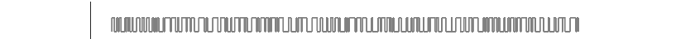
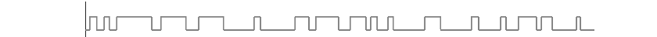
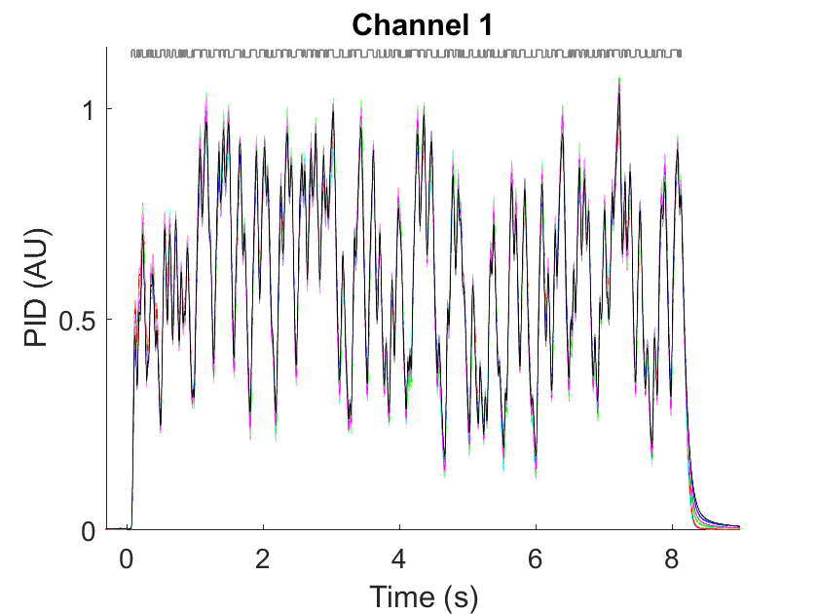
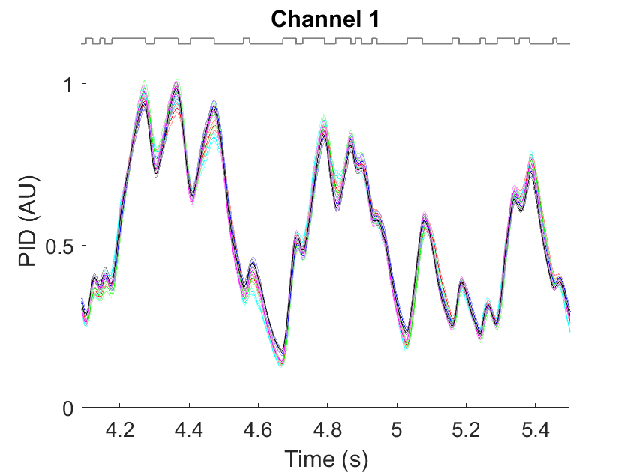
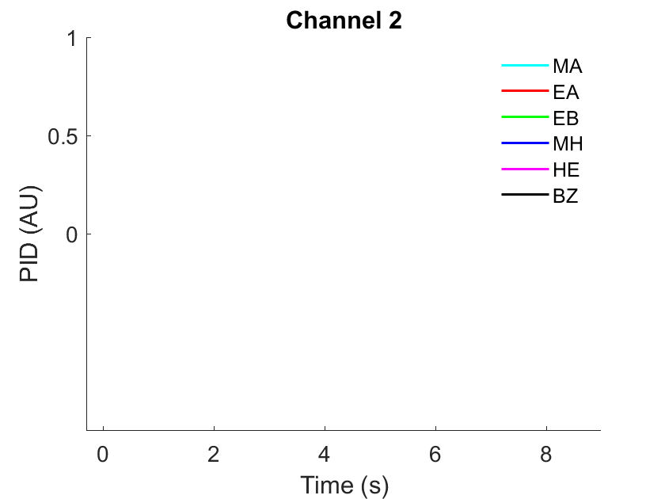
A
B
PID (AU)
Time (s)
Time (s)
Methyl acetate
Ethyl acetate
Ethyl butyrate
Methyl hexanoate
2-heptanone
Benzaldehyde
Generating reproducible mixed odour stimuli
A) Normalised PID timecourse signal from all six odorants during 8.2 s randomly fluctuating odour
stimuli. (B) zoomed section. Grey lines above each panel show the olfactometer valve state.

Slide 4
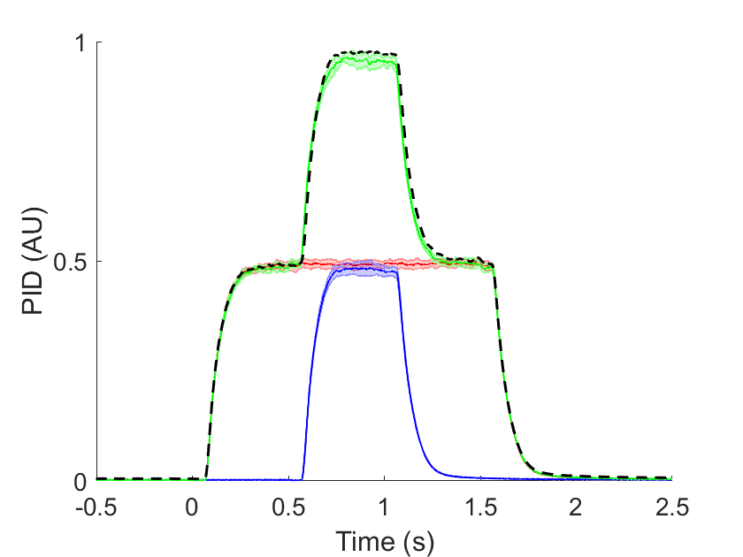
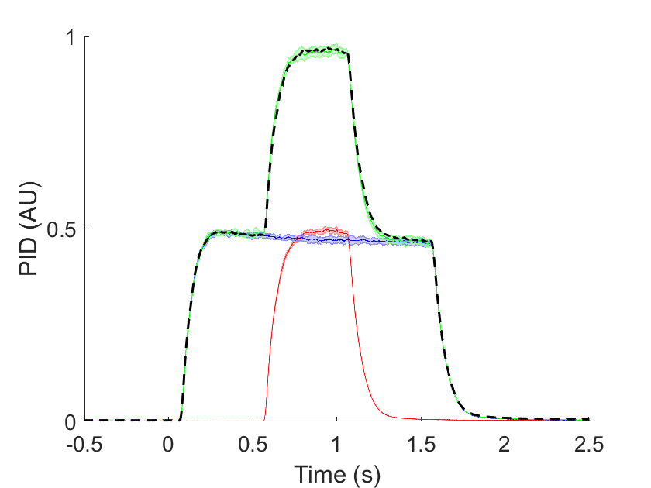
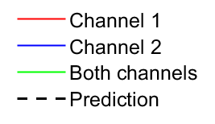
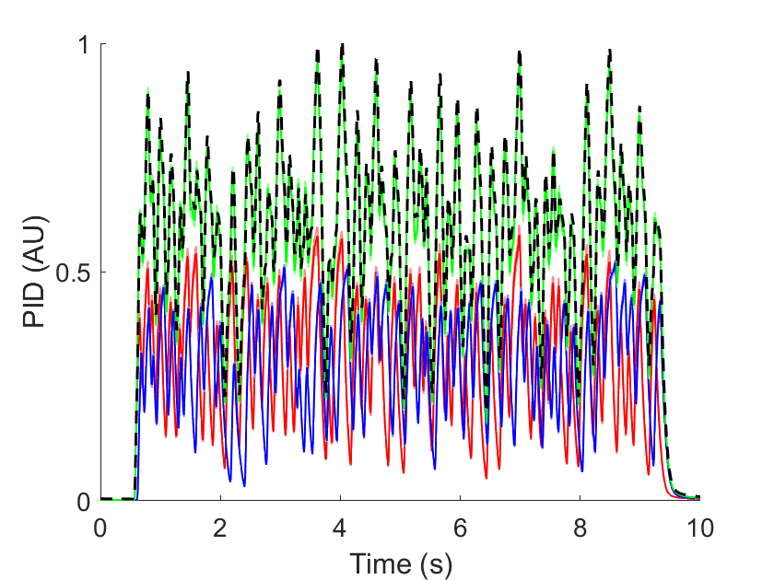
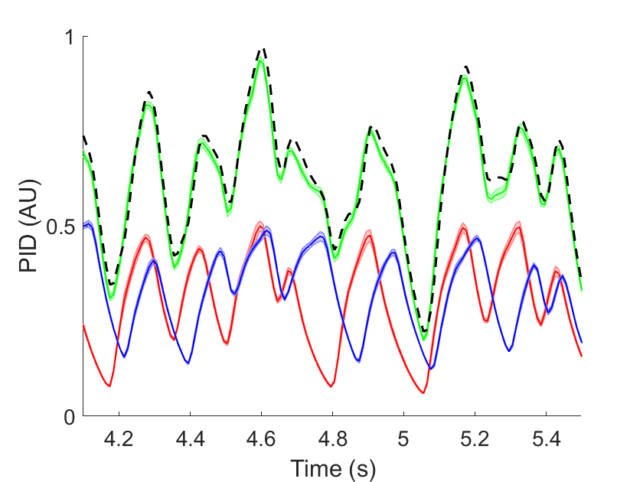
A
B
PID (AU)
C
D
PID (AU)
Time (s)
Time (s)
Independence of channels
A) A short pulse delivered from channel 2 on a longer pulse from channel 1. B) A short pulse
delivered from channel 1 on a longer pulse from channel 2. Dashed line generated from adding
individual single pulses from each channel (red and blue). Comparison with actual combined
pulse (green) reveals little difference. C) The combination of the two channels can also be accurately predicted during randomly fluctuating stimuli. D) zoomed region of (C) These stimuli were generated with pure 2-heptanone in both channels.

Slide 5
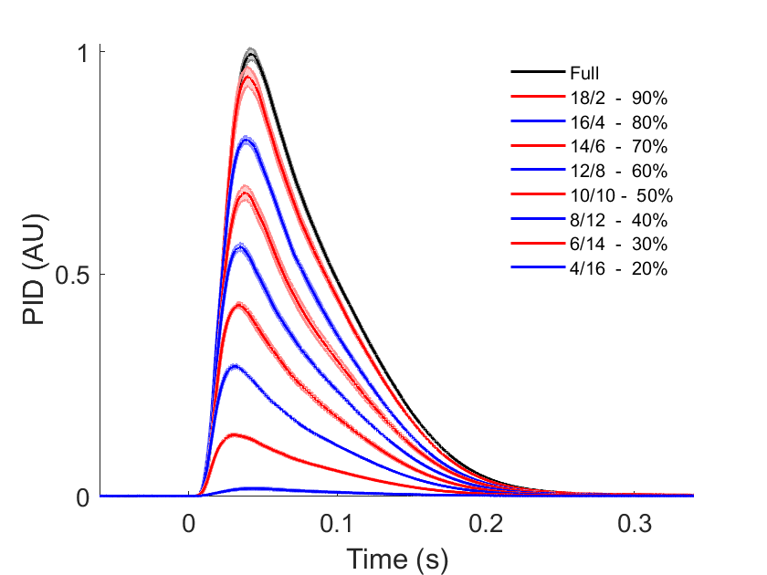
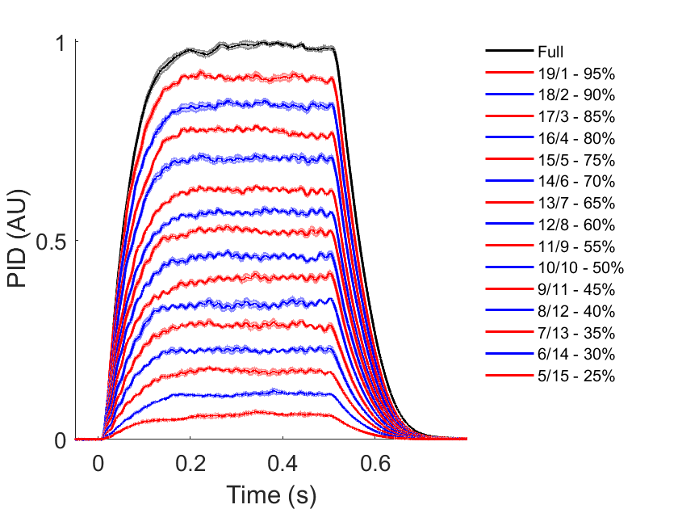
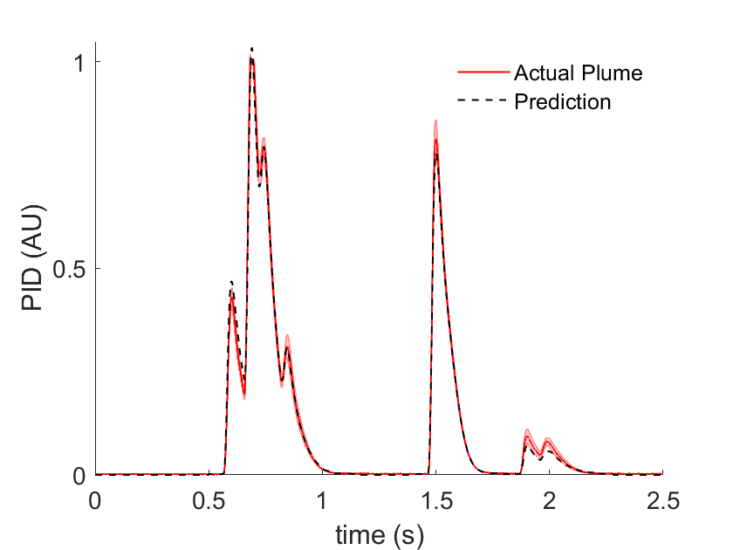
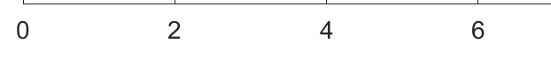
A
B
PID (AU)
PID (AU)
Time (s)
Time (s)
C
D
5 Hz
10 Hz
PID (AU)
Time (s)
Time (s)
Generating naturalistic odour stimuli
A) PID output during single cycle, generated by reducing duration of odour during 20 ms period
(e.g. 18/2 = 18 ms ON & 2 ms OFF) B) PID signal during 25 cycles, generating stable 500 ms
odour pulses of decreasing concentration. C) Prediction of a simple plume, generated by combining pulses from (A). D) Representative odour stimuli produced by opening the valve with 0.5 pulse duty. Complete pulses formed by valve cycles up to 5 Hz. These stimuli were all generated with ethyl acetate.

