Slide 1

Detecting anomalies in
RICH headers
BeeRump 2018

Slide 2


#> whoami
@JusticeRage
GReAT employee
A few open-source projects on GitHub
Manalyze
ApkTrack
FreedomFighting (⬅️ SSTIC 2018!)
Tor exit node operator
Not CISSP®

Slide 3
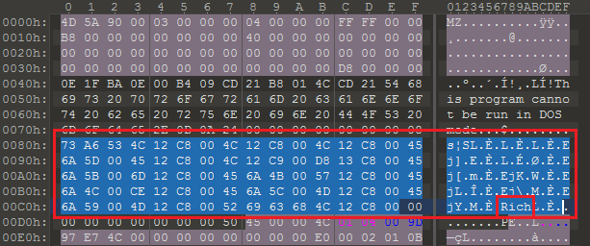
“RICH” header
An undocumented structure present in PE files
Opaque
Will always be added by Visual Studio
Notes:
Automatically added to all binaries generated by Microsoft’s build-chain (at link time) since 1998 (VS6)
Located in the middle of the MS-DOS stub
Was first discussed around 2007 – caused some paranoia regarding possible inclusion of personal data. Bonus points who sues Microsoft for the RICH header on RGPD grounds.
2008: used as proof against a malware author to show a sample was compiled on a machine belonging to them.
3

Slide 4
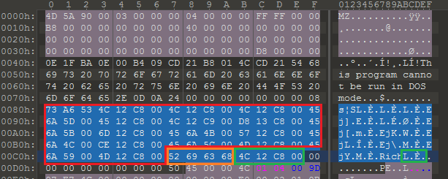
“RICH” header – Structure
Obfuscated start marker (“DanS”)
Obfuscated binary data
End marker (“Rich”)
XOR key
BLOB
XOR Key
More information: http://bytepointer.com/articles/the_microsoft_rich_header.htm

Slide 5
Header “RICH” – Blob
RICH Header:
------------
XOR Key: 0x76456920
Unmarked objects: 0
241 (40116): 17
243 (40116): 173
242 (40116): 30
C++ objects (23013): 2
199 (41118): 5
ASM objects (VS2015 UPD3 build 24123): 24
C++ objects (VS2015 UPD3 build 24123): 122
C objects (VS2015 UPD3 build 24123): 37
Imports (VS2008 SP1 build 30729): 29
Total imports: 478
C++ objects (VS2015 UPD3.1 build 24215): 123
Resource objects (VS2015 UPD3 build 24210): 1
151: 26
Linker (VS2015 UPD3.1 build 24215): 1
Notes:
Data dumped from Notepad++
Structure: ID / Build number / Count
ID = type d’objet (.c, .cpp, ressource…). Différentes chaînes de compilation génèrent des ID différents pour le même type d’objet.
Build number = révision de la chaîne de compilation. Croissants au sein d’une même famille (Ex: VS 2015) mais pas entre familles.
Problème : cible mouvante : pas de référence pour les ID ni les build numbers ☹

Slide 6
“RICH” header – XOR key
4 bytes, *not* random
Can be derived from the DOS and RICH headers
Each byte from the DOS header is rotated by its offset
Each ID / build number pair is rotated by the associated count
C++ implementation of the XOR key generation
Notes:
Key takeaway: the XOR key is redundant information. In other words, it can be used as a checksum.
That’s it for the RICH header overview. Let’s look into why we’re talking about it today.

Slide 7
OlympicDestroyer
Campaign against the Pyeongchang 2018 Winter Olympics
The wiper (3c0d740347b0362331c882c2dee96dbf) stands out:
Same RICH header as a BlueNoroff sample
Implying the executables were compiled on the same machine
Code similarities (file deletion routine) with BlueNoroff malware
Possible false flag operation as presented at SAS 2018
https://securelist.com/the-devils-in-the-rich-header/84348/

Slide 8
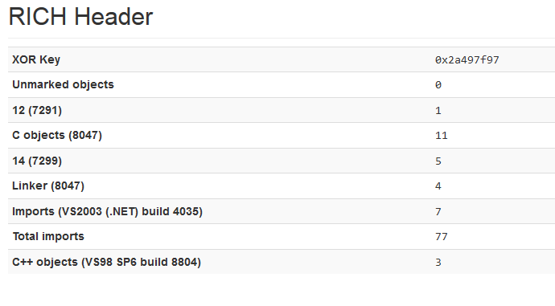
OlympicDestroyer
“Built” with VS 2003 / VS 6
Uses VS 2010’s startup code in ___tmainCRTStartup.
Contains references to mscoree.dll which didn’t exist at the time.
Notes:
The 8047 build number is related to VC6 according to Kaspersky but I couldn’t find any resource confirming this.
Additionnaly, a sample of the same malware was found on an online sandbox with its original RICH headers.

Slide 9



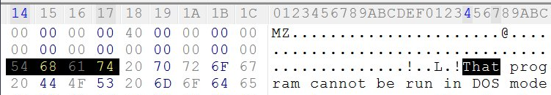
Looking for anomalies in the RICH header
RICH support added to Manalyze mid-March 2018
Old technique I wanted to detect:
https://twitter.com/zerosum0x0/status/925486850399019009/
Notes:
This was a nice opportunity to implement RICH header parsing in Manalyze and look for additional ways to exploit it.

Slide 10
Looking for anomalies in the RICH header
The XOR key is a checksum on the DOS header
Verify that it is valid:
-------------------------------------------------------------------------------
~/Code/Manalyze/resources/tampered.exe
-------------------------------------------------------------------------------
Summary:
--------
Architecture: IMAGE_FILE_MACHINE_I386
Subsystem: IMAGE_SUBSYSTEM_WINDOWS_GUI
Compilation Date: 2016-Jul-25 00:55:51
Detected languages: English - United States
[ MALICIOUS ] The file headers were tampered with.
The RICH header checksum is invalid.
Notes:
First and most direct idea. Everyone already does this :)

Slide 11
Looking for anomalies in the RICH header
OlympicDestroyer: the whole RICH header is copied, so the checksum is valid
There must be other inconsistencies
Count the actual number of imports
Notes:
For some reason I haven’t been able to figure out, it’s quite common for the RICH header to report more imports than there actually are. However, I have yet to find a legitimate executable where the RICH header indicates less of them, so I’ve added this heuristic to Manalyze as well.
Idea: apply the same logic to the number of resources?

Slide 12
Looking for anomalies in the RICH header
Compare the actual number of imports with the one reported in the RICH header:
-------------------------------------------------------------------------------
~/Code/Manalyze/resources/3c0d740347b0362331c882c2dee96dbf // Olympic Wiper
-------------------------------------------------------------------------------
Summary:
--------
Architecture: IMAGE_FILE_MACHINE_I386
Subsystem: IMAGE_SUBSYSTEM_WINDOWS_GUI
Compilation Date: 2017-Dec-27 09:03:48
Detected languages: English - United States
[ SUSPICIOUS ] The PE is packed or was manually edited.
The number of imports reported in the RICH header is inconsistent.
Notes:
When this happens, I can think of two possibilities:
The RICH header was overwritten with one from a different binary
The program has been packed and its IAT is not the original one
To the best of my knowledge, this is an original technique

Slide 13
Conclusion
It’s harder than expected to fake a RICH header
Useful for static analysis:
Mostly unknown to unsophisticated attackers
Leaks information about the author’s build chain
Inconsistencies imply modifications after the binary was compiled
Applications to malware clustering
Same RICH header ➡️ same codebase + compiled on the same machine
Nearest neighbors probably belong to the same family
https://blog.kwiatkowski.fr/?q=en/rich-header

