Slide 1
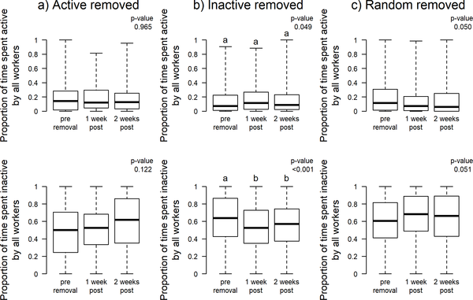

Fig 1.
Charbonneau D, Sasaki T, Dornhaus A (2017) Who needs ‘lazy’ workers? Inactive workers act as a ‘reserve’ labor force replacing active workers, but inactive workers are not replaced when they are removed. PLOS ONE 12(9): e0184074. https://doi.org/10.1371/journal.pone.0184074
https://journals.plos.org/plosone/article?id=10.1371/journal.pone.0184074

