Slide 1
Bee Spelled
Naomi Perry, Thomas Lewallen, Jack Dwyer

Slide 2
Problem Definition
There is a need for an efficient way to study for a spelling bee or spelling test
The most common way of doing so involves being tested by a friend/family member
Current applications lack desired functionality (using the word in a sentence, origin, voice recognition, etc.)

Slide 3
Scope of System
The system will allow users to create their own lists of words by typing, pasting, and importing them from a text file
Users will also be able to hear the questions, sentences, origins, etc.
The system will recognize the user both speaking and typing their answers
Users will also be able to save lists for future use and share lists with other users

Slide 4
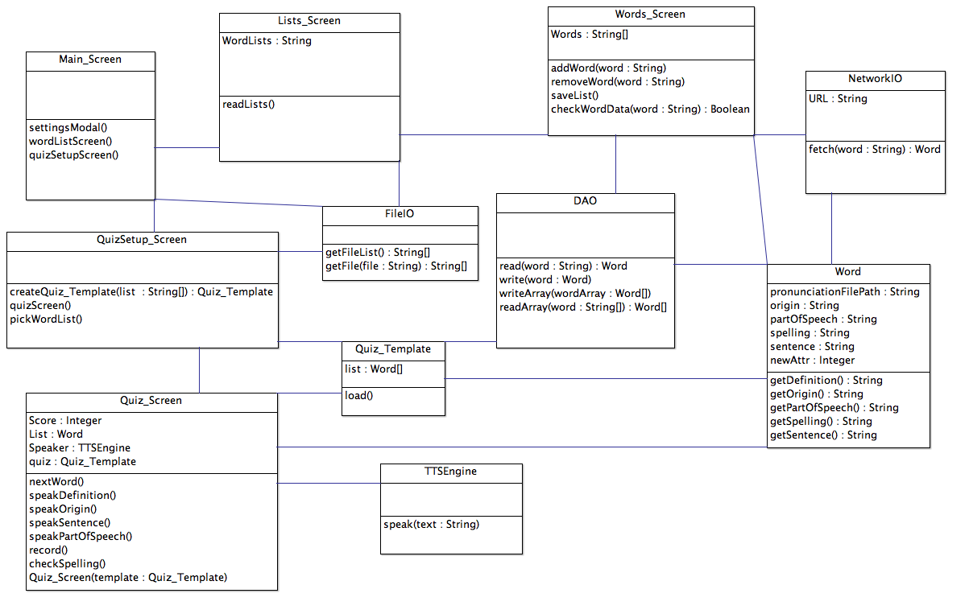
Class Diagram

Slide 5
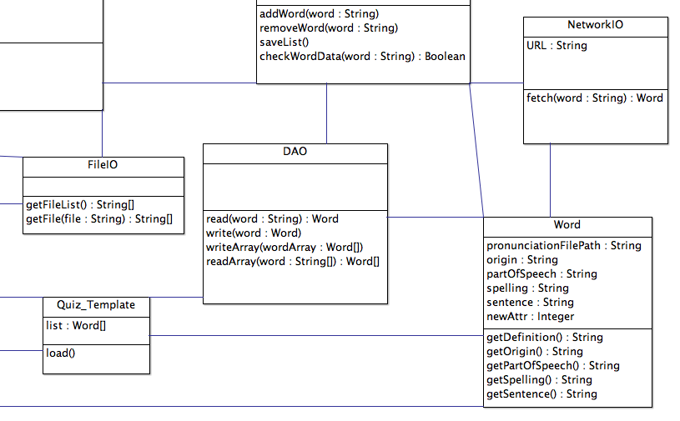
Class Specifics…

Slide 6
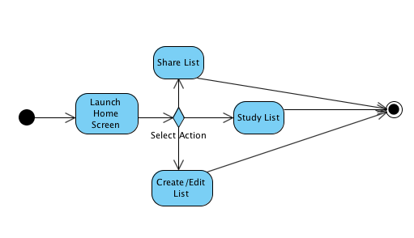
Main Activity Diagram

Slide 7
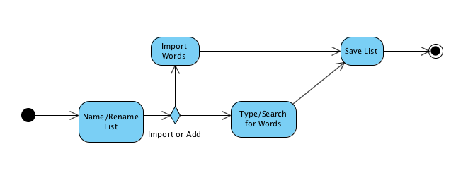
Create/Edit List Activity Diagram

Slide 8
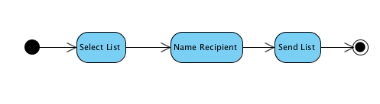
Share List Activity Diagram

Slide 9
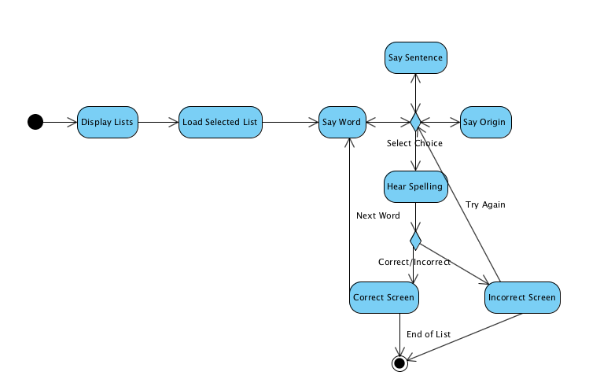
Study List Activity Diagram

Slide 10
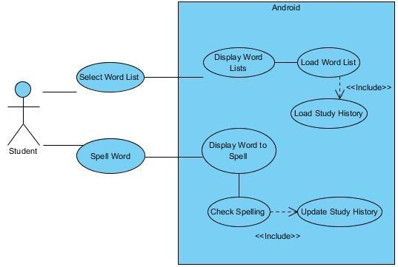
Study Word List Use Case Diagram
Notes:
This is the study word list use case diagram. Once a user selects a word list to be tested, the word list and study history for that word list is loaded. Then the user is tested on words in the list based on their study history and the history is updated based on the user's correctness.

Slide 11
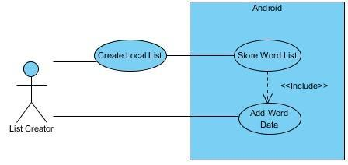
Create Local Word List Use Case Diagram
Notes:
This is the create local word list use case diagram. The user names the list and adds data for all of the words and it is stored on their device.

Slide 12
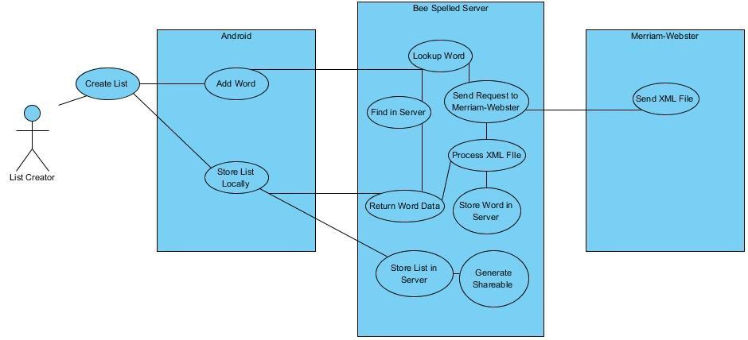
Create Sharable Word List Use Case Diagram
Notes:
This is the create sharable word list use case diagram. When the user types a word, it is sent to our server. If the word is found in our server, it returns the data for that word to the user's device. If it is not found in our server, we request the word from Merriam-Webster and process the XML file for that word. Then the word data is stored in our server and is returned to the user's device. Once the user finishes adding words to the list, the list is stored on their device for testing and on the server for sharing. The user is also given options to share the list with other people.

Slide 13
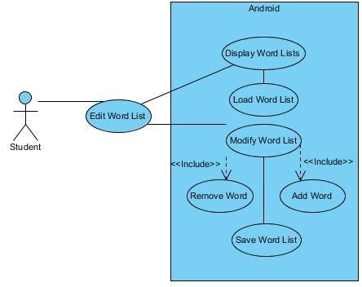
Modify Word List Use Case Diagram
Notes:
This is the modify word list use case diagram. The user selects a word list to edit and is then given the option to add or remove words from the list. When the user is finished, the word list is saved.

Slide 14
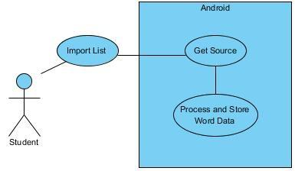
Import Word List Use Case Diagram
Notes:
This is the import word list use case diagram. The user selects the text file containing the word list and it is processed and stored on the device.

Slide 15
Feature Priority
Required
Create a list by typing and adding audio
Import a list from a text file
Save lists for future use
Edit previously made lists
Test users from a word list
Allow user to hear word, origin, definition, and sentence while being tested
Allow user to spell word by speaking or typing
Possible
Share lists with other users
Create a list by searching Merriam-Webster words
Future Work if Time Available
Gamification
More methods for creating lists

Slide 16
Risks
Scope Creep
Exceeding limits of free license of Merriam-Webster API
Technology doesn’t work as expected (Specifically Voice to Text)
Inexperience with the Android platform
Productivity

