Slide 1
Pattern Analysis & Machine Intelligence Praktikum: MLPR-19 Week 1: Versioning and documentation
Andrés Fernández, Martin Mundt, Tobias Weis

Slide 2


Versioning – what is it and why should we use it?
Keeping track and documenting changes to your code and / documents
Reasons to use versioning:
Troubleshooting and backtracking
Logging
Remote backup
Simplified addition of features
Sharing with a team

Slide 3

Versioning – what is it and why should we use it?
Works by having a copy of your code on a server as a master-copy, changes can be sent or received.
There exists a huge ecosystem of different version control systems, most common are:
Git
Mercurial
CVS (concurrent versions systems)
SVN (subversion)
Git and Mercurial are distributed: the server has a master-repository, but there is a local repository on the user’s machine
SVN and CVS are non-distributed and all commits go to the server

Slide 4

Versioning – what is it and why should we use it?
This enables:
Keeping track of changes to files and folders
Teamwork on code with multiple authors in parallel
A record of who did what and when
The „why“ is provided by commit messages
Release of stable versions while working on new features

Slide 5
Versioning - diffs
https://www.git-tower.com/blog/content/posts/90-diff-tools-windows/meld.png

Slide 6
Git
Open source version control system designed for speed and efficiency
Best insurance against
Accidental mistakes (like deleting files)
Remember what has been changed (and why)
Hard-drive-failures, fire, earthquakes
Created by Linus Torvalds (for managing Linux kernel)
„I‘m an egoistical bastard, and I name all my projects after myself. First ‚Linux‘, now ‚Git‘“ Linus Torvalds

Slide 7
Git
Server
Getting a Git-Server:
Hosted solutions include github.com (widespread, public repos free), bitbucket.com
Self-hosted gitserver: gitlab
Client
Getting the Git client:
Windows: Download from http://git-scm.com/downloads
Mac: brew install git
Linux: sudo apt-get install git

Slide 8
Git – why distributed?
Use GIT on your local machine without being connected to the internet
Revisions (commits) you make to your local repo are available to you only
The next time you are online (or you want to), you can push your changes to the server for sharing/backup
The local nature makes it effortless to create branches to isolate your work
A lot of minor changes (local commits) can be pushed as a single commit to remote branch

Slide 9
Git - workflow
Obtain a repo (only needed once)
git init, git clone
If repo already exists, make sure to first pull any changes by others
git pull
Make changes to some files, then
git status, git commit –m“Always write clear commit messages“
Add new files:
git add mynewfile.py
git commit mynewfile.py –m“added mynewfile.py“
Push to the server
git push

Slide 10
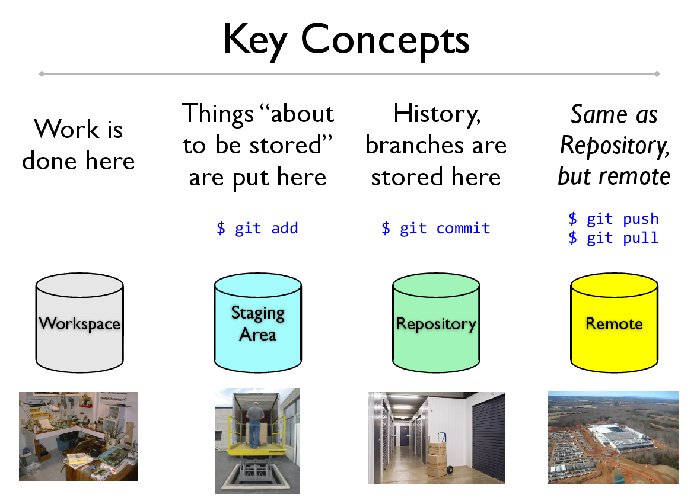
Git - workflow
Source: http://de.slideshare.net/eykanal/git-introductory-talk

Slide 11
Git
Branches
Allow to try out ideas/experiment isolated from the master-branch of the code
Enable to work on long-running topics without interferring/breaking the master-branch
Share work-in-progress with others
Incorporate finished work into master-branch

Slide 12
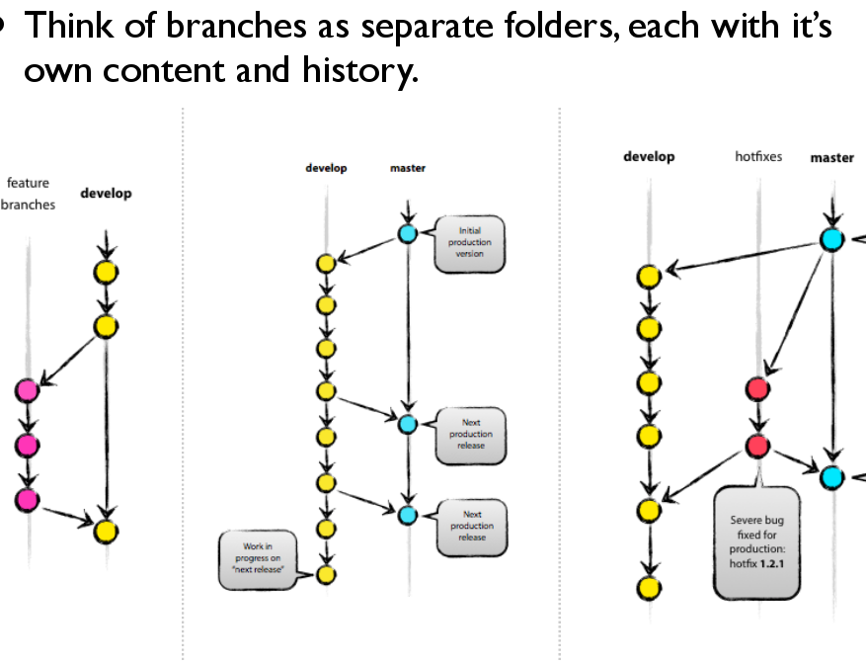
Git - branches
Source: http://de.slideshare.net/eykanal/git-introductory-talk

Slide 13
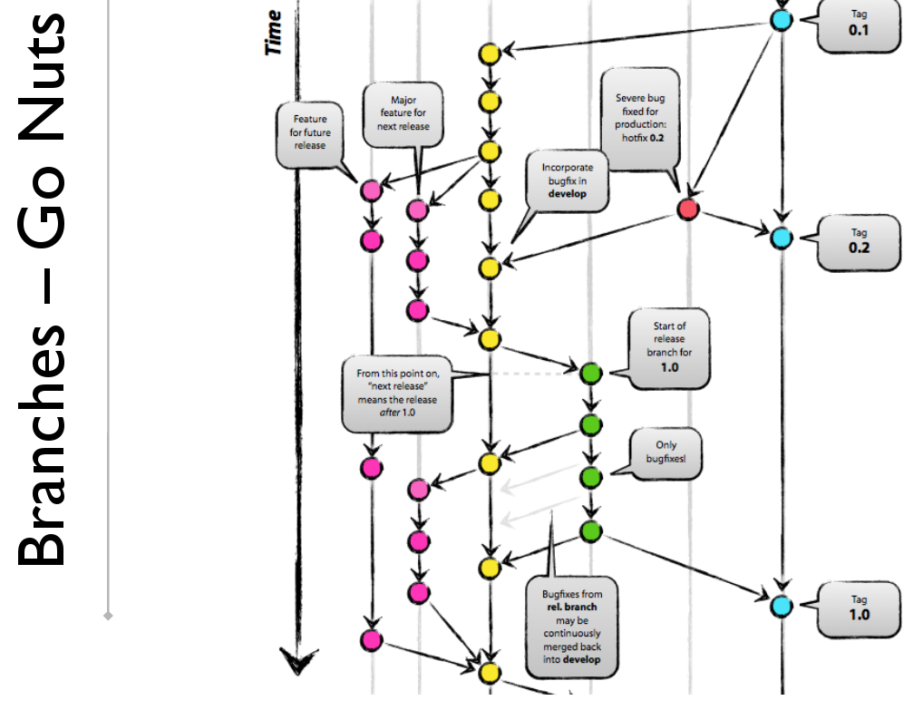
Git - branches
Source: http://de.slideshare.net/eykanal/git-introductory-talk

Slide 14
Git – branching workflow
Download/Create a local repo
$ git clone
$ git init
Checking what's changed
$ git status
$ git log
Storing edits
$ git add
$ git commit
Updating your local repo
$ git pull (git fetch)
$ git branch
$ git merge
Storing changes offsite/offbox
$ git commit
$ git push
Storing changes offsite/offbox
$ git tag
$ git push

Slide 15
Git
Additional tips/conventions:
Do not put large binary files in plain git (use git-lfs, or a fileserver)
Always create a README in the toplevel directory describing your work
Try to only keep runnable code in the master-branch
Github.com:
Public repos are free
Easy-to-use web-interface
Has markdown enabled for *.md files (README)
Has a wiki for every repo

Slide 16
Python style guidelines
Guidelines on formatting code, comments and docstrings for ease of readability
https://www.python.org/dev/peps/pep-0008

Slide 17
PEP8
Limit all lines to a max of 79 characters
Separate top-level function and class definitions with two blank lines
Method definitions inside a class are separated by a single blank line
Use blank lines in functions (sparingly) to indicate logical sections

Slide 18
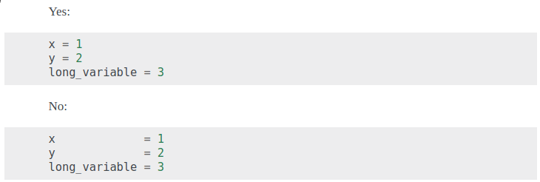
PEP8
Whitespaces
NOT immediately inside parentheses, brackets or braces
NOT immediately before a comma, semicolon or colon
NOT immediately before open parenthesis that starts the argument list
NOT immediately before open bracket that starts indexing or slicing
NOT more than one space around an operator

Slide 19
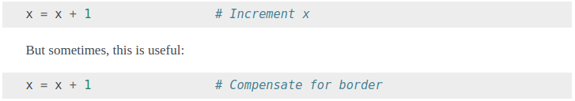
PEP8: comments
Comments
Worst: comments that contradict the code (keep them up-to-date!)
Should be complete sentences
Comments should always be written in English
Block comments generally apply to code that follows them, indented to same level as the code. Each line starts with a # and a single space
Inline comments are on the same line as the code
Use inline comments sparingly, and only to add additional explanations

Slide 20
Docstrings
Documentation Strings (Docstrings)
PEP257
Write them for all public
Modules
Functions
Classes
Methods
Not necessary for non-public methods (but put a comment there (after the def))
Docstrings start and end with “““

Slide 21
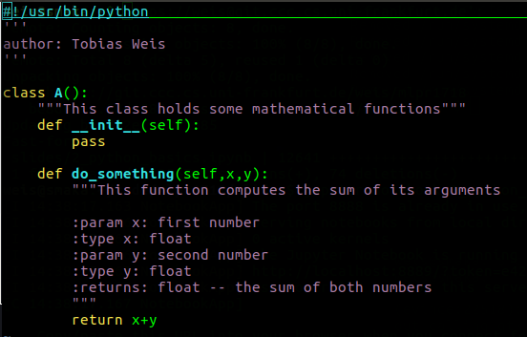
Docstrings
Inside code, for this class: „sphinxy“ docstrings:

Slide 22
Documentation generation with Sphinx
In source folder; sphinx-quickstart. Set root folder to ./docs
In docs-folder: sphinx-apidoc –o source/ ../
Open index.rst, insert source/modules.rst to toc
In conf.py, add the source-path to your system path import os, sys sys.path.insert(0, os.path.abspath(„..“)
In conf.py, add globaltoc.html to html_sidebars
Make html -> Google-chrome ./_build/html/index.html
Make latexpdf -> evince ./_build/pdf/projectname.pdf

Slide 23
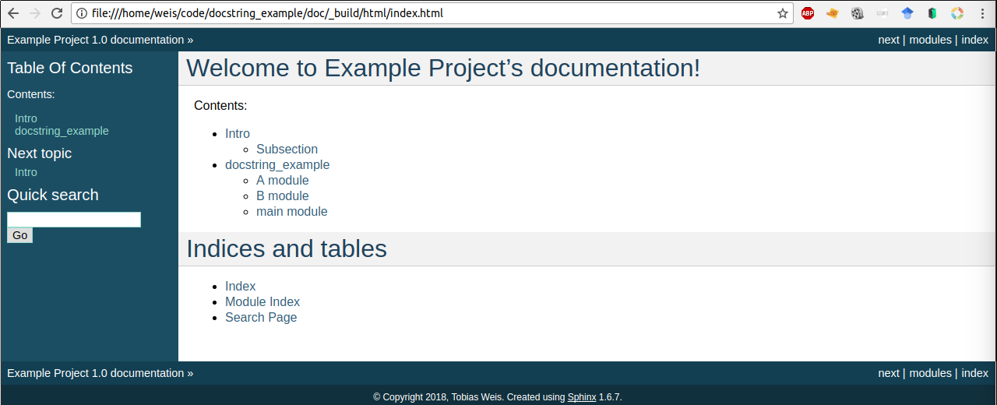
Sphinx

Slide 24
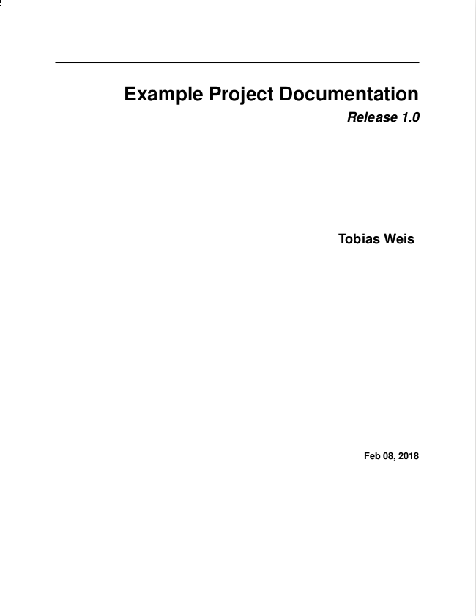
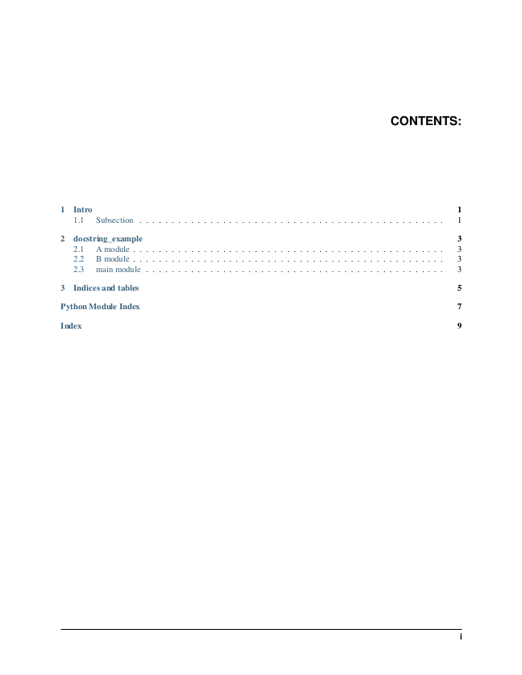
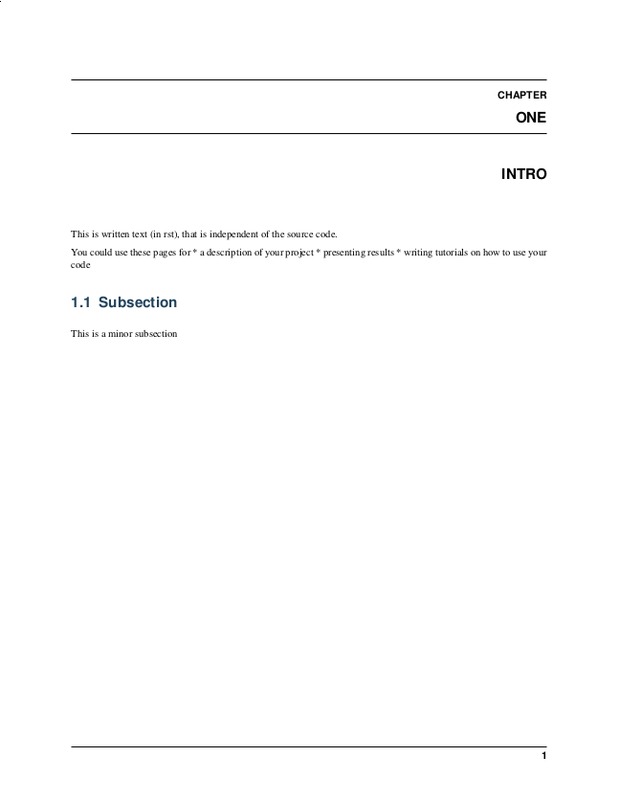
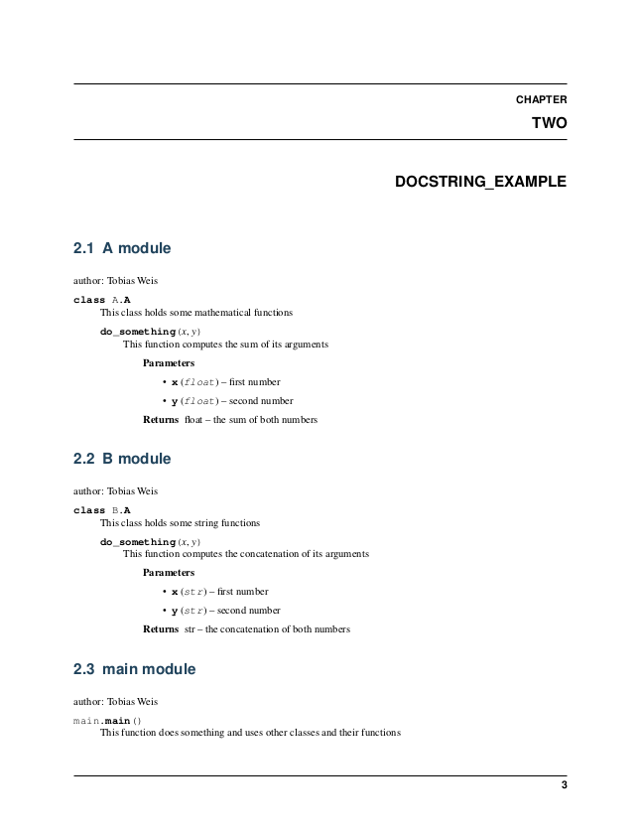
Sphinx: LaTex report

