Slide 1
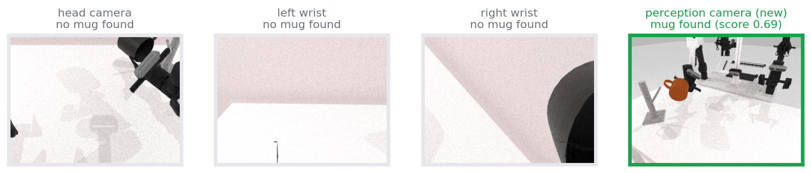




Perception we can now measure and trust
Saved camera frames, scored offline against simulator labels; every fix measured before and after
40 → 0
wrong “safe to release” answers on toppled mugs
Same moment, four cameras: only the new perception camera finds the mug in the right gripper
10% → 75%
The evaluation loop
mug found while in the right gripper
0.09 → 0.88
Capture
SAM 3 cache
Evaluate
Fix
run the policy, save frames + labels
segment each frame once (GPU)
real provider vs labels (CPU, seconds)
one rule, one test, re-score
right-arm lift recall (precision stays 1.00)
Notes:
We built an offline loop: capture frames from the frozen policy with simulator labels kept separate, ask SAM 3 once per frame, then replay everything through the real perception provider on CPU. Every fix is measured on the same frames. Highlights: a surface-normal check stopped all 40 wrong 'safe to release' answers on toppled mugs; a fixed perception-only camera finds the right-held mug 75% of the time instead of 10%; and right-arm lift detection went from 0.09 to 0.88 recall with precision 1.00. Also: captures render only frames that are used (about 30x fewer renders) and policy calls time out after 5 minutes.

Slide 2


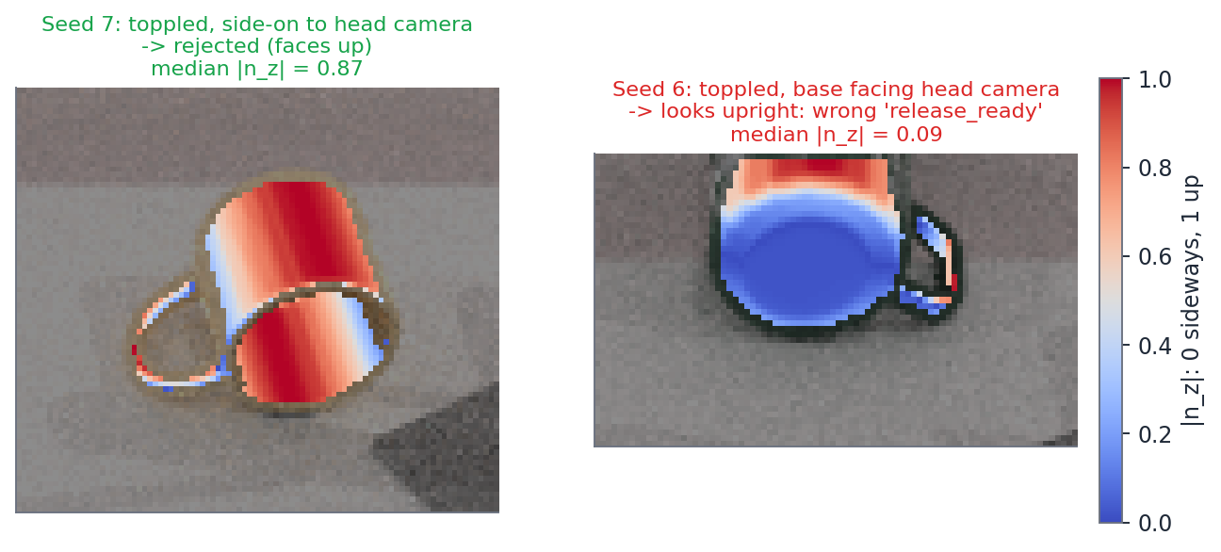


What it means for the supervisor
Every stop, retry and release decision is a predicate, and in a real run predicates come only from cameras
Perception
cameras → SAM 3 → depth → facts
facts: lifted? safe to release?
Supervisor
planner: stop · retry · release
one skill per turn
Frozen VLA policy
Blind spot
moves both arms, never changed
A mug toppled end-on looks upright: 25 wrong answers in one episode. Next fix: mug axis from depth.
A wrong “true” makes the supervisor act on something false; “unknown” only makes it wait. So we optimise precision first.
Notes:
The supervisor sits on the frozen policy and decides when to stop it, retry, or let go of the mug. It decides from predicates, and in a real run those come only from perception. That is why precision matters most: a wrong 'true' makes it open the gripper on a toppled mug; 'unknown' only makes it wait. On held-out seeds 5 to 9, with every rule frozen, lift detection kept precision 1.00, but one mug that toppled with its base facing the head camera looked upright and produced all 25 wrong release answers. Without that episode both release predicates stay at 1.00. The fix, estimating the mug's axis from depth, is the next perception task.

Slide 3






Next: recover from failures instead of aborting
Plans only: bounded skill commands, each gated by a perception check
Toppled
detected
Grip across
the axis
Lift
10 cm
Roll 90°
(new skill)
Place at
stage pose
Staged ✓
resume handoff
Retry facts from the gripper
Build order
1
Save toppled states as checkpoints
seeds 6 and 7
2
Prove the motion with the oracle
can the arm do it?
3
Add the perception facts, scored offline
can the eyes see it?
Fingers stop part-way
= mug held
Fingers close fully
= grasp missed
4
End to end on fresh seeds
success with vs without recovery
Measured finger opening + camera position → grasp confirmed / failed, transfer complete
Notes:
Recovery is the next phase, and nothing here is implemented yet. When the policy topples the mug, the supervisor would grip it across its axis, lift it, roll it 90 degrees with a new bounded skill, place it at a publicly defined staging pose and resume the normal handoff, checking a perception fact at every step. For grasp retries, cameras alone cannot see finger contact, so we would add the measured finger opening: fingers that stop part-way mean the mug is held, fingers that close fully mean the grasp missed. We would start from saved toppled states and prove the motion with the oracle before writing perception code, then confirm everything on fresh seeds.

