Slide 1
PRESCRIPTIVE ANALYTICS OF UK 2019 ROAD ACCIDENT data
OSAGIE ELLIOT AIBANGBEE

Slide 2

PROBLEM
“Saving lives is one of the finest things a man can do.” Abraham Lincoln
By analysing the 2019 UK road accidents data, how can we set up more effective measures/policies to reduce the number of future accident casualties/fatalities?
GOAL:
Assist government officials by prescribing effective, data-driven suggestions based on insights gained from data analysis.
Subtasks: data cleaning, feature engineering, correlation analysis, association mining, inferential statistics, and recommendation
https://www.google.com/url?sa=i&url=https%3A%2F%2Fwww.pinterest.com%2Fpin%2F453526624949908194%2F&psig=AOvVaw2OA65rlDnroukW8pMYzef3&ust=1676898992624000&source=images&cd=vfe&ved=0CA4QjRxqFwoTCKj1itPVof0CFQAAAAAdAAAAABAE

Slide 3
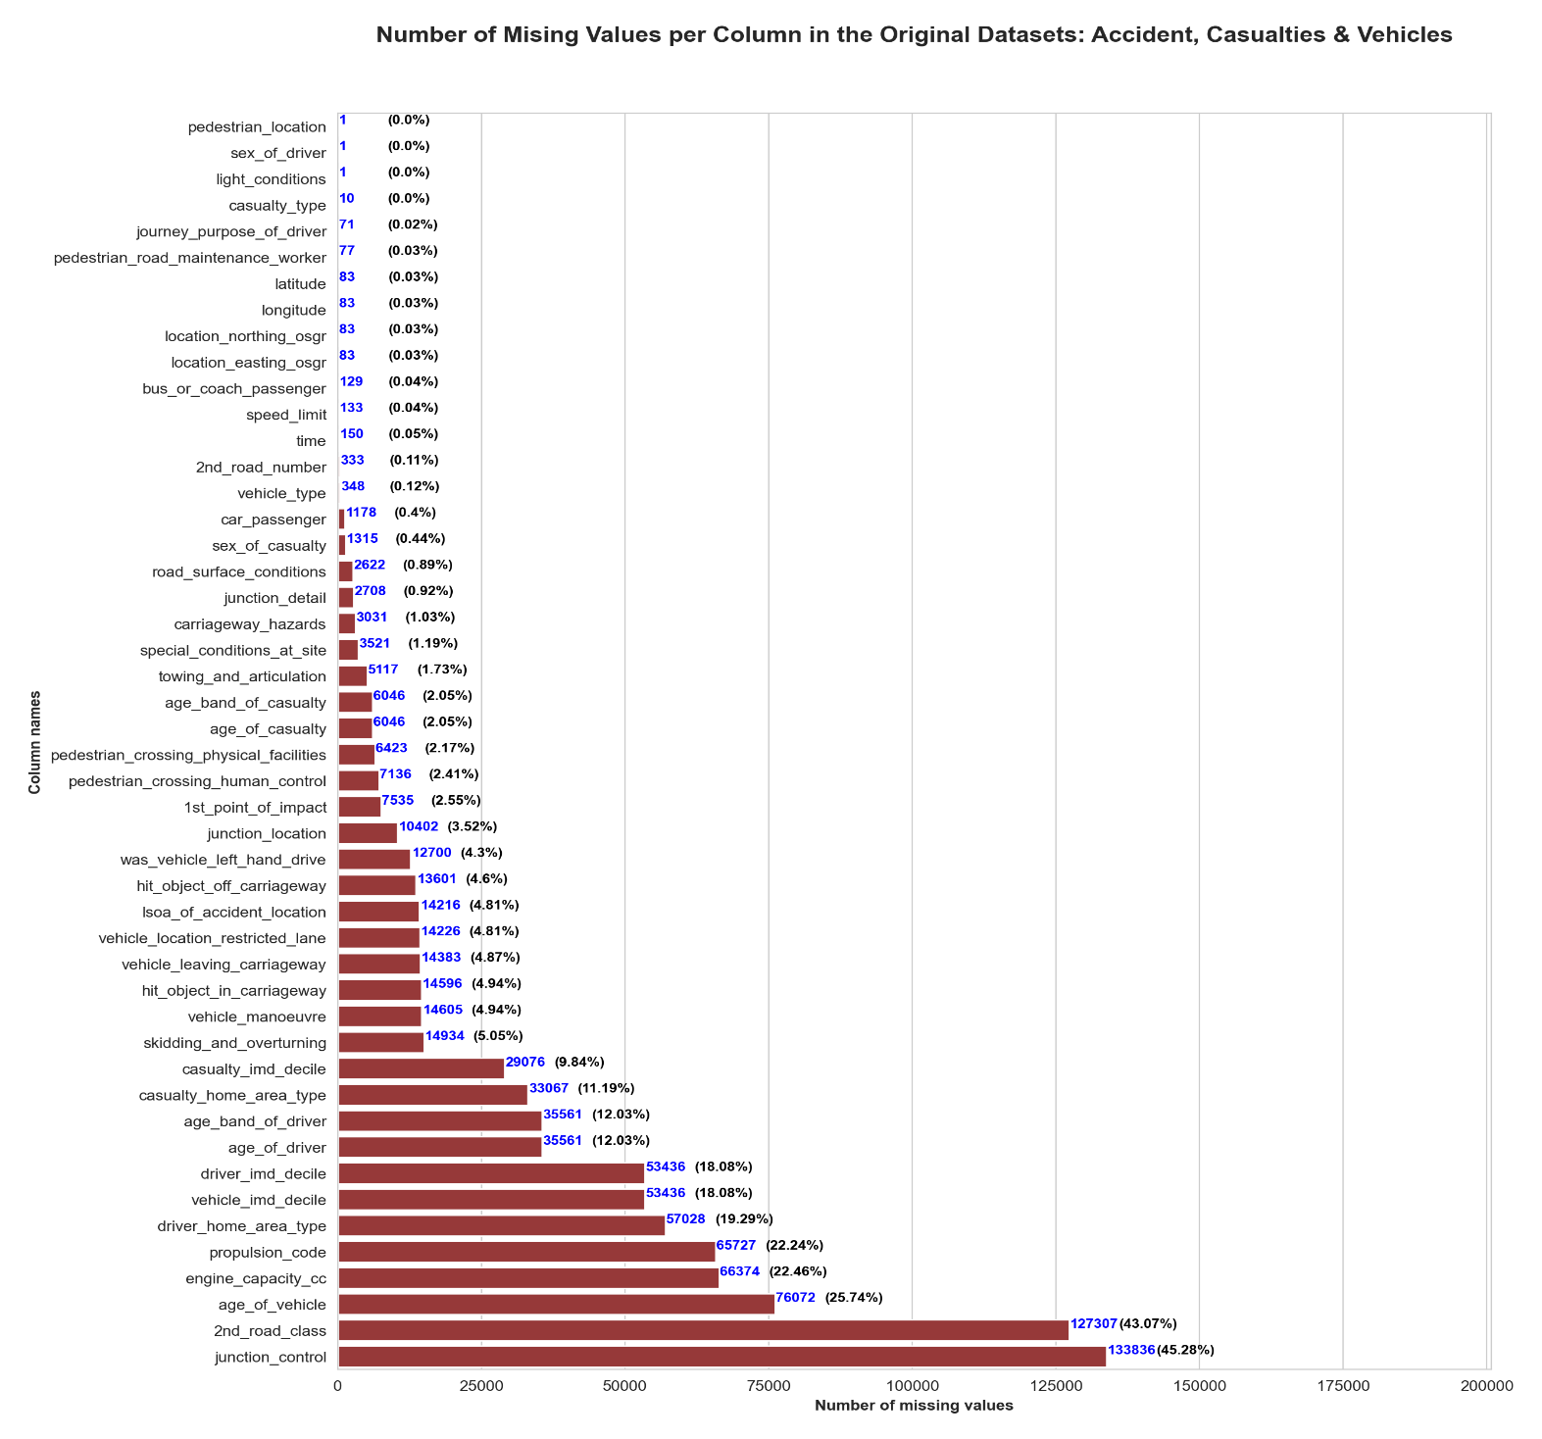
DATA CLEANING
Original datasets (CSV & XLSX files) were merged on the ‘accident_index’ identifier and resulted in a database of 295,579 rows and 69 columns.
Listwise deletion: Missing values in columns with ≤2.5% of the total entries were dropped.
Imputation:
Using the two or three most correlated features to derive modal/median replacement values for nulls.
Placeholders used to retain the consistency of data type. E.g., missing 2nd_road_class entries were replaced with 6 to maintain its numeric data type.
Retained 93% of the data (after cleaning) for further analysis.

Slide 4
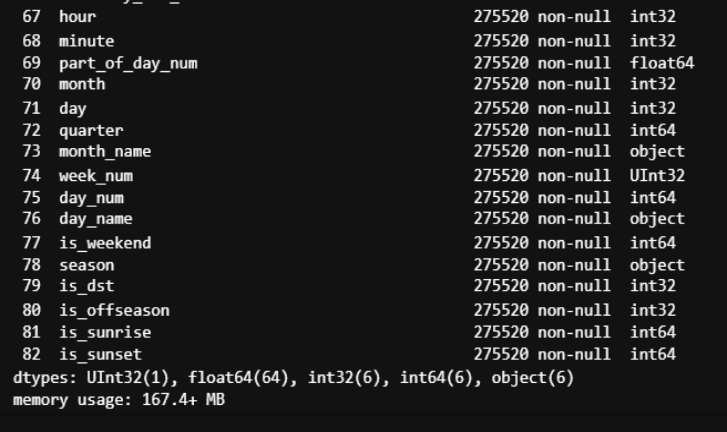
FEATURE ENGINEERING
part_of_day
1. morning (5am – 11.59am)
2. afternoon (12pm – 16.59pm)
3. evening (17pm – 20.59pm)
4. night (21pm – 4.59am)
is_weekend: Weekend is Saturday and Sunday.
quarter: yearly quarters
season: (autumn, spring, summer, and winter).
is_dst (2019 Daylight Saving Time): 1am March 31 to 2am October 27.
is_offseason (Premier League offseason indicator): 13 May – 8 August 2019
is_sunrise and is_sunset: sunrise/sunset time boundaries
NOTE: The time and date columns were dropped to minimize data duplicity.

Slide 5
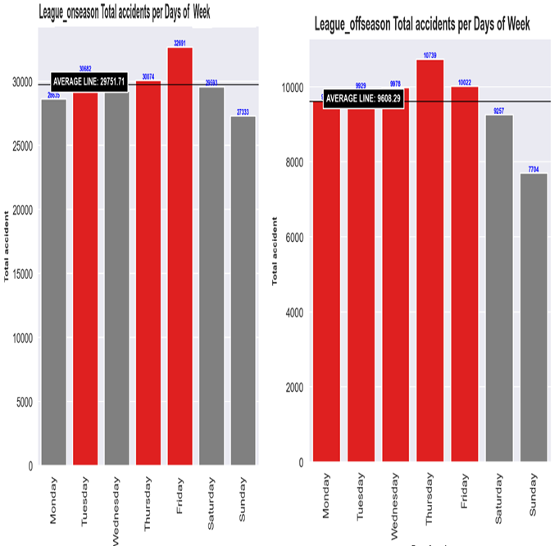
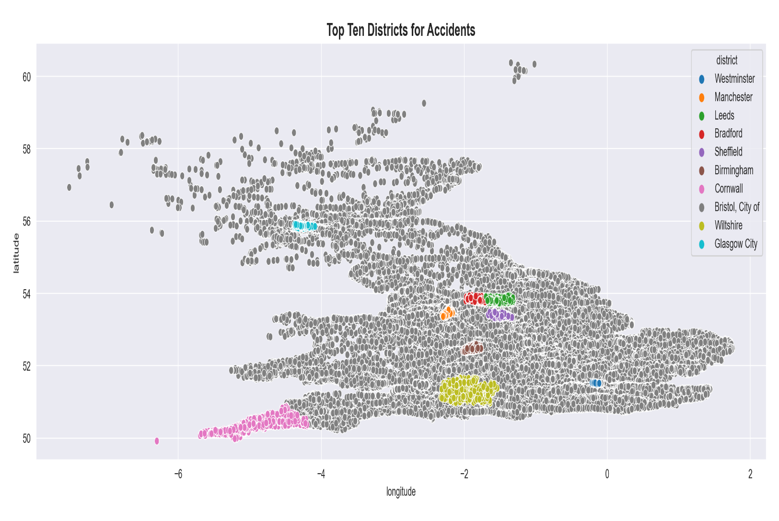
EXPLORATORY ANALYSIS
Districts with Highest Accidents

Slide 6
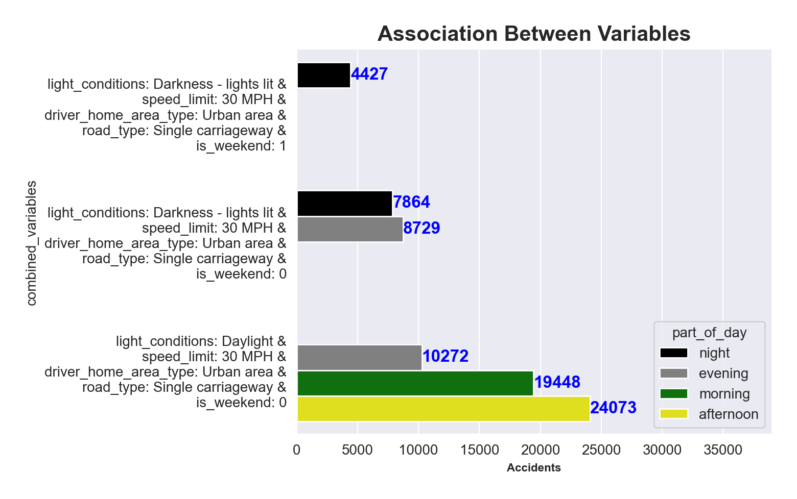
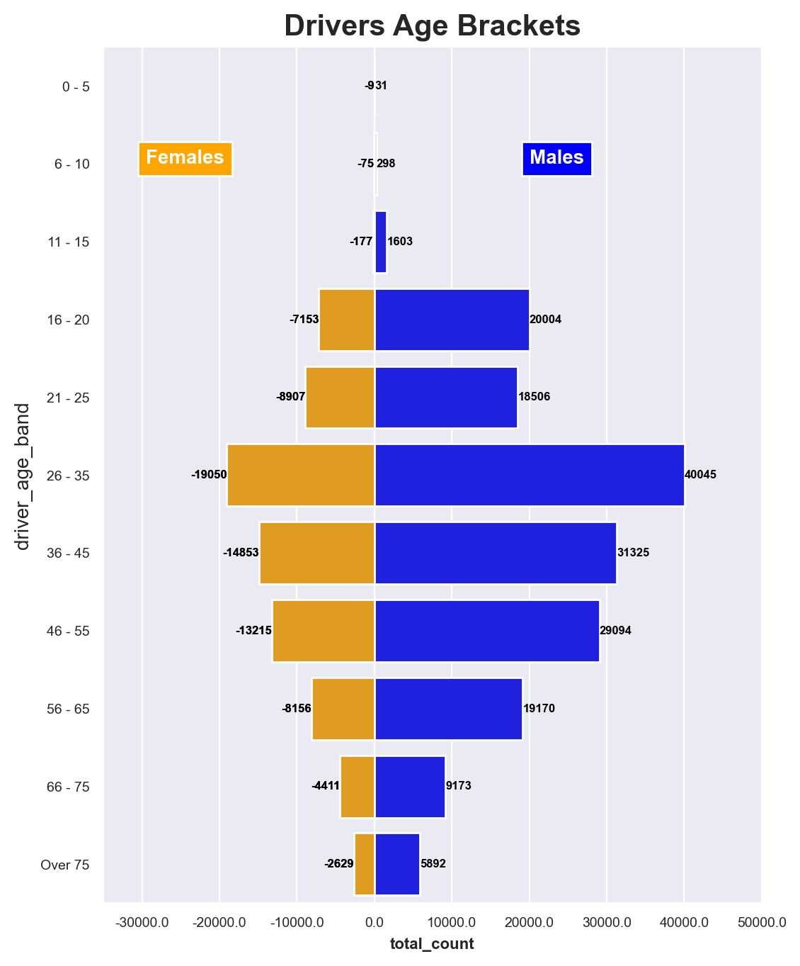

Slide 7
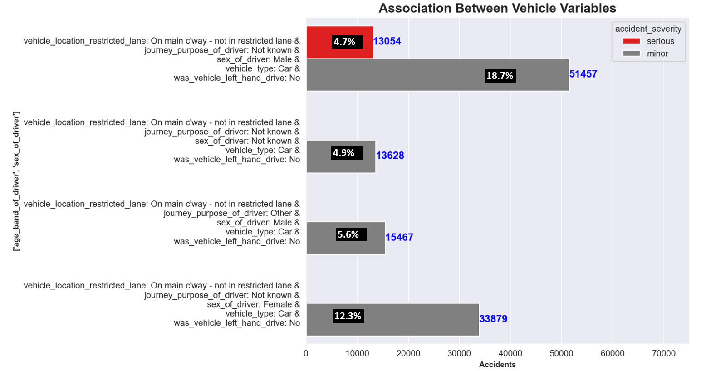
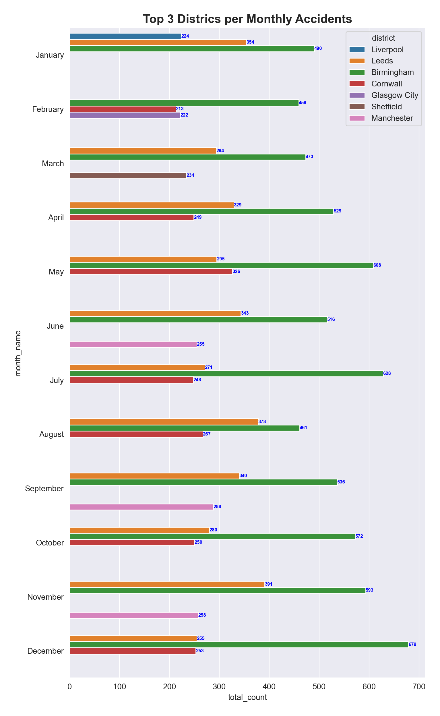
Monthly Accidents per District

Slide 8
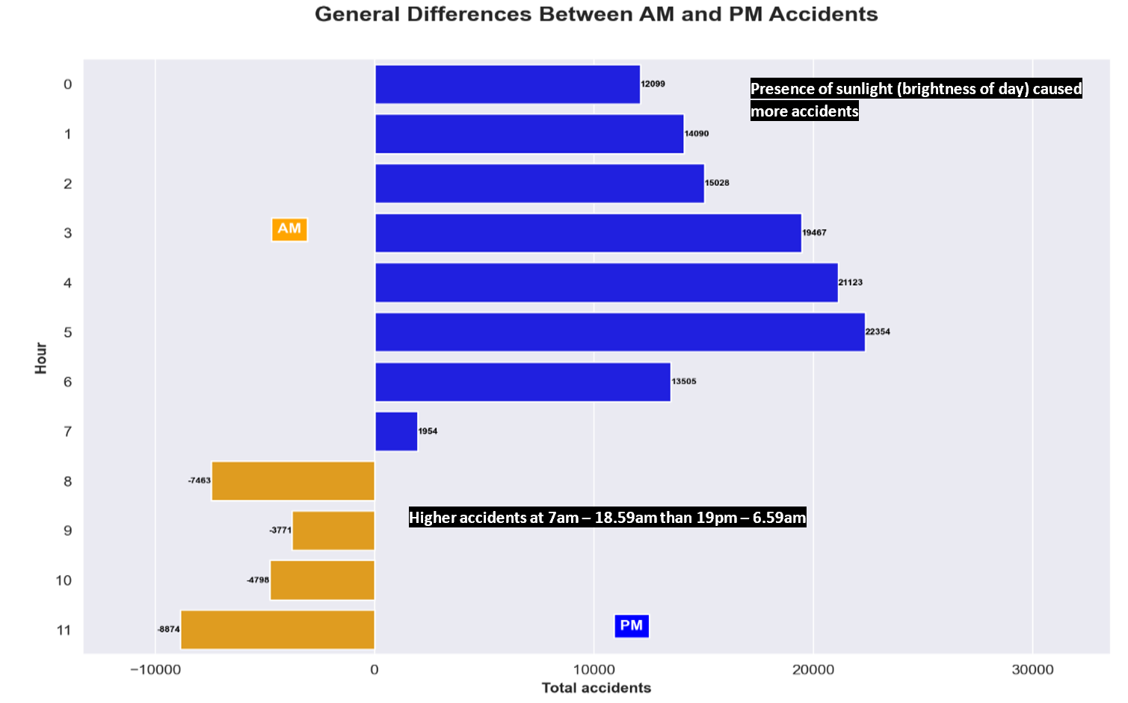
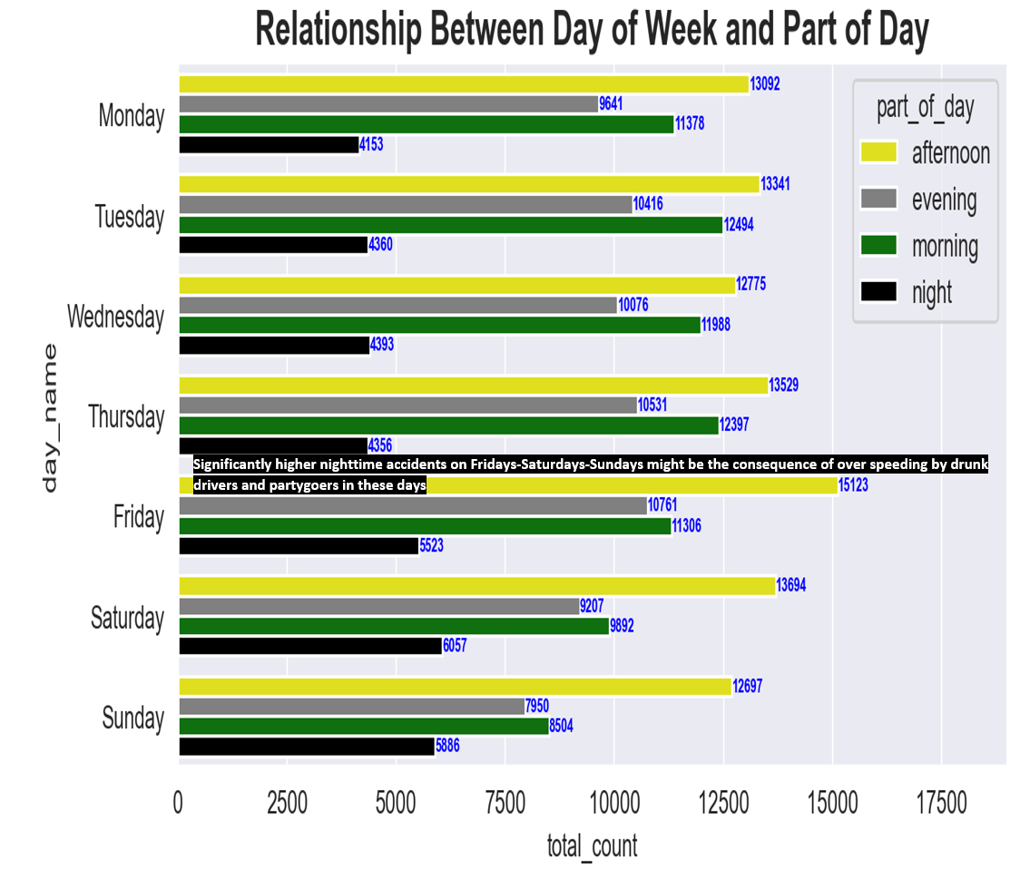
INFERENTIAL ANALYSIS

Slide 9
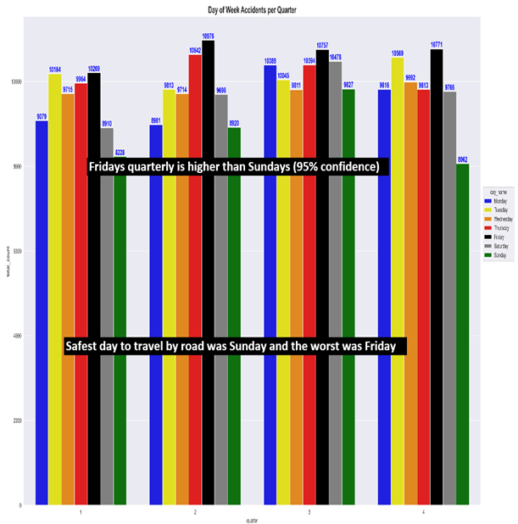
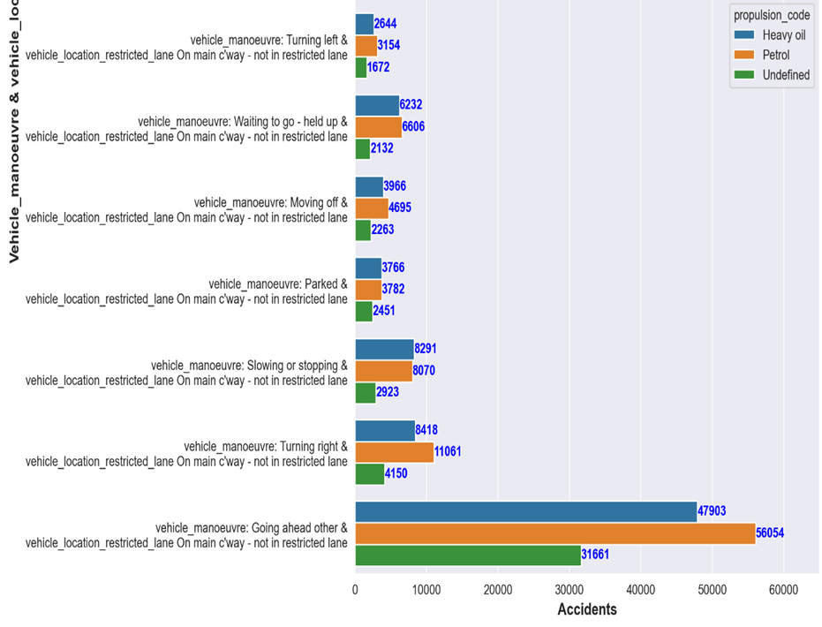

Slide 10
CONCLUSION
More campaigns should be taken to venues like football stadiums and sports centers in the top ten districts to educate young males about dangers of over-speeding, drunk driving, and driving at sunrise hours.
Always enforce a strict adherence to the speed limit, penalize defaulters and test the alcohol/drug level of suspecious drivers before allowing them back on the road especially on Friday, Saturday and Sunday nights.
Increase the speed bumps and add minor road demarcations (where possible) to the busiest non-restricted single carriageways in places like Birmingham, Leeds and Cornwall.
Ensure that all streetlights along public roads are in good conditions to aid night visibility and increase traffic controls (human/facility) on single carriageways.
FUTURE DROP IN ACCIDENT CASUALTIES

