Slide 1
Introduction to AI
Artificial intelligence (AI) involves the theory and practice of designing computer systems that can learn from and identify patterns in data. These systems use algorithms and models to perform tasks typically associated with human intelligence, such as speech and image recognition, as well as decision-making. AI is built on techniques like machine learning and neural networks, and it also encompasses advanced concepts like deep learning and natural language processing.
Overview of Knowledge Representation
Knowledge Representation in AI refers to the way in which artificial intelligence systems store, organize, and utilize knowledge to solve complex problems. It is a crucial aspect of AI, enabling machines to mimic human understanding and reasoning. Knowledge representation involves the creation of data structures and models that can efficiently capture information about the world, making it accessible and usable by AI algorithms for decision-making, inference, and learning.

Slide 2
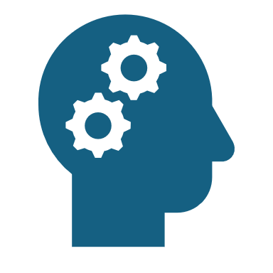
Types of Knowledge Representation
Logical Representation: Uses formal logic (propositional and predicate logic) to represent knowledge in a structured and precise way, allowing AI to derive conclusions through inference. Commonly used in applications like theorem proving and rule-based systems.
Example: Rule-based systems for automated theorem proving.
Semantic Networks: Graph-based structures where nodes represent concepts and edges represent relationships. They are used in AI to model relationships between concepts, enabling tasks like classification and natural language processing.
Example: Word associations in natural language processing.
Frames: Data structures representing objects or events with attributes (slots) and values. Frames allow AI to make inferences about typical scenarios, often used in representing structured knowledge like a "car" with attributes like make, model, and owner.
Example: A "car" frame with slots for make, model, and owner, used in object recognition systems.

Slide 3

IBM Watson for Healthcare
IBM Watson for Healthcare is an AI system used for medical diagnosis, especially in oncology and genomics. It represents knowledge using natural language processing (NLP) to analyze medical literature and patient records, structured knowledge bases for clinical guidelines, and machine learning models to predict diagnoses and treatments. This allows Watson to process large amounts of medical data quickly, providing personalized treatment options based on genetic profiles. Its main challenge is handling vast and evolving medical knowledge, which it addresses through continuous learning.

Slide 4
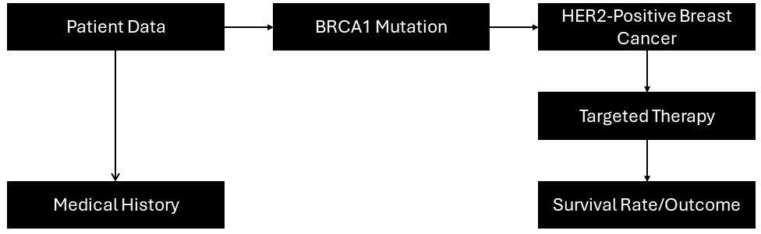
Diagram of the Semantic Network
Watson analyzes patient data and navigates this semantic network to:
Identify Relevant Information: The system reviews patient records, identifies relevant genetic mutations, and connects them to possible breast cancer types.
2. Recommend Treatment: Based on the relationships in the semantic network, the system suggests treatments that have been effective for other patients with similar profiles.
3. Predict Outcomes: Watson uses past data and clinical studies to predict the most likely outcomes for the selected treatment, helping doctors choose the best course of action for their patient.
This semantic network allows Watson to represent complex medical relationships and deliver personalized, data-driven treatment recommendations for patients.

Slide 5
Conclusion
Effective knowledge representation is important because it allows systems to store, organize, and use information so it can solve complicated problems, make decision, and perform tasks similar to human intelligence. I learned how different methods like logical representation, semantic networks, and frames help AI to understand and interact with the world. Applying these methods, seen in IBM Watson for Healthcare, highlights their role in transforming data into useable insights, showing the real-world impact of a well plan AI models.

