Slide 1
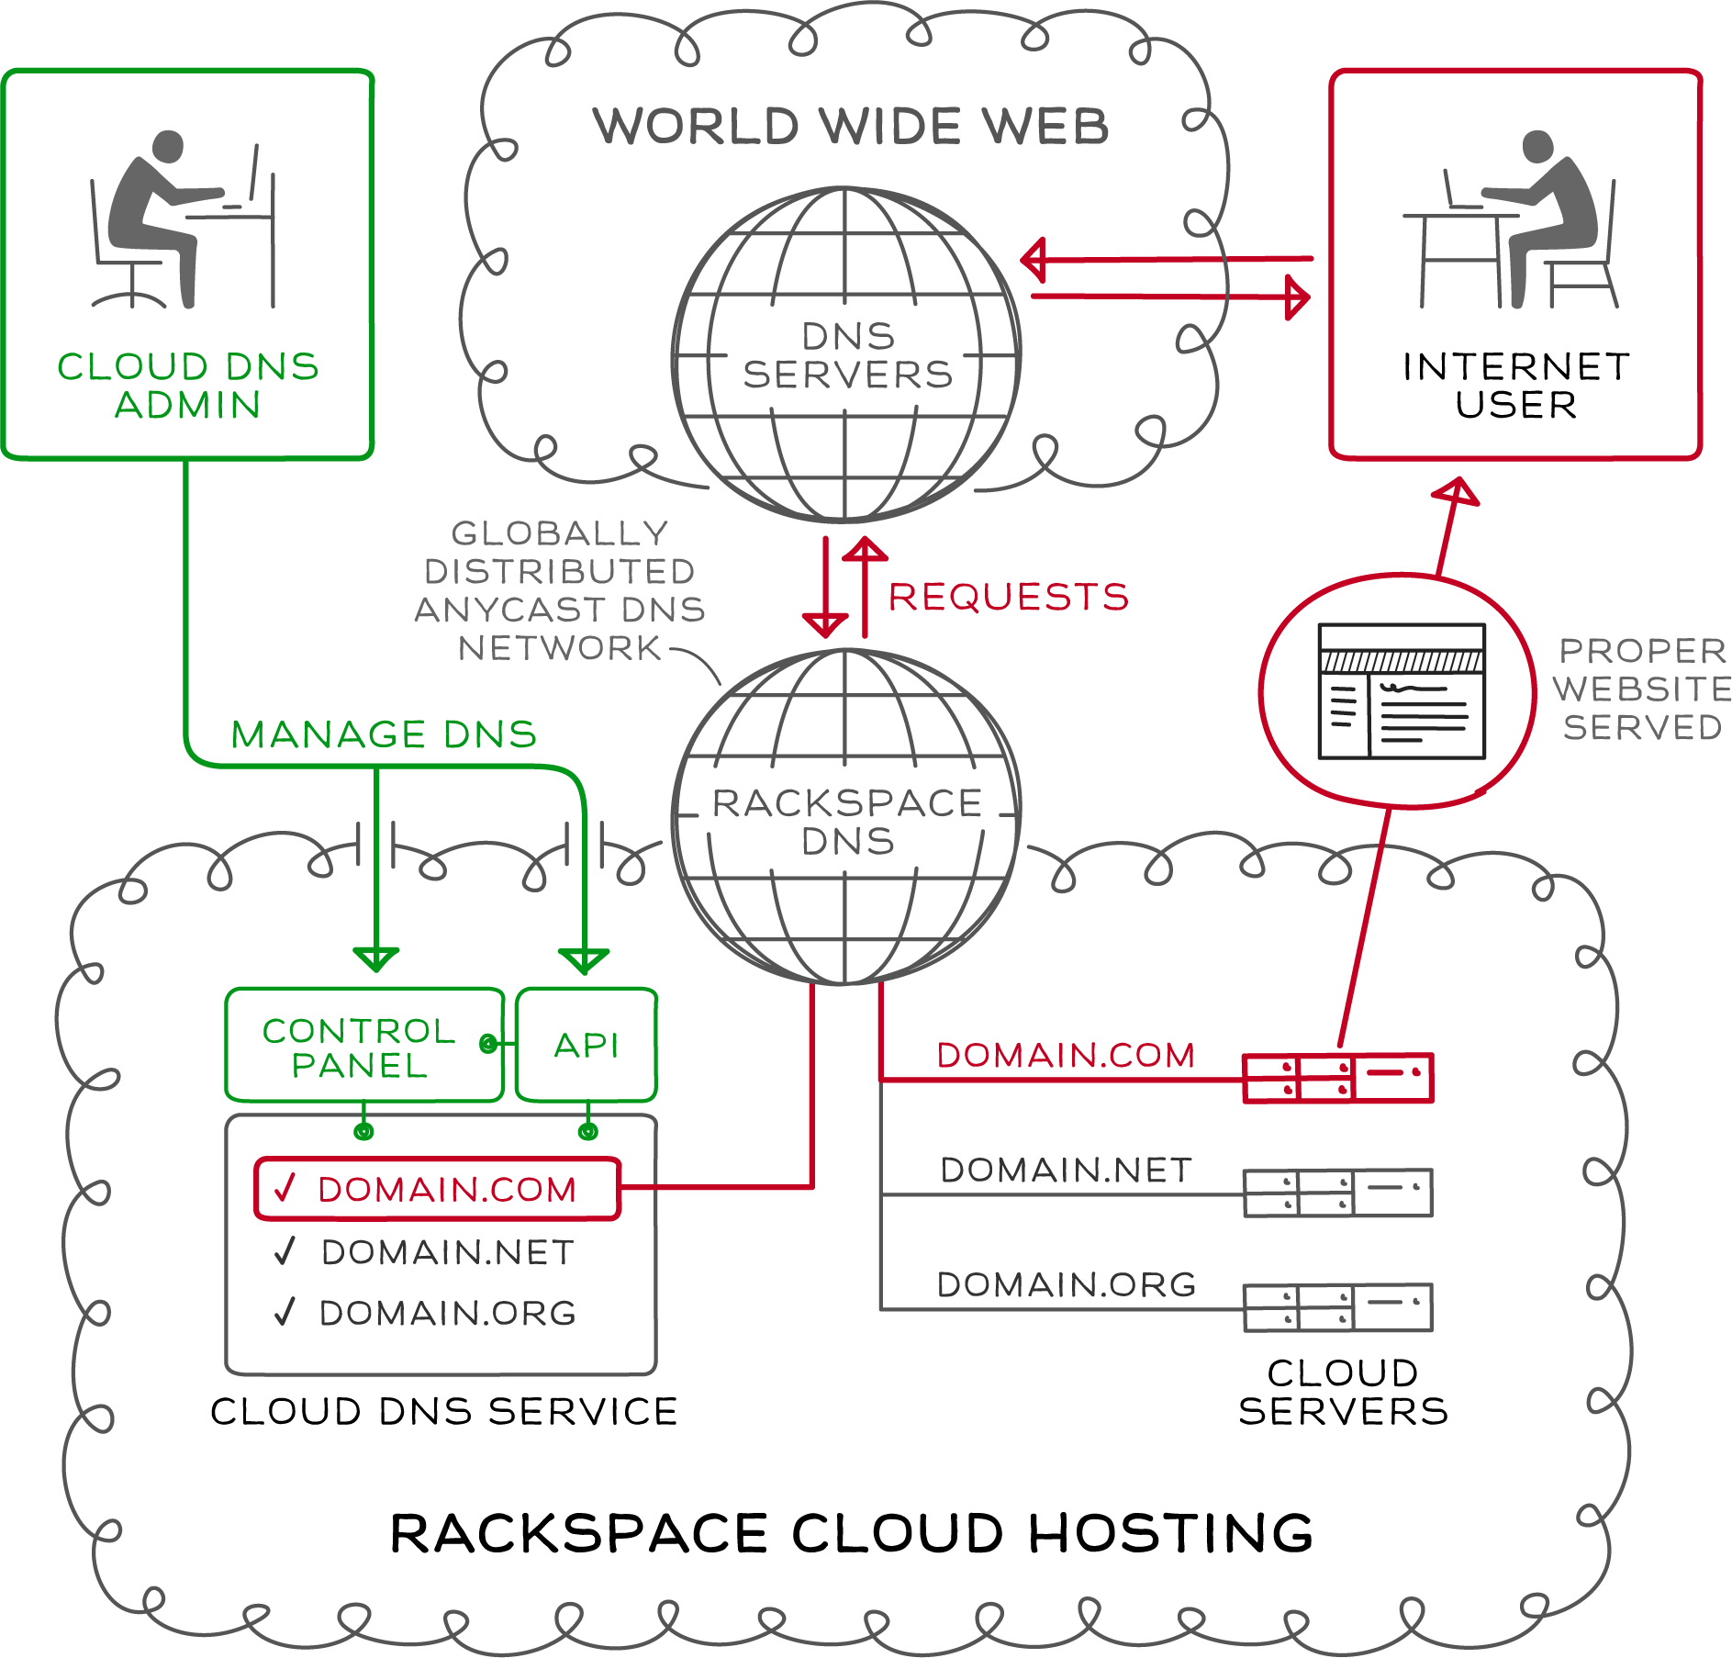
BASIC ARCHITECTURE

Slide 2



BASIC ARCHITECTURE (cont’d)
ESB Mosso Services Account Service
Cloud DNS
PowerAPI
Cloud Auth v1.1
Autohost DNS Engine
Notes:
Implementation and management of our Cloud DNS solution is available through our API. To use our API, customers should have a general understanding of DNS management and be familiar with:
RESTful Web Services
JSON and/or XML Data Serialization Formats
Available operations are listed on this chart
List Domains
List all domains and subdomains manageable by the account specified. Display IDs and names only.
Filter domains by domain name: list all domains and subdomains manageable by the account specified that match the name domainName. Display IDs and names only.
List Domain Details
List details of the specified domain. Display all details, including records. This operation provides the detailed output for a specific domain configured and associated with an account. This operation is not capable of returning details for a domain that has been deleted.
List Domain Changes
This call shows all changes to the specified domain since the specified date/time. The since parameter is optional and defaults to midnight of the current day. See Section 3.9, “Date/Time Format” for details on how to specify this parameter's value.
Create Domains
This operation provisions one or more new DNS domains under the account specified, based on the configuration defined in the request object. If the corresponding request cannot be fulfilled due to insufficient or invalid data, an HTTP 400 (Bad Request) error response will be returned with information regarding the nature of the failure in the body of the response. Failures in the validation process are non-recoverable and require the caller to correct the cause of the failure and POST the request again.
Modify Domains
This operation modifies DNS domain(s) attributes only. Records cannot be added, modified, or removed. Only the TTL and email address attributes of a domain can be modified.
Remove Domains
This operation removes one or more specified domains from the account; when a domain is deleted, its immediate resource records are also deleted from the account. By default, if a deleted domain had subdomains, each subdomain becomes a root domain and is not deleted; this can be overridden by the optional deleteSubdomains parameter. When a domain is deleted, any and all configuration data is immediately purged and
is not recoverable via the API. In a request to remove multiple domains, a failure on a single part of the request will cause the entire request to fail. Utilizing the optional deleteSubdomains parameter on domains without subdomains does not result in a failure.
Import Domain
This operation provisions a new DNS domain under the account specified by the bind9- formatted file configuration contents defined in the request object. If the corresponding request cannot be fulfilled due to insufficient or invalid data, an HTTP 400 (Bad Request) error response will be returned with information regarding the nature of the failure in the body of the response. Failures in the validation process are non-recoverable and require the caller to correct the cause of the failure and POST the request again.
Export Domain
This operation provides the bind9-formatted contents of the requested domain. This operation is for a single domain only, and as such, does not traverse up or down the domain hierarchy for details (that is, no subdomain information is provided).
List Records
List all records configured for the domain or list the details for a specific record. SOA cannot be modified.
Add Records
Add new record(s) to the domain.
Modify Records
Modify the configuration of a record or records in a domain
Remove Records
Remove a record or multiple records from a domain

Slide 3
BASIC ARCHITECTURE (cont’d)
Zeus Load Balancer
MySQL Data Store
SMX 4 (OSGI)
Jetty
Limit group membership
Async job information
Apache CXF
Cloud DNS API Layer
Active MQ (JMS)
Apache Camel
Autohost DNS Engine
Cloud DNS Service Adapter
Cloud DNS Autohost Adapter Implementation

