Slide 1



Cloud DNS
Tech Training
Automate and Simplify DNS Management Daniel Morris, Sr. Product Manager - Platform
Confidential Material

Slide 2
AGENDA
What is Cloud DNS?
What new features and benefits are we offering customers?
Who is this for?
When does it launch?
How much does it cost?
How does my customer get it?
Who do I contact for questions?
Notes:
During this presentation we will cover
What is Cloud DNS?
What new features and benefits are we offering customers?
Who is this for?
When does it launch?
How much does it cost?
How does my customer get it?
Who do I contact for questions?

Slide 3
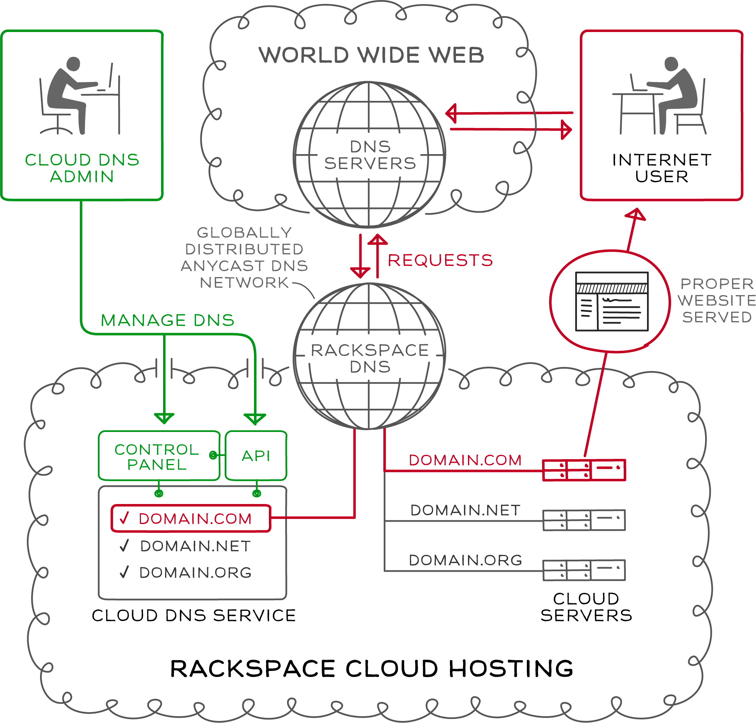
WHAT IS CLOUD DNS?
Internet phonebook
Globally distributed network
Programmatic API
Automated domain (zone) management
Notes:
The Domain Name System is essentially the phonebook for the internet. It manages the relationships between IP address (the phone numbers), and domains (individuals and corporations). All domains and their components, such as mail servers, utilize DNS to resolve to the appropriate locations.
Domians: A domain is an entity/container of all DNS-related information containing one or more records.
Subdomians: Subdomains are domains within a parent domain, and subdomains cannot be registered. Subdomains allow you to delegate domains. Subdomains can themselves have subdomains, so third-level, fourth-level, fifth-level, and deeper levels of nesting are possible.
Records: A DNS record belongs to a particular domain and is used to specify information about the domain. There are several types of DNS records. Each record type contains particular information used to describe that record’s purpose. Examples include mail exchange (MX) records which specify the mail server for a particular domain and name server (NS) records which specify the authoritative name servers for a domain.
Existing Rackspace DNS Infrastructure (Globally Distributed Anycast Network)
Rackspace currently has DNS servers located in Texas, Virginia, Chicago, Hong Kong and London. Within each datacenter, we have our nameservers split up so that we have no single point of failure in front of our DNS servers.
Using anycast, we broadcast IP addresses from each location. This gives us two advantages.
The DNS queries will generally go to the geographically closest nameservers. This gives faster results no matter where the queries originate.
If an entire datacenter were to fail, or even if all of the DNS servers within a specific datacenter were to fail, the DNS queries will automatically start going to the next best location.
All of our DNS servers are monitored 24/7, and we receive alerts in our email and on our phones if anything goes wrong.
See Jason Bratton for more information on our DNS infrastructure.

Slide 4
WE ALREADY HAVE DNS … WHATS NEW?
Contains features customers requested
Comprehensive REST-based API
New supported record types
Performance improvements
Full time-to-live (TTL) control
Simplified migration
Simplified and automated domain management
Notes:
Rackspace Cloud DNS automates and simplifies your Domain Name System management and has many of the features our customers have been asking for, including:
Comprehensive REST-based API
Multiple Record Types
Performance Improvements
Domain Delegation
Full TTL Control
Simplified Migration
The available management operations allow you to easily manage domains, sub-domains, and records via the REST-based API. You can list, add, modify, and remove domains and records, as well as import and export domains.
Additionally, advanced operations are available that allow you to easily manage mail servers, zone delegation, and create SPF records.
And bringing your DNS configurations to Rackspace is simple. The import and export feature allows you to import a BIND 9 formatted zone file of domains and their records into and out of your account.

Slide 5
DETAILED FEATURE SET
REST-based API - RESTful API lets customers customize solutions to automate DNS management.
Multiple Record Types – Supports the following record types: A, CNAME, NS, TXT, AAAA, DKIM, MX, SRVR, and SPF.
Comprehensive Management Capability - List, add, modify, and remove domains. List, add, modify, and remove DNS records. Import and export domains.
Domain Delegation – Delegate a domain or sub-domain to a non-Rackspace name server via modifications to a DNS record.
Full TTL Control – Easily update the default time to live (TTL) and resource record TTL values.
Globally Distributed Anycast DNS Network – Our internal network leverages Anycast to make DNS more reliable and resilient.
Simplified Migration – To simply migrating DNS configurations to and from Rackspace, the import and export features allow you to import or export a text list or BIND 9 formatted file of managed domains and their configuration details into and out of your account
IPv6 - In addition to supporting IPv4, Cloud DNS is IPv6 ready when you are.

Slide 6
AVAILABLE API OPERATIONS
Domains
List Domains
List Domain Details
List Domain Changes
Create Domain(s)
Modify Domain(s)
Delete Domains(s)
Search (Filter Domains)
Import Domain
Export Domain
Records
List Records
List Record Details
Add Records
Modify Records
Remove Records
Notes:
Implementation and management of our Cloud DNS solution is available through our API. To use our API, customers should have a general understanding of DNS management and be familiar with:
RESTful Web Services
JSON and/or XML Data Serialization Formats
Available operations are listed on this chart
List Domains
List all domains and subdomains manageable by the account specified. Display IDs and names only.
Filter domains by domain name: list all domains and subdomains manageable by the account specified that match the name domainName. Display IDs and names only.
List Domain Details
List details of the specified domain. Display all details, including records. This operation provides the detailed output for a specific domain configured and associated with an account. This operation is not capable of returning details for a domain that has been deleted.
List Domain Changes
This call shows all changes to the specified domain since the specified date/time. The since parameter is optional and defaults to midnight of the current day. See Section 3.9, “Date/Time Format” for details on how to specify this parameter's value.
Create Domains
This operation provisions one or more new DNS domains under the account specified, based on the configuration defined in the request object. If the corresponding request cannot be fulfilled due to insufficient or invalid data, an HTTP 400 (Bad Request) error response will be returned with information regarding the nature of the failure in the body of the response. Failures in the validation process are non-recoverable and require the caller to correct the cause of the failure and POST the request again.
Modify Domains
This operation modifies DNS domain(s) attributes only. Records cannot be added, modified, or removed. Only the TTL and email address attributes of a domain can be modified.
Remove Domains
This operation removes one or more specified domains from the account; when a domain is deleted, its immediate resource records are also deleted from the account. By default, if a deleted domain had subdomains, each subdomain becomes a root domain and is not deleted; this can be overridden by the optional deleteSubdomains parameter. When a domain is deleted, any and all configuration data is immediately purged and
is not recoverable via the API. In a request to remove multiple domains, a failure on a single part of the request will cause the entire request to fail. Utilizing the optional deleteSubdomains parameter on domains without subdomains does not result in a failure.
Import Domain
This operation provisions a new DNS domain under the account specified by the bind9- formatted file configuration contents defined in the request object. If the corresponding request cannot be fulfilled due to insufficient or invalid data, an HTTP 400 (Bad Request) error response will be returned with information regarding the nature of the failure in the body of the response. Failures in the validation process are non-recoverable and require the caller to correct the cause of the failure and POST the request again.
Export Domain
This operation provides the bind9-formatted contents of the requested domain. This operation is for a single domain only, and as such, does not traverse up or down the domain hierarchy for details (that is, no subdomain information is provided).
List Records
List all records configured for the domain or list the details for a specific record. SOA cannot be modified.
Add Records
Add new record(s) to the domain.
Modify Records
Modify the configuration of a record or records in a domain
Remove Records
Remove a record or multiple records from a domain

Slide 7
SUPPORTED RECORD TYPES
A
AAAA
CNAME
MX
SOA*
NS - NEW!
TXT - NEW!
DKIM
SPF
SRV - NEW!
* users will not be able to create SOA records (as this is handled by the system) but they will be able to modify TTL and email address
Notes:
A – IPv4 address used to map hostnames to an IP address of the host
CNAME – canonical name record – points to another hostname that already has an A record associated with it. The CNAME works like an alias.
MX – used to specify a mail server that is responsible for accepting email messages on behalf of a recipients domain
SOA - Specifies authoritative information about a domain, including the primary name server(s), the email of the domain administrator, the domain serial number, and TTL’s
AAAA – IPv6 address used to map hostnames to an IP address of the host
NS - NS (or Name Server) records indicate where the domain’s DNS hosting services are located. It effectively delegates a domain to use a set of name servers.
TXT - This is a text record and is used primarily for SPF and DKIM records. An SPF (Sender Policy Framework) record allows administrators to specify which hosts are allowed to send e-mail from a given domain by creating a specific SPF Record in the public (DNS). Mail exchangers then use the DNS to check that mail from a given domain is being sent by a host sanctioned by that domain's administrators. DomainKeys Identified Mail (DKIM) is a method for associating a domain name to an email, thereby allowing an organization to take responsibility for a message in a way that can be validated by a recipient.
SRV – used to define the location of (hostname and port) of servers used for a specific service
*Additionally, the service supports DKIM and SPF records. These are TXT records with custom attributes indicating the record type. We do not currently support the SPF RR type as defined in the following RFC

Slide 8
WHEN IS IT AVAILABLE?
Cloud DNS is Generally Available as of Oct 26th, 2011
US and UK
Available via the API for customers with a Cloud account
UI integration will not be available until Reach (Q1 timeframe)
Notes:
As part of the next phase of this project, we will be completely overhauling the DNS management within the new Reach UI. We will be exposing the full set of capabilities that are available via API, including management of TXT records, TTL settings, import/export and more.
Note: The Cloud DNS API will not be integrated into the existing Control Panel. Minor enhancements to supported record types will continue to be made but will be done through a different set of client libraries.

Slide 9

HOW MUCH DOES IT COST?
There is no cost for using Rackspace Cloud DNS!
Existing Cloud Servers, Cloud Servers with a Managed Service Level, RackConnect, and Cloud Sites customers have access to the Rackspace Cloud DNS by default.
Notes:
Now on to the big question, price. Rackspace Cloud DNS is FREE. There is no cost for using the Rackspace Cloud DNS ! Existing Cloud Servers™, Cloud Servers with a managed service level, Cloud Sites™, and RackConnect™ customers have access to the Rackspace Cloud DNS by default. This is an excellent product to help sell existing cloud services.

Slide 10
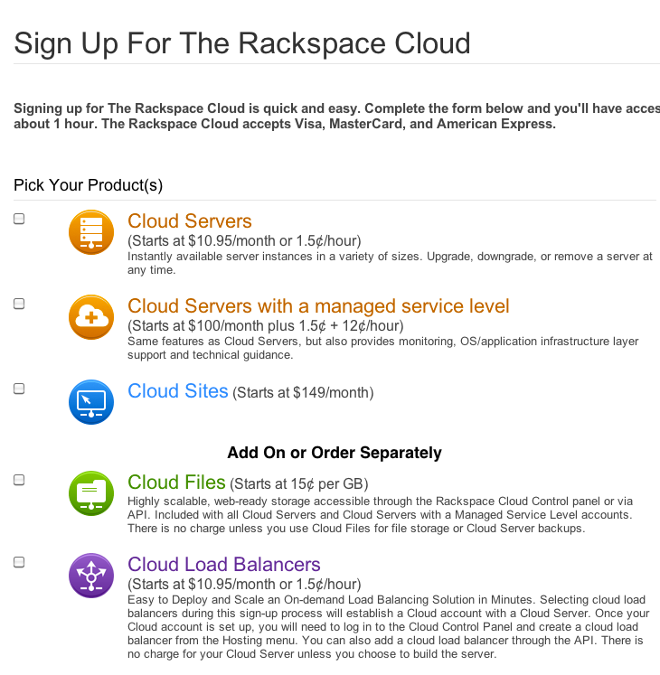
HOW DO YOU SIGN UP
Get a Cloud Account
API GUIDE
Notes:
Getting started using Rackspace Cloud DNS is easy…
Sign-Up for a Rackspace Cloud Account
If you don't have a Rackspace Cloud account, go to the Order Now page and sign up for an account. Once you have a Rackspace Cloud account, you automatically have access to the Rackspace Cloud DNS using your existing Rackspace Cloud Authentication credentials. Before you begin, take a look at the Rackspace Cloud DNS Developers guide for information on accessing and authenticating with the service.
Create or Import Domains
Using the Rackspace Cloud DNS API, use the "Create Domains" or “Import Domains” API operation to start managing your domains. Note: If you are already using the DNS management capabilities of the Cloud control panel, then all your existing domains will be capable of being managed from the API.
Begin Managing your Domains
Leverage the API to list, add, modify, and remove domains and records as needed.

Slide 11
WHAT DO WE SUPPORT?
Backed by Fanatical Support
Chat/phone/ticket support available during normal business hours
Support includes:
Authentication troubleshooting and verification
Basic Guidance for what API calls to use based on user needs
Verify DNS infrastructure availability
Provide documentation where available
Verify/confirm DNS details
1st, 2nd, and 3rd level escalation support (see speaker notes)
Encourage your customers to begin using the new Cloud DNS API today. The API’s capabilities available for customers will significantly lower our existing support burden.
Notes:
CLOUD DNS GA SUPPORT
Applies to both Core and Managed Cloud accounts:
New Support Stuff:
Cloud DNS service will be covered by existing product SLAs (Cloud DNS will not have its own SLA)
24x7x365 Chat/Phone/Ticket Support
Basic customer guidance for what Cloud DNS API calls apply based on customer needs
Cloud DNS API authentication troubleshooting and verification
Cloud DNS SMEs - 1st Level Escalated Support
Cloud DNS Operations - 2nd Level Escalated Support
Cloud DNS Development - 3rd Level Escalated Support
Customers should be directed to submit any Cloud DNS feature requests and/or enhancements to http://feedback.rackspacecloud.com/forums/71021-product-feedback/category/28803-rackspace-cloud-dns.
Same Support Stuff:
Existing CP ticket categories and sub-categories + routing will remain available and as-is today
CP authentication troubleshooting and verification
Verify Cloud DNS infrastructure availability via existing DNS management/support tools
Provide users with documentation where/when available
Verify/confirm domain details via existing DNS management/support tools
Assistance with domain migrations/transfers
DNS Manager - General Support
DNS Manager - Escalated Support
Rackspace DNS Infrastructure - Escalated Support
Core account Support should not create, configure, or delete any domains on behalf of a user; users will be solely responsible for creating, configuring, and deleting domains via API.
NOTE: Managed Cloud Support may choose to provide this level of service based on their discretion and currently set expectations around DNS support at the Managed Cloud account level.

Slide 12
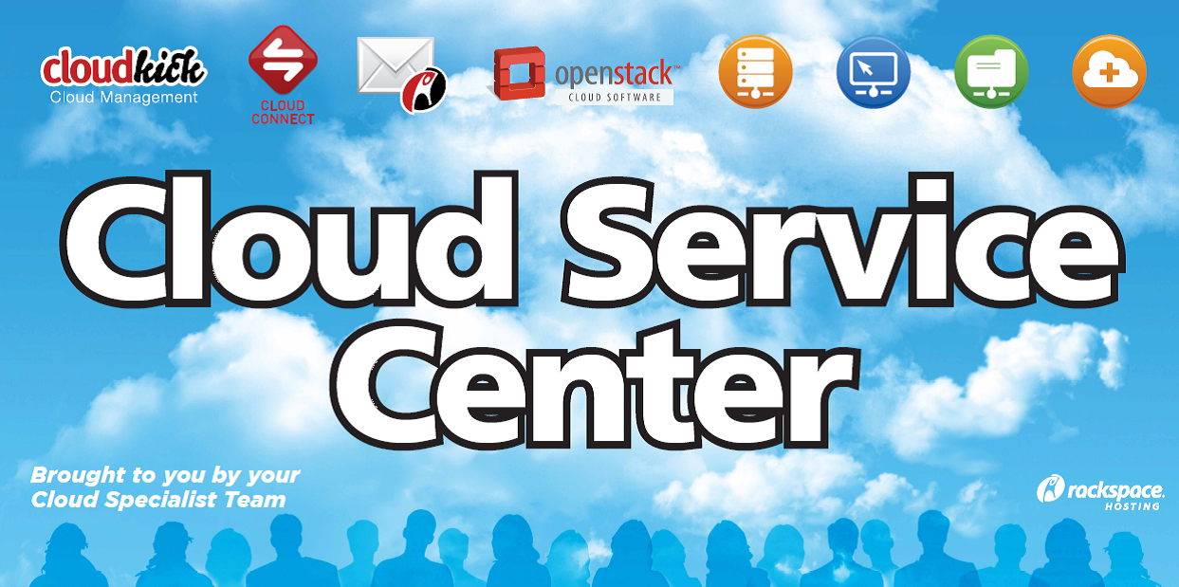
QUESTIONS?
Technical Questions (SME’s)
First shift: Darren Carpenter, Travis Hall
Second shift: Mark Lessel
Third shift: Sam Chapler, Miguel Salazar
Product Questions
Daniel Morris – daniel.morris@rackspace.com

Slide 13
BACKUP SLIDES

Slide 14
TEAM CONTACTS
Role | Name | Phone | E-mail
Product Manager | Daniel Morris | 501.1176 | daniel.morris@rackspace.com
Technical Product Manager | Nicole Hairston | 501.5439 | nicole.hairston@rackspace.com
Project Manager | Betsy Luzader | 501.4458 | betsy.luzader@rackspace.com
Product Marketing | Jerry Schwartz | 501.3227 | jerry.schwartz@rackspace.com
Launch Manager | Heather Felty | 501.5513 | heather.felty@rackspace.com
UK Product Manager | Peter Day | 507.4274 | peter.day@rackspace.co.uk
UK Product Marketing | Matt Johns | 507.4543 | matt.johns@rackspace.co.uk

Slide 15
IMPORTANT LINKS
Product Page
http://www.rackspace.com/cloud/cloud_hosting_products/clouddns
API / Developers Guide
http://docs.rackspace.com/api/
Notes:
Additional information can be found at the following links.

