Slide 1



Cloud DNS
Rackspace TechTalk
October 28, 2011
Automate and Simplify DNS Management
Emmanuel Ankutse – Software Engineer - Platform
Randall Burt - Software Engineer - Platform
Confidential Material

Slide 2
AGENDA
What is Cloud DNS?
Overall Goals of the Product
Architecture and External System Interfaces
Technology Choices and the Benefits and Drawbacks
Technical Challenges and Resolutions
API Demo
Notes:
During this presentation we will cover
What is Cloud DNS?
What new features and benefits are we offering customers?
Who is this for?
When does it launch?
How much does it cost?
How does my customer get it?
Who do I contact for questions?

Slide 3
WHAT IS CLOUD DNS?
RESTful API for managing Cloud customer domains
Public API for customers
Management API for internal use
Free
Value add for any Cloud customer
Notes:
The Domain Name System is essentially the phonebook for the internet. It manages the relationships between IP address (the phone numbers), and domains (individuals and corporations). All domains and their components, such as mail servers, utilize DNS to resolve to the appropriate locations.
Domians: A domain is an entity/container of all DNS-related information containing one or more records.
Subdomians: Subdomains are domains within a parent domain, and subdomains cannot be registered. Subdomains allow you to delegate domains. Subdomains can themselves have subdomains, so third-level, fourth-level, fifth-level, and deeper levels of nesting are possible.
Records: A DNS record belongs to a particular domain and is used to specify information about the domain. There are several types of DNS records. Each record type contains particular information used to describe that record’s purpose. Examples include mail exchange (MX) records which specify the mail server for a particular domain and name server (NS) records which specify the authoritative name servers for a domain.
Existing Rackspace DNS Infrastructure (Globally Distributed Anycast Network)
Rackspace currently has DNS servers located in Texas, Virginia, Chicago, Hong Kong and London. Within each datacenter, we have our nameservers split up so that we have no single point of failure in front of our DNS servers.
Using anycast, we broadcast IP addresses from each location. This gives us two advantages.
The DNS queries will generally go to the geographically closest nameservers. This gives faster results no matter where the queries originate.
If an entire datacenter were to fail, or even if all of the DNS servers within a specific datacenter were to fail, the DNS queries will automatically start going to the next best location.
All of our DNS servers are monitored 24/7, and we receive alerts in our email and on our phones if anything goes wrong.
See Jason Bratton for more information on our DNS infrastructure.

Slide 4
OVERALL GOALS
Reduce support costs via customer self-service
8% of support volume is DNS related
Consolidate access to DNS infrastructure
Provide RESTful DNS API in order to align with enterprise architecture roadmap
Add features customers requested
New supported record types
Performance improvements
Full time-to-live (TTL) control
Simplified migration
Simplified and automated domain management
Notes:
Rackspace Cloud DNS automates and simplifies your Domain Name System management and has many of the features our customers have been asking for, including:
Comprehensive REST-based API
Multiple Record Types
Performance Improvements
Domain Delegation
Full TTL Control
Simplified Migration
The available management operations allow you to easily manage domains, sub-domains, and records via the REST-based API. You can list, add, modify, and remove domains and records, as well as import and export domains.
Additionally, advanced operations are available that allow you to easily manage mail servers, zone delegation, and create SPF records.
And bringing your DNS configurations to Rackspace is simple. The import and export feature allows you to import a BIND 9 formatted zone file of domains and their records into and out of your account.

Slide 5
DETAILED FEATURE SET
REST-based API – Public RESTful API lets customers customize solutions to automate DNS management.
Multiple Record Types – Supports the following record types: A, CNAME, NS, TXT, AAAA, DKIM, MX, SRV, and SPF.
Comprehensive Management Capability - List, add, modify, and remove domains. List, add, modify, and remove DNS records. Import and export domains.
Domain Delegation – Delegate a domain or sub-domain to a non-Rackspace name server via modifications to a DNS record.
Full TTL Control – Easily update the default time to live (TTL) and resource record TTL values.
Globally Distributed Anycast DNS Network – Our internal network leverages Anycast to make DNS more reliable and resilient.
Simplified Migration – To simply migrating DNS configurations to and from Rackspace, the import and export features allow you to import or export a text list or BIND 9 formatted file of managed domains and their configuration details into and out of your account
IPv6 - In addition to supporting IPv4, Cloud DNS is IPv6 ready when you are.

Slide 6
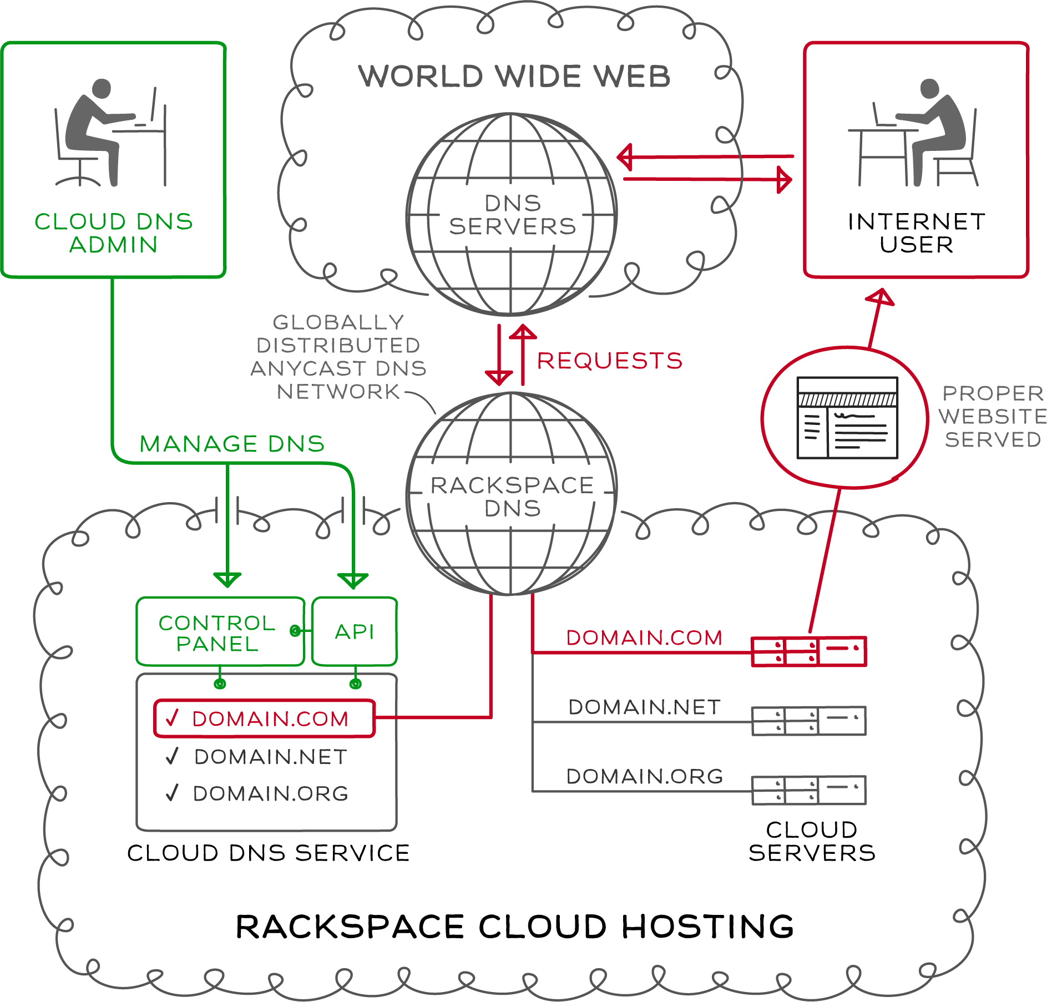
BASIC ARCHITECTURE

Slide 7



BASIC ARCHITECTURE (cont’d)
ESB Mosso Services Account Service
Cloud DNS
PowerAPI
Cloud Auth v1.1
Autohost DNS Engine
Notes:
Implementation and management of our Cloud DNS solution is available through our API. To use our API, customers should have a general understanding of DNS management and be familiar with:
RESTful Web Services
JSON and/or XML Data Serialization Formats
Available operations are listed on this chart
List Domains
List all domains and subdomains manageable by the account specified. Display IDs and names only.
Filter domains by domain name: list all domains and subdomains manageable by the account specified that match the name domainName. Display IDs and names only.
List Domain Details
List details of the specified domain. Display all details, including records. This operation provides the detailed output for a specific domain configured and associated with an account. This operation is not capable of returning details for a domain that has been deleted.
List Domain Changes
This call shows all changes to the specified domain since the specified date/time. The since parameter is optional and defaults to midnight of the current day. See Section 3.9, “Date/Time Format” for details on how to specify this parameter's value.
Create Domains
This operation provisions one or more new DNS domains under the account specified, based on the configuration defined in the request object. If the corresponding request cannot be fulfilled due to insufficient or invalid data, an HTTP 400 (Bad Request) error response will be returned with information regarding the nature of the failure in the body of the response. Failures in the validation process are non-recoverable and require the caller to correct the cause of the failure and POST the request again.
Modify Domains
This operation modifies DNS domain(s) attributes only. Records cannot be added, modified, or removed. Only the TTL and email address attributes of a domain can be modified.
Remove Domains
This operation removes one or more specified domains from the account; when a domain is deleted, its immediate resource records are also deleted from the account. By default, if a deleted domain had subdomains, each subdomain becomes a root domain and is not deleted; this can be overridden by the optional deleteSubdomains parameter. When a domain is deleted, any and all configuration data is immediately purged and
is not recoverable via the API. In a request to remove multiple domains, a failure on a single part of the request will cause the entire request to fail. Utilizing the optional deleteSubdomains parameter on domains without subdomains does not result in a failure.
Import Domain
This operation provisions a new DNS domain under the account specified by the bind9- formatted file configuration contents defined in the request object. If the corresponding request cannot be fulfilled due to insufficient or invalid data, an HTTP 400 (Bad Request) error response will be returned with information regarding the nature of the failure in the body of the response. Failures in the validation process are non-recoverable and require the caller to correct the cause of the failure and POST the request again.
Export Domain
This operation provides the bind9-formatted contents of the requested domain. This operation is for a single domain only, and as such, does not traverse up or down the domain hierarchy for details (that is, no subdomain information is provided).
List Records
List all records configured for the domain or list the details for a specific record. SOA cannot be modified.
Add Records
Add new record(s) to the domain.
Modify Records
Modify the configuration of a record or records in a domain
Remove Records
Remove a record or multiple records from a domain

Slide 8
BASIC ARCHITECTURE (cont’d)
Zeus Load Balancer
MySQL Data Store
SMX 4 (OSGI)
Jetty
Limit group membership
Async job information
Apache CXF
Cloud DNS API Layer
Active MQ (JMS)
Apache Camel
Autohost DNS Engine
Cloud DNS Service Adapter
Cloud DNS Autohost Adapter Implementation

Slide 9
TECHNOLOGIES EMPLOYED
Apache CXF
Generation of Client for services from wadl or wsdl
Handled ReSTful calls; we focused on business logic
Content negotiation
(De) Serialization
Some input validation

Slide 10
TECHNOLOGIES EMPLOYED (cont’d)
ServiceMix4 (osgi)
Classpath resolution and class loading (osgi)
Module re-use through Service Registry
(-VE) Self-contained Integration tests are more challenging to implement than in JBI-based ServiceMix3

Slide 11
TECHNOLOGIES EMPLOYED (cont’d)
Spring
Facilitates composition of objects (IoC injection)
Dozer
Facilitates mapping objects across application layers
(-VE) Dozer does not yet always play with osgi class loading; sometimes fails to see mapping file on classpath
Resolved with Thread.currentThread.setContextClassloader(get.Class().getClassloader());
Dozer is fixing this issue

Slide 12
TECHNOLOGIES EMPLOYED (cont’d)
Mockito/Spring
Helps with stubbing out external services for better unit testing
ehCache
For caching information from external services in order to improve performance

Slide 13
INTERESTING TECHNICAL ISSUES
Dependence on other systems and caching
dependence on other services necessitated some caching
How long to keep cache(s)?
Auth
Account Service (DDI/EU) relationships

Slide 14
INTERESTING TECHNICAL ISSUES (cont’d)
PowerAPI Integration
We embedded PowerAPI code into DNS Rate limiting code
Originally refactored PowerAPI filters as CXF filters
Running in the Apache CXF layer
With PowerAPI release 0.9 and Repose, CXF approach was no longer applicable
Added jetty handlers to create appropriate context for PowerAPI
Used jetty handlers to “mock” filter chain required by PowerAPI servlet filters

Slide 15
INTERESTING TECHNICAL ISSUES (cont’d)
Auth Integration (1.0 and 1.1)
Auth1.0 Integration was more challenging
Xmlrpc
We get Auth token from Auth service and then get the corresponding owner from the Mosso Service
Auth 1.1 has more features
We get owner information as well with the one call to the Auth 1.1 service

Slide 16
INTERESTING TECHNICAL ISSUES (cont’d)
Performance and User Experience
New Relic helped to identify bottleneck areas
“Hand-tracing” further narrowed down to specifics
Pooled HTTP workers
Converted from hard-coded HTTP request to CXF client generation and pooling to backend (Blackbox)
Converted hard-coded request XML generation to CXF request XML generation
Implemented Async feature and Status calls for all API calls other than GET calls in order to improve user experience

Slide 17
AVAILABLE API OPERATIONS
Records
List Records
List Record Details
Add Records
Modify Records
Remove Records
Jobs Status
List Pending Jobs Status Summary
List Pending Jobs Status Details
Domains
List Domains
List Domain Details
List Domain Changes
Create Domain(s)
Modify Domain(s)
Delete Domains(s)
Search (Filter Domains)
Import Domain
Export Domain
Notes:
Implementation and management of our Cloud DNS solution is available through our API. To use our API, customers should have a general understanding of DNS management and be familiar with:
RESTful Web Services
JSON and/or XML Data Serialization Formats
Available operations are listed on this chart
List Domains
List all domains and subdomains manageable by the account specified. Display IDs and names only.
Filter domains by domain name: list all domains and subdomains manageable by the account specified that match the name domainName. Display IDs and names only.
List Domain Details
List details of the specified domain. Display all details, including records. This operation provides the detailed output for a specific domain configured and associated with an account. This operation is not capable of returning details for a domain that has been deleted.
List Domain Changes
This call shows all changes to the specified domain since the specified date/time. The since parameter is optional and defaults to midnight of the current day. See Section 3.9, “Date/Time Format” for details on how to specify this parameter's value.
Create Domains
This operation provisions one or more new DNS domains under the account specified, based on the configuration defined in the request object. If the corresponding request cannot be fulfilled due to insufficient or invalid data, an HTTP 400 (Bad Request) error response will be returned with information regarding the nature of the failure in the body of the response. Failures in the validation process are non-recoverable and require the caller to correct the cause of the failure and POST the request again.
Modify Domains
This operation modifies DNS domain(s) attributes only. Records cannot be added, modified, or removed. Only the TTL and email address attributes of a domain can be modified.
Remove Domains
This operation removes one or more specified domains from the account; when a domain is deleted, its immediate resource records are also deleted from the account. By default, if a deleted domain had subdomains, each subdomain becomes a root domain and is not deleted; this can be overridden by the optional deleteSubdomains parameter. When a domain is deleted, any and all configuration data is immediately purged and
is not recoverable via the API. In a request to remove multiple domains, a failure on a single part of the request will cause the entire request to fail. Utilizing the optional deleteSubdomains parameter on domains without subdomains does not result in a failure.
Import Domain
This operation provisions a new DNS domain under the account specified by the bind9- formatted file configuration contents defined in the request object. If the corresponding request cannot be fulfilled due to insufficient or invalid data, an HTTP 400 (Bad Request) error response will be returned with information regarding the nature of the failure in the body of the response. Failures in the validation process are non-recoverable and require the caller to correct the cause of the failure and POST the request again.
Export Domain
This operation provides the bind9-formatted contents of the requested domain. This operation is for a single domain only, and as such, does not traverse up or down the domain hierarchy for details (that is, no subdomain information is provided).
List Records
List all records configured for the domain or list the details for a specific record. SOA cannot be modified.
Add Records
Add new record(s) to the domain.
Modify Records
Modify the configuration of a record or records in a domain
Remove Records
Remove a record or multiple records from a domain

Slide 18
SUPPORTED RECORD TYPES
A
AAAA
CNAME
MX
SOA*
NS - NEW!
TXT - NEW!
DKIM
SPF
SRV - NEW!
* users will not be able to create SOA records (as this is handled by the system) but they will be able to modify TTL and email address
Notes:
A – IPv4 address used to map hostnames to an IP address of the host
CNAME – canonical name record – points to another hostname that already has an A record associated with it. The CNAME works like an alias.
MX – used to specify a mail server that is responsible for accepting email messages on behalf of a recipients domain
SOA - Specifies authoritative information about a domain, including the primary name server(s), the email of the domain administrator, the domain serial number, and TTL’s
AAAA – IPv6 address used to map hostnames to an IP address of the host
NS - NS (or Name Server) records indicate where the domain’s DNS hosting services are located. It effectively delegates a domain to use a set of name servers.
TXT - This is a text record and is used primarily for SPF and DKIM records. An SPF (Sender Policy Framework) record allows administrators to specify which hosts are allowed to send e-mail from a given domain by creating a specific SPF Record in the public (DNS). Mail exchangers then use the DNS to check that mail from a given domain is being sent by a host sanctioned by that domain's administrators. DomainKeys Identified Mail (DKIM) is a method for associating a domain name to an email, thereby allowing an organization to take responsibility for a message in a way that can be validated by a recipient.
SRV – used to define the location of (hostname and port) of servers used for a specific service
*Additionally, the service supports DKIM and SPF records. These are TXT records with custom attributes indicating the record type. We do not currently support the SPF RR type as defined in the following RFC

Slide 19

HANDS-OFF CONTINUOUS BUILD, INTEGRATION & DEPLOYMENT
Platform Jenkins CI Server
Target SMX Node
Platform Apt Repository
Cron
DEV Repo
Puppet
Platform Git Repository
QA Repo
Apt
Staging Repo
Production Repo
Platform Maven Repository
Custom Repository Import Scripts

Slide 20
HANDS-OFF CONTINUOUS BUILD, INTEGRATION & DEPLOYMENT (cont’d)
Master built and deployed to DEV nightly
Master built and deployed to QA twice a week
Email notification of QA deployments to developers, QE, and management team members

Slide 21
HANDS-OFF CONTINUOUS BUILD, INTEGRATION & DEPLOYMENT (cont’d)
Package naming using maven plugins was problematic
Still need to “close the loop” with integration test “gatekeepers”
Unit test act as build gateway now, but no functional validation
No push-button deployment to Staging or Production
Need to automate schema migrations and validation

Slide 22
POSSIBLE FUTURE FEATURES
Architectural:
Collapse Business Services
Reduce Adapter to simple SPI with no code
Consolidate code into service provider(s)
Better leverage OSGI service registry
Replace MySQL data store (with Redis, say)
PTR Record Type Implementation
Domain Registration

Slide 23
LINKS
Product Page:
http://www.rackspace.com/cloud/cloud_hosting_products/dns
Latest docs:
http://docs-beta.rackspace.com/internal/api/
Code Repository:
http://repo-n01.cloudplatform.rackspace.net/gitweb/

Slide 24
QUESTIONS?
Technical Questions
Emmanuel Ankutse: emmanuel.ankutse@rackspace.com
Randall Burt: randall.burt@rackspace.com
Craig Cobb: craig.cobb@rackspace.com
Justin Jose: justin.jose@rackspace.com
Keith Bray: keith.bray@rackspace.com (Software Dev. Mgr)
Product Questions
Daniel Morris: daniel.morris@rackspace.com
Nicole Hairston: nicole.hairston@rackspace.com

Slide 25
TEAM CONTACTS
Role | Name | Phone | E-mail
Product Manager | Daniel Morris | 501.1176 | daniel.morris@rackspace.com
Software Development Manager | Keith Bray | 501.1066 | Keith.bray@rackspace.com
Technical Product Manager | Nicole Hairston | 501.5439 | nicole.hairston@rackspace.com
Project Manager | Betsy Luzader | 501.4458 | betsy.luzader@rackspace.com
Product Marketing | Jerry Schwartz | 501.3227 | jerry.schwartz@rackspace.com
Launch Manager | Heather Felty | 501.5513 | heather.felty@rackspace.com
UK Product Manager | Peter Day | 507.4274 | peter.day@rackspace.co.uk
UK Product Marketing | Matt Johns | 507.4543 | matt.johns@rackspace.co.uk

