Slide 1
Web Based Customs Management
Theme: Commercial Project
Team Name: Orion

Slide 2
Introduction
Web application for customs departments to incorporate all the transactions involved within a digital environment.

Slide 3
Objectives
Transparency
Centralized Monitoring
Convenient Data Analysis
Fast & Reliable System
Replace manual system

Slide 4
Features
Centralization of data
Responsive Design
Efficient analysis of Data
Transparency & Monitorization
Extendable Project

Slide 5
Overview of our Proposed System
Import permit
Verification of claimed goods(Barcode Scanner)
Operator fetches the verified data
Calculation of tax amount for arrived goods
Authentication of paid Tax amount
Goods clearance

Slide 6
Hierarchy of the system
Central
Department
Branch Offices
Department Chief
Officer
Computer Operator

Slide 7
Implementation Challenges
Data Security
Time & cost management
Approach to Government
Data Optimization

Slide 8
How the challenges are incorporated in our System?

Slide 9
Data Security
Encrypted Login credentials
Encrypted Data transfer
SSL Certified
Admin approved accounts

Slide 10
Data Optimization
Compactness of Data
Loading Optimization
Data Storage on Cloud
Use of NoSQL

Slide 11
Future Enhancement
Object Detection using ML
Internet Banking
csv format data Download & Upload
Automatic Data Backup
Tax rate Amendment Alert
Category wise Report Analysis
Modifiable to Local Market

Slide 12
Revenue Model
Self Hosting
Selling of Application
Monthly or Annual charge
Self owned Expert team

Slide 13
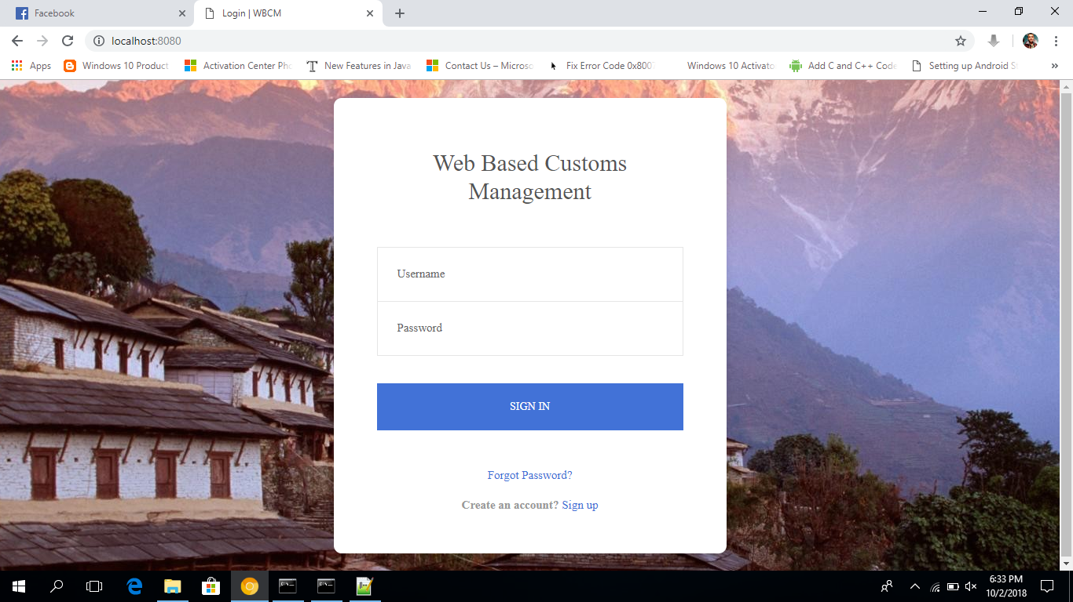

Slide 14
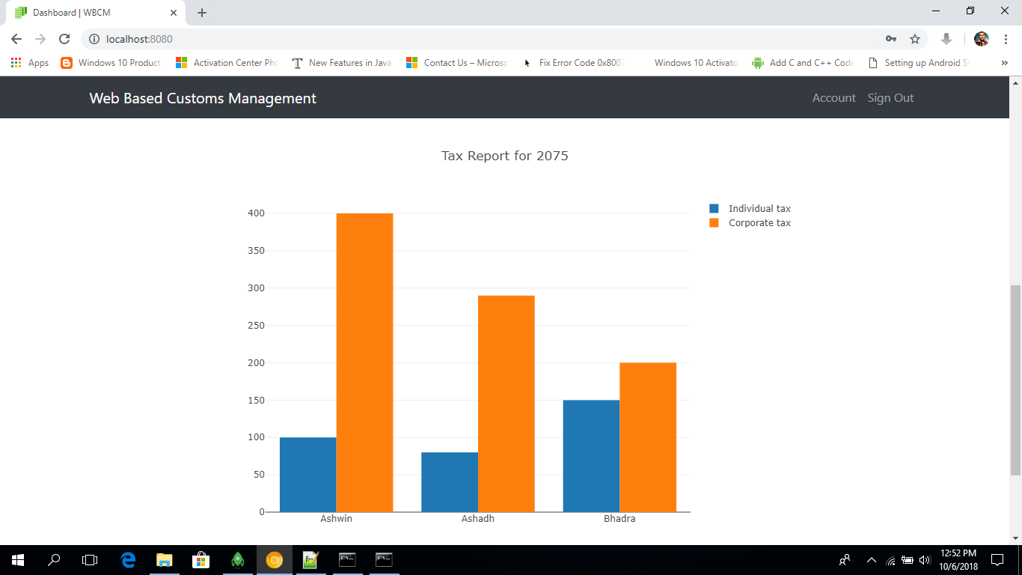

Slide 15
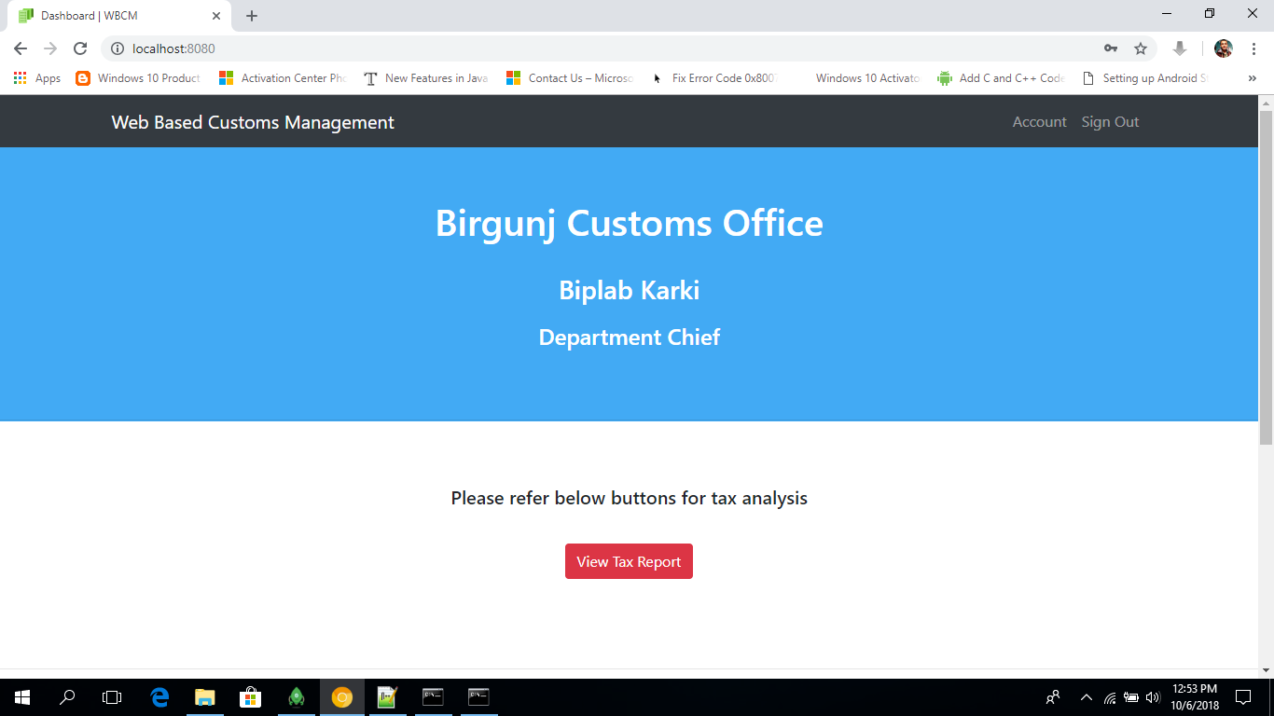

Slide 16
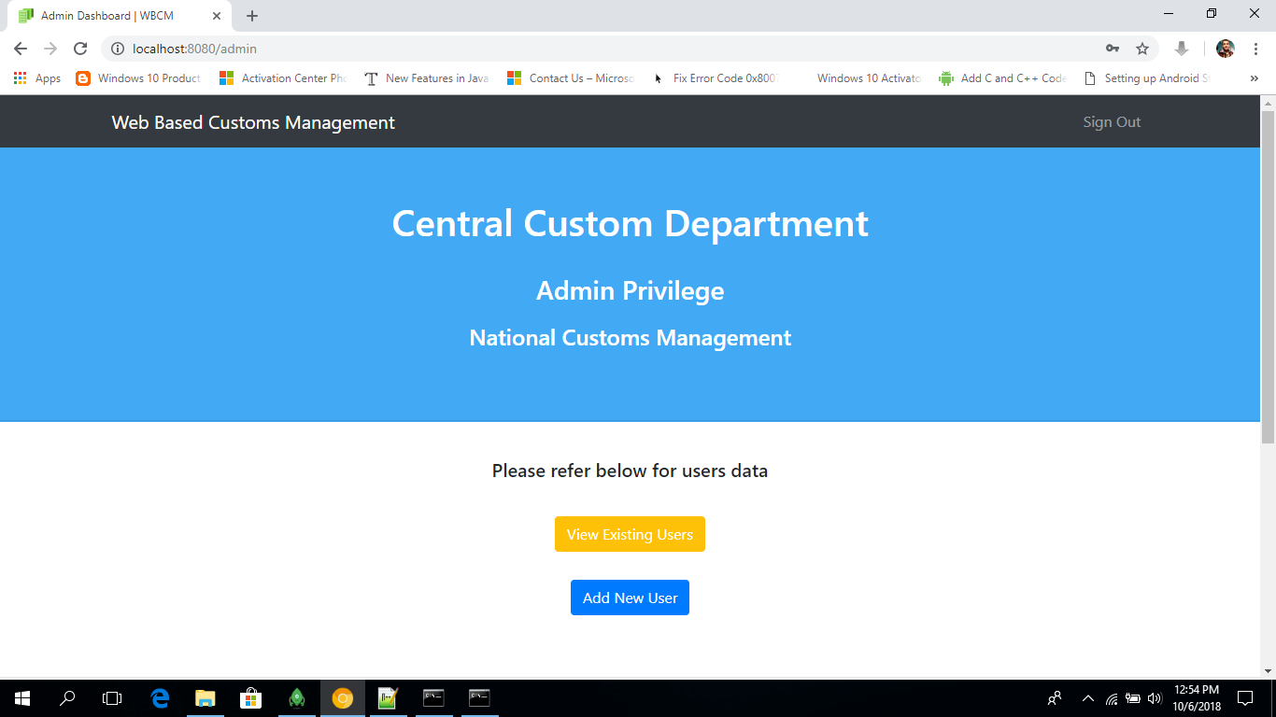

Slide 17
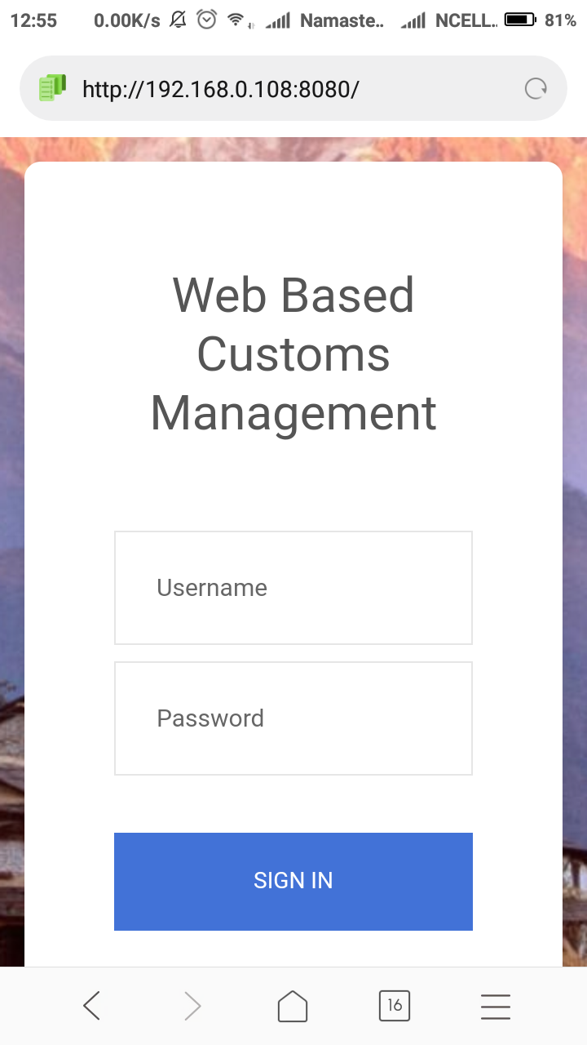

Slide 18
THANK YOU!!!

