Slide 1

Text Summarization with T5 and PEGASUS Models
Team Members:
Bipin Pandey
Nakul Budhathoki
Pujan Shrestha
Bronia John
Diksha Gusain
Harish Kundal
Parminder Kaur
Simarjeet Kaur
Priya Mehta
Natural Language Processing Project DSMM Group 1 & Group 3

Slide 2
Introduction
Text summarization is becoming increasingly crucial as the volume of information available continues to grow exponentially. Traditional summarization techniques often struggle to maintain the balance between conciseness and informativeness. This project leverages advanced transformer models like T5 and PEGASUS to develop a more accurate and efficient summarization system, addressing these challenges head-on.

Slide 3
Targeted Audience
Journalists: Need to quickly summarize news articles to keep up with fast-paced reporting.
Researchers: Require concise summaries of academic papers to stay updated on the latest findings.
Legal Professionals: Need to condense lengthy legal documents for efficient case preparation.
Educators: Summarize textbooks and articles to provide students with essential information.
Business Analysts: Need to distill key points from large reports for informed decision-making.

Slide 4
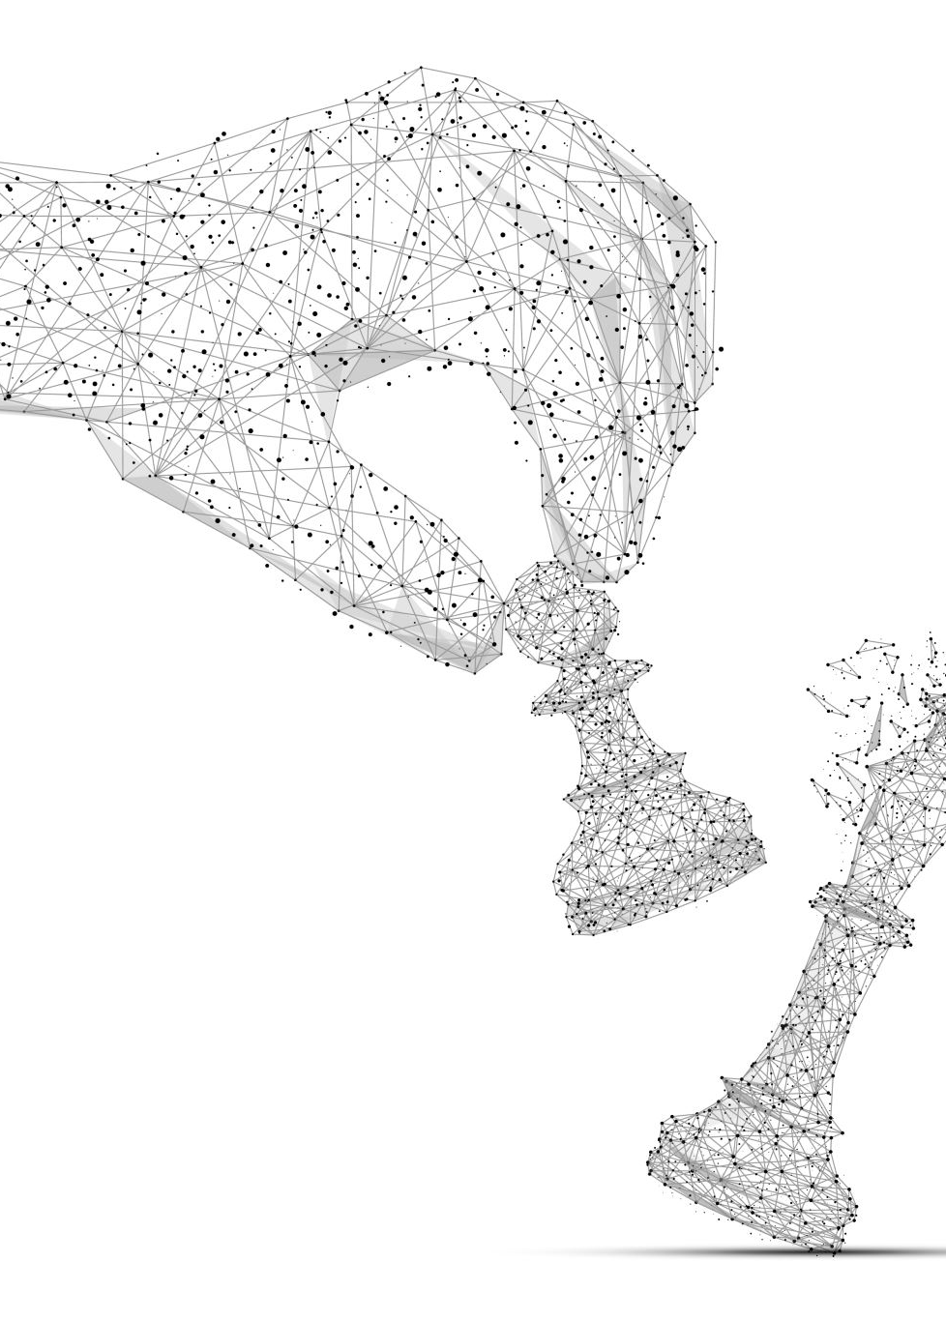
Proposed Solution
A hybrid model combining results of T5 and PEGASUS, benefiting from T5's versatility and PEGASUS's specialization in abstractive summarization.

Slide 5
Why this solution?
Alternative Solutions:
- Manual Summarization: Time-consuming and prone to human error.
- Traditional Extractive Methods: Often result in disjointed summaries that lack coherence and context.
- Generic Summarization Tools: May not be specialized for the specific domain, leading to less accurate results.
Why Choose Our Solution?
- Balanced Approach: By combining results from T5 and PEGASUS, we ensure that the summaries retain key information while also being coherent and well-organized.
- Adaptability: The model can be fine-tuned and adapted to different domains, making it a versatile tool for various professional needs.
- Efficiency: Automated summarization significantly reduces the time and effort required to generate high-quality summaries.

Slide 6

Objectives
Primary Objective:
Develop a strong summarization system combining T5 and PEGASUS for precise summaries.
Secondary Objectives:
Evaluate performance using ROUGE scores.
Experiment with varying summary lengths.
Deploy the model for public use.

Slide 7
Methodology
Dataset:
News articles and their summaries.
Preprocessing:
Text cleaning, tokenization, lemmatization, and n-gram extraction.
Model Selection:
Overview of T5 and PEGASUS models.

Slide 8
Evaluation Metrics
T5 Model:
- ROUGE-1: 0.3387
- ROUGE-2: 0.1311
- ROUGE-L: 0.2419
PEGASUS Model:
- ROUGE-1: 0.3485
- ROUGE-2: 0.1231
- ROUGE-L: 0.2121
Combined Model:
- ROUGE-1: 0.3387
- ROUGE-2: 0.1311
- ROUGE-L: 0.2419

Slide 9

Interpretation of ROUGE Scores
T5 excels in key term identification. PEGASUS provides better flow and organization. Combined model balances both aspects.

Slide 10
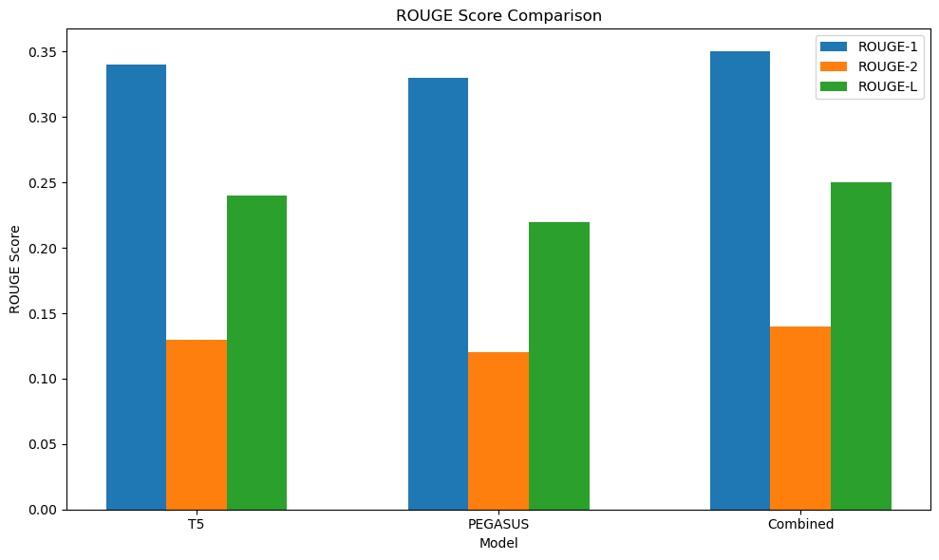
ROUGE Score Visualization

Slide 11
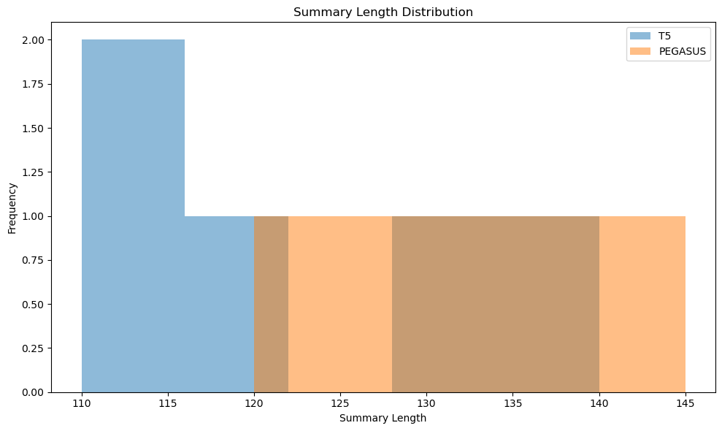
Summary Length Distribution

Slide 12

Deployment:
Model deployed using Flask and Gradio.
User-friendly interface for text input and summary generation.
Performance Optimization:
Use of techniques like torch.no_grad to improve speed.
GITHUB LINK

Slide 13
Conclusion Findings:
The combined T5 and PEGASUS model generates coherent, informative summaries.
Implications: Useful for summarizing news articles, legal documents, and research papers.

Slide 14

Future Work
Model Improvements:
Explore additional models and techniques.
Deployment Enhancements: Focus on scalability and faster response times.

