Slide 1
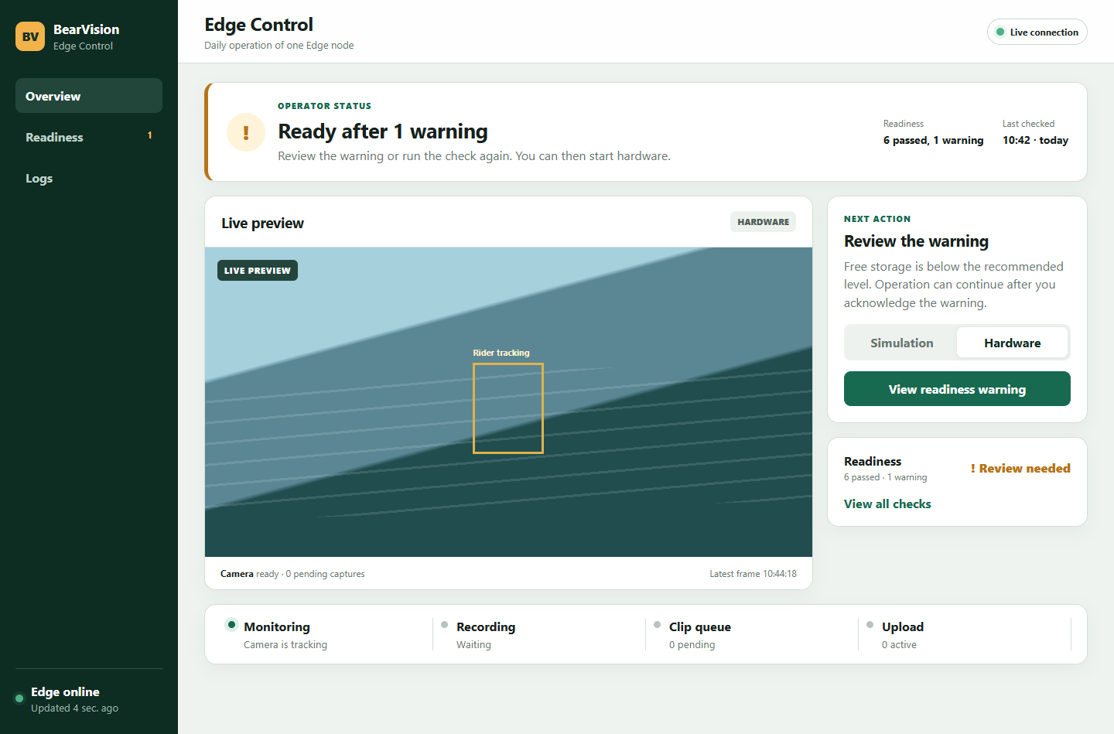
Edge Control
A calmer operator overview
Readiness details and logs move to separate screens. Readiness status and its start action remain on the overview.
Design prototype · September 10, 2026
Notes:
Static mockup data. The design is based on apps/edge-control and edge-control-operator-monitoring-plan.md.

Slide 2
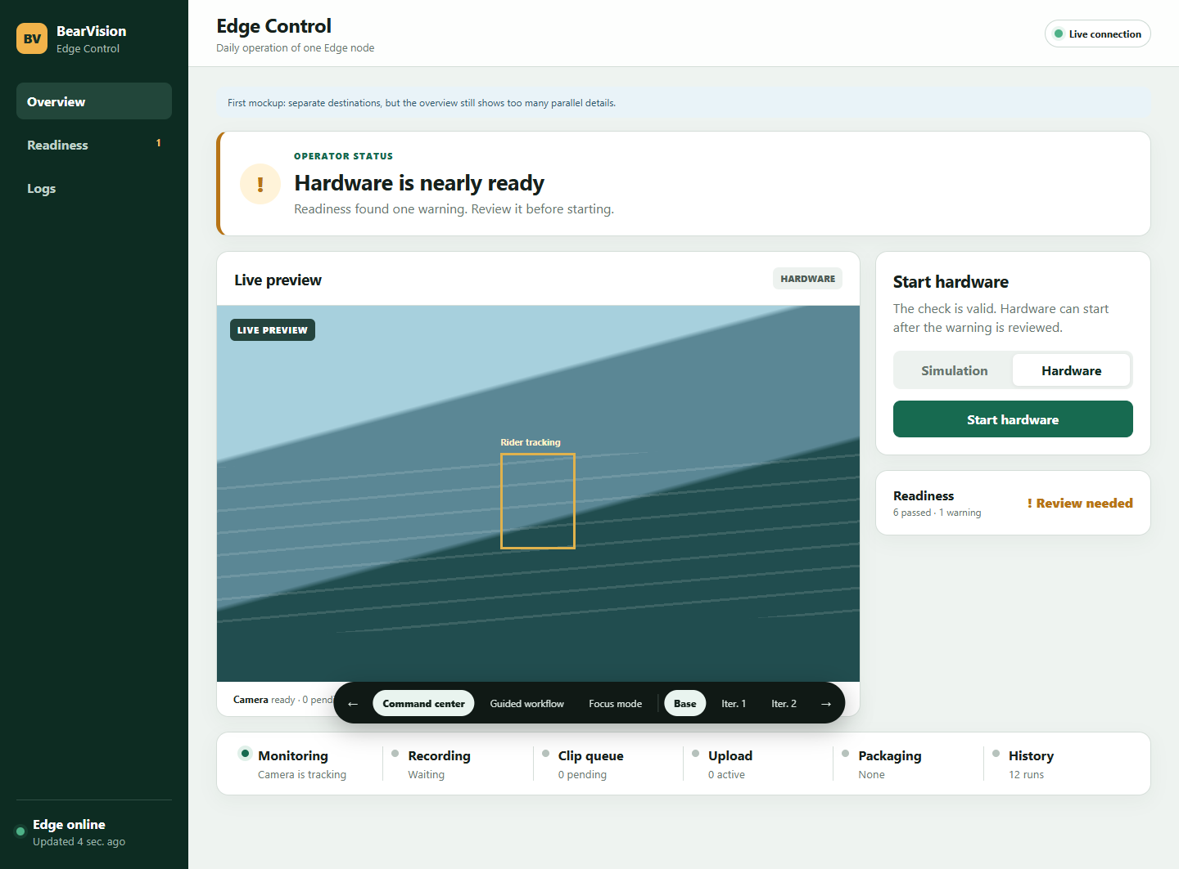
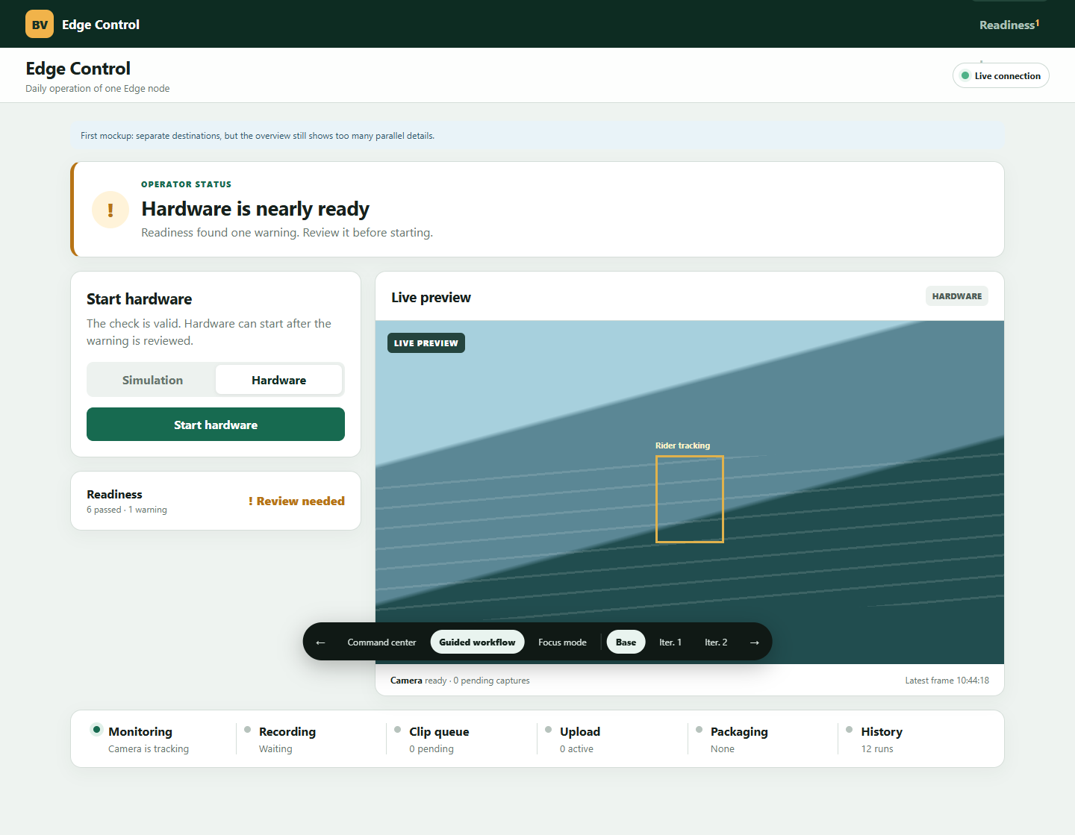
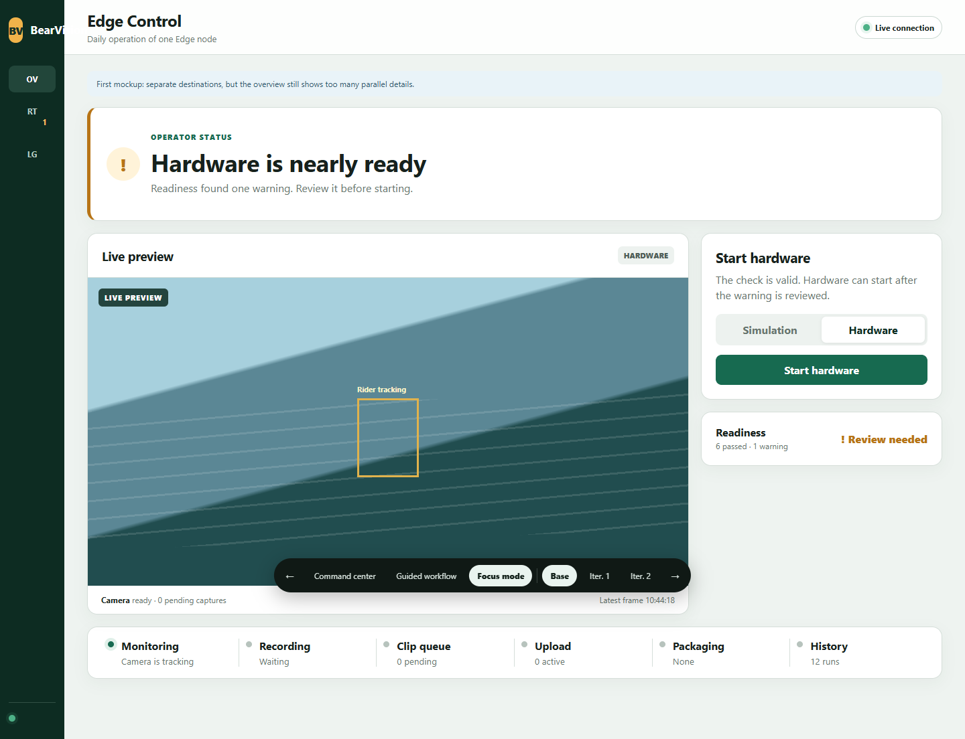
Three directions
The same capabilities with different orientation and information priority
Command center
Guided workflow
Focus view
Persistent navigation with clear destinations
Setup first, preview as the main workspace
Maximum preview space with compact navigation
Selected direction: Command center
Persistent navigation makes it easiest to return after an interruption. Full labels require no learned abbreviations.
Notes:
Operator review, round 1. The three screenshots come from one throwaway prototype with variant parameters.

Slide 3
Operator review · round 1
The command center wins, but the base version gives conflicting signals
1
Too many pipeline details
Packaging and history compete with the current operation.
2
Readiness is too passive
The status appears, but the route to details is unclear.
3
The CTA is misleading
The screen requires warning review, but the button says “Start hardware”.
The operator's question
What should I do now?
Notes:
Review performed with the Bear Vision Edge Operator persona. Findings apply to the shown static screen.

Slide 4
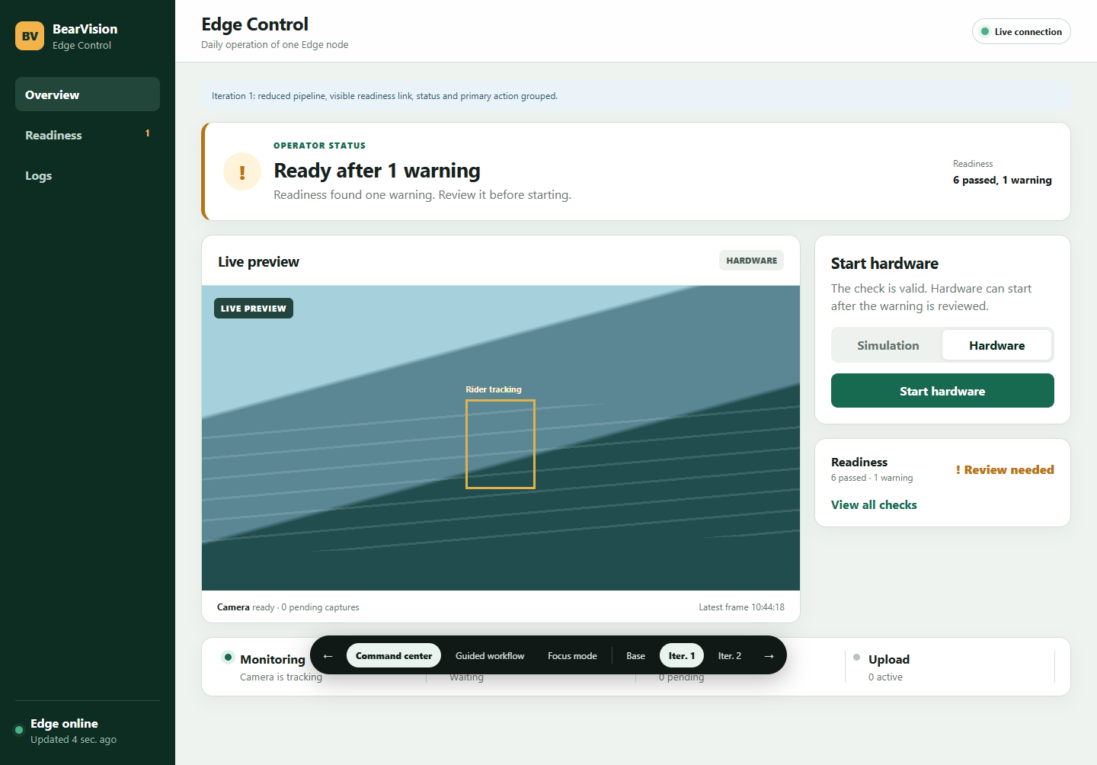
Operator review · round 2
Iteration 2 makes the next action and check age clear
Iteration 1
Iteration 2
Less pipeline noise and a visible link to checks. The start button still contradicts the warning.
“Last checked” supports returning after an interruption. The CTA opens the specific warning before start.
Result: one status, one next action
Notes:
Operator review, round 2. Iteration 2 is the recommended direction.

Slide 5
Final overview
Status, readiness summary and the check action remain on the overview
Notes:
Final mockup. Prototype-switcheren og reviewnoterne er skjult i dette screenshot.

Slide 6
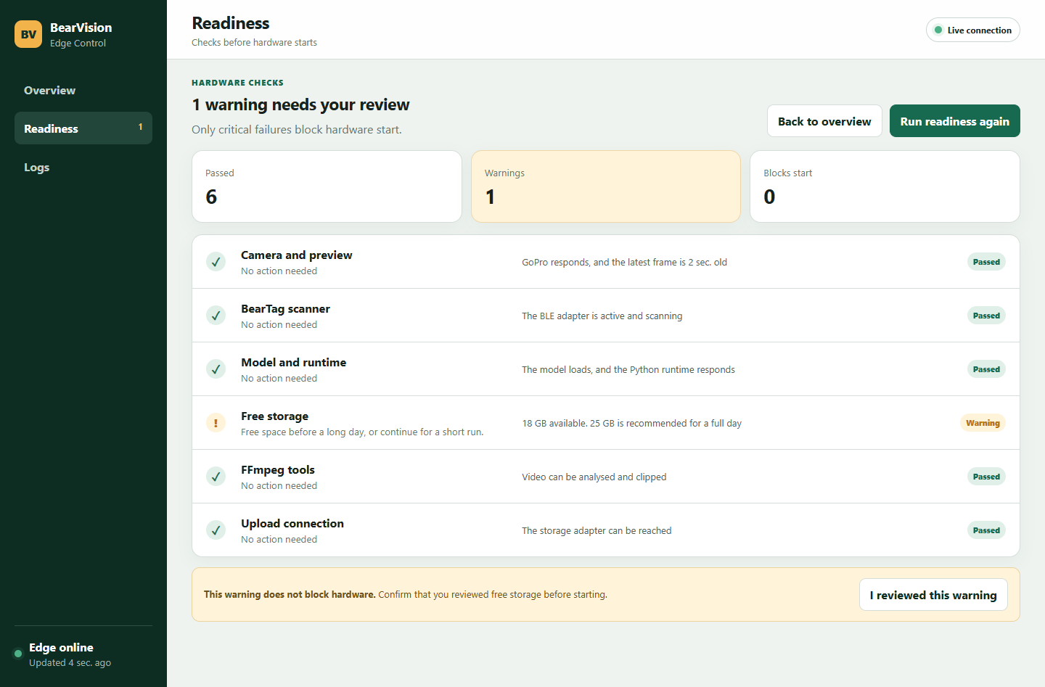
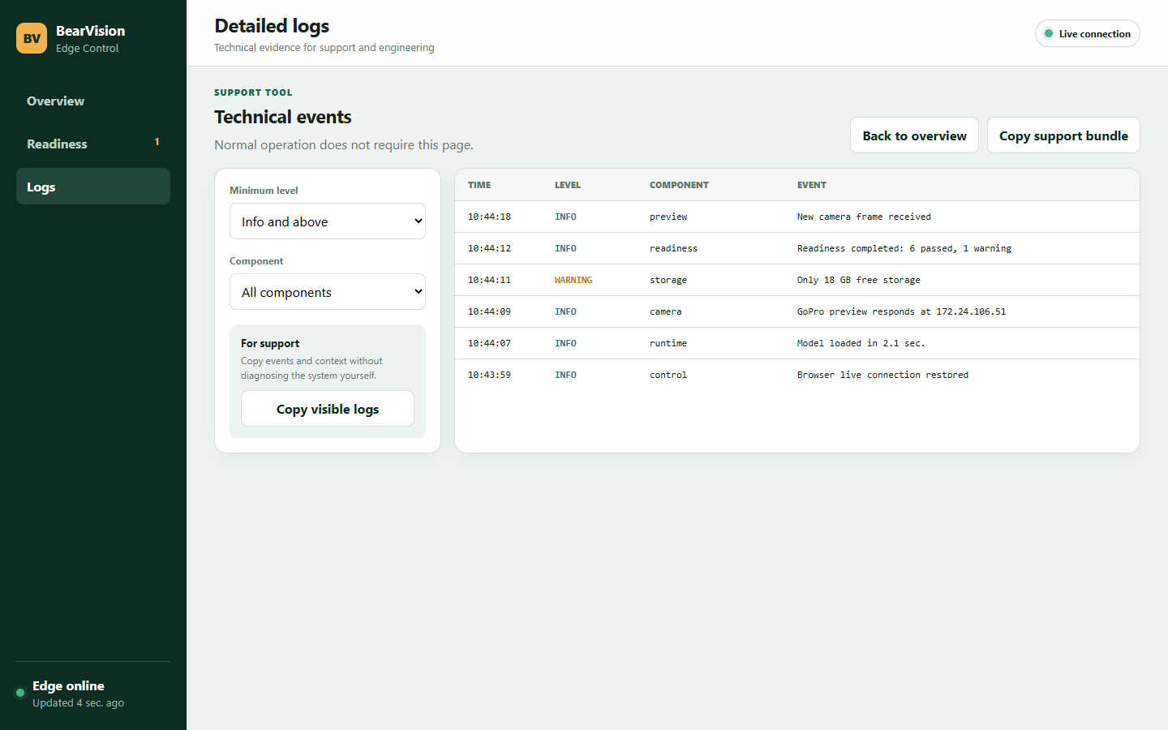
Separate detail screens
Readiness guides the operator. Logs support diagnosis.
Readiness
Detailed logs
Groups passed checks, warnings and blocking failures. Each issue explains its impact and the next action.
Filters and support evidence stay away from daily operation. The operator does not have to diagnose the system.
Recommendation: implement the information architecture, then validate it with a cable park operator.
Notes:
Final static mockups. Persona review is a design hypothesis and does not replace user interviews or interaction testing.

