Slide 1




AT85.02
Data Modeling and Management
Lab06: NEO4J - Graph Model
This Photo by Unknown Author is licensed under CC BY

Slide 2
Outline
Neo4J Graph database Overview
CRUD Operations
1. CREATE
1.1 Create Node
1.2. Create many Nodes and Relationships at once.
2. QUERY
2.1 Basic Query
2.2 Make Recommendations
2.3 Aggregate
3. UPDATE
3.1 Update Property of Node or Relationship
3.2 Update Label
4. DELETE
4.1 Delete a specific node
4.2 Delete a specific relationship
4.3 Remove Label from a node
4.4 Remove a property

Slide 3
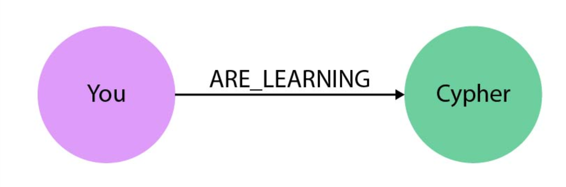


Slide 4
Neo4j is an open-source, NoSQL graph database.
Property Graph data model
Cypher Graph query language
Notes:
Neo4j, like many other graph databases, builds upon the property graph model;
labeled nodes are connected via directed, typed relationships.
Both nodes and relationships hold arbitrary properties (key-value pairs).
There is no rigid schema, but with node-labels and relationship-types we can have as much meta-information as we like.
The relationships are treated with as much value as the database records themselves.
This allows the engine to navigate your connections between nodes in constant time.
That compares favorably to the exponential slowdown of many-JOIN SQL-queries in a relational database.

Slide 5
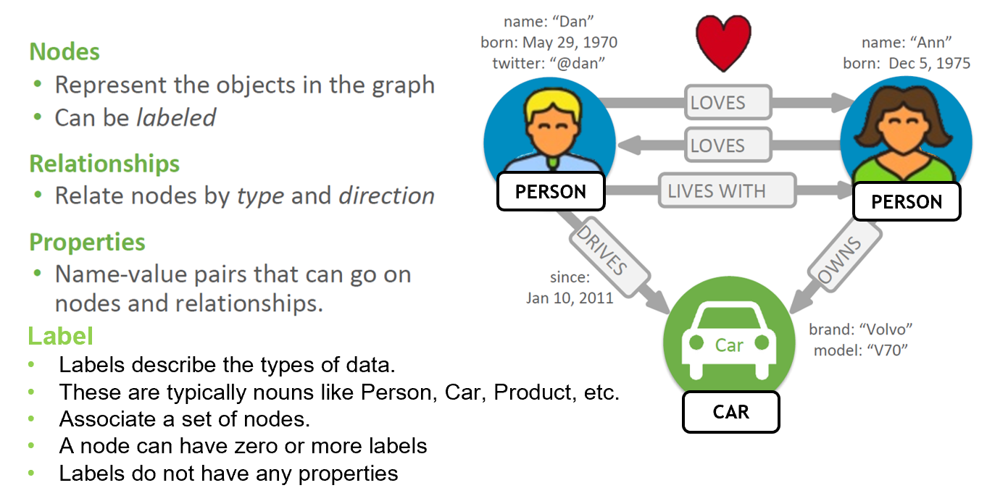
Property Graph Model

Slide 7
Cypher Query Language (CQL)
uses patterns to describe graph data
familiar SQL-like clauses
declarative, describing what to find, not how to find it

Slide 8
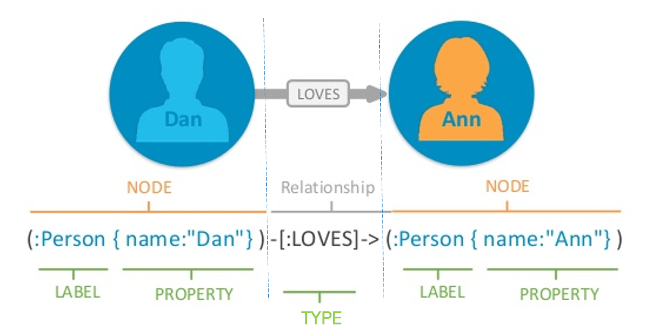
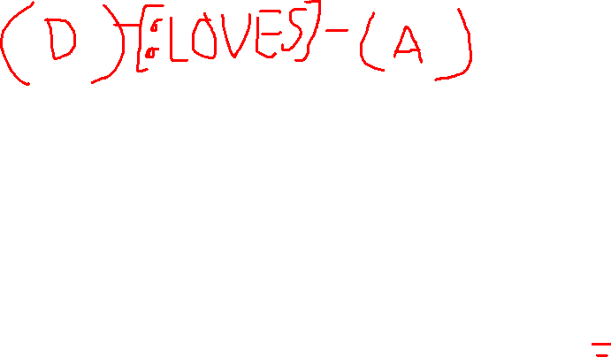
Cypher Query Language Syntax

Slide 9
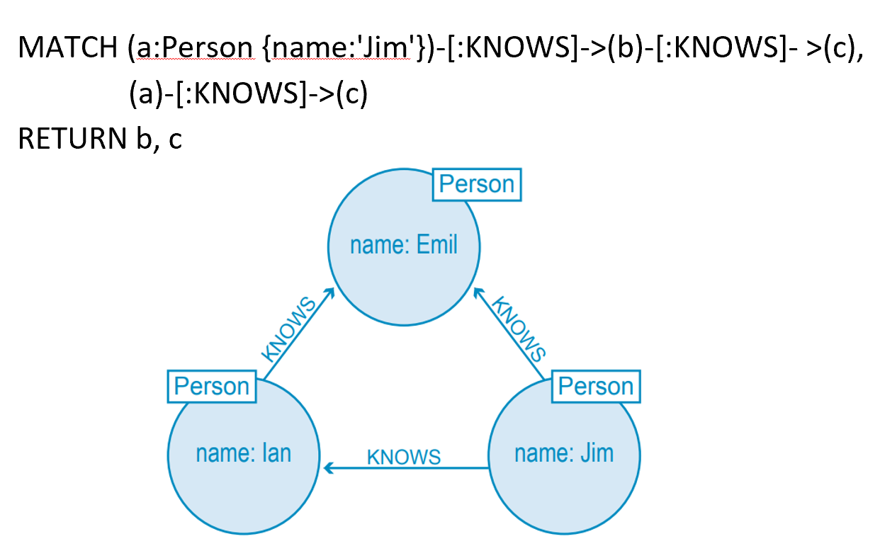
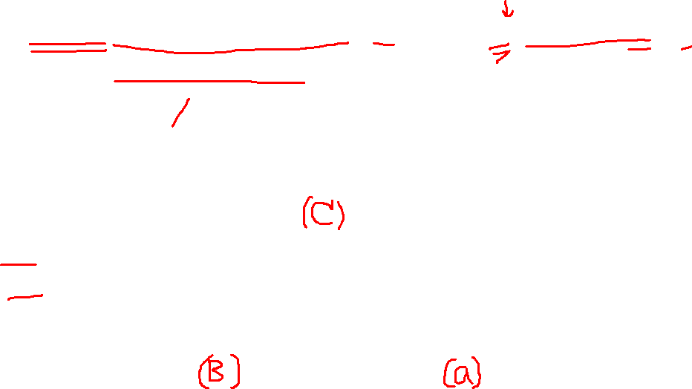
Example
Who is b?
Who is c?

Slide 10

Getting Started
Neo4j Sandbox (Demonstration)
https://sandbox.neo4j.com/

Slide 11
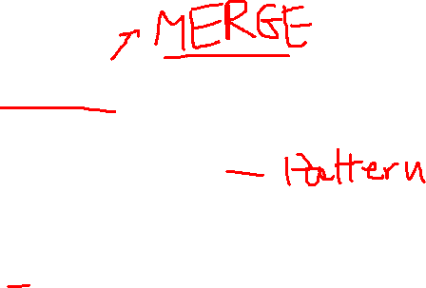
CRUD operations
Create/Insert
Read/Query
Update
Delete

Slide 12

Case Study: Social Network

Slide 13
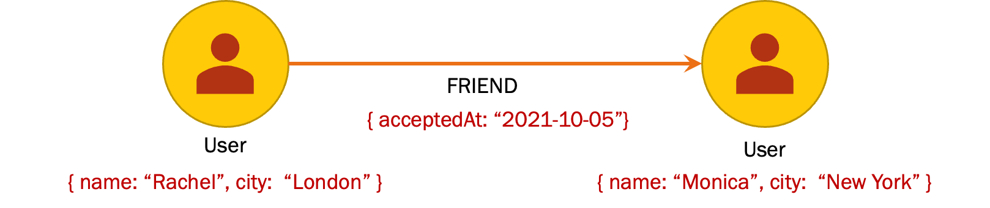
1. CREATE
Create Nodes with a relationship
CREATE (r:User { name: "Rachel", city: "London" }),
(m:User { name: "Monica", city: "New York" }),
(r)-[:FRIEND {acceptedAt:"2021-10-05"}]-> (m)

Slide 14
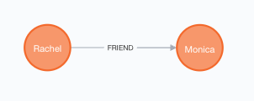
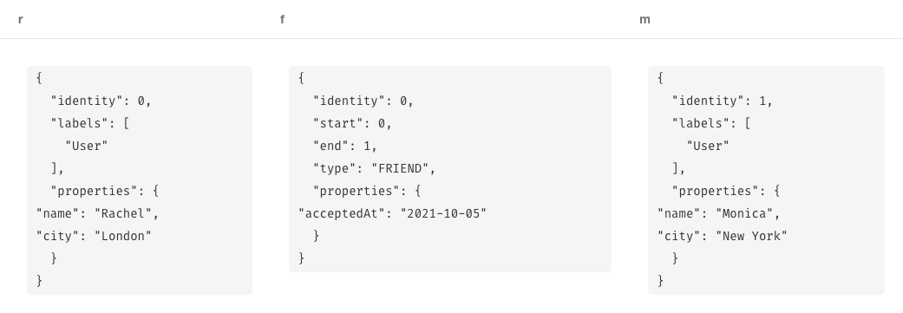
CREATE (r:User { name: "Rachel", city: "London" }),
(m:User { name: "Monica", city: "New York" }),
(r)-[f:FRIEND {acceptedAt:"2021-10-05"}]-> (m)
RETURN r,f,m
Graph View
Table View

Slide 15
Your Turn (1)
Create Cypher commands that insert two more users and make them as friends. Try add other properties than city.
Make each users you added as friends with the 2 previous users (Rachel and Monica).

Slide 16
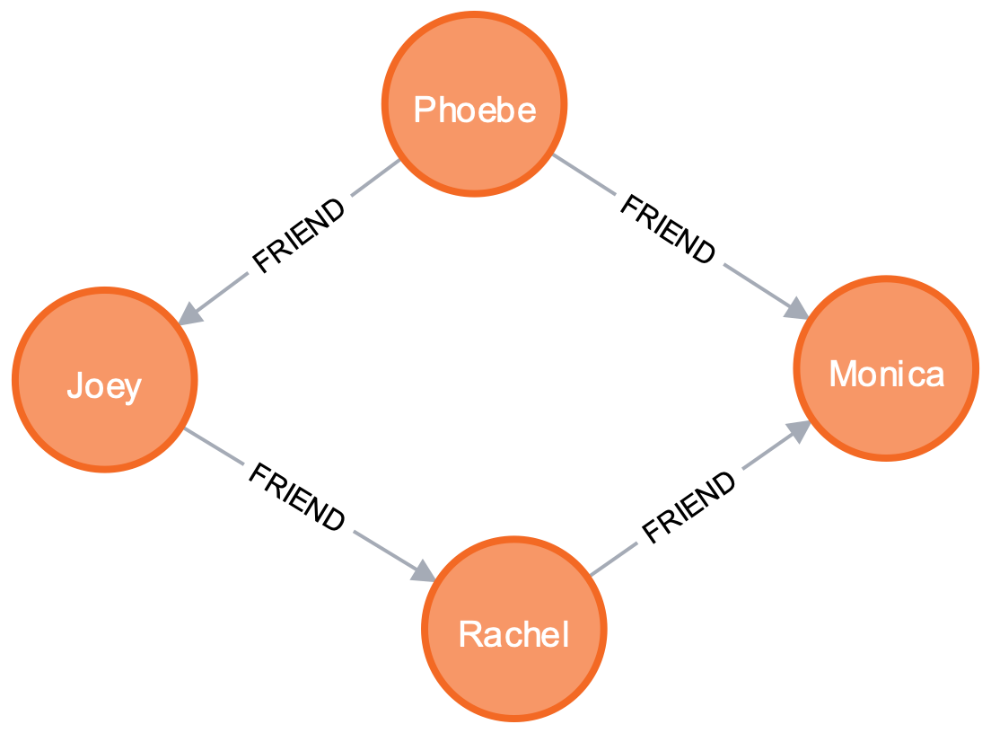
1. CREATE
Create more friendships
MATCH (r:User), (m:User),(ph:User),(j:User)
WHERE r.name="Rachel" AND m.name="Monica" AND ph.name = "Phoebe” AND j.name="Joey”
CREATE (ph)-[:FRIEND {acceptedAt: date() }]-> (m),
(j)-[:FRIEND {acceptedAt: date() }]-> (r)
RETURN r,m,ph,j;

Slide 17
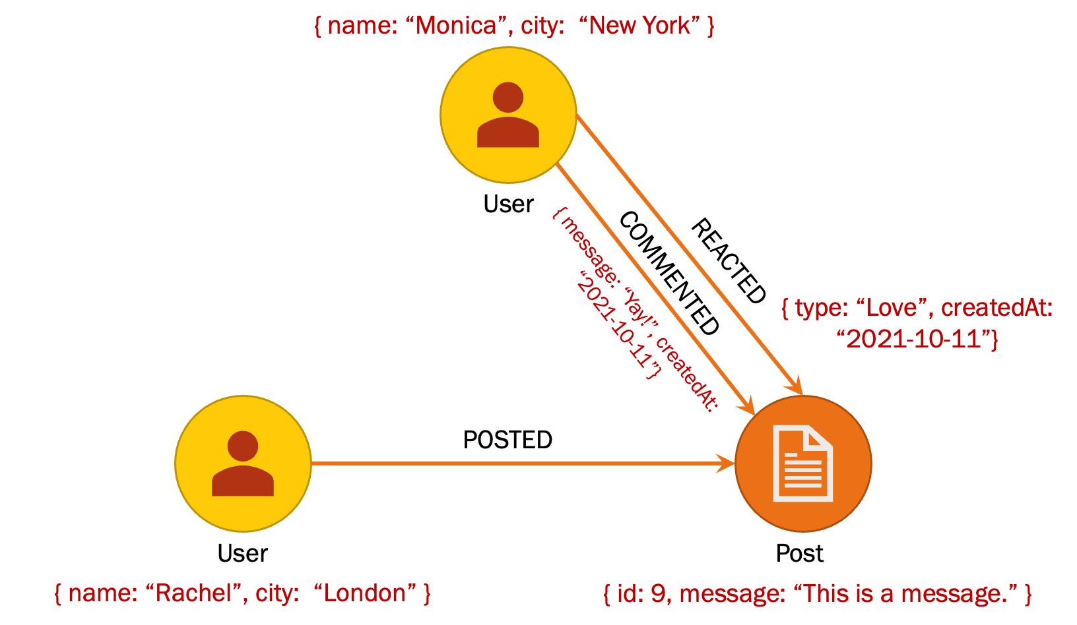
1. CREATE
Create a post , a comment and a reaction.
MATCH (r:User), (m:User)
WHERE r.name="Rachel" AND m.name="Monica"
CREATE (p:Post { id:"9", message: "This is a message." } ),
(r)-[:POSTED]->(p),
(m)-[:REACTED { type: "Love", createdAt: date() }]->(p),
(m)-[:COMMENTED { message: "Yay!", createdAt: date() }]->(p)
RETURN r,m,p;

Slide 18
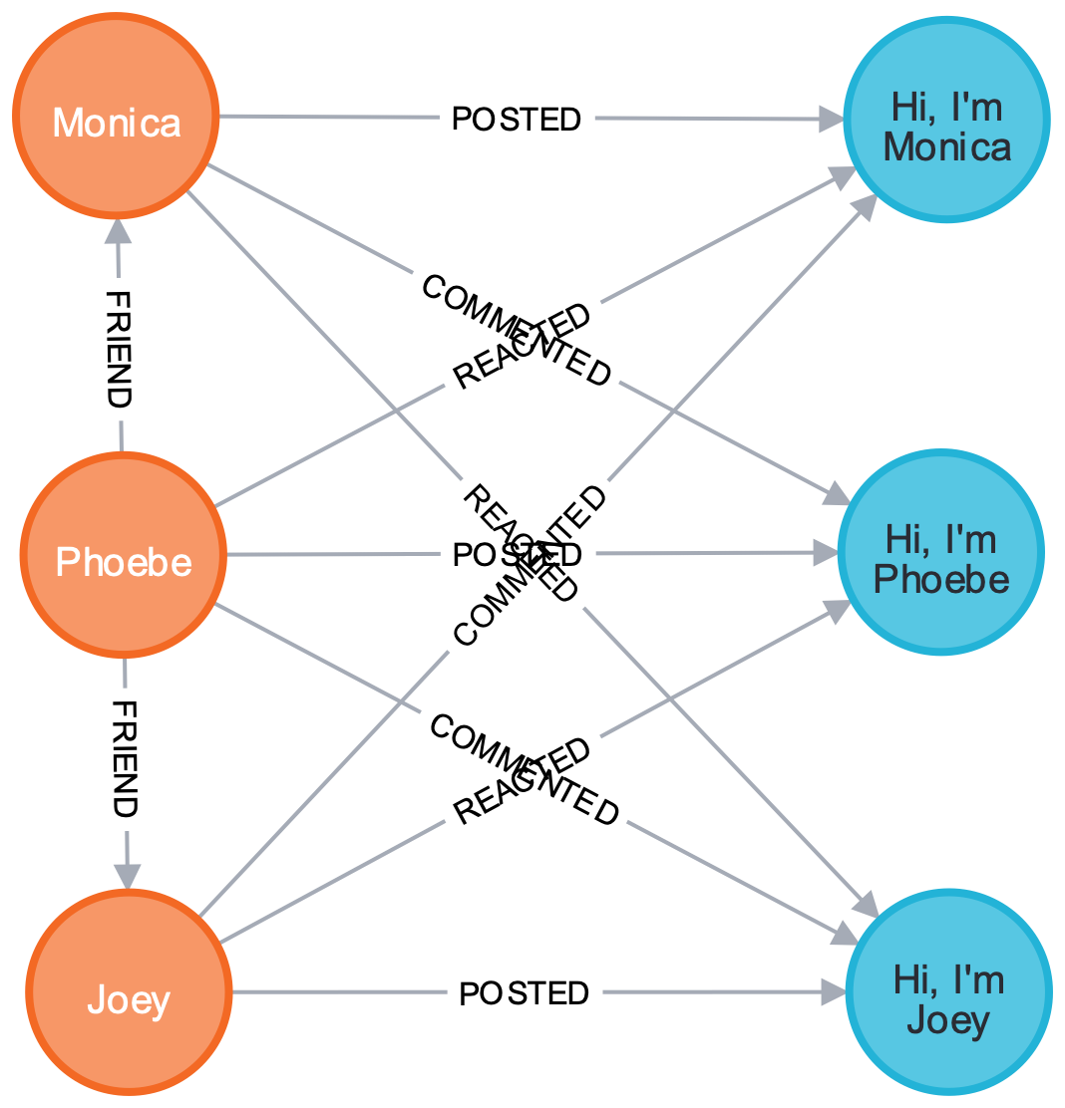
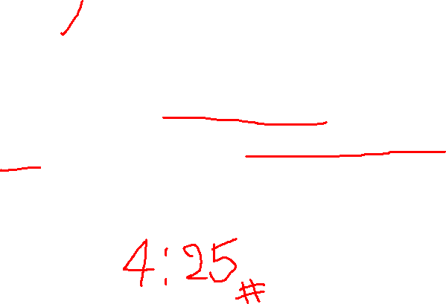
Your Turn (2)
Create 3 more posts.
Each must be posted by existing users and get at least a reaction and a comment from other users.

Slide 19
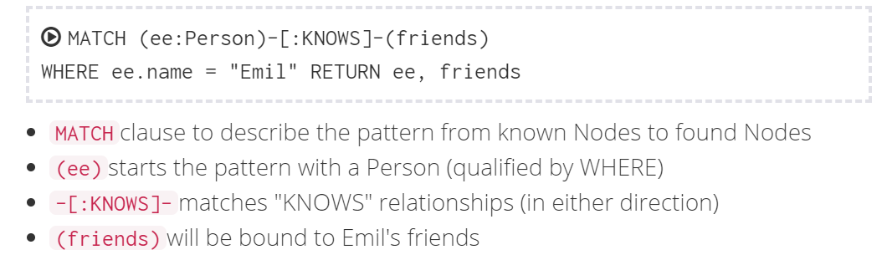
2. QUERY
2.1 Basic query the graph (Pattern matching )
EX.1 Find Emil’s Friends

Slide 20
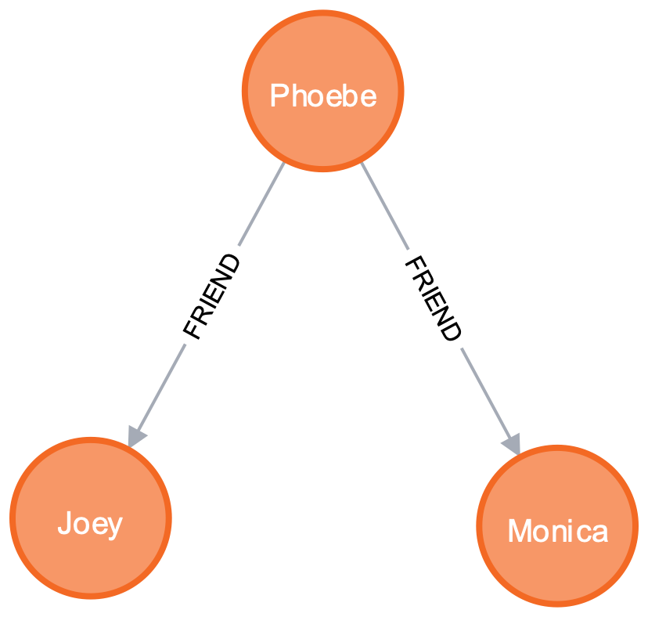
EX.2 Find Immediate Friends
MATCH (u:User)-[:FRIEND]->(f)
WHERE u.name = "Phoebe"
RETURN u,f;

Slide 21
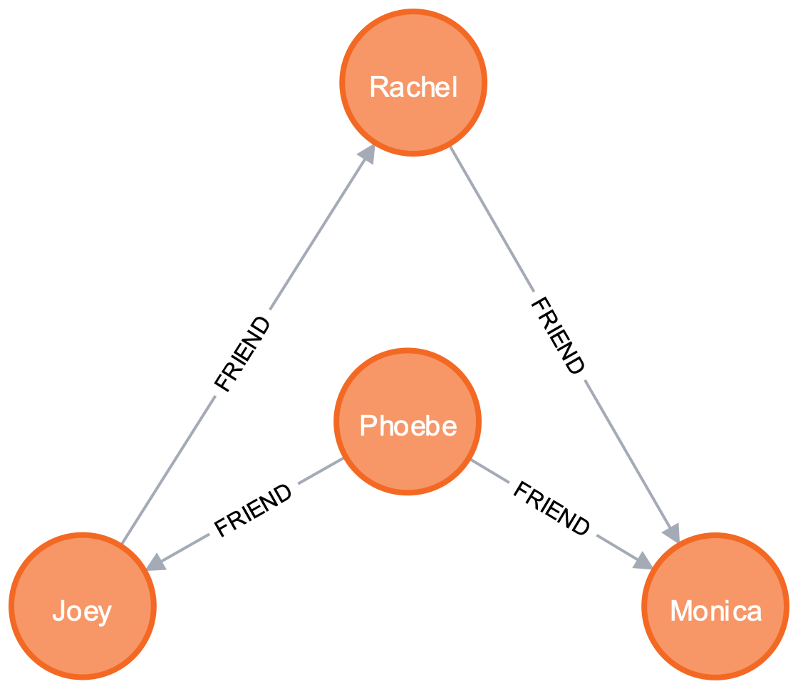
EX.3 Find Friends of Friends
MATCH (u:User)-[:FRIEND*]->(f)
WHERE u.name = "Phoebe"
RETURN u,f;

Slide 22
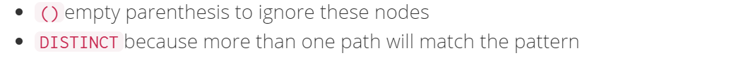
2.2 Make Recommendations (Pattern matching )
EX.4 Rachel is planning to go to Newark for a business trip, so she is looking for her friends who know someone living that city.
MATCH (r:User)-[:FRIEND]->()-[:FRIEND]-(newarkian)
WHERE r.name="Rachel" AND newarkian.city="Newark"
RETURN DISTINCT newarkian;
Notes:
MATCH (js:Person)-[:KNOWS]-()-[:KNOWS]-(surfer)
WHERE js.name = "Johan" AND surfer.hobby = "surfing"
RETURN DISTINCT surfer

Slide 23
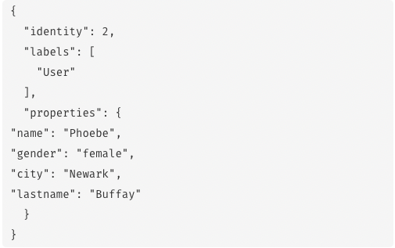
MATCH (r:User)-[:FRIEND]->()-[:FRIEND]-(newarkian)
WHERE r.name="Rachel" AND newarkian.city="Newark"
RETURN DISTINCT newarkian;

Slide 24
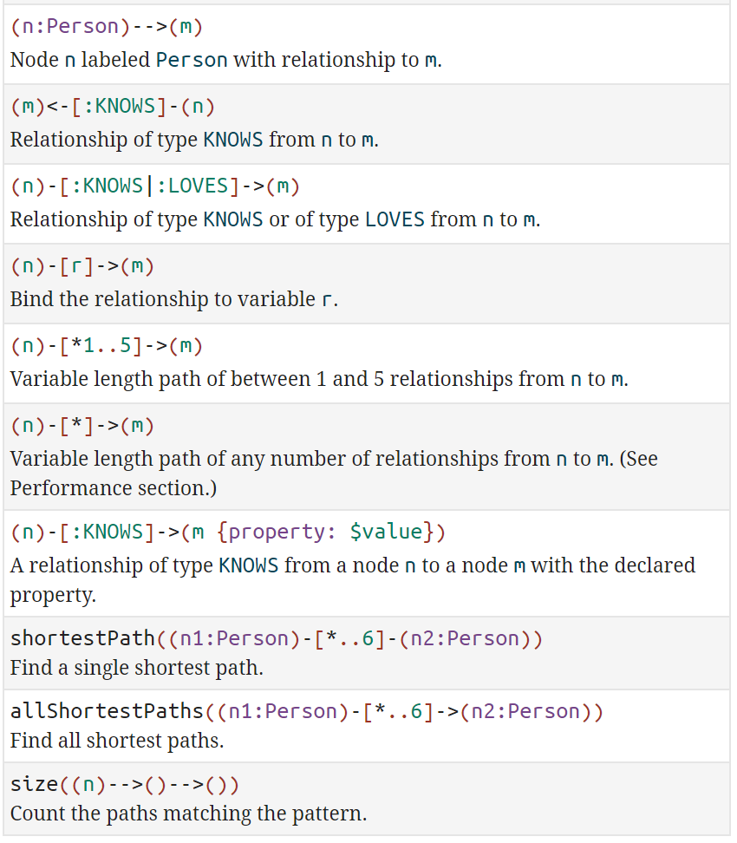
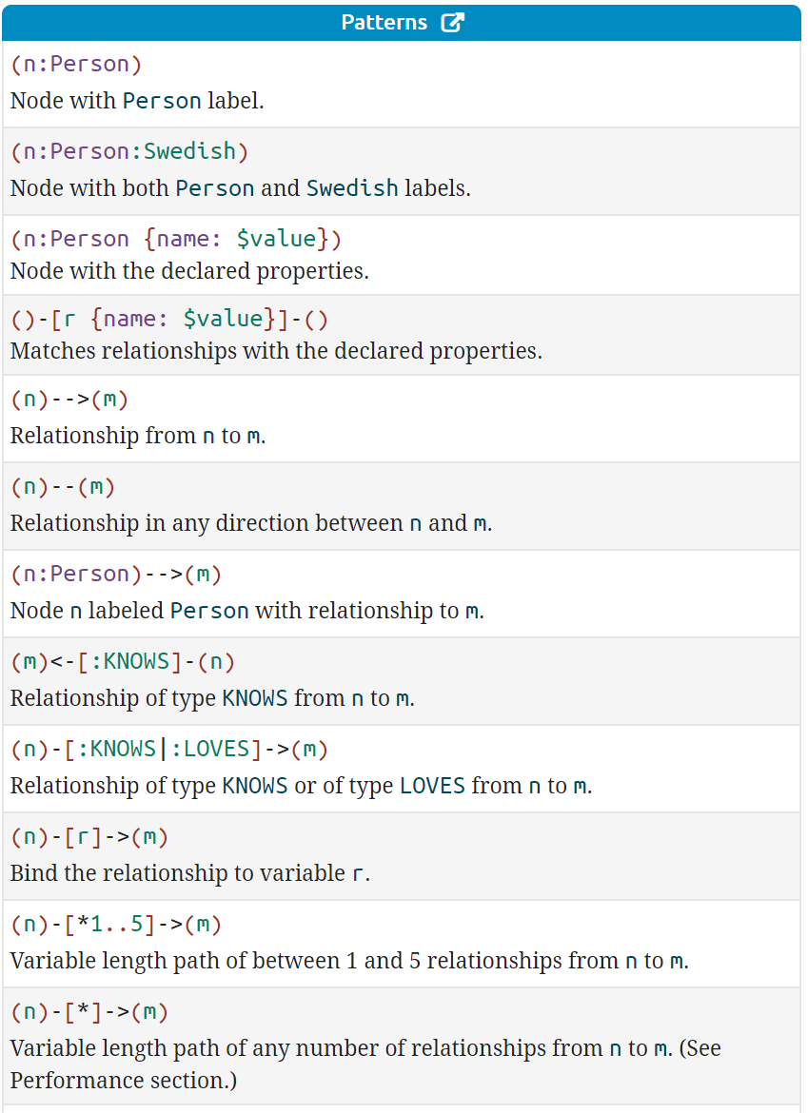
More Patterns
Notes:
https://neo4j.com/docs/cypher-refcard/current/?_ga=2.36519011.2100542366.1602562344-214533698.1600745849

Slide 25
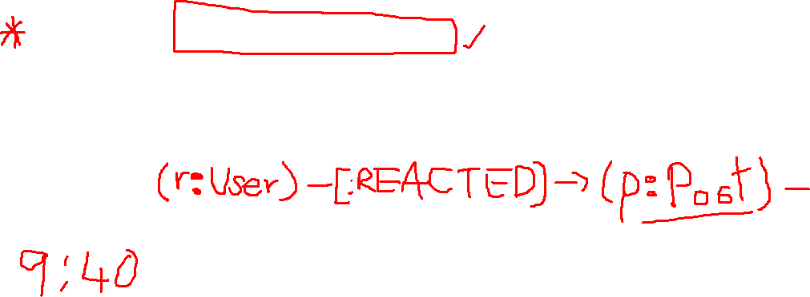
Your Turn (3)
Find who reacted all Monica’s post.
Modify the above command to find all friends of the reactor of Monica’s post.

Slide 26
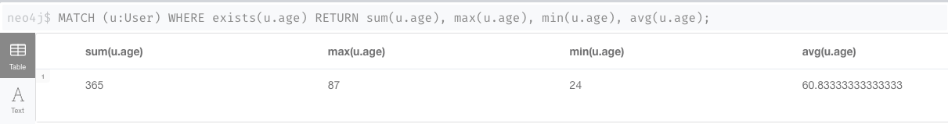
2.3 Aggregation
EX.5-1 Find total, average, minimum and maximum age of all users
MATCH (u:User) WHERE exists(u.age)
RETURN sum(u.age), max(u.age), min(u.age), avg(u.age);
Notes:
MATCH (n:Person) WHERE exists(n.age) RETURN sum(n.age),max(n.age),min(n.age),avg(n.age)

Slide 27
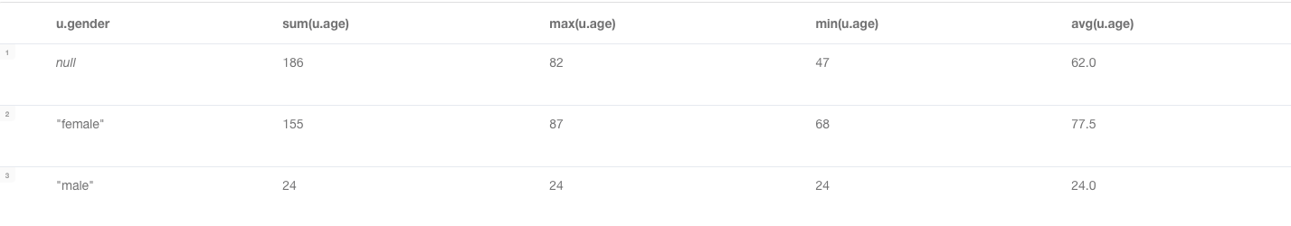
2.3 Aggregate
EX.5-2 Find Total, Average, Minimum, Maximum age of all people grouped by users’ gender.
MATCH (u:User) WHERE exists(u.age)
RETURN u.gender, sum(u.age), max(u.age), min(u.age), avg(u.age);
Notes:
MATCH (n:Person) WHERE exists(n.age) RETURN sum(n.age),max(n.age),min(n.age),avg(n.age)

Slide 28
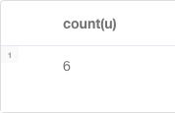
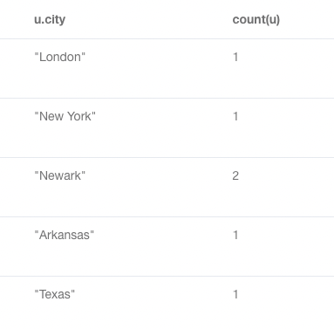
EX.6 Find total number of users
// Without a grouping key
MATCH (u:User) RETURN count(u);
// With a grouping key MATCH (u:User) RETURN u.city, count(u);
Notes:
MATCH (n:Person) WHERE exists(n.age) RETURN sum(n.age),max(n.age),min(n.age),avg(n.age)

Slide 29
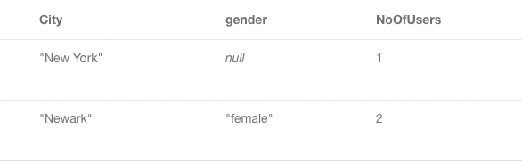
EX.7 Find Total number of persons who have pet
MATCH (u:User) WHERE u.age >=60
RETURN u.city AS City,
u.gender AS gender,
count(u) AS NoOfUsers;
Notes:
MATCH (n:Person) WHERE exists (n.pet) RETURN count(n)

Slide 30
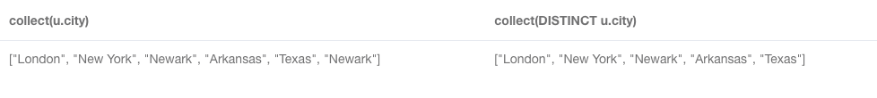
EX.8 Enumerate all cities of users
MATCH (u:User)
RETURN collect(u.city), collect(DISTINCT u.city);
Notes:
MATCH (n:Person) WHERE exists (n.pet) RETURN count(n)

Slide 31
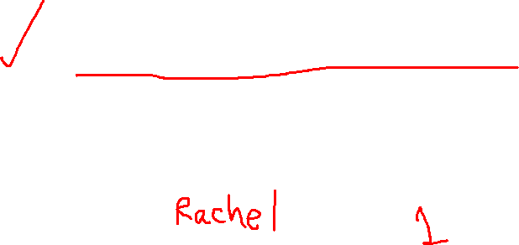
Your Turn (4)
Count all posts grouped by each user.
List all friends’ name of each user. Show friends names in the same column.

Slide 32

3. UPDATE
3.1 Update Node or Relationship Property
EX.9 Set Johan’s surname to be ‘Taylor’ and age =40
MATCH (r:User) WHERE r.name="Rachel"
SET r.lastname = "Berry", r.age=34
RETURN r.name, r.lastname, r.age;

Slide 33

(1) If you set a property with NULL value = removing the property
EX.10 Remove Rachel’s age.
MATCH (r:User {name:"Rachel"})
SET r.age = NULL
RETURN r;

Slide 34
(2) Set mutate properties using +=
Any properties in the map that are not on the node or relationship will be added.
Any properties not in the map that are on the node or relationship will be left as is.
Any properties that are in both the map and the node or relationship will be replaced in the node or relationship.
However, if any property in the map is null, it will be removed from the node or relationship.

Slide 35

EX.11 Update Monica’s age and workplace using +=
MATCH (m:User { name: "Monica" })
SET m += { age: 39, workplace: "World Bank" }
RETURN m.name, m.age, m.workplace;

Slide 36
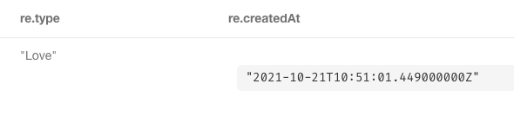
EX.12 Update Phoebe’s reaction on the Monica’s post by changing the reaction type to ‘Love’ and recording a current date-time.
MATCH (:User { name : "Phoebe's"})-[re:REACTED]->(p:Post)<- [:POSTED]-(:User { name : "Monica" })
SET re.type="Love", re.createdAt=datetime()
RETURN re.type, re.createdAt;

Slide 37
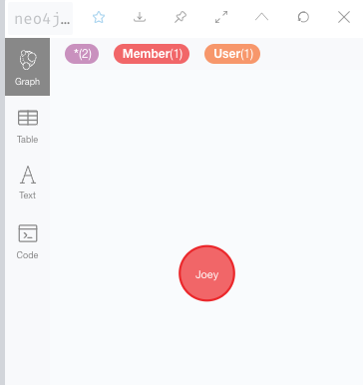
3.2 Update a node label
Use SET to set Label(s) to a node
EX.13 Update Label for Johan to be Parent and Employee
MATCH (j {name:"Joey"})
SET j:User:Member
RETURN j;

Slide 38
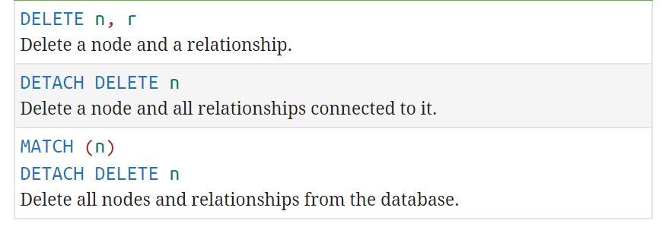
4. DELETE

Slide 39
4.1 Delete a specific node
EX.14 Delete Kim’s node
MATCH (k {name: ‘Kim'})
DETACH DELETE k;
Notes:
Verify: MATCH (n)-[r]-(m) return n,r,m

Slide 40
4.2 Delete a specific relationship
EX.15 Undo a reaction of Monica on a Joey’s post.
MATCH (m{name: 'Monica'})-[re:REACTED]->(p)<-[:POSTED]- (j{name:'Joey'})
DELETE re;
Notes:
Verify: MATCH (n)-[r]-(m) return n,r,m

Slide 41
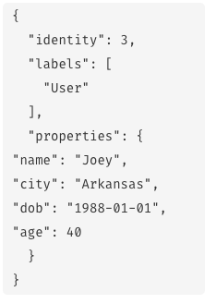

4.3 Remove Label from a node
EX.16 Remove label Member from Joey
MATCH (j {name: 'Joey'})
REMOVE j:Member
RETURN j;
Notes:
Verify: MATCH (n)-[r]-(m) return n,r,m

Slide 42
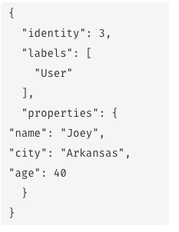
4.4 Remove a property
EX.17 Remove DOB property Joey’s node
MATCH (j {name: 'Joey'})
REMOVE j.dob
RETURN j;
Notes:
Verify: MATCH (n)-[r]-(m) return n,r,m

Slide 43
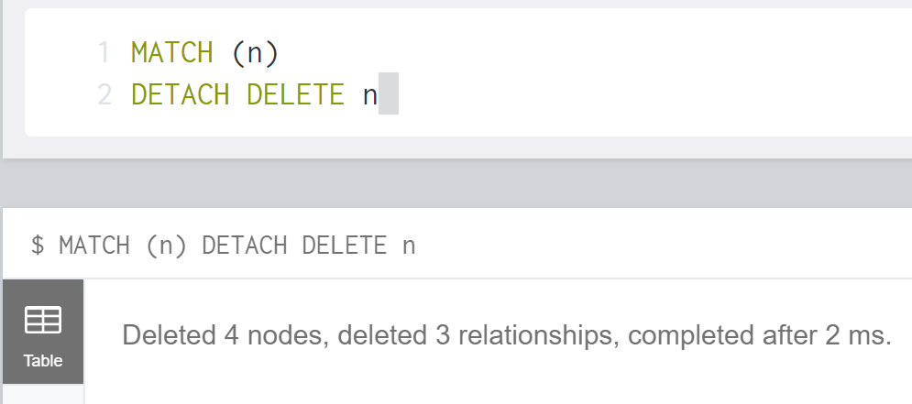

4.5 Delete ALL nodes
EX.18 Delete ALL nodes
MATCH (n)
DETACH DELETE n
Notes:
Verify: MATCH (n)-[r]-(m) return n,r,m

Slide 44
References
Migrating SQL to Cypher https://neo4j.com/developer/guide-sql-to-cypher/
Patterns Matching https://neo4j.com/docs/cypher-manual/current/syntax/patterns/
Aggregating functions https://neo4j.com/docs/cypher-manual/current/functions/aggregating/
SET property using MAP https://neo4j.com/docs/cypher-manual/current/clauses/set/#set-setting-properties-using-map
Importing Data from CSV Files https://neo4j.com/developer/guide-import-csv/
Setting Up Neo4j on AWS EC2 https://www.inoutcode.com/aws/how-to-setup-neo4j-on-aws-ec2/

Slide 45

Thank You.

