Slide 1
HiCH: Hierarchical Fog-Assisted Computing Architecture for Healthcare IoT
By Iman Azimi, Arman Anzanpour, amir rahmani, tapio pahikkala, marco levorato, pasil liljeberg, nikil dutt

Slide 2
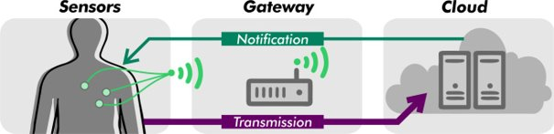
Background
Growing demand for 24/7 autonomous health monitoring services
Rapid response and accuracy are instrumental in treatment
Healthcare IoT
Early detection
Prevention via prediction
Data analytics
Simple vs Complex
Remote vs Cloud-based vs Fog-based
Examples:
ECG monitoring systems
Insulin regulations
General IoT system for remote patient monitoring
1
Notes:
Introduce the problem/need for Healthcare IoT, as well as the challenges the systems currently face.
-Simple IoT only data collection, transmission, and visualiztion for users (ie no decision making), ECG Monitor
-Complex medical cyber-physical systems (MCPS) autonomously acutate sensor data, local decision making, Insulin regulator

Slide 3
Background cont...
Challenges of Healthcare IoT
Network dependability
Bandwidth/Latency
Stability
Lack of robustness
Complex computations
Machine learning algorithms
Big data
Overload storage
Limited processing capabilites
2
Notes:
-Extension of "client-server" model used in the Internet to encompass "things" not suitable for human health scenarios (non-safety applications)
-Similar issues involved with autonomous vehicles

Slide 4
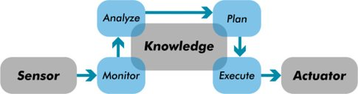
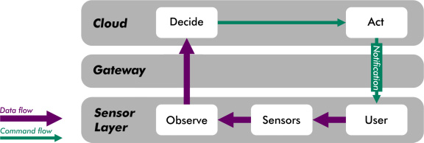
Related Works
Observe-Decide-Act (ODA)
MAPE-K
Observe
Manage data collection
Decide
Analyze and exploit data
Act
Implement proper actions
Well-suited for local CPS computation
Cannot exploit resources in distributed/hierarchical systems
Monitor
Collect data from sensors
Analyze
Data analytics to models
Plan
Generating procedures
Execute
Implement procedures
Shared Knowledge
3
Notes:
Existing computing models for healthcare IoT architecture
-ODA most commonly used in CPS systems,local computation capacity at sensor network/centralized cloud IoT
-MAPE-K provides automated management components for computational units and specifies system behaviors, all components access partiall/fully to shared knowledge base
-Monitor collects data from different resources, closest component to sesing fabric, can track and determine events to be analyzed
-Analyze data patterns, prdiction techniques and meta data exploited
-Plan selecting or generating procedure for system from inputs from analyze component, either be single command or complicated plan.
-Execute necessary changes to system to implement procedure from plan, adjust behavior of system

Slide 5
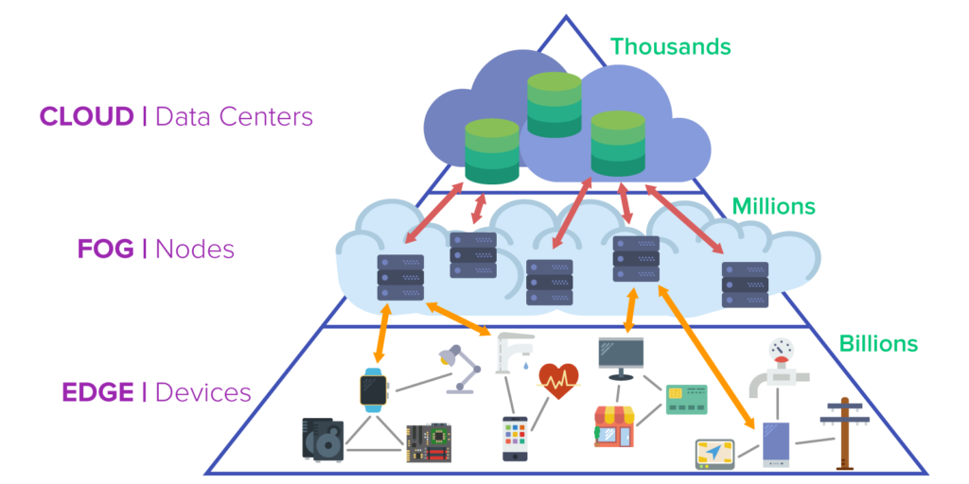
Quick Mention
Fog Computing
Extends cloud computing paradigm to edge devices
Enables local computation, storage, and control
Improved privacy, reliability, latency
Methods are limited to low computational tasks
4
Notes:
-Gateway devices perform local data processing along with data transmission to the cloud, enables resource management at the local layer.
-Enables limited computation to locally handle basic, yet critical services (great for healthcare systems)
-Rule based methods for methods due to low computational power
-Therefore, machine learning algorithms for local decision making cannot be implemented in the fog

Slide 6
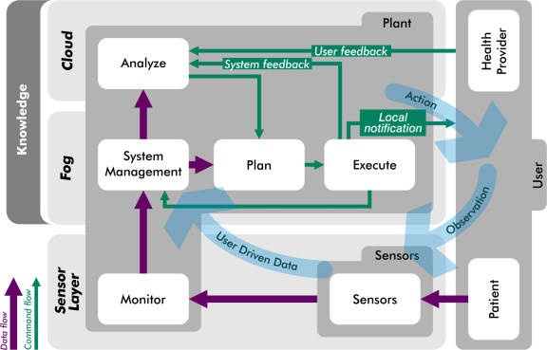
HiCH: Proposed System
Incorporates MAPE-K, fog and cloud computing paradigms
Hierarchical partitioning and machine learning algorithms
Map MAPE-K components into IoT layers
Closed-loop resource management
Main Ideas:
Map heavy training procedures to cloud
Outsource trained hypothesis to fog nodes
Exploit edge knowledge to enhance resource management
5
Notes:
-Green line is command flow, purple line is data flow, blue arrows show closed loop effect

Slide 7
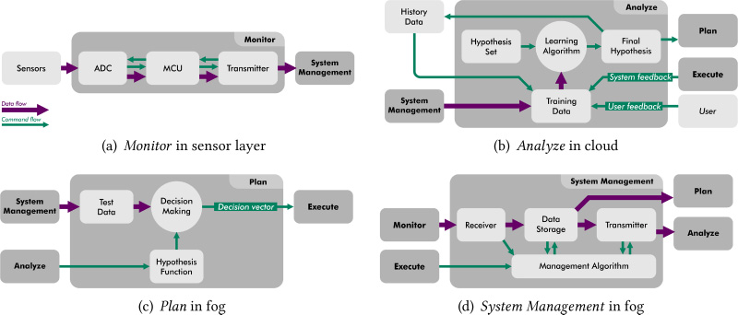
HiCH Components: Monitor
ADC to convert sensor outputs
MCU for data aggregation in local storage and pre-processing
Noise filtering
Normalization
Transmitter packets data to be sent to System Management
Packet size and transmission period depend on data type collected by sensors
6
Notes:
-Analog to digital converter
-Microcontroller unit
-For case study: sensor was a single-channel ECG, MCU was ATmega328P, transmitter RN42

Slide 8
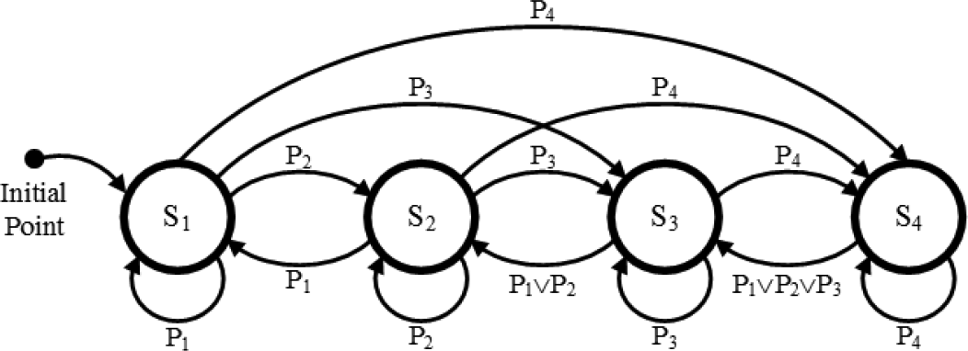
HiCH Components: System Manager
Receiver collects sensory data
Stored and organized in Data Storage
Sends complete set of sensory data to Plan for local decision making
Transmitter sends data to remote servers (cloud)
Management Algorithm
Data reduction and transmission rate
Controlled by decision vector sent from Plan to Execute
7
Notes:
-Organized in a data structure (specific not mentioned)
-Management Algorithm communicates with Data storage/Transmitter to control data reduction/transmission rate
-S1 most cost-effective setting w/lowest transmission rate from fog to cloud, Sn being the most accurate setting w/ highest performance
-P1 patient conditions which is normal, Pn being high-risk condition

Slide 9


HiCH Components: Analyze
Machine learning training procedure
Supervised learning model
Define hypothesis function in the Hypothesis Set ($h ∈ H$) to satisfy:
$$h :X →Y$$
Where $X ∈\text{ℝ}d$is the input space with d attributes and $Y$ is the output space
$X$ and $Y$ created/updated from sensor data, History Data, and Plan/User feedback.
$h$ generated in Learning Algorithm
Initialized from Hypothesis Set
Runtime updates with training data
Final Hypothesis stores $h$ and sends it to Plan and History Data for training
Linear machine learning method:
$$h(x) = sgn⁡(wTx + b)$$
where:
$sgn⁡()$is a sign function
$x$ is the input with d attributes
$b$ = bias constant
$w$ = weight vector inferred by learning algorithm
8
Notes:
-Machine learning algorithm dependent on input/sensor data chosen, limited processing power/storage capacity at gateway edge nodes (Plan), linear works best for HiCH
-Output space is a vector of patient or context conditions: either normal or emergency, can be expanded to provide multi-class classifications
-Weight and bias inferred by the learning algorithm from training data
-Nonlinear classifiers may also be fitted to HiCH, however some may be unsuited

Slide 10

HiCH Components: Plan
Fog layer local computation
Sensor data sent to Test Data, creates Decision Making input
$x^{′}∈$ℝ^{d}
Similar feature extraction as Analyze in Test Data
Classified in Decision Making via current hypothesis
Trained hypothesis periodically downloaded into Plan (daily, weekly)
Decision vector indicates the patient’s current condition
9
Notes:
-Updating classifier function(trained hypothesis) is specified w/ respect to the types of sensor data

Slide 11
HiCH Components: Execute
Fulfills actuation in system
Forwards decision vector to other components
System Management updates algorithm
Local notification on patient’s condition
Analyze to re-train data
10
Notes:
-Decision vector sent to System Management to update Management Algorithm, can adjust data/transmission rate (state changes)
-Local notification to update patient/providers about patient condition
-System feedback to improve training data

Slide 12
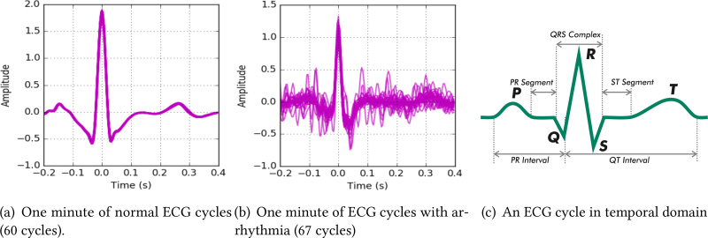
Case Study
Focus on Arrhythmia detection in ECG monitors
Patients suffering from CVD’s
Single-channel ECG 250 samples/s
Each sample is 3 bytes
10 second windows for ECG signals
1 minute transmission period from fog to cloud
Training/Test data from “Long-Term ST Database” via Physiobank
Data transmitted from sensor memory card
Simulates “sensing”
Biosppy toolbox in Python
11
Notes:
-Arrhythmia = irregular heartbeats (too fast, too slow)
-CVD = cardiovascular diseases
-ECG = electrocardiograph

Slide 13



Case Study cont…
Training Data unit denoising ECG input signal
Extracts 5 features from temporal domain
QRS complex
Twave duration
RR and PR interval
ST segment
Cross-correlation
where f = ECG cycle, and g is a Triangular signal defined by:
T = signal length = QRS complex length
A = amplitude = QRS amplitude
Utilize the two signal’s similarities for detecting peaks in each ECG cycle
Support Vector Machine (Learning Algorithm)
Distinguishes between binary classifiers
Low computation costs
Calculates $w$ and $b$, sends to Plan
$$\left(f∗g\right)\left(τ\right)≝\int_{−∞}^{∞}{f∗\left(t\right)g\left(t+τ\right)dt}$$
$$x\left(t\right)=\left\{\begin{aligned}0 |t|≥1 \\ &A[1−\frac{\left|t\right|}{T}] \left|t\right|<1\end{aligned}\right.$$
12
Notes:
-RR peaks = heart rate variability, time interval between heartbeats
-Temporal domain derived from separate study
-All cycles aligned to visualize differences
-Cross correlation is a measure of similarity of two series as a function of the displacement of one relative to other (comparing signals)
-Triangle signal ??
-SVM = supervised machine learning algorithm, low computation costs compared to other alternatives (neural networks, ect)

Slide 14
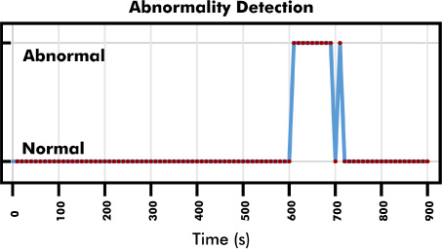


Case Study cont…
$w$ and $b$ received from SVM classifier
$x$ features extracted from $x^{′}∈$ℝ^{d}
Inner product between $w$ and $x$
Incoming ECG signals defined in 10 second windows
Each window classified individually
Linear machine learning method:
$$h(x) = sgn⁡(wTx + b)$$
where:
$sgn⁡()$is a sign function
$x$ is the input with d attributes
$b$ = bias constant
$w$ = weight vector inferred by learning algorithm
13
Notes:
-Each red dot is a decision sent from Plan

Slide 15
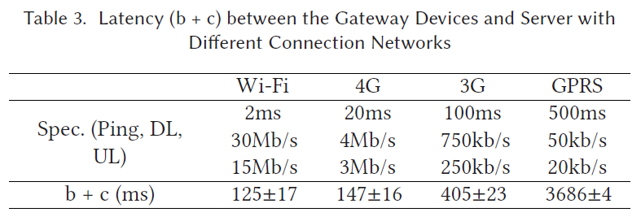
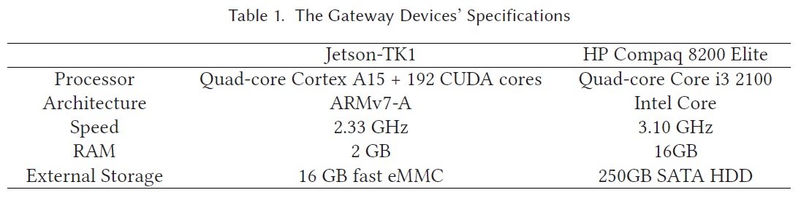


Evaluation: Response Time
Transmission time:
$a$ = sensor -> gateway
$b$ = gateway -> cloud
$c$ = cloud -> gateway
$d$ = gateway -> senor
Computation time:
$α$ = data analytics in cloud
Linode VPS (22 $±$ 3ms)
$β$ = data analytics in fog
Jetson-TK1 (27 $±$ 2ms)
HP (65 $±$ 3ms)
Sensor node sends 8000 bytes/transmission
$a$ = 651 ms
$d$ = 43 ms
$b$ and $c$ are not fixed; depend on network
14
Notes:
-3 bytes per sample, 250 samples/s, 10 seconds = 7500 bytes + 500 bytes for header
-RN-42 Bluetooth using 115200 bit/s baud rate
-Cloud server is Linode VPS with two 2.5GHz Intel Xeon CPUs, 4gb ram, ssd storage, apache web server ubuntu linux

Slide 16
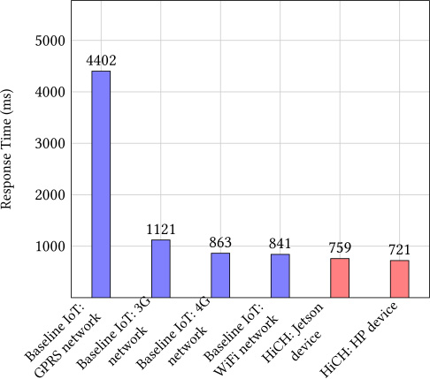
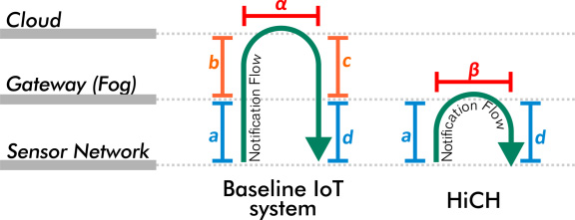

Evaluation: Response Time cont…
Baseline IoT = $a$ + $b$ + $α$ + $c$ + $d$
HiCH = $a$ + $β$ + $d$
Baseline IoT systems rely on network transmission rate
HiCH relies on computational capacity
Raspberry Pi Zero response time of 1414ms
15

Slide 17
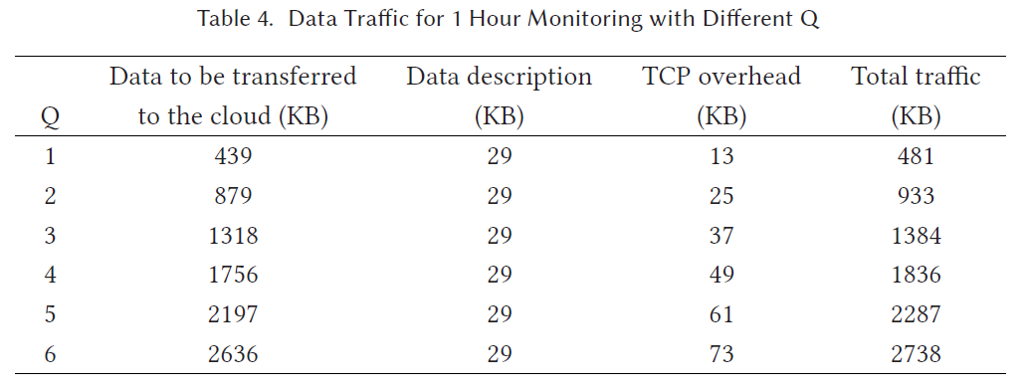
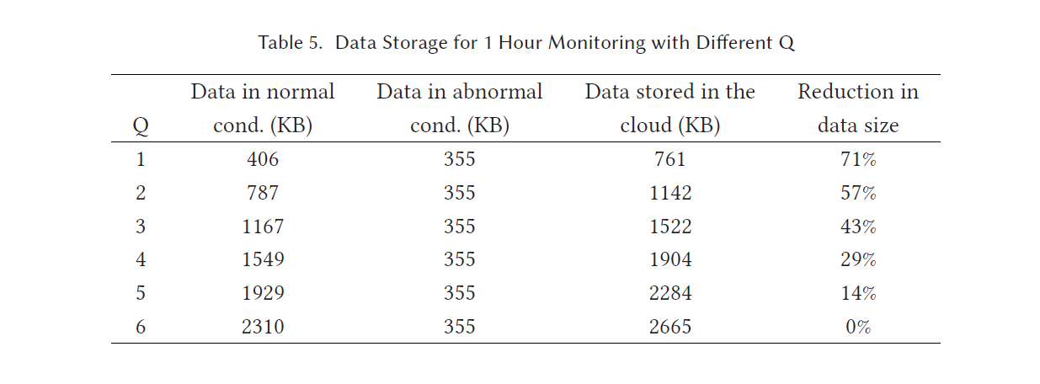
Evaluation: Bandwidth
Traffic handled by System Management
Q as parameter (Patient’s state/condition)
Transmission rate reduced 82% if Q = 1
Baseline IoT = Q6
Transmission rate/storage for single patient
Reduction even more significant with increased patients/sensor data
16
Notes:
-Use cache size to estimate required bandwidth
-1(normal) to 6(emergency)

Slide 18
Conclusion
Autonomous health monitoring systems require a high level of accuracy and availability
Conventional IoT cloud-based systems can suffer from degraded access and response times
HiCH successfully improved baseline IoT systems by introducing:
Hierarchical computing architecture
Closed-loop management technique
Disadvantages:
Limited on choice of learning algorithm
Future work: personalized energy management for sensor’s battery life
17
Notes:
-Hierarchy includes enhanced MAPE-K model mapped to IoT layers (sensor, gateway, cloud)
-closed loop control enables dynamic/personalized resource management
-Instanced based algorithms struggle with HiCH, mostly linear works. Can lead to lowered accuracy, application-specific

