Slide 1
IMDB Movies

Slide 2
Project Introduction
Analysis of IMDB movies database using SQL.
Dataset includes movie details, ratings, revenue, and directors.
Aim is to extract insights about movie performance and trends.
Used SQL queries to analyze popularity, revenue, and ratings.
Helps identify successful movies and bankable directors.

Slide 3
Problem Statement
Analyze the IMDB movies database using SQL.
Retrieve and explore movie and director information.
Identify popular and high-revenue (bankable) movies.
Determine top-performing and most productive directors.
Generate insights from data using SQL queries

Slide 4
Objectives of The Project
Understand and explore the IMDB movies dataset.
Apply SQL queries for data retrieval and analysis.
Perform filtering, aggregation, and JOIN operations.
Identify popular movies and revenue performance.
Determine top directors based on productivity and earnings.

Slide 5
Dataset Overview
Database used: IMDB Movies Database
Contains two tables: Movies and Directors
Movies table includes title, budget, revenue, popularity, and ratings.
Directors table includes director name, gender, and department.
Tables are linked using Director ID for analysis.

Slide 6
Tools & Technologies Used
Tools
MySQL Database
MySQL Workbench / SQL Client
Technologies
SQL (Structured Query Language)
Relational Database Management System (RDBMS)

Slide 7
Methodology / Workflow
Connected to the project movie database.
Loaded and validated the dataset for accuracy.
Explored table structure and relationships.
Merged movies and directors tables using INNER JOIN.
Executed SQL queries to analyze popularity, revenue, and ratings.
Verified results and extracted insights for reporting.

Slide 8

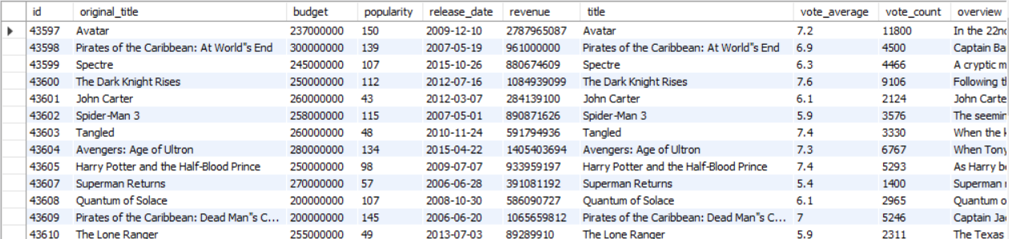
SQL Analysis – Movies Table
Retrieve all records from the movies table.
Input
Output

Slide 9

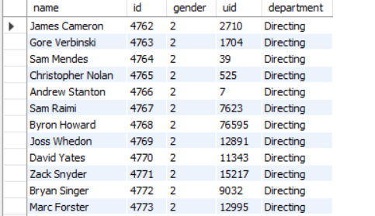
SQL Analysis – Directors Table
Retrieve all records from the directors table.
Input
Output

Slide 10


SQL Analysis – Total Movies
What is the total number of movies in the database?
Input
Output

Slide 11

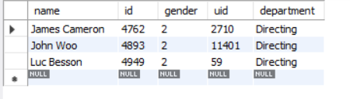
SQL Analysis – Specific Directors
Retrieve details of selected directors.
Input
Output

Slide 12

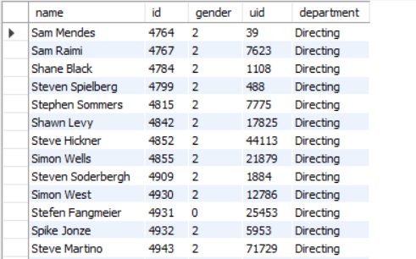
SQL Analysis – Directors Starting with “S”
Retrieve directors whose names start with the letter ‘S’.
Input
Output

Slide 13


SQL Analysis – Female Directors Count
How many female directors are in the database?
Input
Output

Slide 14
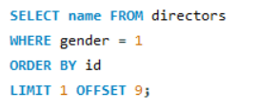

SQL Analysis – 10th Female Director
Retrieve the name of the 10th female director.
Input
Output

Slide 15
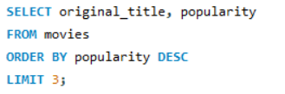
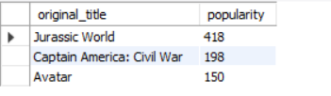
SQL Analysis – Most Popular Movies
Which are the top 3 most popular movies?
Input
Output

Slide 16
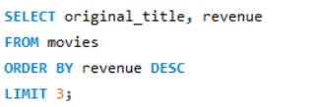
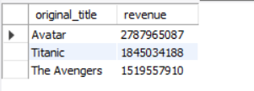
SQL Analysis – Most Bankable Movies
Which are the top 3 highest revenue (most bankable) movies?
Input
Output

Slide 17
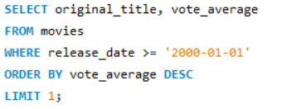

SQL Analysis – Highest Rated Movie After 2000
Which movie released after January 1, 2000 has the highest rating?
Input
Output

Slide 18
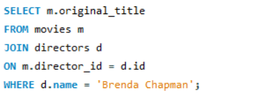

SQL Analysis – Movies by Brenda Chapman
Which movies were directed by Brenda Chapman?
Input
Output

Slide 19
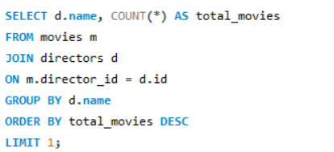

SQL Analysis – Director with Most Movies
Which director has directed the highest number of movies?
Input
Output

Slide 20
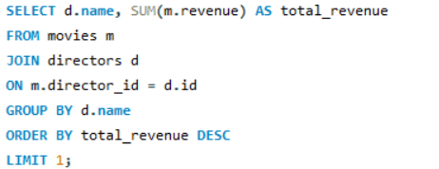

SQL Analysis – Most Bankable Director
Which director has generated the highest total revenue?
Input
Output

Slide 21
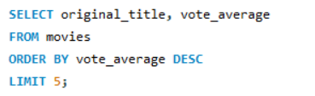
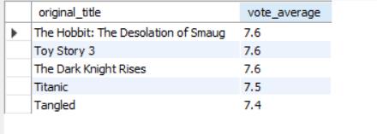
SQL Analysis – Top Rated Movies
Which are the top 5 highest rated movies?
Input
Output

Slide 22
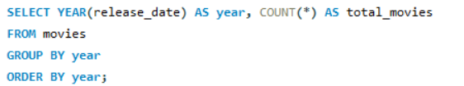
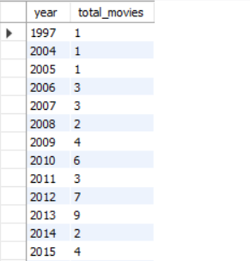
SQL Analysis – Movies Released Per Year
How many movies were released each year?
Input
Output

Slide 23
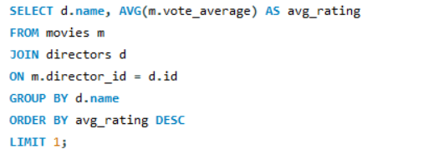

SQL Analysis – Director with Highest Average Rating
Which director has the highest average movie rating?
Input
Output

Slide 24
Key Insights
Popularity and revenue do not always go hand in hand — some highly rated movies are not the highest earners.
A small number of directors contribute to a large share of movie production.
High revenue movies indicate strong audience reach and commercial success.
Movies released after 2000 continue to achieve strong ratings and audience approval.
Certain directors consistently deliver higher-rated films, showing quality and audience trust.

Slide 25
Conculsion
This project helped turn raw movie data into meaningful insights.
We identified which movies are popular, which earn the most, and which directors perform best.
The analysis showed how ratings, popularity, and revenue reflect audience preferences.
Using SQL made it easier to connect data and discover real patterns.
Overall, the project demonstrates how data analysis helps understand success in the film industry.

Slide 26
THANK YOU

